Slide 1
Machine Learning Algorithms CIA 1
Presented By
Hemanath Kumar J

Slide 2
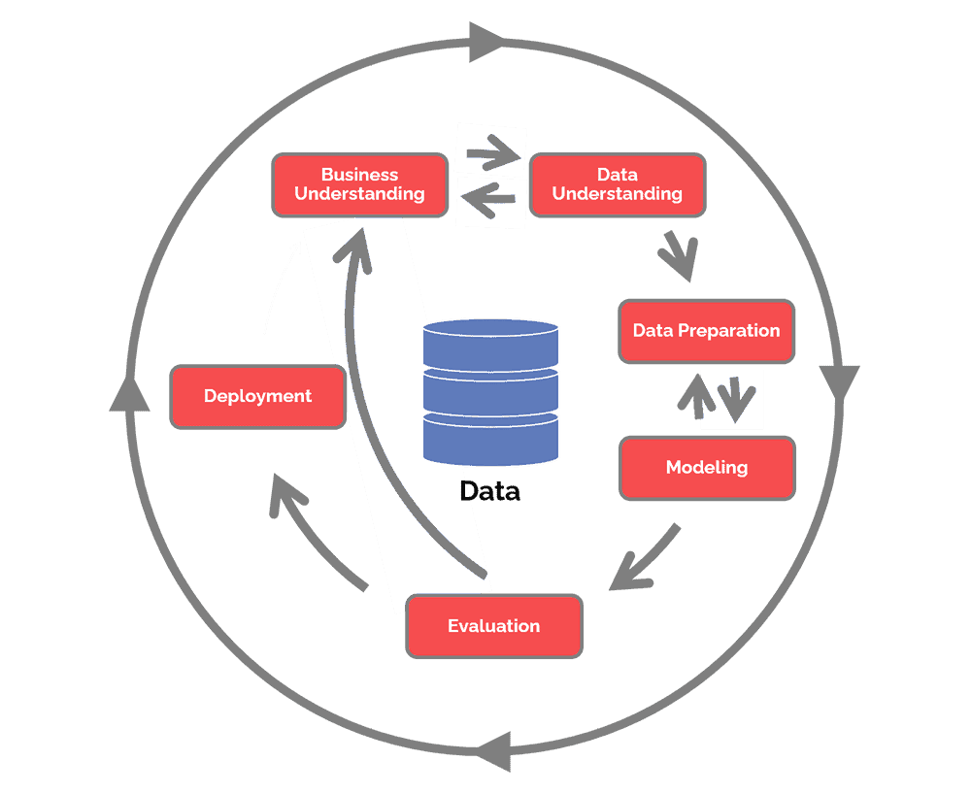
BUSINESS UNDERSTANDING
This article provides several measures of CEO compensation, as well as characteristics of the CEO and measures of his firm’s performance. The data is used to study CEO and firm characteristics to determine the important factors influencing CEO compensation
DATA UNDERSTANDING
To understand the determinants of CEO compensation, one hundred observations were randomly selected from the 800 listed in the Forbes article. The sample of one hundred CEOs and their firms represent a cross-sectional sample of America’s largest corporations. In our cross-section, the CEO and firm characteristics were based on 1991 measures

Slide 3
PROBLEM STATEMENT
To study different factors and firm characteristics that influence the compensation provided to the CEO of a firm
VARIABLES
COMP - Sum of salary, bonus and other 1991 compensation, in thousands of dollars
AGE - The CEOs age, in years
EDUCATN - The CEOs education level, 1 for no college degree, 2 for a college undergraduate degree and 3 for a graduate degree
BACKGRD - Background type, 0 for unknown, 1 for technical, 2 for insurance, 3 for operations, 4 for banking, 5 for legal, 6 for marketing, 7 for administration, 8 for sales, 9 for financial and 10 for journalism
TENURE - Number of years employed by the firm
EXPER - Number of years as the firm CEO
SALES - 1991 sales revenues, in millions of dollars
VAL - Market value of the CEO’s stock, in natural logarithmic units
PCNTOWN - Percentage of firm’s market value owned by the CEO
PROF - 1991 profits of the firm, before taxes, in millions of dollars
COMPANY - Company name
BIRTH - The CEOs birthplace

Slide 4
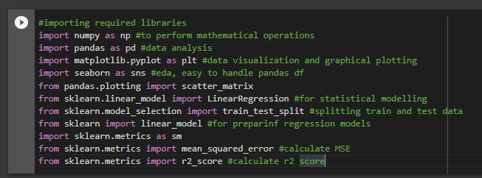
ANALYSIS IN PYTHON (Hemanth Kumar J)
Following are the analysis that has been done using PYTHON with respect to the problem statement
Google Colab is used to write and execute the program
LIBRARIES

Slide 5
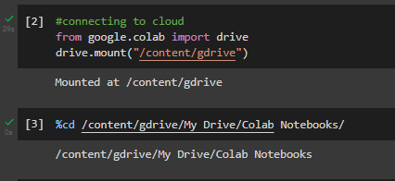
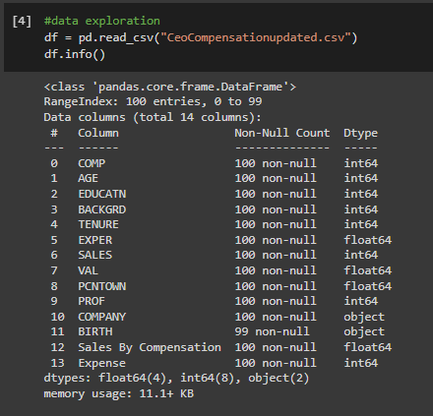
MOUNTING THE LOCATION
READING THE DATA

Slide 6
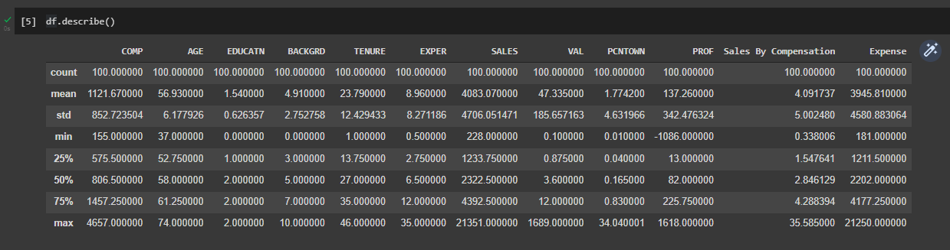
SUMMARY OF THE DATA
Finding overall summary about all the available variables
Quadrant average of each variables are also shown with describe() function

Slide 7
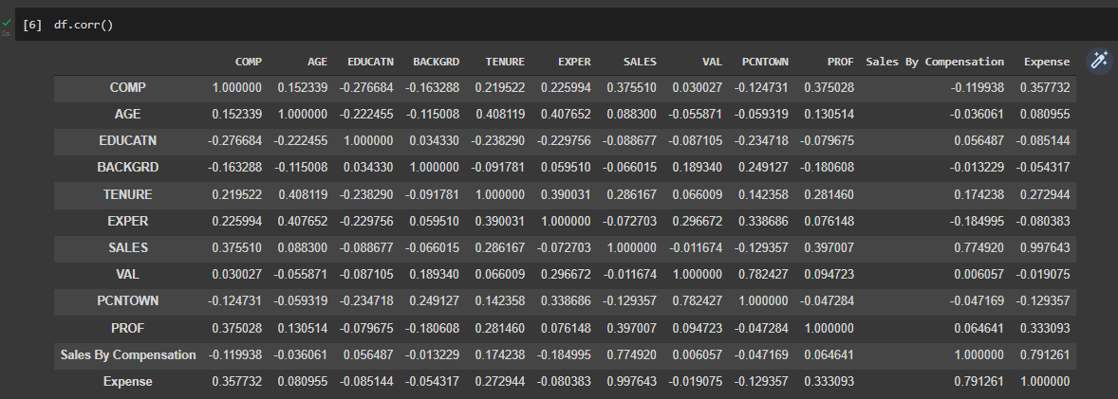
CORRELATION
Through corr() we will be able to know how much a variable is depended over another variable

Slide 8
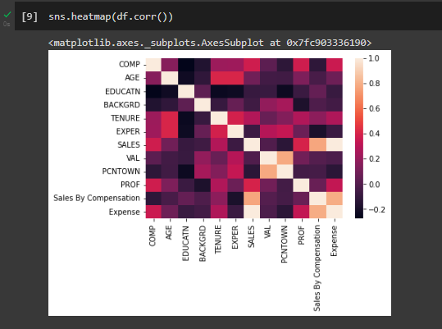
HEATMAP
In this heatmap, the darker shades of the chart represent higher values than the lighter shade

Slide 9
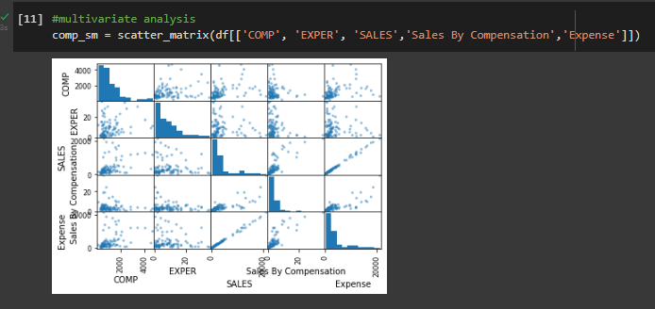
SCATTER MATRIX
The scatter matrix shows the relation between different variables. The datapoints are very much dispersed between comp and sales which indicates that the relation is weak. The relationship is strong for Sales by comp and comp

Slide 10
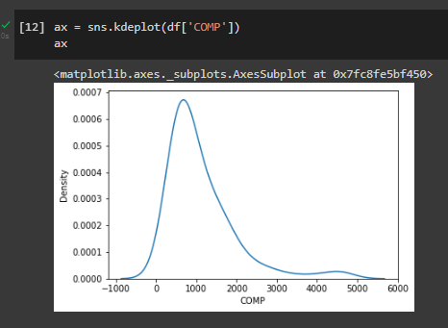
KERNEL DENSITY ESTIMATION
The dependent variable COMP is left skewed, which indicated that the mean is greater than the median

Slide 11
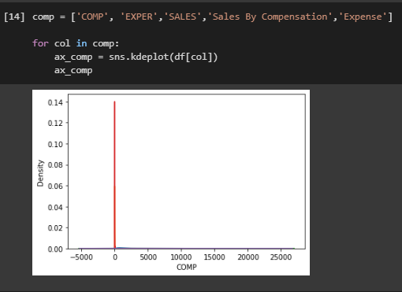
KERNEL DENSITY ESTIMATION
KDE for few of the key variables are plotted. The density is highest for dependent whereas other variables have low density

Slide 12
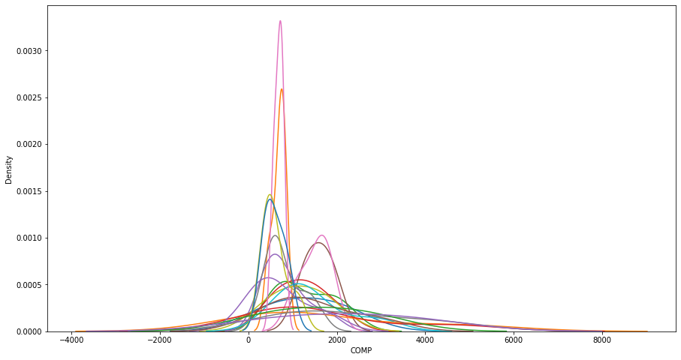
KERNEL DENSITY ESTIMATION
KDE for all the variables

Slide 13
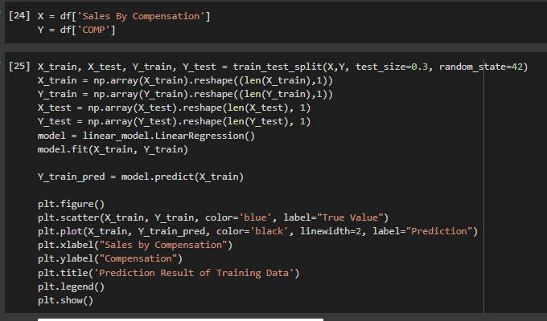
UNIVARIATE LINEAR REGRESSION
30 % of the dataset is considered as test data and regression is performed. Two more variables Sales by Comp and Expense has been added as a part of data manipulation, in order to increase the R2 score.

Slide 14
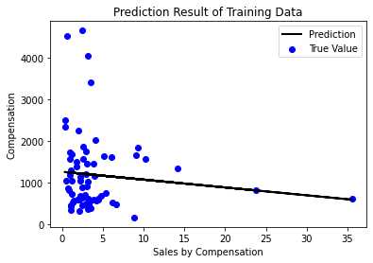
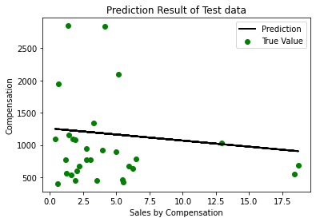
UNIVARIATE LINEAR REGRESSION
Here, we can see the prediction result of training and test data. Some datapoints are seen at the above which indicates that the few companies provide more compensation even though the sales percentage is low.

Slide 15
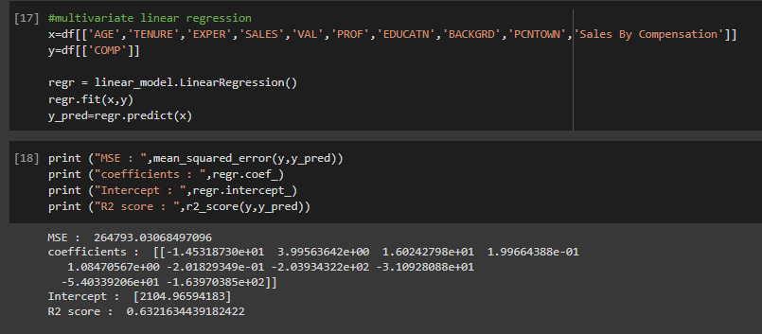
MULTIVARIATE LINEAR REGRESSION
R2 score is around 63% which indicates that the model is 63% accurate

