Slide 1
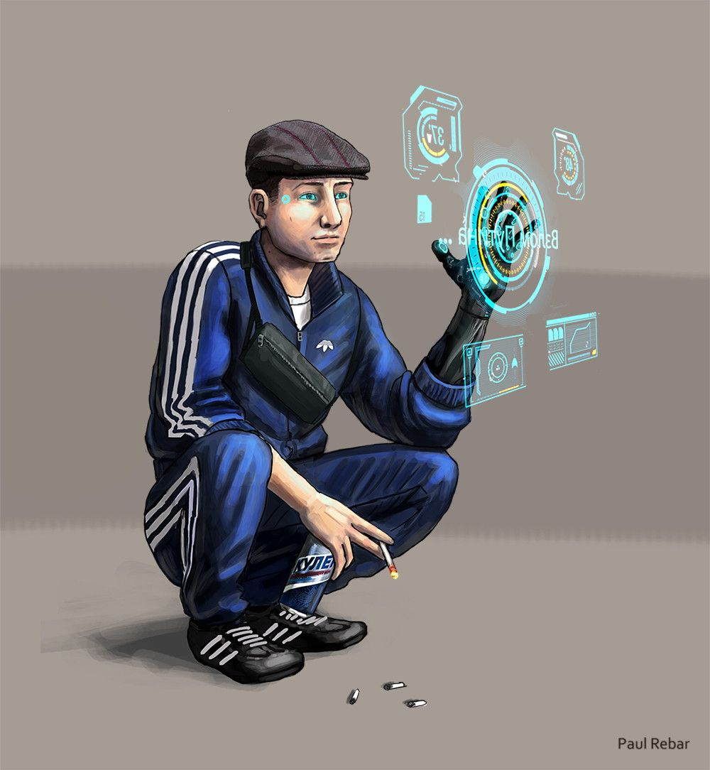
d1m1try
Pt.2

Slide 2
Disclaimer
First of all, d1m1try project does not support any actions that violate law in any means. Cracking the security of computer systems is bad and considered as a crime to gain unauthorized access to computer systems. The purpose of this educational material is building competence on how to create robust automotive products by getting hands-on experience about frequent vulnerabilities.
d1m1try Project is published under the GNU General Public License v3.0.
Credits:
Story and technical framework: János Kovács
Slide 1: All rights reserved by Paul Rebar. The publishing of his painting here happens with his explicit acceptance.
Slide 3: Victoria Pickering, Common Creative license: CC BY-NC-ND_2.0
Slide 4: Bravo_Zulu_, Common Creative license: CC BY 2.0
Slide 5: opensourceway, Common Creative license: CC BY-SA 2.0
Slide 6: Djibouti, Common Creative License: CC BY-NC-ND_2.0

Slide 3

It’s all set up
Sasha texted you the key word signaling the device is on its place inside the truck.
You and your guys are waiting from a safe distance for the truck to leave the warehouse in the direction it always do. Oleg got his car emptied for the cargo to fit.
You check the device status, and you see that the connection is active.

Slide 4

…here they go. The convoy of trucks carrying supplies to the loyal-to-system elite are ahead your position, one of them connected with your device.
This is your chance to make sure you and your people will not get to back hungry for some time.
HELP0: Execute run_stage2.bat in the home directory of your project. There is 2 flag for this challenge.

Slide 5

Something is wrong. The command you used successfully for disabling the engines does not work this time. Maybe there has been a security patch since the software version of the ECU you tested.
OK.
No need to panic. Think… Try to find another way to take down your target.
HELP1 (change color of hidden text): Think of leveraging a service another than the diagnostics.
HELP2 (change color of hidden text): You should get familiar with CWE Top 25.
HELP2 (change color of hidden text): Ever wondered, what would happen if you reference a non-existent place in the memory? And did the developers?

Slide 6
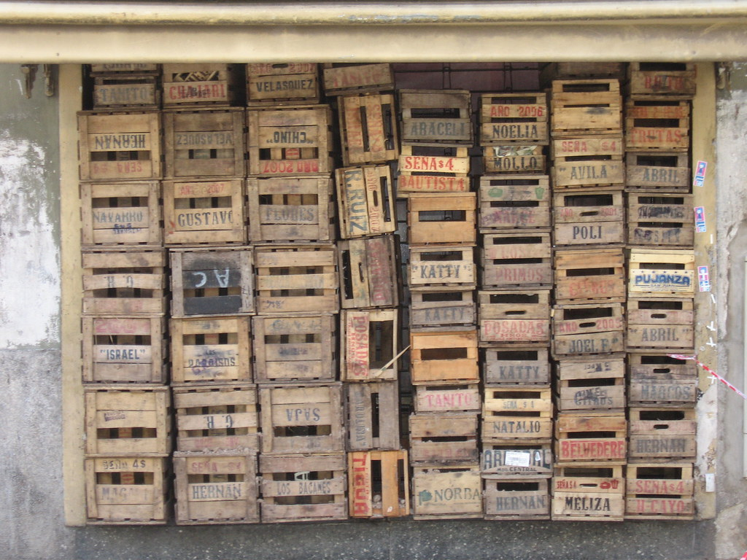
You and your guys made it.
In the truck, there is healthy food – fish, meat and vegetables – that will not only be enough for you, but you will be able to donate the ones you know in your neighborhood. This is great news – for now.
The government will obviously spot that one of the trucks went missing, as they will wonder where the cargo went. You need to remove any evidence that can be traced back to you. Thanks to the ignorance of the regime, no cameras are placed in this poor neighborhood, since the safety of your people is none of their concerns.
You disconnect the device from the vehicle network and do your best to remove any evidence that can be found in the old truck incriminating you and your folks.

Slide 7
Takeaway Box
The exception handling done explicitly in the software is crucial to keep the products secure.
It is important to consider abuse cases (like the one from pt1) or edge cases (like the one from this part) and think about anything that can go wrong during code execution.
More information on this type of vulnerability including mitigations: https://cwe.mitre.org/data/definitions/119.html

