Slide 1
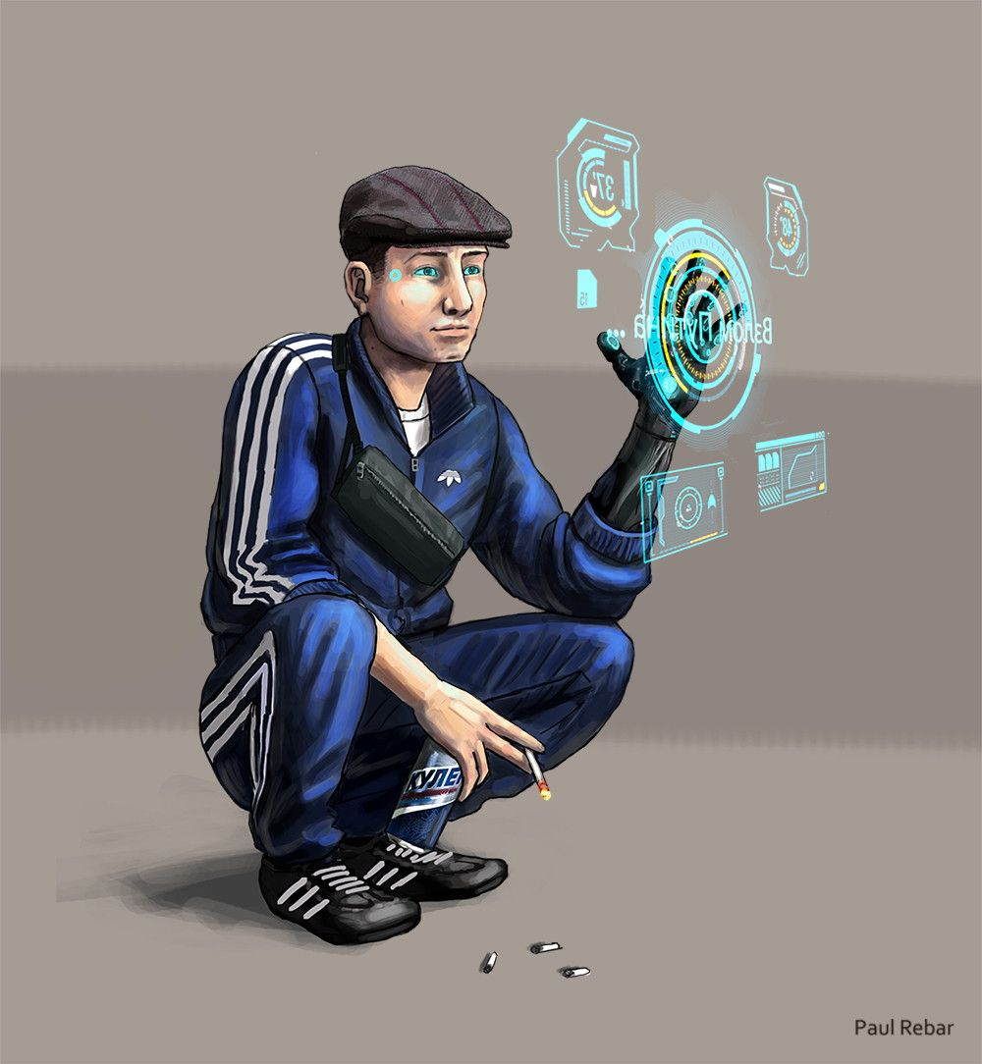
d1m1try
Pt.3

Slide 2
Disclaimer
First of all, d1m1try project does not support any actions that violate law in any means. Cracking the security of computer systems is bad and considered as a crime to gain unauthorized access to computer systems. The purpose of this educational material is building competence on how to create robust automotive products by getting hands-on experience about frequent vulnerabilities.
d1m1try Project is published under the GNU General Public License v3.0.
Credits:
Story and technical framework: János Kovács
Slide 1: All rights reserved by Paul Rebar. The publishing of his painting here happens with his explicit acceptance.
Slide 3: Kat..., Common Creative license: CC BY-NC-ND_2.0
Slide 4: Jim Valentine, Common Creative license: CC BY-NC 2.0
Slide 5: Weaponeer, Common Creative license: CC BY-NC 2.0
Slide 6: Brecht Bug, Common Creative License: CC BY-NC-ND_2.0
Slide 11: Chris-Håvard Berge, Common Creative License: CC BY-NC 2.0

Slide 3
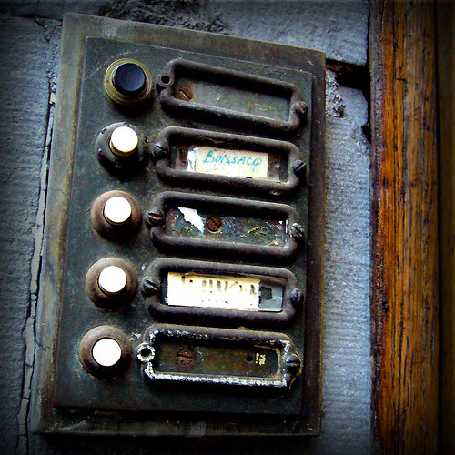
Uninvited visitors
The majority of the looted food is still in your fridge, when your doorbell is ringing.

Slide 4
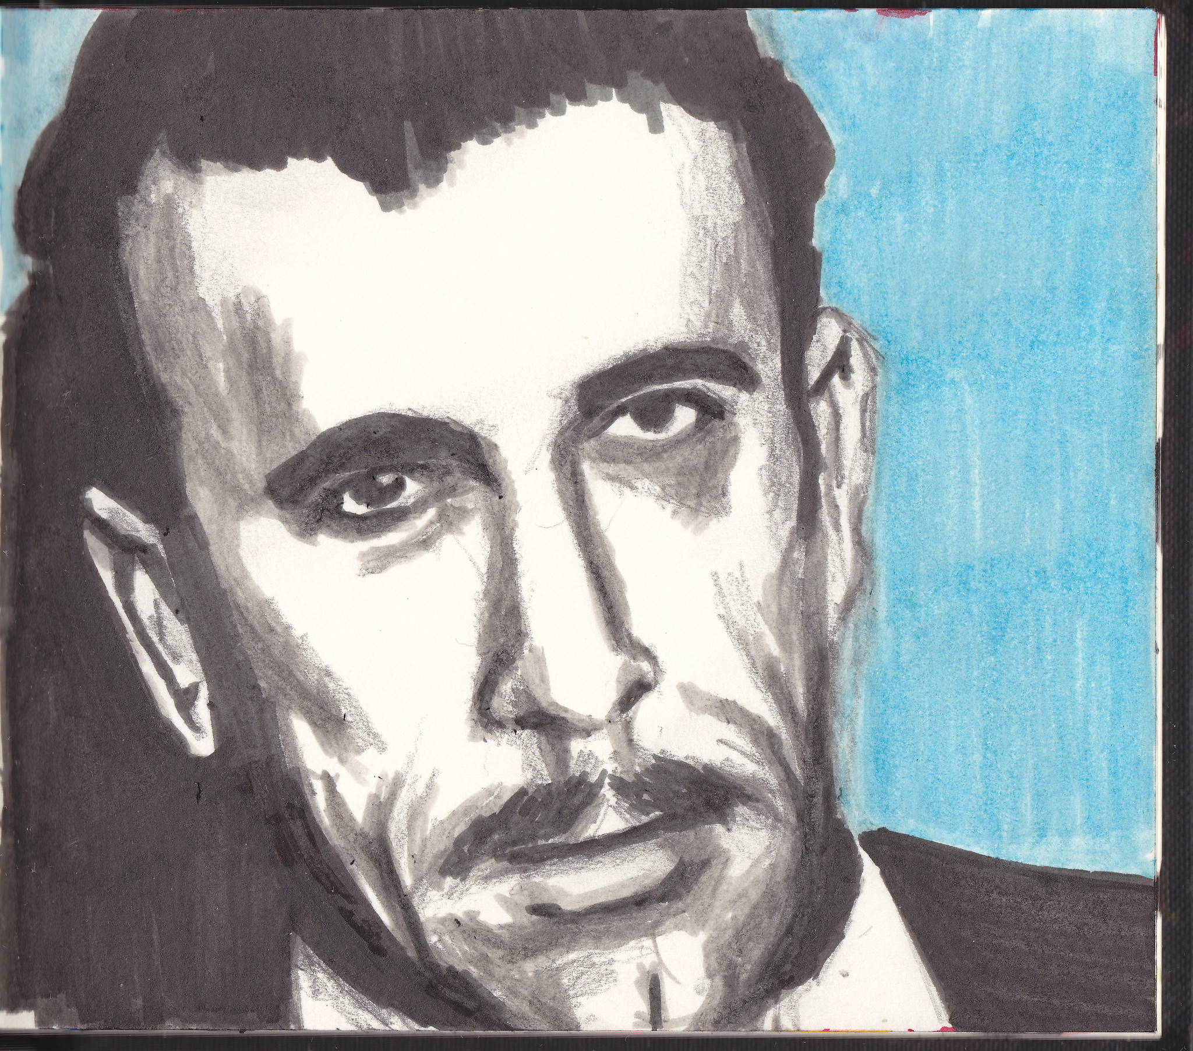
You’ve got interesting visitors. Bogdan, one of the big guys and two of his muscles from the Raróg, a gang with quite violent reputation. You are quite astonished, since you thought about getting caught by the cops for last time’s affair, but you never imagined that you might find such guests standing on your doormat instead of the officers.
A lot of ideas come across your mind, including that the agents of the government might rented them to do the dirty work. However, it’s on now, and you try not to loose your shit, since that never helped anyone out in a situation like this.
‚Wrong address, gentlemen?’ – you ask casually. For your largest surprise, they reply with cool and respect.
‚Hello. We are looking for Dimitri.’– says Bogdan. So they are really after you. But they rang the bell and not kicked the door onto you. This can be a good sign, right?
‚That’s me. What can I help you?’
He looks around, and you see he is not comfortable to talk while being in the open in the corridor. Since you feel you have nothing to loose, you invite them in.

Slide 5
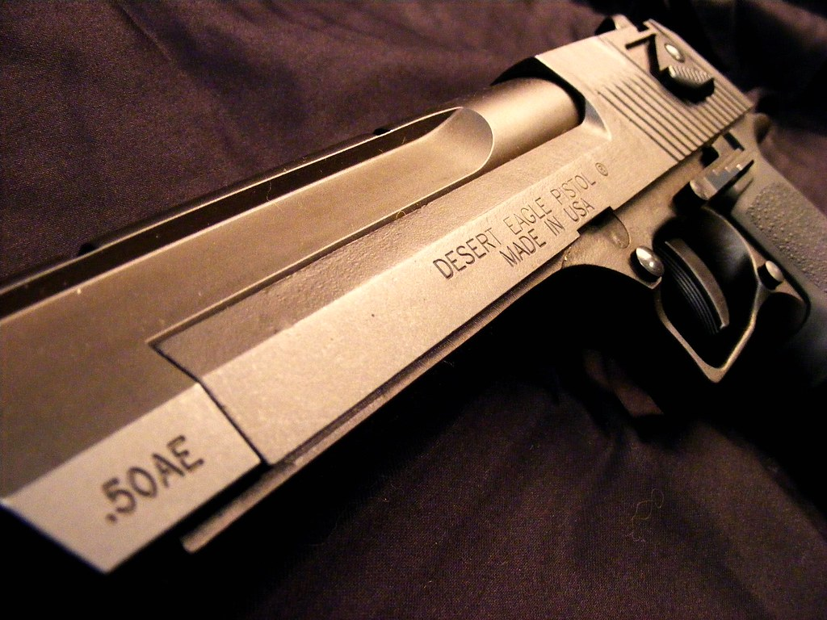
They get inside, Bogdan takes a seat near your kitchen table and one of the bodyguards casually puts a golden plated gun on your fridge. Just to adjust your attitude, you hope.
‚With the Super cargo, you did a great job.’ – says Bogdan.
‚…well, thanks.’ – you replies after some hesitation.
‚We never knew that there are people with a talent like yours here in this shitty district. Do you know why we are here?’ – he says, and without waiting for your answer, he continues. – ‚We could use your skills, you know?’
‚What… do you mean?’

Slide 6
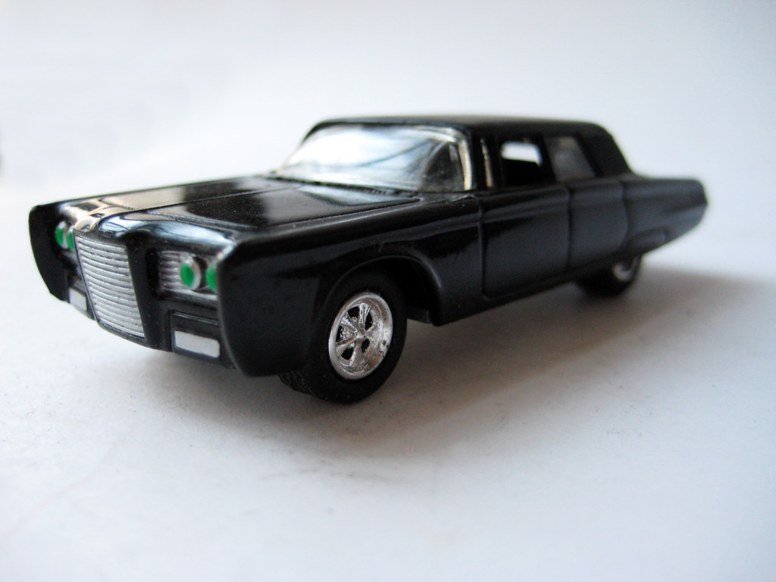
‚Have you heard about the street racing, man? There is only one thing I love as much as coke and kurwas, and you know what is that? It’s winning. – Bogdan says.
You are speechless.
‚So here is the deal. We won’t get you hooked up by the cops and will use our partners in the police to prevent them finding you, if you help us. I’ve got a Syndicate Rusher, you know that car?’
‚A Rusher?!’ – you can’t resist to intervene. – That’s awesome, how did you get one?’
‚…that’s not the point. – he says after some hesitation, and you will remember that it might not be the best idea to interrupt a gang boss in the future.
‚There is this race and I did my best, but my rivals have their rides tuned for maximum performance. Have you know, that there is some hot stuff hidden inside the software of the Rusher ECU?’ – he asks.
‚Not until now.’ – you replies.
‚Well, find it and enable that. We would like this from you.’
‚…okay, I will do my best to fulfill your request.’
‚This is not a request, you are ours now.’ – he says, leaving your chair, heading to the corridor with his guys.

Slide 7

It could be worse. You are still alive, free and you have all of your fingers and toes and your limbs is intact.
On the other hand, all of the perks above should be considered as a temporary situation. You need to deliver the service for Bogdan or you will hang. Simply as that.
There is a problem, tho, you never hacked any car before – well, last time, it could be luck, but now you need to trespass direct security controls, that hide or disable the hot stuff the gangster mentioned.
So you do what every guy living to live should do in such a situation: open the search bar and type how to enable hot stuff on a Syndicate Rusher…

Slide 8

You do not get a lot of results, and some of the forum topics are restricted to registered users only.
Being blackmailed by a mob leader named Bogdan is a huge motivation, tho, so you continue the search relentlessly.
how to enable hot stuff on a syndicate rusher
g3n3r1c_h4ck3r_n4m3 said at Mon 21 January
The Rusher is a really great car, i heard that there is some extra features that could be used for improving the speed and the acceleration of the car.
n4m3l355_tr0ll said at Mon 22 January
Bullsh&t and you are a *moderated* piece of *moderated* who like to lick *moderated*

Slide 9
However, as you moved forward in your research, you started to find interesting pieces of information.
how to enable hot stuff on a syndicate rusher
g3n3r1c_h4ck3r_n4m3 said at Mon 25July
i once activate d this service when i needed to do this to a client it was not really hard
this ecu uses diagnostics to tune the behavior of the funxions the hot stuff is one of them. anyone who request this from the ecu can find out wether hot stuff is enabled or not
if not that mean that no service was purcsased wen the car was deliverd
athenticate as oficial service in diagnostics to tune that parameter

Slide 10
Challenge & Response, huh? It would worth a try to check this out.
HINT: do some research on the topics below.
HELP0: Execute run_stage3.bat in the home directory of your project. There is 1 flag for this challenge.
HELP1: Search the parameters for something that could affect the state of the hot stuff.
HELP2: Try to brute force the privilege escalation to be able to activate the hot stuff.
how to enable hot stuff on a syndicate rusher
g3n3r1c_h4ck3r_n4m3 said at Tue 21 March
The Syndicate Rusher uses a challenge&response mechanism for authentication. You click on getseed and the ECU returns a random number. For this, you need to send a valid response as the argument of authenticate.
4n0th3r_tun3r said at Tue 21 March
The Syndicate softwares often miss brute force protection and often there are two short seed spaces. In this case, it might be okay brute force the authentication manually.

Slide 11

It’s done! The hot stuff is enabled and now Bogdan’s Rusher will be capable of delivering results that it’s owner thrives for in the street races.
Also, your ass is saved for now.

Slide 12
Takeaway Box
The challenge&response key and seed space is crucial in keeping the system secure.
More information on Broken Authentication: https://cwe.mitre.org/data/definitions/1028.html

