Slide 1
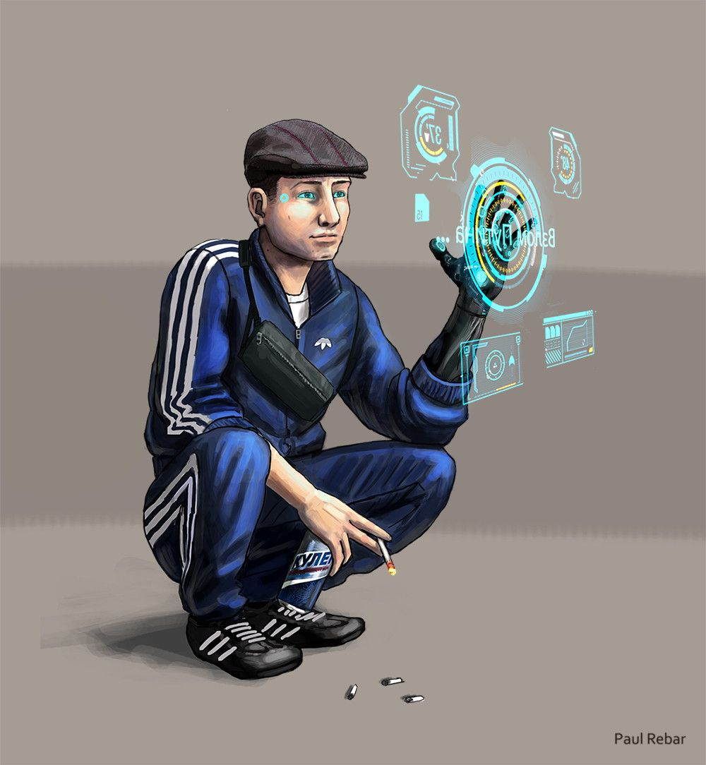
d1m1try
Pt.4

Slide 2
Disclaimer
First of all, d1m1try project does not support any actions that violate law in any means. Cracking the security of computer systems is bad and considered as a crime to gain unauthorized access to computer systems. The purpose of this educational material is building competence on how to create robust automotive products by getting hands-on experience about frequent vulnerabilities.
d1m1try Project is published under the GNU General Public License v3.0.
Credits:
Story and technical framework: János Kovács
Slide 1: All rights reserved by Paul Rebar. The publishing of his painting here happens with his explicit acceptance.
Slide 3: Amal FM (a snip from the original picture), Common Creative license: CC BY 2.0
Slide 4: Felipe Torrents, Common Creative license: CC BY-NC 2.0
Slide 5: Truthout.org, Common Creative license: CC BY-NC-ND 2.0
Slide 6: pantraco_bus, Common Creative License: CC BY 2.0
Slide 7: Za Rodinu, Common Creative License: CC BY-NC-SA 2.0
Slide 11: miss vichan, Common Creative License: CC BY-SA 2.0

Slide 3

Doorbell at midnight
A beautiful woman you’ve never met stands at your door ringing your bell like a maniac.
You know it doesn’t mean any good. But if you pretend not to be at home, she’ll definitely wake up the neighbors and you should avoid attention as much as possible.
Draw a breath, open the door.

Slide 4

‚What can I help you w…’ – you say behind the door, but get interrupted by a really big gun pointed right to the loophole.
‚Let me in.’ – she says.
For having such strong arguments, you can’t resist. She get back to your apartment, staying between you and the door, staring at you in a way you get without any word that in case of you try to act stupid she will literally blow your mind.
‚Are you Dimitri?’ – maybe she doesn’t want to kill you then, having a conversation’s definitely a good sign.
‚Yes. What do you want from me?’ – you ask.
‚I heard about the truck job. And also about Bogdan’s Rusher.’ – so your concept about hiding your traces seems not an effective one – ‚We need your skills, and you will help us.’ – guess she is right.

Slide 5

‚Who are you?’ – you ask.
‚My name is not important here. I know you’ve heard about the Resistance, right?’ - you nod – ‚The government has my guys imprisoned and we cannot let them. The jail they are currently are in is too heavily guarded, and they’re gonna take them to another place which is even worse and I’m sure they won’t make it there. We thought about a lot of option for helping them escaping, but the only option would be okay for that is doing that while on the road.’
‚Okay, It’s not like I want to be disrespectful, okay? But you know I’m a hobby car electrician, and not a gunslinger, right? How can I be a help in this matter?’

Slide 6
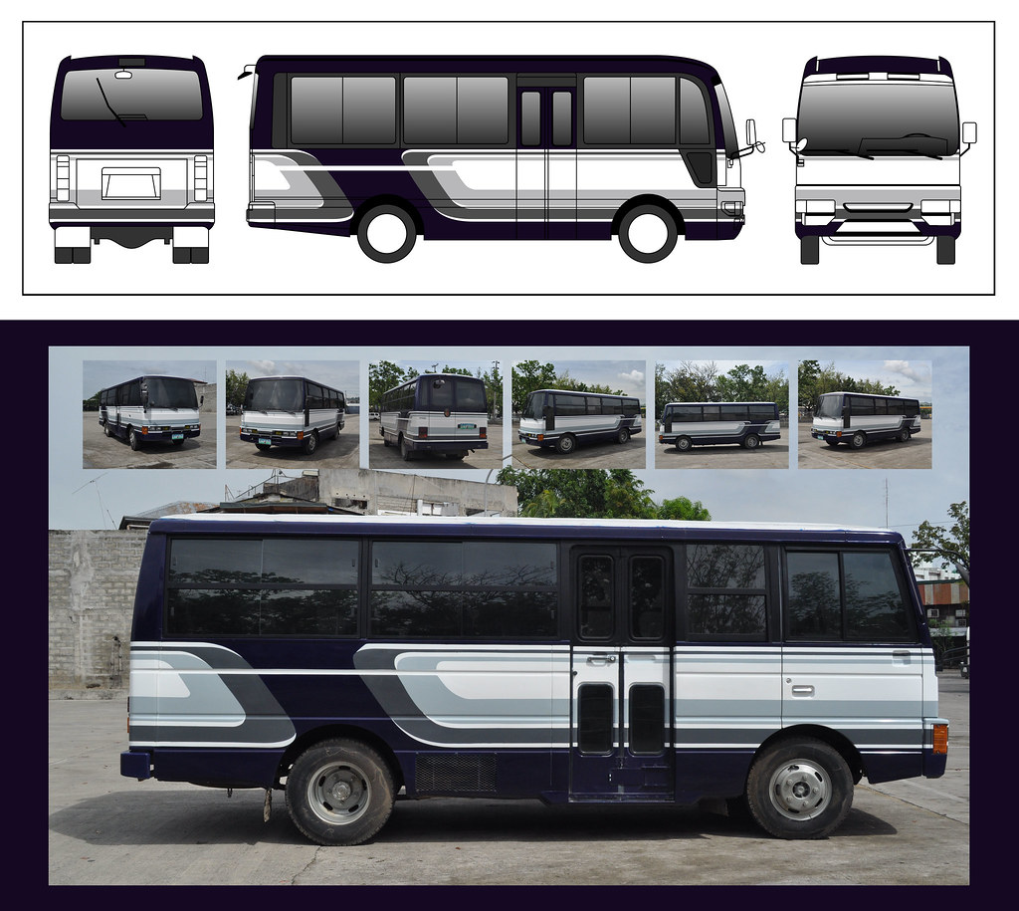
‚They transport the inmates in self driving vehicles to the desert work camps down there in the South. Since the climate is rough and the air is quite toxic, and the route of these robot cars go through several armed outposts, they think it is enough letting the environment do the security of the prisoners. We think it is possible to set up an ambush if we are able to make these cars to take sideways and ambush it while it’s off the official tracks.’
‚Interesting. And how will you connect to the car?’
‚It’s us,’ – she knocks her gun to remind you that from now on, according to he understanding you are forming a team – ‚And we know that you do not know how to get inside state networks’ – how did she find out that? you wonder. – We have other folks who will get you a connection with the robot car, okay? Your job here is only to overwrite the coordinates to 49.0 latitude and 61.0 longitude.’

Slide 7
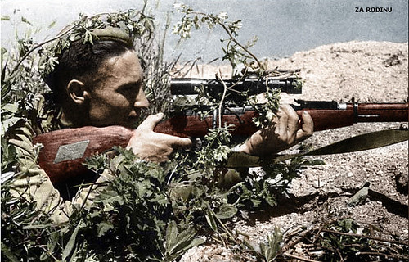
‚It might work. I’ll try to help you.’ – you say.
‚Sure you will.’ – she gets you a data card – ‚It’s on now. We did not want to risk that they might find out our plan, so it’s already happening now.’ – she signals someone by touching a point on her earring. – ‚Put this in your computer, and you have 6 hours to get these coordinates into the vehicle memory. This is a slightly modified version of Syndicate Atlas, You now this type, right? ’
‚Not yet. But it is a temporary situation.’ – you reply with mimed confidence in your voice. You put the data card in and you find a single file called connect_syndicate_atlas.bat. You execute this and try to find out how can you get out of this alive.
HELP0: Execute connect.bat from the datacard. There is 1 flag for this challenge.

Slide 8


It’s not so easy now. The seed space is large enough to not letting you getting the privilege escalation you need.
But the search bar helped you out before, so you say ’whatever’, and start typing.
speed up brute force challenge&response
g3n3r1c_h4ck3r_n4m3 said at Mon 21 January
Brute force can be quite time consuming in case the key space is large enough – but if the proper brute force protection is not applied, then it is only a matter of time.
v0id_huss4r said at Tue 1 December
I would definitely not do a brute force attack manually. It is a waste of time and there are far better ways for that – try to automize the attack – if there is no brute force protection mechanism, it will take some time, but it is not a big deal at all.

Slide 9
Ok, so there are ways to automate brute force. But how do you do that in case of you cannot write software programs?
how to automatize brute force challenge&response
g3n3r1c_h4ck3r_n4m3 said at Fri 1July
there are plenty of scripts on the internet for brute forcing authentication – including challeng&resp as well
g3n3r1c_h4ck3r_n4m3_2 said at Sun 10 Oct
Of course there are scripts to brute force authentication for vehicles! Try to browse this and this page for more info.

Slide 10
You followed those links you found in the forums. More than half of them was either garbage or virus, but you finally found a script leveraging the original diagnostic tool that might be used to brute force the privilege escalation you need to save the political prisoners – and yourself.
HELP0.2: Search for arrow.bat in the directory of your project.
syndicate diagnostic brute force script
g3n3r1c_h4ck3r_n4m3 said at Tue 21 March
You should use the arrow.bat for gaining service level access for a Syndicate Atlas. It will provide you the authorization you need without much trouble.
4n0th3r_tun3r said at Tue 21 March
Here is how to use arrow.bat: first, start it. It will open the diagnostic tool but with the plugin functionalities hidden it that. After opening it, connect tester and close it, which will open the dialog of a python shell. It will be used as the following: type ecu.bruteForceScripted(*insert_seed_space*) and then start the script. It will do the job for you and you will get back to the tester UI with elevated rights. ^.^

Slide 11
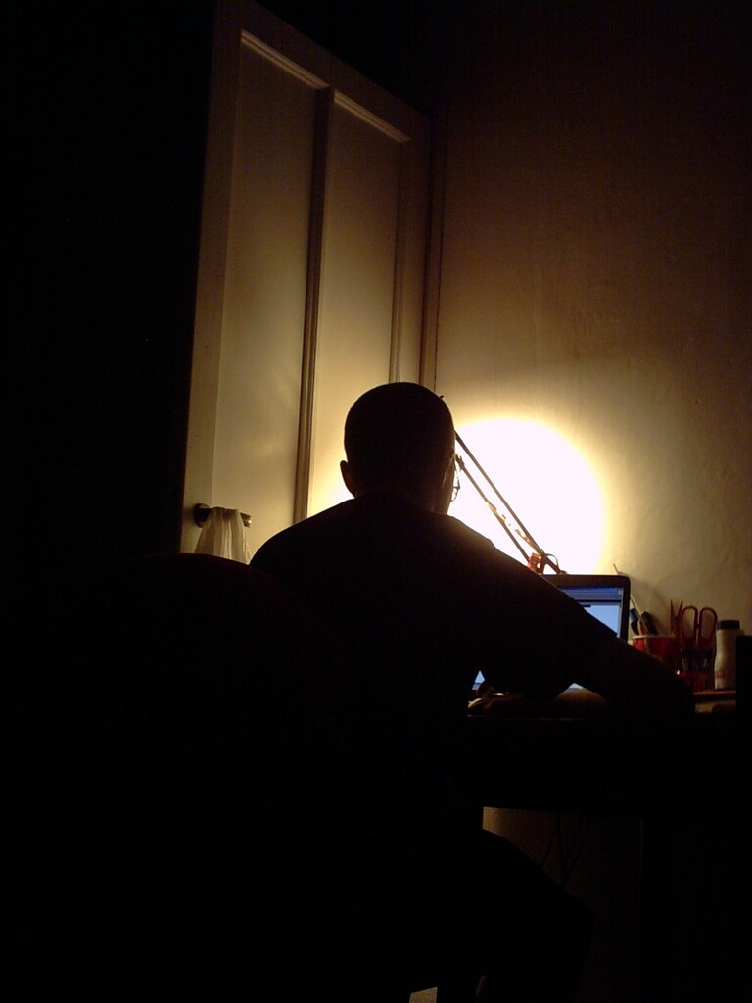
You made it! The mysterious resistance girl seems really happy. It is really good news for you, since in this case your life is likely to be spared.
‚What… about now?’ – you ask.
‚We’re all good now. Take care of yourself, see you.’ – she says, while grabs his gun and leave your apartment closing carefully the door behind her.
Nice, you belong to the resistance now.

Slide 12
Takeaway Box
Even the key space is large enough to prevent a manual attempt to elevate privilege, if that lacks a proper brute force protection, it will be no break for the scripts written specifically for this purpose.
Mission Critical data shall be protected thoroughly and exposing it to interfaces not necessary for the mission itself shall be avoided.
More information on Improper Restriction of Excessive Authentication Attempts: https://cwe.mitre.org/data/definitions/307.html

