Slide 1
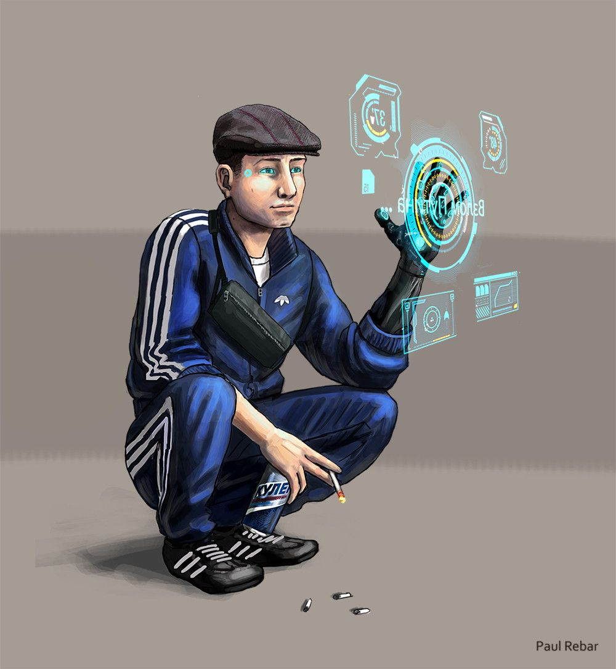
d1m1try
Pt.5

Slide 2
Disclaimer
First of all, d1m1try project does not support any actions that violate law in any means. Cracking the security of computer systems is bad and considered as a crime to gain unauthorized access to computer systems. The purpose of this educational material is building competence on how to create robust automotive products by getting hands-on experience about frequent vulnerabilities.
d1m1try Project is published under the GNU General Public License v3.0.
Credits:
Story and technical framework: János Kovács
Slide 1: All rights reserved by Paul Rebar. The publishing of his painting here happens with his explicit acceptance.
Slide 4: Dave Halberstadt, Common Creative license: CC BY-NC-ND 2.0
Slide 5: Patrick Finnigan, Common Creative license: CC BY 2.0

Slide 3

A message from Noone
It’s been months since last time you heard about the Resistance.
Your tuner business is starting to go well. Your role in the performance of Bogdan’s vehicle spread fast among the street racing community and it gets you some money.
You work late again, when a message appears on your computer.
TASK: Open message.bat.
HINT: Use an online tool to decrypt the message.

Slide 4

You do what the message said. As soon as you get back to your chair, you hear sudden steps on the corridor, the sound of something being put onto your doormat, knocking then fast steps again.

Slide 5
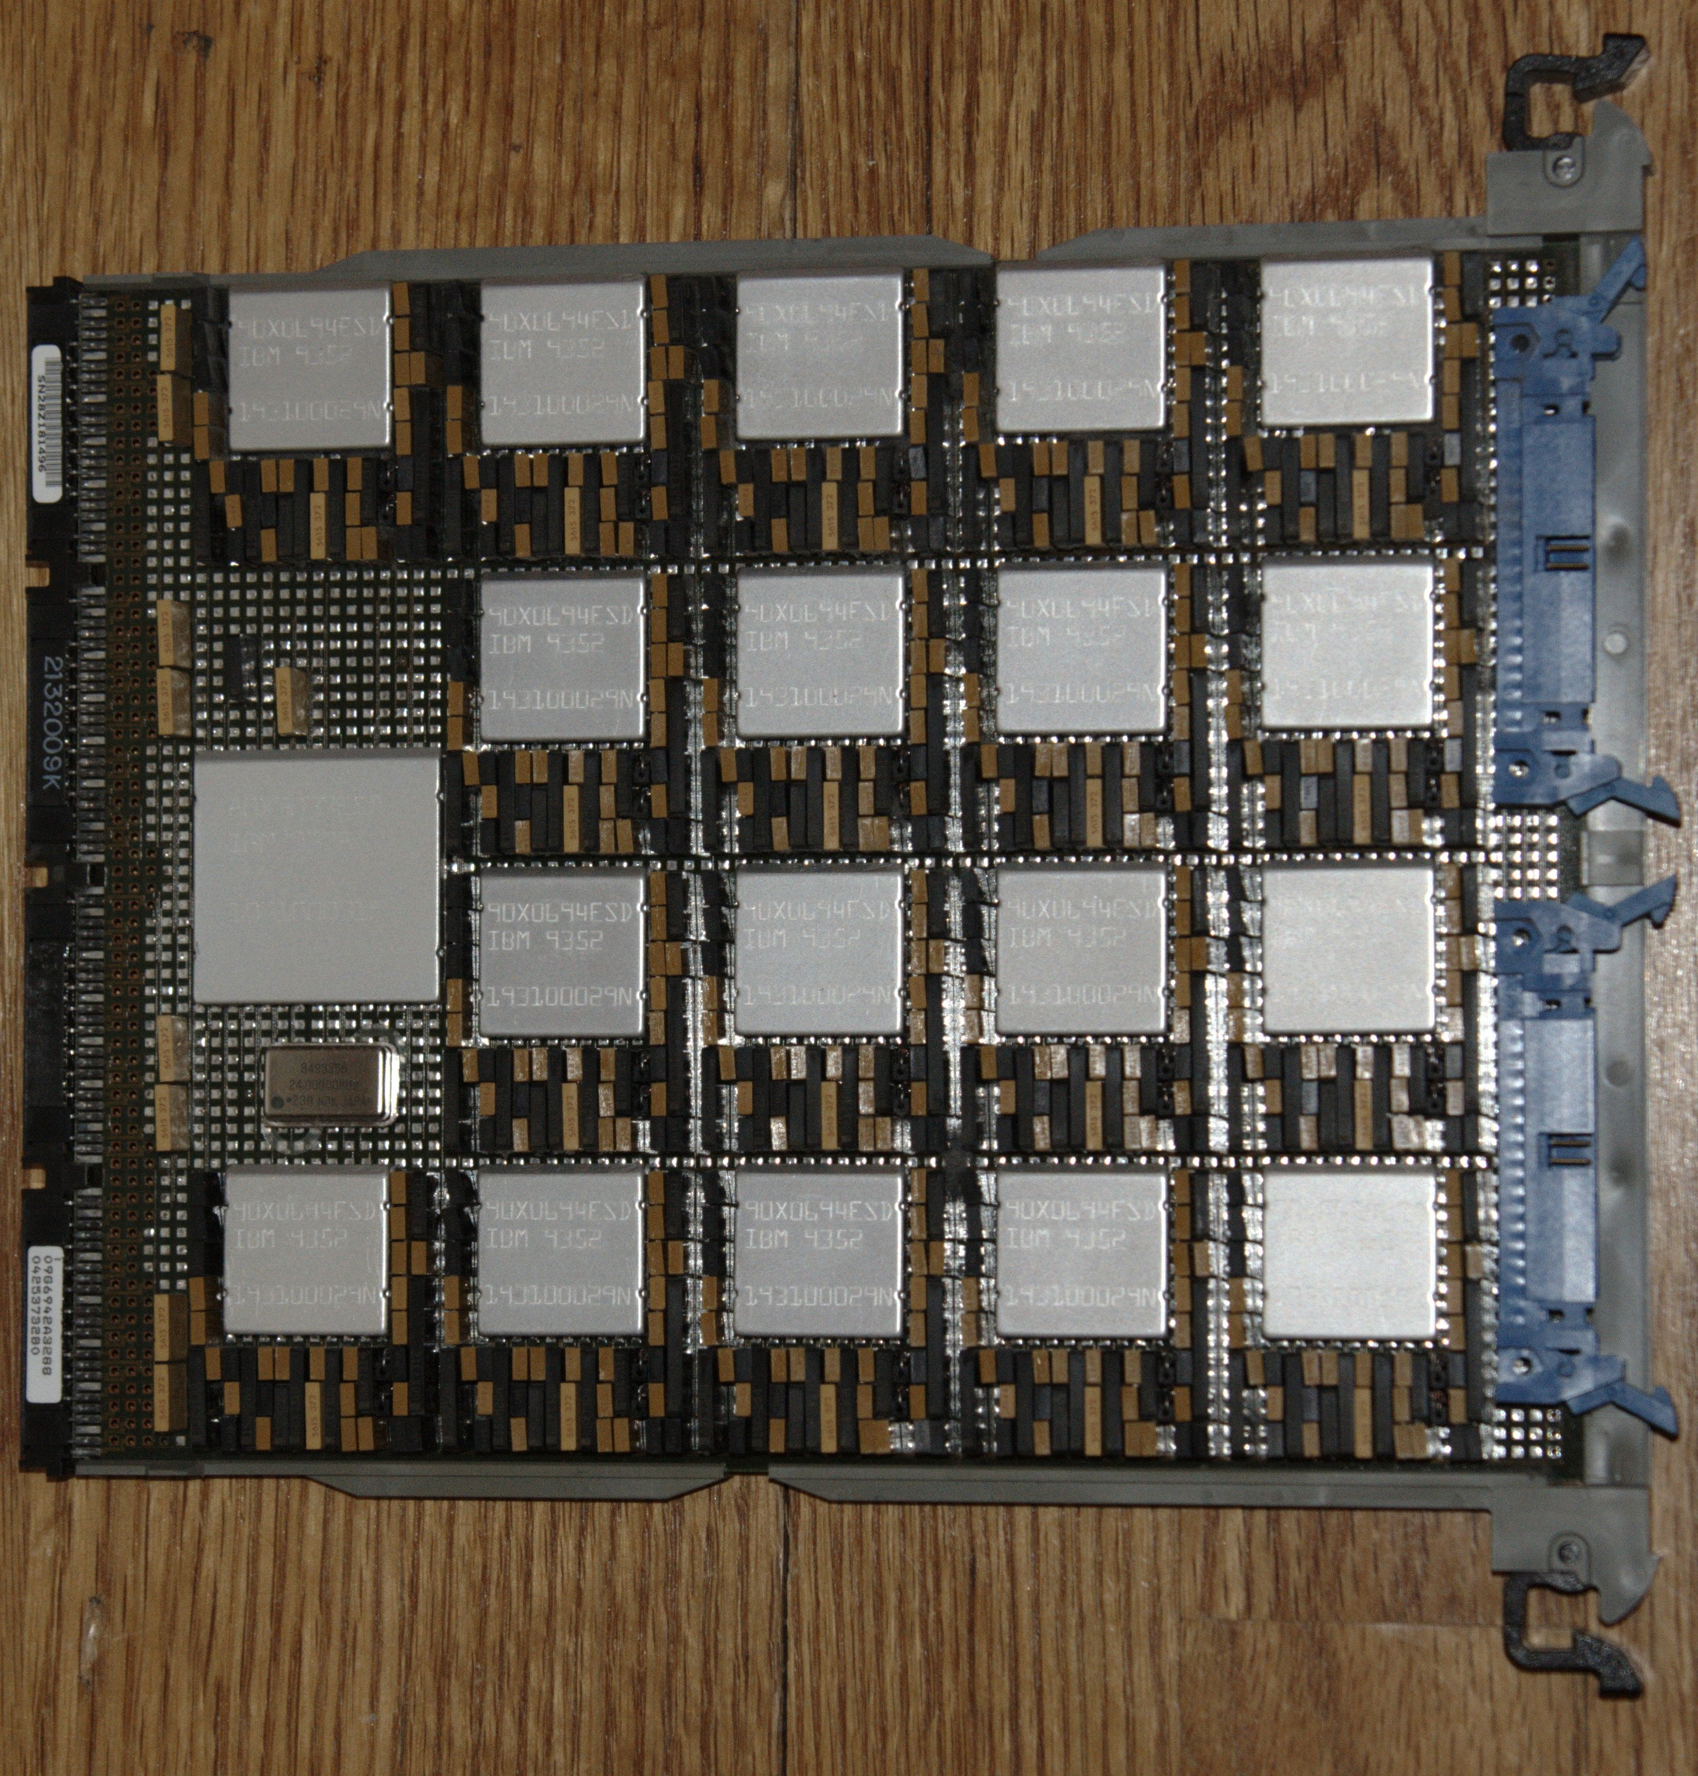
When you get to your door, the corridor is empty again, except the box in front of your apartment, with a computer of some old Syndicate car.
You place your current work aside and connect to this unit.
TASK: The one said in the message.
HINT0: Execute run_stage5.bat to start challenge.
HINT1: If you can’t use the evident way to do something, use other attack surface to make yourself able to go there.

Slide 6
Takeaway Box
It is not enough for secure an attack surface considering only the front lines, any backdoor can compromise the entire system.
Consider the accessibility of the security-critical data when designing production and development features as well.
Personally Identifiable Information (PII) might be stored on automotive systems which needs special care and protection.
More information on Privilege Chaining: https://cwe.mitre.org/data/definitions/268.html

