Slide 1
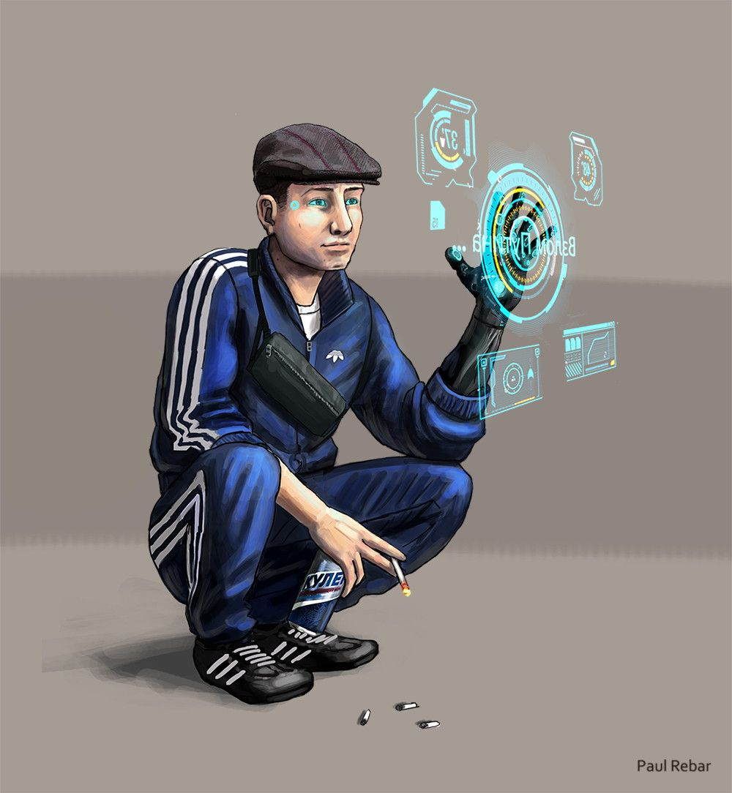
d1m1try
Pt.1

Slide 2
Disclaimer
First of all, d1m1try project does not support any actions that violate law in any means. Cracking the security of computer systems is bad and considered as a crime to gain unauthorized access to computer systems. The purpose of this educational material is building competence on how to create robust automotive products by getting hands-on experience about frequent vulnerabilities.
d1m1try Project is published under the GNU General Public License v3.0.
Credits:
Story and technical framework: János Kovács
Slide 1: All rights reserved by Paul Rebar. The publishing of his painting here happens with his explicit acceptance.
Slide 3: Mnoguagolnik , Common Creative license: CC BY-NC-SA 2.0
Slide 4: bloodless baron, This work is marked as being in the public domain.
Slide 5: bagaball, Common Creative license: CC BY 2.0
Slide 6: born1945, Common Creative License: CC BY 2.0
Slide 8: clhendricksbc. Common Creative License: CC BY 2.0
Slide 13: Andy C of Fandom, considered as being in the public domain.

Slide 3
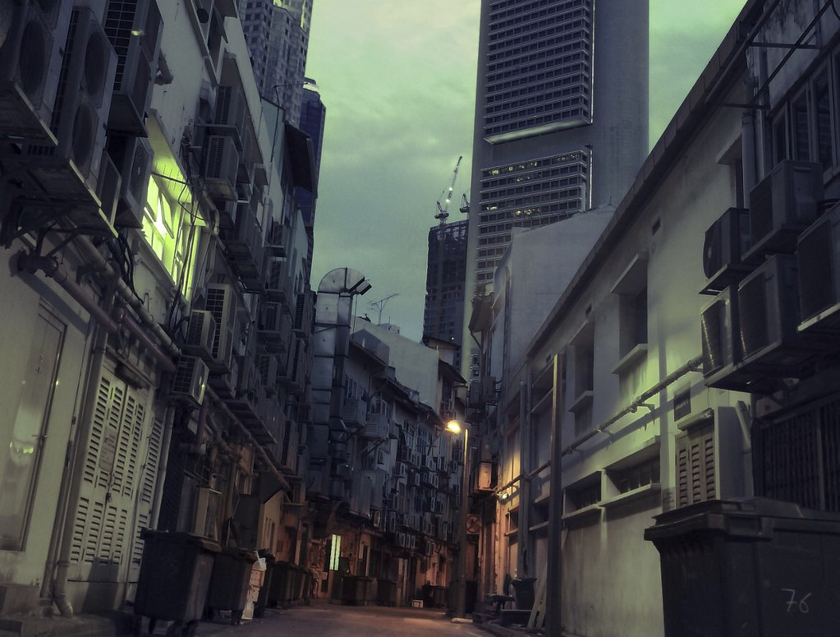
Chernograd, 2072
Another night in the electric mist of this gigantic city, with the size of a smaller country full of dirty streets.
The population is fighting for the living, since it is really hard to feed so much people. And it is even harder when the government does not care about its citizens, its only focus is getting rich from others’ money, but hey… don’t rush so far in this story.
Your name is Dimitri, a guy in his mid 20’s coming from the Kaliningrad district, looking after a job for 4 years now without any hope, earning some money with selling revived computers to the poor, tuning the cars of the luckier ones and living up the few rubels that your father left for you when he surrounded his war on cancer.
Of course, if he could get any medical service, perhaps he’d still be here, but in Eastern Europe, this is life for your kind.

Slide 4

The evening lockdown has just started, you open your door silently in your apartment and try to slip under the radar of your neighbors ready to report your suspicious behaviour for the authorities. You hope you won’t encounter any policeman on the streets, and even if so, your fake work papers will make them let you go.
The streets are nearly empty, the stench of the canals irritates your nose and lungs, but your mask helps a little bit.
You make it without detected by the officials, at least you hope so, reaching the door of the abandoned school building.

Slide 5
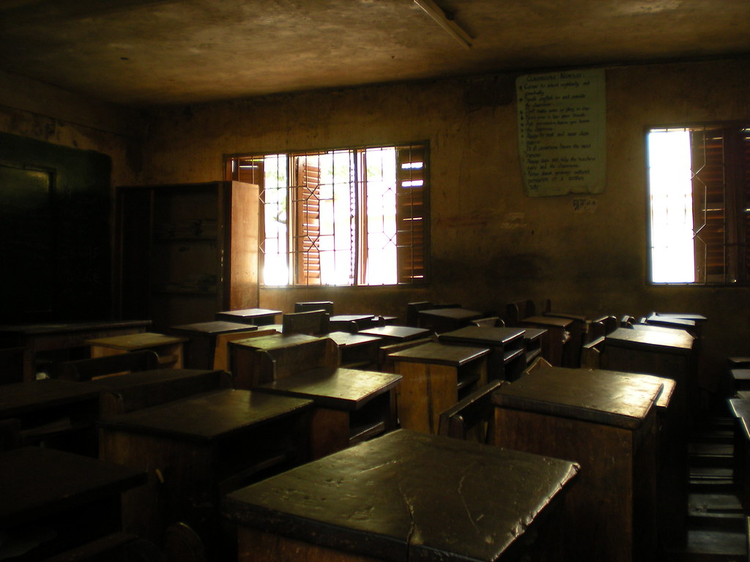
Your friends are waiting for you there. Since the government banned people gathering in the evenings, you are getting together here sometimes to drink some poorly distilled vodka and to let your frustration out about the system you are forced to live in.
Vasili greets you with a big hug and the kisses like always. Sasha – who are lucky to work for the state-owned food distributor called Super – needed to work overtime and Oleg went out to give him a lift. You are even more angry for that corporation – on top of not providing enough for the average people in Chernograd, they delay your fun time with your friend.

Slide 6
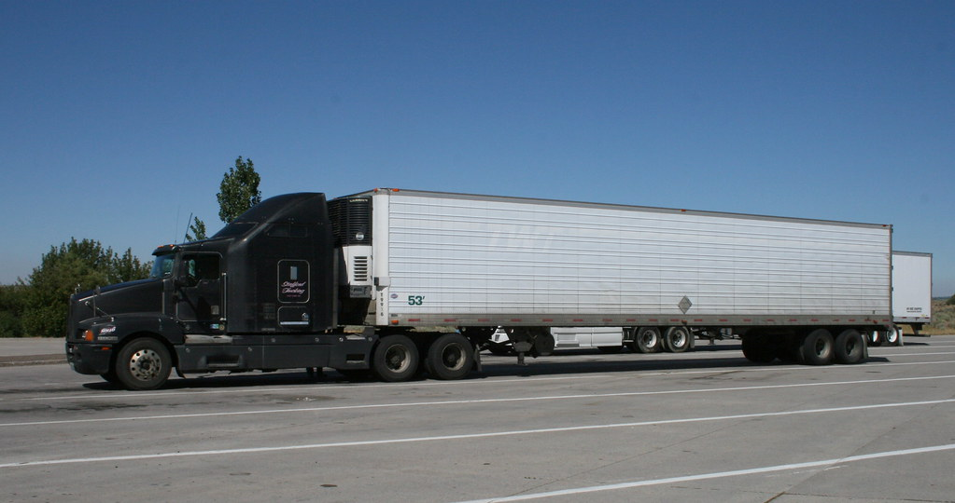
When they finally arrive, a fresh bottle of booze, a fresh bread , a smoked ham and some pickles gets on the table. Being an employee of a food distributor does not come without perks, at least.
Sasha looks like crap, he is really tired because he needed to load up the logistics bay of the warehouse. They load autonomous trucks there that delivers the goods to the districts of the privileged folks of the system.
‚What trucks do you use?’ – you ask.
‚Oh, the Syndicate ones. T250’s and 340’s. Shitty old wagons, I wonder how can they still operate.’ – he replies.
‚Interesting…’ - thoughts starts to born in your mind, but it is maybe just the effect of the vodka. – ‚These ones are connected via the state-network. If someone could connect them and would make them stop on the way, the food shortage would be solved for us and some other folks here in the district, right?’
The others look curious for you. Everyone is almost constantly hungry. Of course they are interested in any way for getting some food.

Slide 7
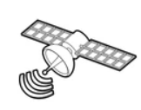



‚These vehicles need access to external information to be able to drive themselves, right? If I would get an access like this, maybe I could use their built-in diagnostic functions to make them stop. I think I could earn you enought time to take as much of the cargo as possible.’ – you say.
‚Are you insane? This is robbery! We will hang if they got us!’ – Oleg replies.
‚I’d rather hang than starving. I’m sick of that. I’m in.’ – says Vasili. The rest become silent, an nods that you’ve got their buy-in too.
‚But let’s drop this stuff for a while. We are drunk and I also need to do some feasibility research.’ - you already start wondering about how you can do that, and the rest shares their thoughts on yesterday’s football match. You feel that everyone still thinks about this opportunity, but it is the best not to talk about that until the point when it’s game on.
You cannot be sure who is listening.

Slide 8
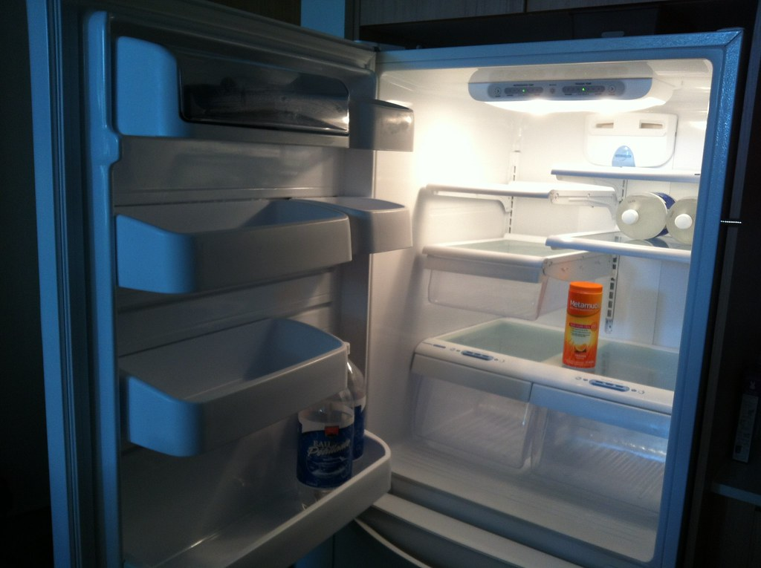
You need some time to analyze your possibilities, so you excuse yourself and leave early tonight. Your walk home was sobering in the cold streets, even the smell is less disturbing now.
After your sleep, you think about last night’s meetup. Alcohol can make people overly confident, but remembering the empty shelves on the local stores, looking at the starving people of the streets and opening your empty fridge assures you that you really need to do something about this matter.

Slide 9
You do some research about the fleet management system of Syndicate Automotive.
According to the original plan, you somehow log to the fleet management system or connect to the vehicle interface listening to this fleet management system data flow.
Unfortunately for you, since you are not a world-class hacker, breaking the fleet management system of one of the world’s largest car manufacturer is out of option.
You still could bribe someone at the mechanic workshops, but you are lacking the financial resources for that and you need to try staying under the radar.
Currently, it is clear that you need to discard the remote attack planned initially.

Slide 10
This does not mean however, that you are out of options.
Since your friend works at Super’s warehouse, he has physical access to the vehicle, your target. If you can get a device which can be connected to the diagnostic port of the vehicle, then you will be able to remotely execute diagnostic requests which would otherwise require direct access. This device is quite cheap and you order it from your friend immediately.
However, your friend can only get you a separate diagnostic connector and the device without its pins wired out. You need to wire them yourself. You know, that the old Syndicate trucks use a connector copied from the late OBD-2 standard.
HW RECON TASK: find an OBD-2 channel and learn, how it works. Which is the CAN-H pin of the OBD-2 connector?
Create a sha-256 digest of this answer at https://emn178.github.io/online-tools/sha256.html
Answer is: E7F6C011776E8DB7CD330B54174FD76F7D0216B612387A5FFCFB81E6F0919683

Slide 11
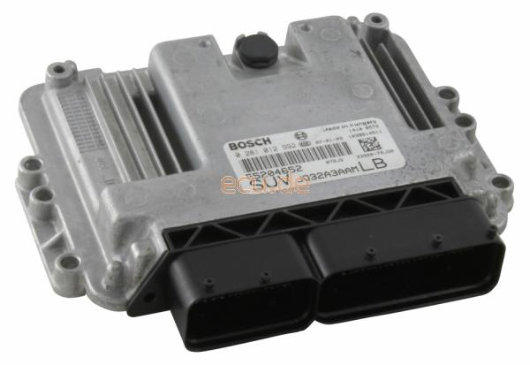
You still need to do some research. Hopefully, your implementation of your remote diagnostic tool wiring will work.
However, it still would be useful to try out everything in your lab.
You start searching in the state-network for information about this vehicle. You are curious about what is the Engine Control Unit (ECU) belonging to this vehicle type – and you manage to get one from the junk yard.
Your problem now is that while you supplied your ECU with the 12V it need for operation, that you do not know, which pin should you connect with your diag tool in case you will need to communicate over CAN.
You learn that this ECU is a late – but exact – copy of the ancient EDC16C39.
TASK: Find the 12V, the 12V ACC, the K, the GND, the CAN-L and the CAN-H pins of the EDC16C39. You should submit this to the hash generator as a 12V|12VACC|K|GND|CAN-L|CAN-H format.
Example: 12V is pin 2, 12V ACC is pin 78, K pin is pin 11, GND is pin 5, CAN-L is pin 22, CAN-H is pin 99. You should give 2781152299 as the answer.
The answer is: 8c670b14828a4b4c3cc7530004d62229f2ac54f507b14234384f50b777633b3b
source: ecu.hu

Slide 12
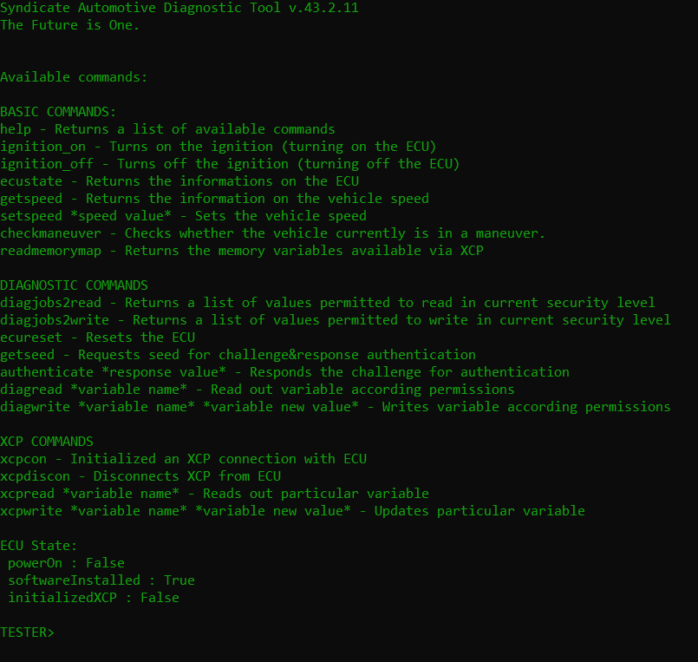
You manage to give the old ECU back to life in a simulation environment.
You connect a 12V power to its pins, give a positive signal to the ignition and connect the CAN channels with proper resistance on its ending.
You immediately notice that the software itself has nothing in common with the old EDC16, the Syndicate might have stolen the hardware schematics and loaded its own program to the flash memory. Nothing you found online about the EDC16 can be used here and nothing you find here can be used with a real EDC16, even if you can find a car still equipped with this ancient control unit.
But this doesn’t really matters, anyway, since your target is a Syndicate vehicle with a Syndicate software.
Your goal is to make this engine stop. Find a way for that.
HELP0: Execute run_stage1.bat in the home directory of your project. There is 1 flag for this challenge.
HELP1 (highlight hidden text): The solution would became evident when you find it in the diagnostic jobs..

Slide 13

…and you make it.
You feel confident and your plan seems to work.
The only thing remains to do is preparing everything and making your friends wait for the truck when it will go out of business and collect the goods it carried for you.

Slide 14
Takeaway Box
The required privilege level for every available service shall be thoroughly revised considering the use cases and the abuse cases of the functionality.
Sometimes, the risk of such possible threat does not go above the business value provided by the (probable) vulnerable configuration, however, it might happen that some (ab)use cases were overseen.

