Slide 1
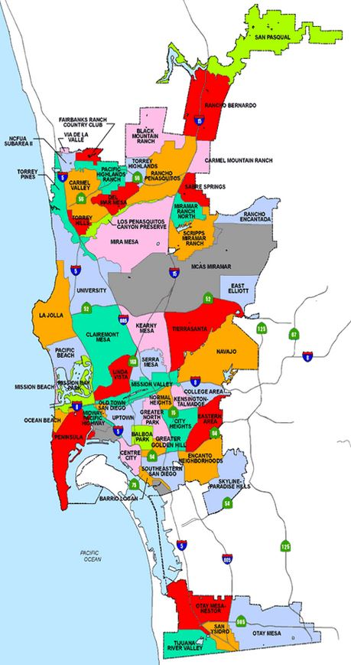
Finding an Optimal Location for a New Sushi Restaurant in San Diego, CA
Applied Data Science Capstone Project
The Battle of Neighborhoods (Week2) Assignment
H-K Kim
May 28, 2020

Slide 2
1. Introduction
In this project, I will try to help my friend who is looking for an optimal location for his sushi restaurant in beautiful San Diego, CA.
Since there are already many sushi restaurants in San Diego, he is looking for a location where there are various kinds of business stores but few sushi or Japanese restaurants in vicinity. If other conditions are the same, he prefers a location which is near the ocean.
I will use my data science skills to detect the optimal location for his new sushi restaurant.

Slide 3

2. Data
I will download "community_bounds.csv" from https://data.world/san-diego/community-bounds, and use it as an input data.
The csv file contains the information of latitude & longitude coordinates of 63 neiborhoods in San Diego.
I will use Foursquare API to extract number of restaurants and their type and location in every neighborhood in San Diego.

Slide 4
Clean up the data:
In the data, 63 neighborhoods are displayed.
However, 'Military Facilities' and 'Reserve' occur multiple times, and they should be removed since no restaurants can be run in such neighborhoods.
So, I will handle 55 neighborhoods.

Slide 5
3. Methodology
I will use geopy library to get the latitude and longitude values of San Diego.
In order to define an instance of the geocoder, I will define a user_agent, which will be named 'SD_explorer’.
The next page will show a map of San Diego with neighborhoods superimposed on top.
Folium is a great visualization library. We can zoom into the map and click on each circle mark to reveal the name of the neighborhood.

Slide 6
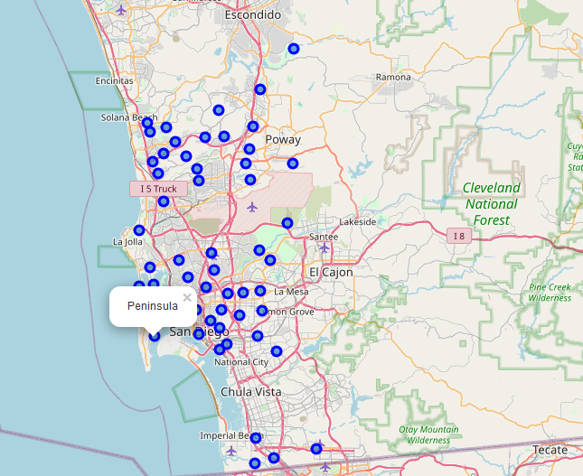

Slide 7
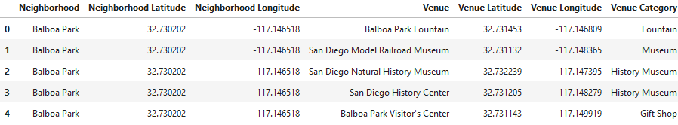
Exploration of neighborhoods in San Diego
I will utilize the Foursquare API to explore the neighborhoods and segment them.

Slide 8
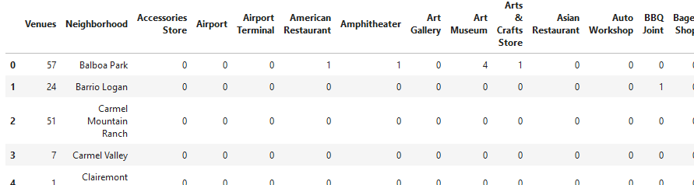
Analysis of Each Neighborhood
First of all, I check which kind of venue categories are detected in each neighborhood. 211 kinds of venue categories are detected.
Second, I check how many venues are detected in each neighborhood.

Slide 9
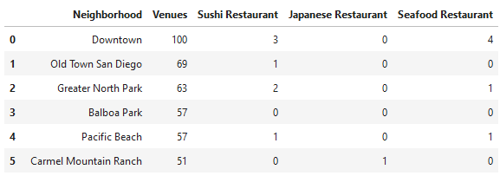


4. Results
I will sort out the neighborhoods on the basis of Venues column and check how many Sushi or Japanese restaurants or even Seafood restaurants in each neighborhood.

Slide 10
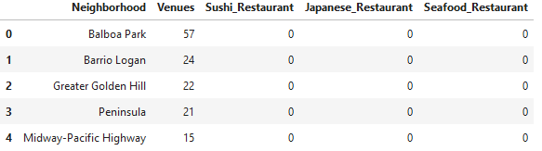

I will also check which neighborhoods have neither Suchi Restaurants, Japanese Restaurants, nor even Seafood Restaurants.

Slide 11
5. Discussion
This result shows that Balboa Park is the optimal location to open a new Sushi restaurant in San Diego, since there the greatest number of venues among neighborhood which do not have sushi, Japanese or seafood restaurants.
However, since even if there is one sushi restaurant in Old Town San Diego, there are 21% more venues than Balboa Park, which means the former is much busier neighborhood than the latter.
Of course, there must be many other factors to find an optimal location for a new restaurant such as availability, rent price, easy accessibility, convenience of parking, etc. In this project, all such factors are ignored.

Slide 12
6. Conclusion
I will give the following two neighborhood names to my friend:
Balboa Park - having the greatest number of venues among neighborhoods without any sushi, Japanese, or seafood restaurants.
Old Town San Diego - having 21% more venues than Balboa Park but there is one sushi restaurant
I think he will choose one of them, considering other factors.

