Slide 1
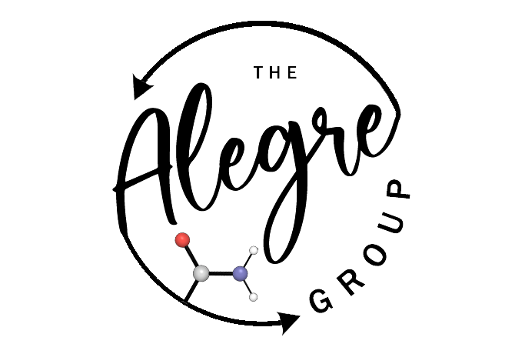

AI workshop
Basics of Chemical Machine Learning, AQME and Descriptor Generation

Slide 2
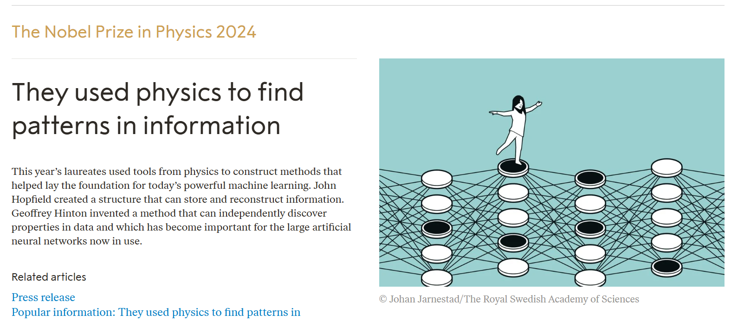
The AI “hype”

Slide 3
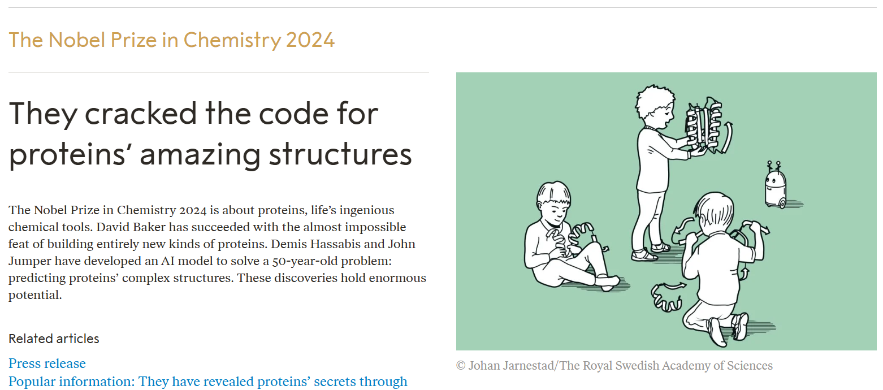
The AI “hype”

Slide 4
The AI “hype”
Stanford AI Index Report 2024

Slide 5

The AI “hype”
Spain
. . .
0.36
Stanford AI Index Report 2024

Slide 6


The AI “hype”
Consolidación Investigadora 2023
200K or 400K (if AI was included)
Momentum 2024
2 contracts (AI or digital.)
Spain
. . .
0.36
Stanford AI Index Report 2024

Slide 7


Basics of Chemical ML
How does machine learning work?
Data in
“In a village in la Mancha, whose name I do not care to remember, an hidalgo lived not long ago, one of those who keeps a lance on the rack, an old leather shield, skinny nag...”
“To be, or not to be: that is the question: Whether 'tis nobler in the mind to suffer the slings and arrows of outrageous fortune, or to take arms against a sea of troubles, and by opposing end them? To die: to sleep…
ChatGPT, personal communication, February 11, 2023

Slide 8
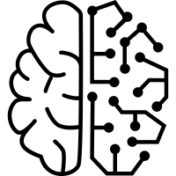
Basics of Chemical ML
How does machine learning work?
Data in
“In a village in la Mancha, whose name I do not care to remember, an hidalgo lived not long ago, one of those who keeps a lance on the rack, an old leather shield, skinny nag...”
“To be, or not to be: that is the question: Whether 'tis nobler in the mind to suffer the slings and arrows of outrageous fortune, or to take arms against a sea of troubles, and by opposing end them? To die: to sleep…
ChatGPT, personal communication, February 11, 2023

Slide 9
Basics of Chemical ML
How does machine learning work?
Data in
Data out
“In a village in la Mancha, whose name I do not care to remember, an hidalgo lived not long ago, one of those who keeps a lance on the rack, an old leather shield, skinny nag...”
Where does Don Quixote begin?
“To be, or not to be: that is the question: Whether 'tis nobler in the mind to suffer the slings and arrows of outrageous fortune, or to take arms against a sea of troubles, and by opposing end them? To die: to sleep…
Who wrote Hamlet?
ChatGPT, personal communication, February 11, 2023

Slide 10
Basics of Chemical ML
How does machine learning work?
Data in
Data out
“In a village in la Mancha, whose name I do not care to remember, an hidalgo lived not long ago, one of those who keeps a lance on the rack, an old leather shield, skinny nag...”
Where does Don Quixote begin?
“Don Quixote begins in a place in La Mancha. Don Quixote of La Mancha is a novel written by the Spanish author Miguel de Cervantes Saavedra. Its first part was published with the title 'The Ingenious Gentleman Don Quixote’…”
“To be, or not to be: that is the question: Whether 'tis nobler in the mind to suffer the slings and arrows of outrageous fortune, or to take arms against a sea of troubles, and by opposing end them? To die: to sleep…
Who wrote Hamlet?
ChatGPT, personal communication, February 11, 2023

Slide 11
Basics of Chemical ML
How does machine learning work?
Data in
Data out
“In a village in la Mancha, whose name I do not care to remember, an hidalgo lived not long ago, one of those who keeps a lance on the rack, an old leather shield, skinny nag...”
Where does Don Quixote begin?
“Don Quixote begins in a place in La Mancha. Don Quixote of La Mancha is a novel written by the Spanish author Miguel de Cervantes Saavedra. Its first part was published with the title 'The Ingenious Gentleman Don Quixote’…”
“To be, or not to be: that is the question: Whether 'tis nobler in the mind to suffer the slings and arrows of outrageous fortune, or to take arms against a sea of troubles, and by opposing end them? To die: to sleep…
“William Shakespeare wrote Hamlet. The tragedy of Hamlet, Prince of Denmark (original title in English: The Tragedy of Hamlet, Prince of Denmark), is a play by the…”
Who wrote Hamlet?
ChatGPT, personal communication, February 11, 2023

Slide 12
Basics of Chemical ML
How does machine learning work in chemistry?
Data in
Science 2018, 360, 186

Slide 13
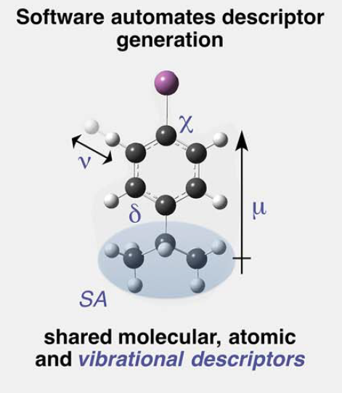
Basics of Chemical ML
How does machine learning work in chemistry?
Data in
Molecular properties
Solubility
m.p.
Atomic properties
Charge
Sterics
Material properties
Component ratio
Process properties
Temperature
Pressure
Science 2018, 360, 186

Slide 14
Basics of Chemical ML
How does machine learning work in chemistry?
Data in
Molecular properties
Solubility
m.p.
Atomic properties
Charge
Sterics
Material properties
Component ratio
Process properties
Temperature
Pressure
Science 2018, 360, 186

Slide 15
Basics of Chemical ML
How does machine learning work in chemistry?
Data in
Data out
Molecular properties
Design an effective catalyst
Solubility
m.p.
Atomic properties
Charge
Sterics
Material properties
Component ratio
Design an optimal solar cell
Process properties
Temperature
Pressure
Science 2018, 360, 186

Slide 16
Basics of Chemical ML
How does machine learning work in chemistry?
Data in
Data out
Molecular properties
Design an effective catalyst
Predicted yield: 92%
Solubility
m.p.
Atomic properties
Charge
Sterics
Material properties
Component ratio
Design an optimal solar cell
Process properties
Temperature
Pressure
Science 2018, 360, 186

Slide 17
Basics of Chemical ML
How does machine learning work in chemistry?
Data in
Data out
Molecular properties
Design an effective catalyst
Predicted yield: 92%
Solubility
m.p.
Atomic properties
Charge
Sterics
Material properties
Component ratio
20% graphene + 40% Si + 40% GaAs
Design an optimal solar cell
Process properties
Predicted solar-cell efficiency: 21%
Temperature
Pressure
Science 2018, 360, 186

Slide 18
Basics of Chemical ML
First step: digitalization of molecules
ACS Catal. 2026, 16, 1

Slide 19
Basics of Chemical ML
First step: digitalization of molecules
ACS Catal. 2026, 16, 1

Slide 20
Basics of Chemical ML
First step: digitalization of molecules
ACS Catal. 2026, 16, 1

Slide 21
Basics of Chemical ML
First step: digitalization of molecules
ACS Catal. 2026, 16, 1

Slide 22
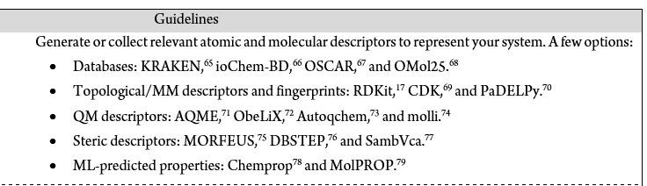
Basics of Chemical ML
First step: digitalization of molecules
ACS Catal. 2026, 16, 1

Slide 23

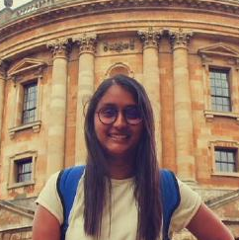
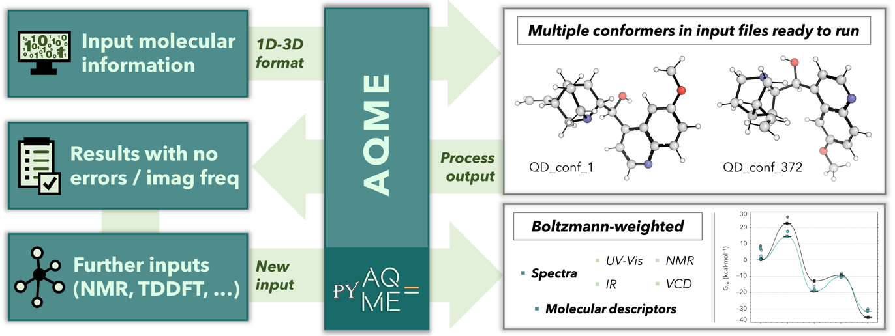
AQME: automation of QM protocols
Overview of AQME
Shree Sowndarya
Dr. Robert S. Paton
WIREs. Comput. Mol. Sci. 2023, e1663

Slide 24
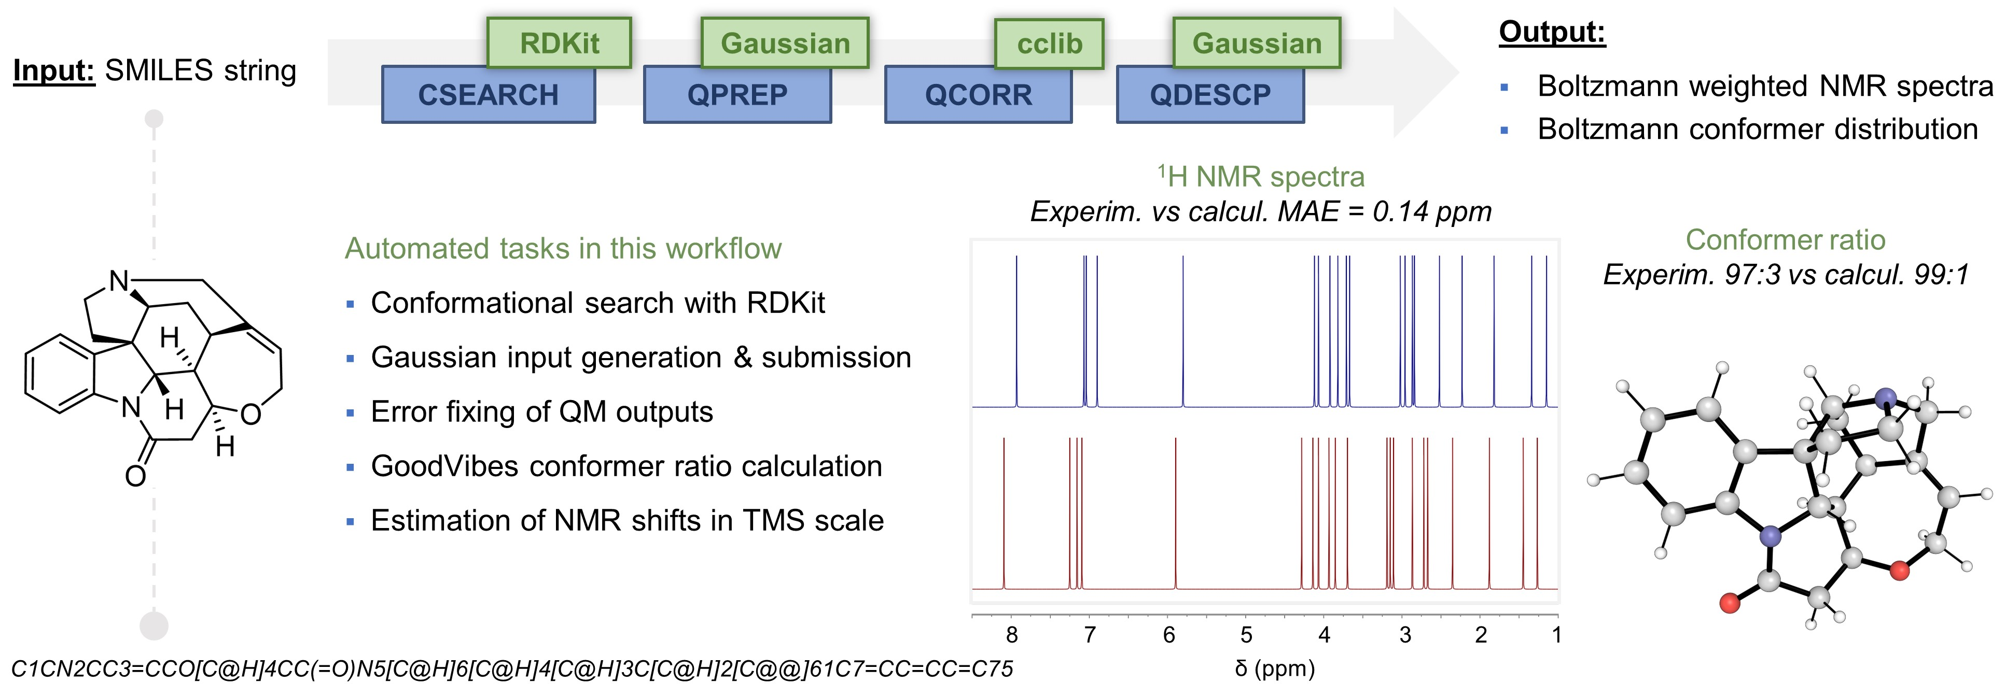
AQME: automation of QM protocols
End-to-end workflows
sbatch AQME_script.sh
Alegre-Requena, Paton & col., WIREs. Comput. Mol. Sci. 2023, e1663

Slide 25


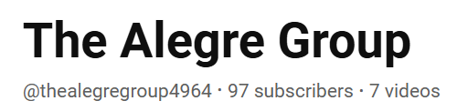







AQME: stats
Users and interest
https://github.com/jvalegre/aqme
www.readthedocs.org/projects/aqme
Prof. Juho Helaja
University of Helsinki
Companies
Known active users:
Academic groups
Dr. A. Vazquez-Mayagoitia
Argonne National Lab.
WIREs. Comput. Mol. Sci. 2023, e1663

Slide 26
AQME: automation of QM protocols
Future Leaders Special Issue. Trends in Chem. 2024

Slide 27
AQME: automation of QM protocols
Future Leaders Special Issue. Trends in Chem. 2024

Slide 28
AQME: automation of QM protocols
Conformer searches are tricky
What’s the most stable conformer in each case?
1: Proc. Comb. Inst. 2023, 39, 877
2, 3: Chem. Eng. J. 2023, 466, 143346.
4: Nature Commun. 2022, 13, 6885.
5: J. Am. Chem. Soc. 2022, 144, 86.
6: Chem. Eur. J. 2017, 23, 15336
7: ChemRxiv, 2023, 10.26434/chemrxiv-2023-8jzsp
Future Leaders Special Issue.
Trends in Chem. 2024

Slide 29
AQME: automation of QM protocols
Conformer searches are tricky
1: Proc. Comb. Inst. 2023, 39, 877
2, 3: Chem. Eng. J. 2023, 466, 143346.
4: Nature Commun. 2022, 13, 6885.
5: J. Am. Chem. Soc. 2022, 144, 86.
6: Chem. Eur. J. 2017, 23, 15336
7: ChemRxiv, 2023, 10.26434/chemrxiv-2023-8jzsp
Future Leaders Special Issue.
Trends in Chem. 2024

Slide 30
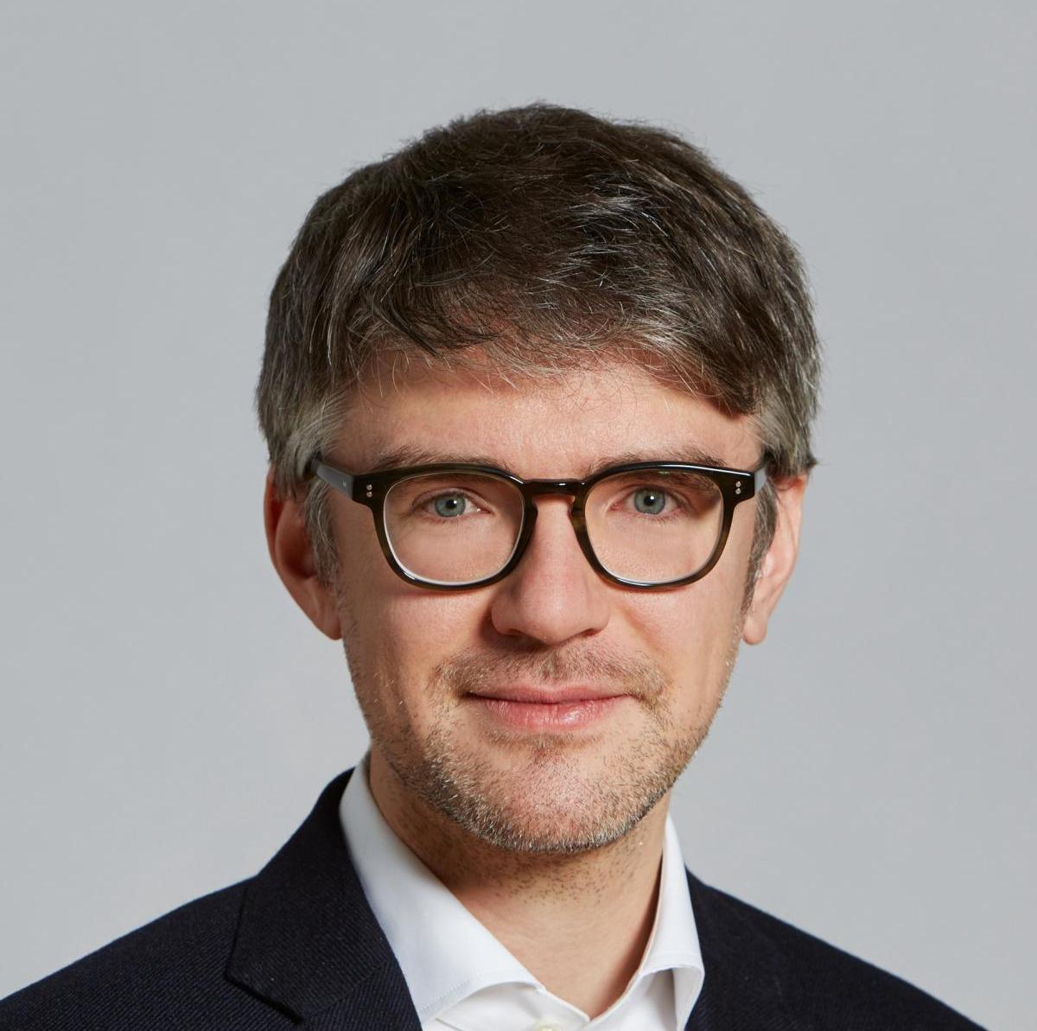


AQME: automation of QM protocols
Dr. Kjell Jorner
Trends in Chem. 2024, 6, 459

Slide 31
AQME: descriptor generation
ACS Catal. 2026, accepted

Slide 32


AQME: descriptor generation
1. Design cost-efficient workflows to promote the use of ML in chemistry
2. Avoid HPC use (Gaussian, ORCA, etc.)
GOAL
1. xTB descriptors were not good enough (low variety)
2. Too many other descriptors with hard interpretation (ie. RDKit)
PROBLEMS
ACS Catal. 2026, accepted

Slide 33
AQME: descriptor generation
AQME v2 – adapted to create a wide variety of xTB-MORFEUS descriptors
ACS Catal. 2026, accepted

Slide 34
AQME: descriptor generation
AQME v2 – adapted to create a wide variety of xTB-MORFEUS descriptors
AQME workflow:
Organic species, organometallic complexes, radicals, etc.
ACS Catal. 2026, accepted

Slide 35
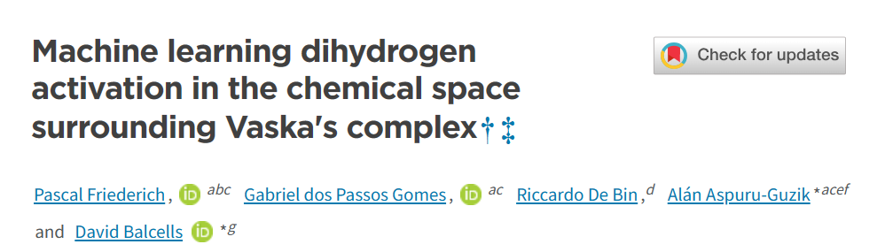
AQME: descriptor generation
Automated generation of predictors
Input: CSV with SMILES
WIREs. Comput. Mol. Sci. 2024, 14, e1733

Slide 36
AQME: descriptor generation
Automated generation of predictors
Input: CSV with SMILES
1 command line
WIREs. Comput. Mol. Sci. 2024, 14, e1733

Slide 37
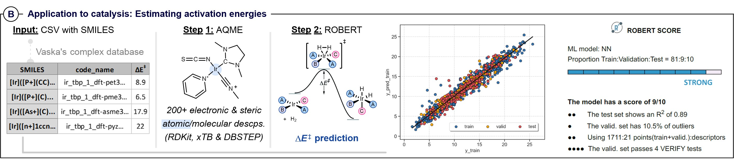
AQME: descriptor generation
Automated generation of predictors
Input: CSV with SMILES
1 command line

Slide 38

AQME: descriptor generation
1. Design cost-efficient workflows to promote the use of ML in chemistry
2. Avoid HPC use (Gaussian, ORCA, etc.)
GOAL
1. xTB descriptors were not good enough (low variety)
2. Too many other descriptors with hard interpretation (ie. RDKit)
PROBLEMS
Human bias: xTB isn’t able to replace DFT, xTB is quite bad for metals, etc.
UPHILL BATTLE

Slide 39
AQME: descriptor generation
Unbiased evaluation of models and overfitting:
- Metrics for 10x 5-fold CV (80%) and test set (20%)
- SHAP analysis for interpretability - Similar ranges in X and Y axis

Slide 40
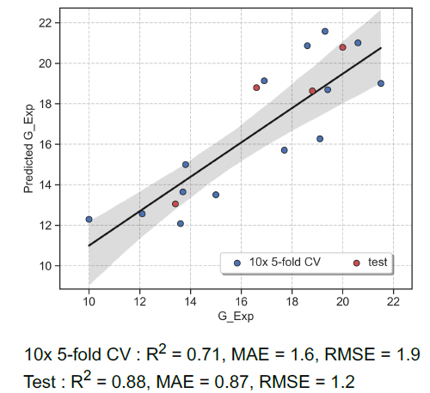
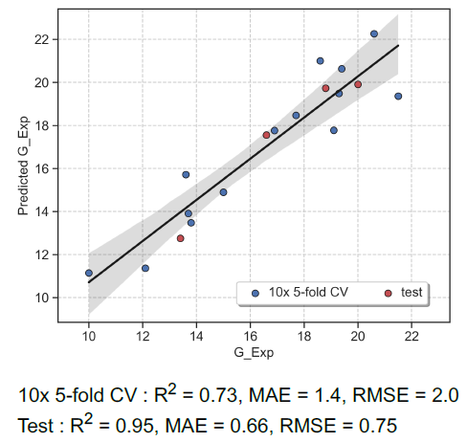
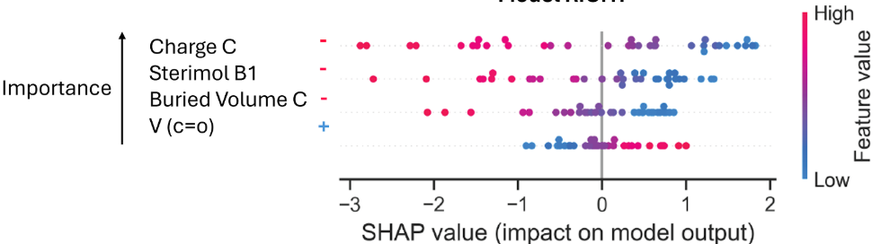
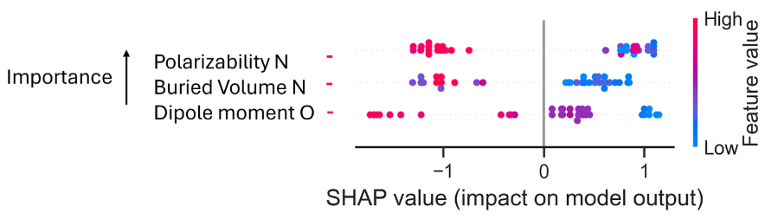
AQME: descriptor generation
Unbiased evaluation of models and overfitting:
18 points

Slide 41
AQME: descriptor generation
Unbiased evaluation of models and overfitting:
18 points
Are these two models good? Decent and comparable (publication quality)

Slide 42
AQME: descriptor generation
Unbiased evaluation of models and overfitting:
xTB
DFT
18 points

Slide 43
AQME: descriptor generation
Unbiased evaluation of models and overfitting:
xTB
DFT
18 points

Slide 44
AQME: descriptor generation
Unbiased evaluation of models and overfitting:
xTB
DFT
18 points

Slide 45
AQME: descriptor generation
Unbiased evaluation of models and overfitting:
xTB
DFT
18 points
Outliers

Slide 46
AQME: descriptor generation
Unbiased evaluation of models and overfitting:
xTB
DFT
18 points
Are these two models good? Actually the one with xTB seems to have more issues
Outliers

Slide 47
AQME: descriptor generation
Unbiased evaluation of models and overfitting:
xTB
DFT
DFT
xTB
18 points
Outliers

Slide 48
AQME: descriptor generation

Slide 49
AQME: descriptor generation
xTB isn’t good for metals
xTB doesn’t work in low-data regimes
Further challenge

Slide 50
AQME: descriptor generation
Expert survey (more than 15 institutions / countries!)
50
ACS Catal. 2026, accepted

Slide 51
AQME: descriptor generation
ACS Catal. 2026, accepted

Slide 52
AQME: descriptor generation
ACS Catal. 2026, accepted

Slide 53
AQME: descriptor generation
ACS Catal. 2026, accepted

Slide 54
AQME: descriptor generation
When compared blindly, experts on the field consider xTB-based ML models to be similar to DFT-based publication-quality models

Slide 55
AQME: descriptor generation
How is this possible if xTB has lower level of theory compared to DFT?
Strong correlations
(even if absolute values are less accurate)
More variety of descriptors
Often, people try less than 5-10 types of QM descriptors (i.e., charge, V_{bur}, Fukui, etc.)
New AQME workflow: 39 descriptors
…
R² > 0.9 in HOMO, LUMO, dipole, V_{bur}, etc.

