Slide 1


AI workshop
Introduction to cheminformatics
Author: Itzel Muro Puente
May 20th, 2026

Slide 2

Cheminformatics
Definition
Combines chemistry, computer science, and information science to organize, process, and present chemical data.

Slide 3
Cheminformatics
Definition
Combines chemistry, computer science, and information science to organize, process, and present chemical data.
Computers don’t know chemistry, the translation of “chemistry” to computer language is necessary.

Slide 4
SMILES
It means Simplified Molecular Input Line Entry System.

Slide 5
SMILES
It means Simplified Molecular Input Line Entry System.
A way to write molecules in one string that is easy for humans to read.

Slide 6
SMILES
It means Simplified Molecular Input Line Entry System.
A way to write molecules in one string that is easy for humans to read.
Examples:

Slide 7
SMILES
It means Simplified Molecular Input Line Entry System.
A way to write molecules in one string that is easy for humans to read.
Examples:
CCC

Slide 8
SMILES
It means Simplified Molecular Input Line Entry System.
A way to write molecules in one string that is easy for humans to read.
Examples:
CCC CC=C

Slide 9
SMILES
It means Simplified Molecular Input Line Entry System.
A way to write molecules in one string that is easy for humans to read.
Examples:
CCC CC=C CC#C

Slide 10
SMILES
It means Simplified Molecular Input Line Entry System.
A way to write molecules in one string that is easy for humans to read.
Examples:
CCC CC=C CC#C c1ccccc1

Slide 11
SMILES
It means Simplified Molecular Input Line Entry System.
A way to write molecules in one string that is easy for humans to read.
Examples:
CCC CC=C CC#C c1ccccc1 ClC(Cl)Cl

Slide 12
SMILES
It means Simplified Molecular Input Line Entry System.
A way to write molecules in one string that is easy for humans to read.
Examples:
CCC CC=C CC#C c1ccccc1 ClC(Cl)Cl
Tutorial on SMILES for more information.

Slide 13
Canonical SMILES
SMILES of molecule?
CCS b) C(S)C c) SCC

Slide 14
Canonical SMILES
SMILES of molecule?
CCS b) C(S)C c) SCC
All are correct, but in a database, will lead to duplicates.

Slide 15
Canonical SMILES
SMILES of molecule?
CCS b) C(S)C c) SCC
All are correct, but in a database, will lead to duplicates.
The canonical SMILES must be obtained to get a unique standardized text representation is a) CCS.

Slide 16
Canonical SMILES
SMILES of molecule?
CCS b) C(S)C c) SCC
All are correct, but in a database, will lead to duplicates.
The canonical SMILES must be obtained to get a unique standardized text representation is a) CCS.
You can check with this tool.

Slide 17
Challenges
Transition metal complexes SMILES

Slide 18
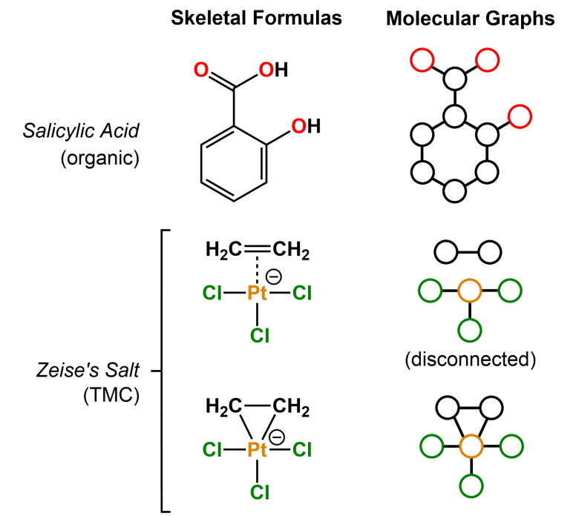
Challenges
Transition metal complexes SMILES
!
Machine-readable object metal-containing compound: no clear bond definitions

Slide 19
Challenges
Transition metal complexes SMILES
!
Machine-readable object metal-containing compound: no clear bond definitions
!
QM accurate calculations are expensive with metals
!
Inconsistent formats across literature

