Slide 1
Tutorial 10: Girvan-Newman; Association Rule Mining
COMP 4331
TA: Vincent Cheng
yzhengbs@connect.ust.hk
HKUST
Notebook on Google Colab
https://colab.research.google.com/drive/1-EzsS7dAE0h9CLqflarQtdJS5t6BDKnI?usp=sharing

Slide 2
Girvan-Newman Algorithm

Slide 3
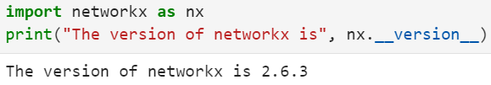
NetworkX
A Python package for the creation, manipulation, … of networks. A handy tool for implementing Girvan-Newman algorithm.
Installation:
pip install network
Import NetworkX

Slide 4





Basic usage
Initialize a graph
Different ways to grow the graph
add one node
add a list of nodes
add one edge
add a list of edges

Slide 5

Basic usage
Remove all nodes and edges
Different ways to shrink the graph
remove one node
remove a list of nodes
remove one edge
remove a list of edges

Slide 6
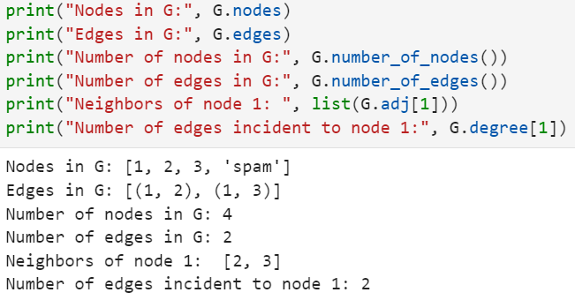
Basic usage
Properties of graph

Slide 7
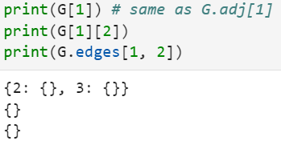
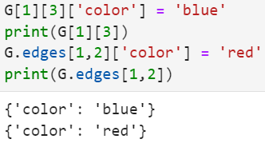
Basic usage
Access edges and neighbors
Set/get attributes of an edge using subscript notation

Slide 8
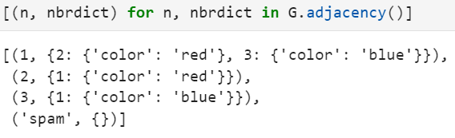
Basic usage
Access all (node, adjacency) pairs in graph

Slide 9
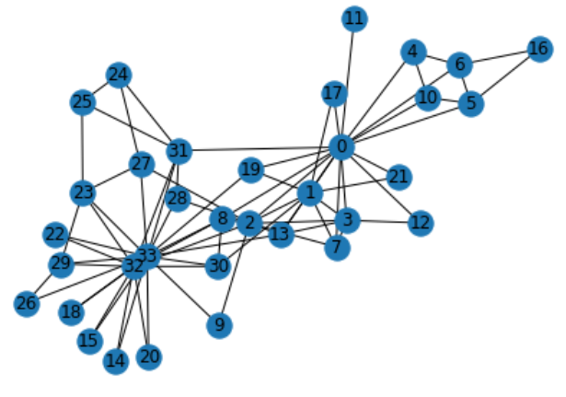
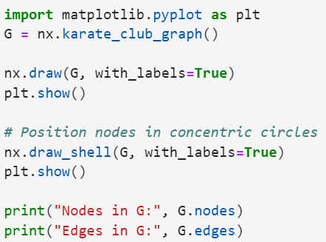
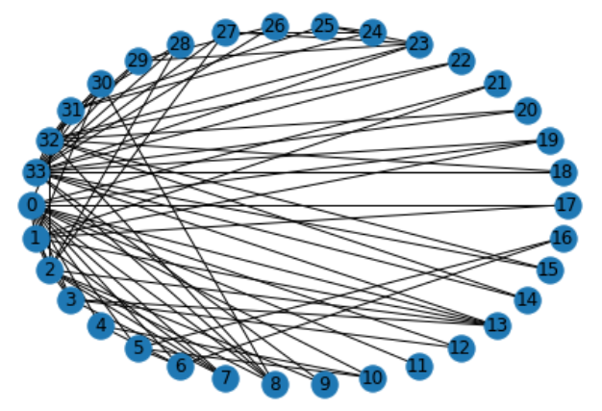
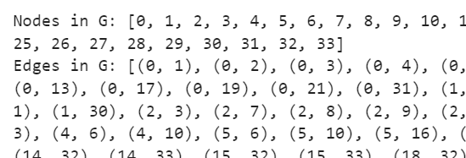
Basic usage
Visualize Zachary’s Karate network

Slide 10

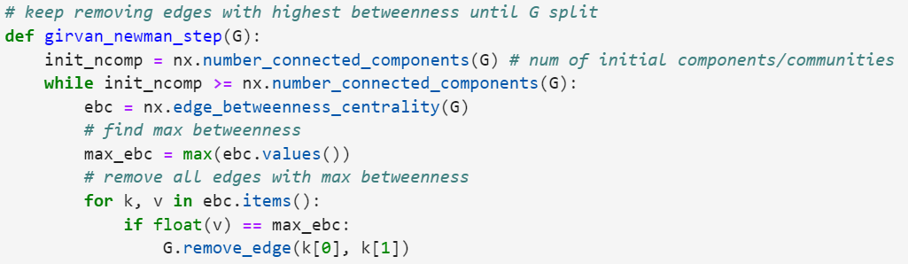
Demo: Girvan-Newman on Zachary’s Karate network
Import libraries
Define one step of Girvan-Newman

Slide 11
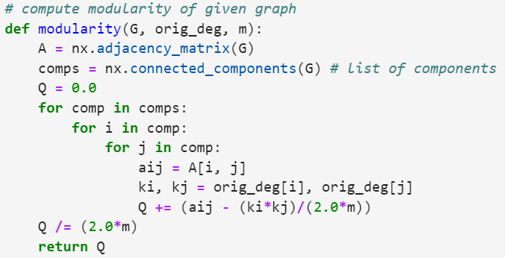
Demo: Girvan-Newman on Zachary’s Karate network
Define modularity measure

Slide 12
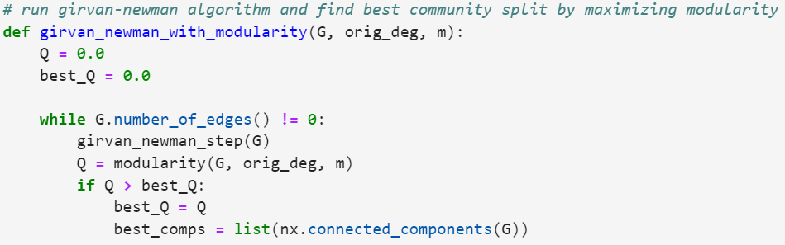
Demo: Girvan-Newman on Zachary’s Karate network
Use Girvan-Newman to find maximum modularity

Slide 13
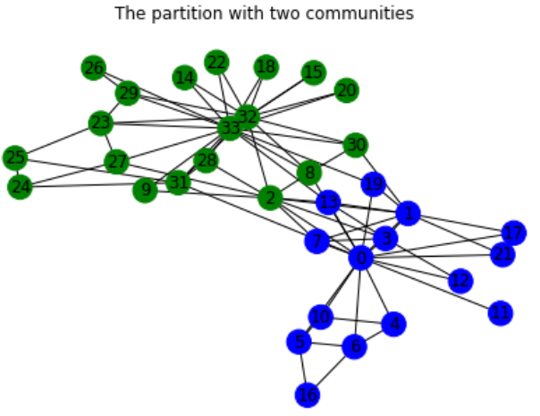
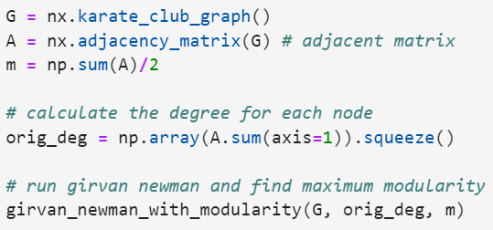
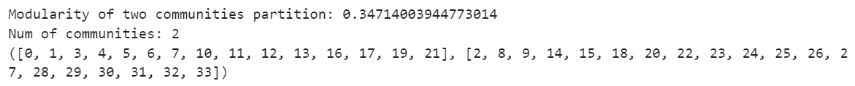
Demo: Girvan-Newman on Zachary’s Karate network
Obtain maximum modularity with Girvan-Newman

Slide 14
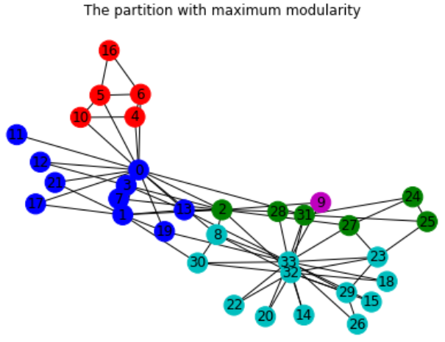
Demo: Girvan-Newman on Zachary’s Karate network
Obtain maximum modularity with Girvan-Newman

Slide 15
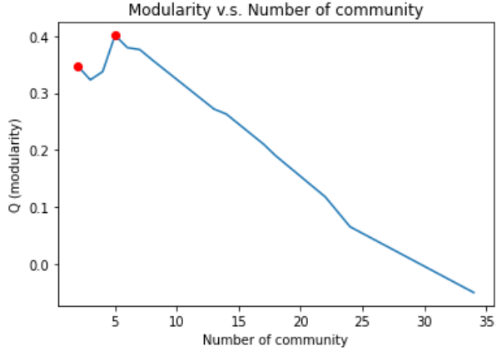
Demo: Girvan-Newman on Zachary’s Karate network
Obtain maximum modularity with Girvan-Newman

Slide 16
Association Rule Mining

Slide 17
Mlxtend
A Python package of useful tools for the day-to-day data science tasks. A helpful tool to do association rule mining.
Installation:
pip install mlxtend

Slide 18
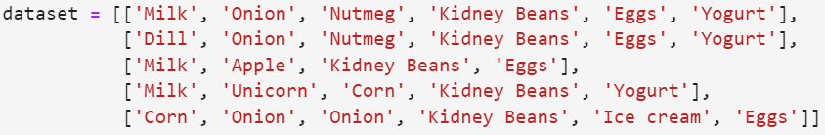
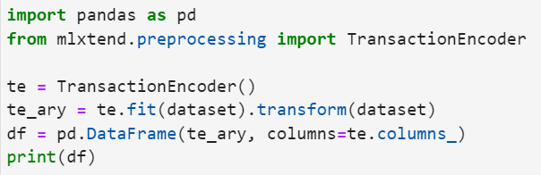
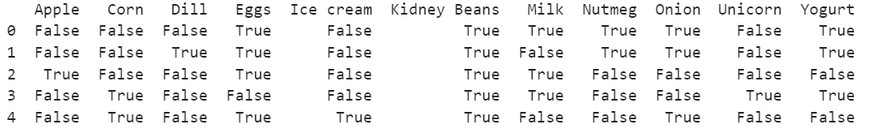
Find frequent itemsets
Suppose we have the following transaction data
Transform it into one-hot encoded DataFrame by using TransationEncoder

Slide 19

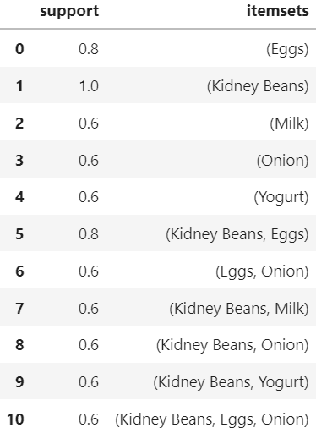
Find frequent itemsets
Obtain itemsets with at least 60% support using Apriori

Slide 20

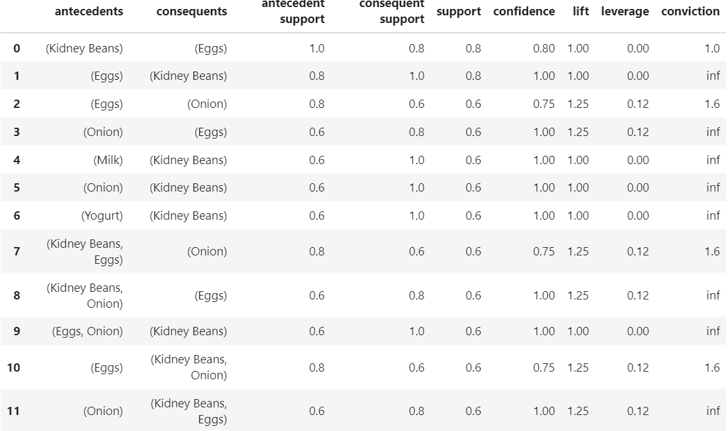
Generate associate rule
association_rules() allows (1) specify metric of your interest, e.g. “confidence” or “lift” (2) specify the according threshold.

Slide 21
Thanks!

