Slide 1
Tutorial 3: Principal Components Analysis
COMP 4331
TA: Runsheng Yu
ryuah@connect.ust.hk
HKUST
Notebook on Google Colab
https://colab.research.google.com/drive/1NgiGM97NrscR8vbtiSqBixeJwWTF5uRJ?usp=sharing

Slide 2
1. Preliminary 2. PCA Basics 3. PCA Applications
Outlines

Slide 3
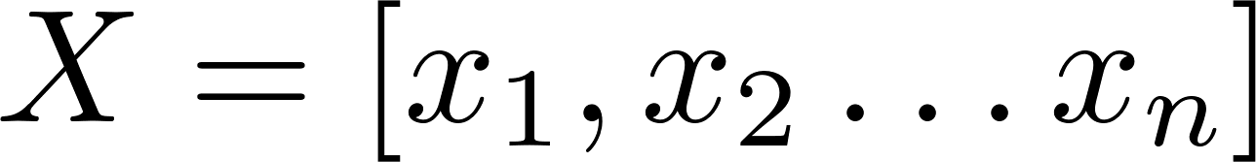
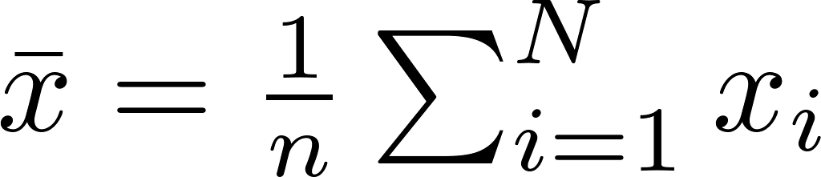

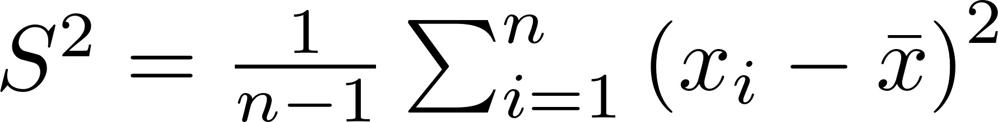
Part 1: Preliminary
Array:
Mean:
Variance:

Slide 4
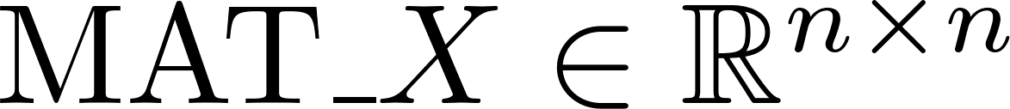
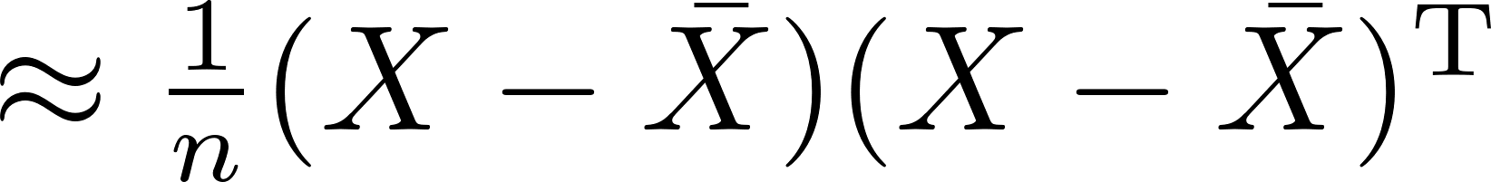
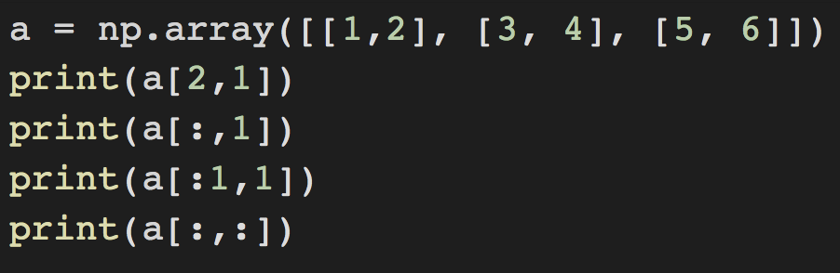
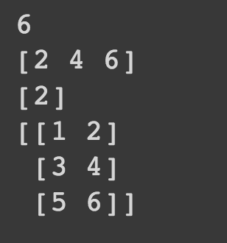
Part 1: Preliminary
Covariance:
Array indexing:

Slide 5
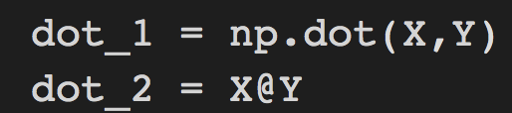
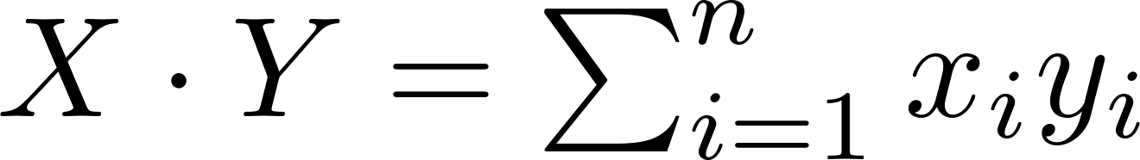
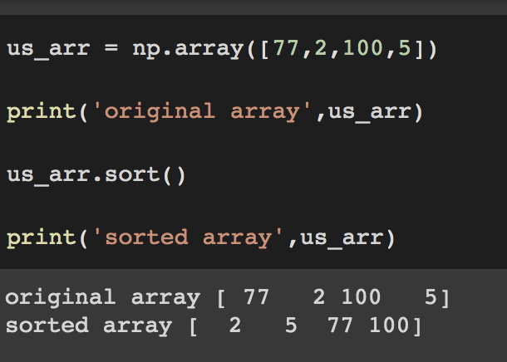
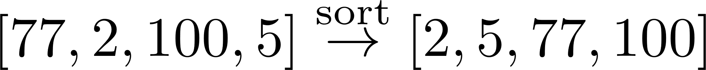
Part 1: Preliminary
Dot Product:
Sort:

Slide 6

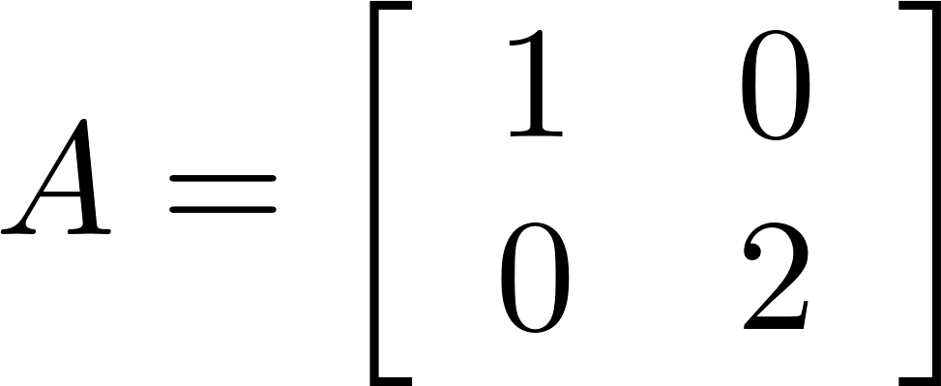
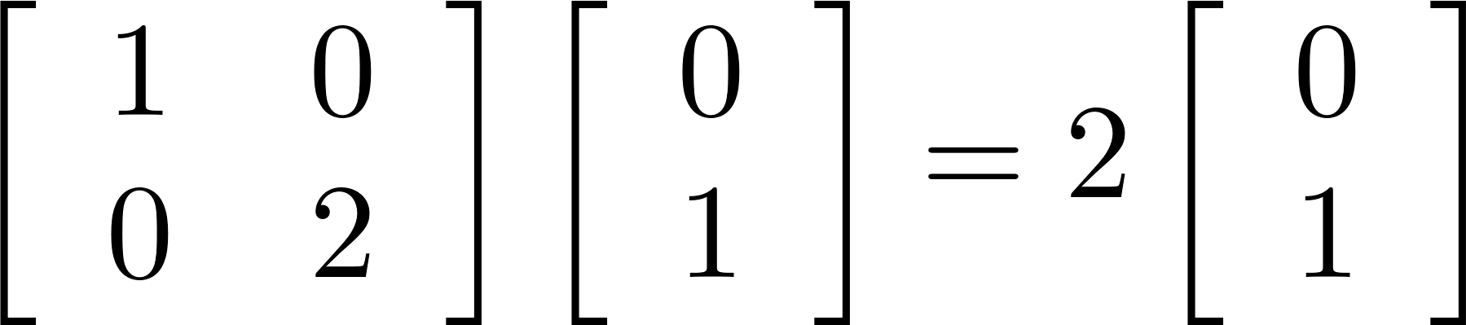
Part 1: Preliminary
Eigenvalue & Eigenvector
Eigenvector
Eigenvalue

Slide 7
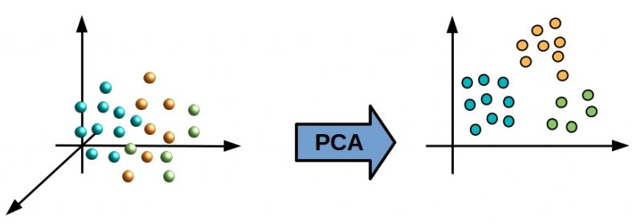
Part 2: PCA Basics
Why PCA?
Dimensionality Reduction
Visualization
Interpretation
Image credits: https://starship-knowledge.com/pca-vs-linear-regression

Slide 8
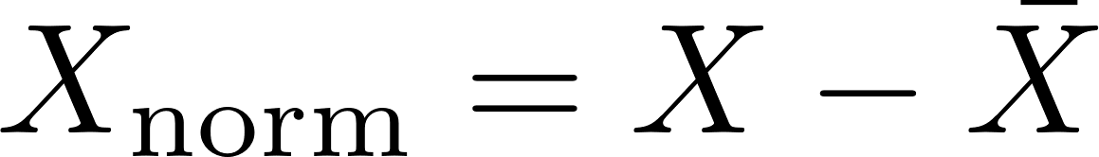
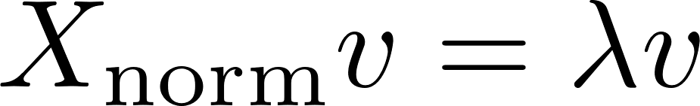

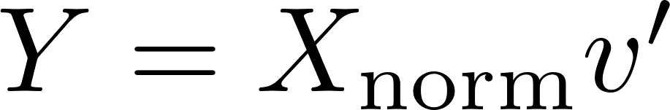
Part 2: PCA Basics
Framework:
1. Standardization
Normalizing each feature by minusing the mean.
2. Computing Covariance Matrix
3. Calculating the eigenvalues and eigenvectors
4. Sort the eigenvalues from highest to lowest
5. Feature Selection

Slide 9

Part 3: PCA Applications
Datasets:
Features:
Sepal Length;
Sepal Width;
Petal Length;
Petal Width.
Classes: 1. Iris Setosa;
2. Iris Versicolour;
3. Iris Virginica.
Image credits: https://archive.ics.uci.edu/ml/datasets/iris

Slide 10
Part 3: PCA Applications
from sklearn.decomposition import PCA
pca = PCA(n_components=2)
Initializing PCA with # components.
PrincipalComponents = pca.fit_transform(x)
Fit the model with X and apply the dimensionality reduction on X.

Slide 11
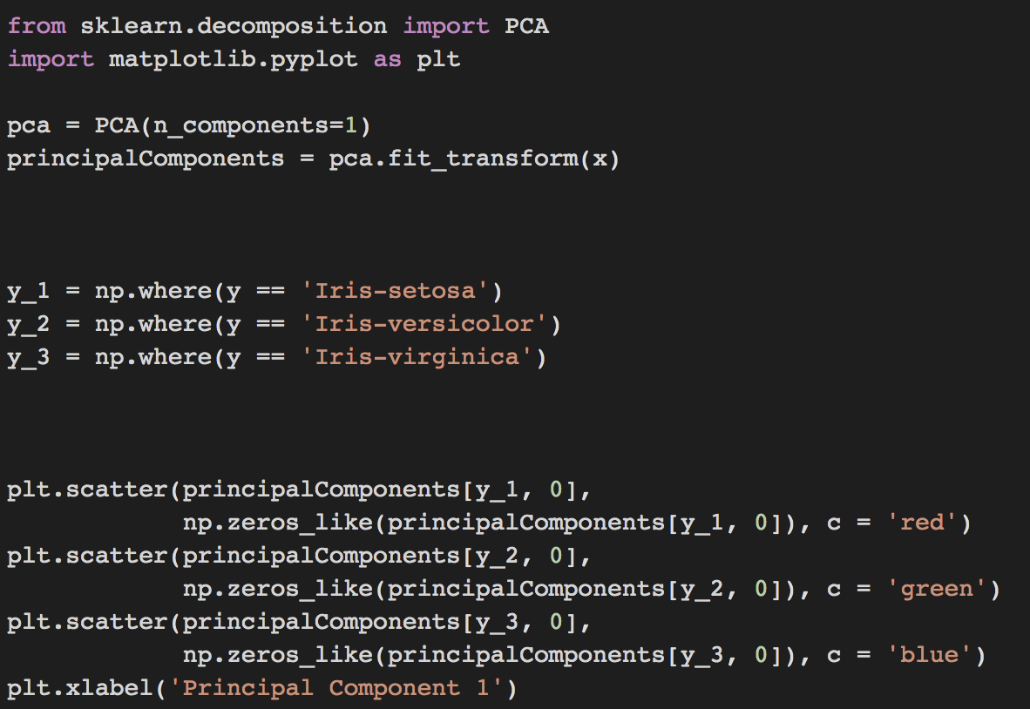
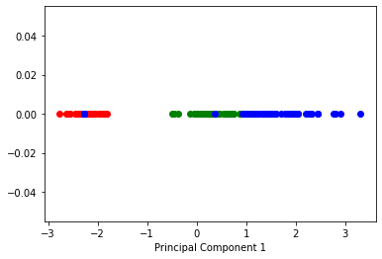
Part 3: PCA Applications
Visualizations:
Visualize the reduced vectors with different
classes (1 principal component).

Slide 12
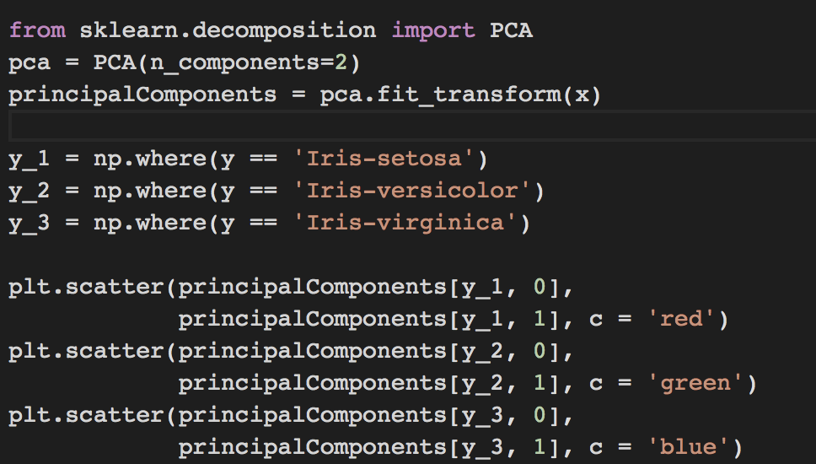
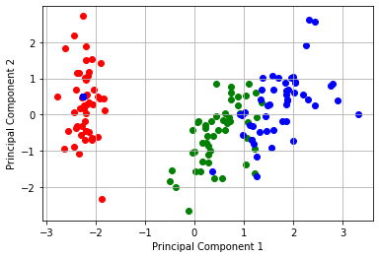
Part 3: PCA Applications
Visualizations:
Visualize the reduced vectors with different
classes (2 principal components).

Slide 13
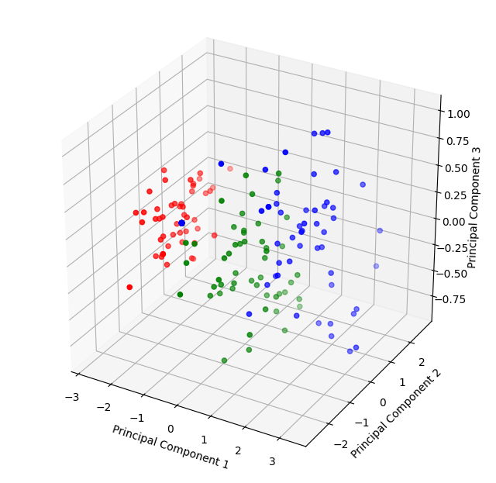
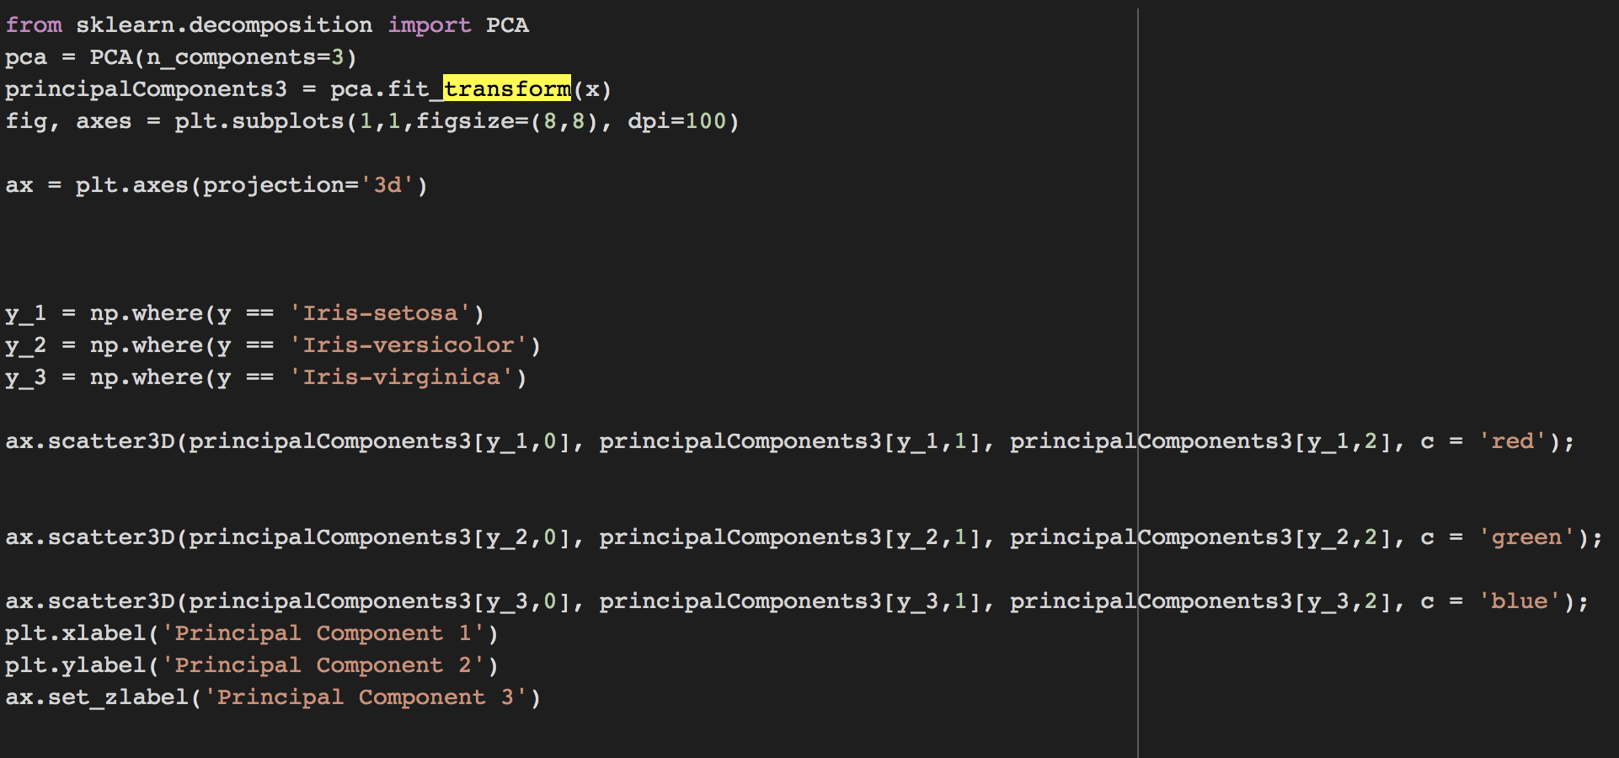
Part 3: PCA Applications
Visualizations:
Visualize the reduced vectors with different
classes (3 principal components).

Slide 14
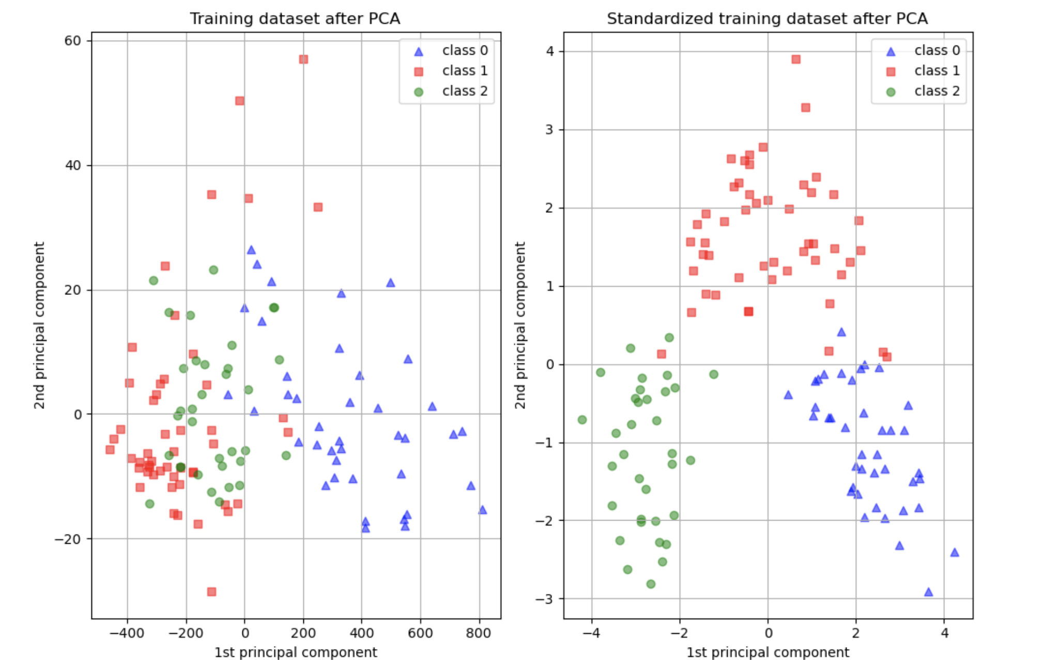
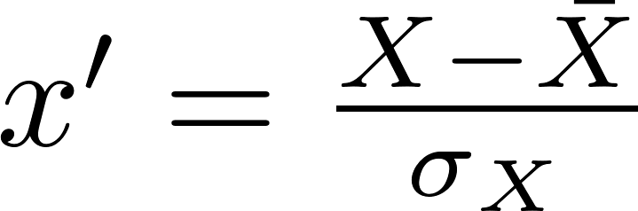
Part 3: PCA Applications
Scale the data:
Z-Score Normalization
from sklearn.preprocessing import StandardScaler
X_prime = StandardScaler().fit_transform(X)
Image credits: https://scikit-learn.org/stable/auto_examples/preprocessing/plot_scaling_importance.html

Slide 15
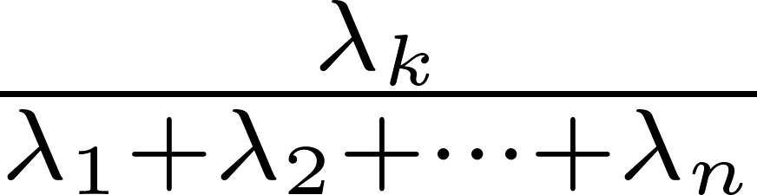
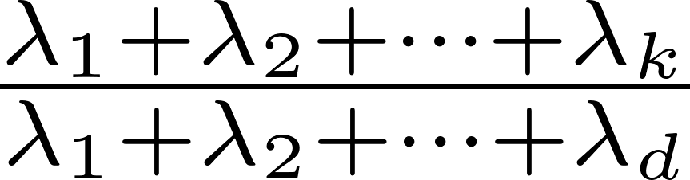
Part 3: PCA Applications
Explained Variance:
Percentage of variance explained by each of the selected components.
pca.explained_variance_ratio_
K-th Explained variance:
Reflect the variance explained by each of the selected components.
The best possible score is 1.0, lower values are worse.
K-th Accumulated Explained variance:

Slide 16
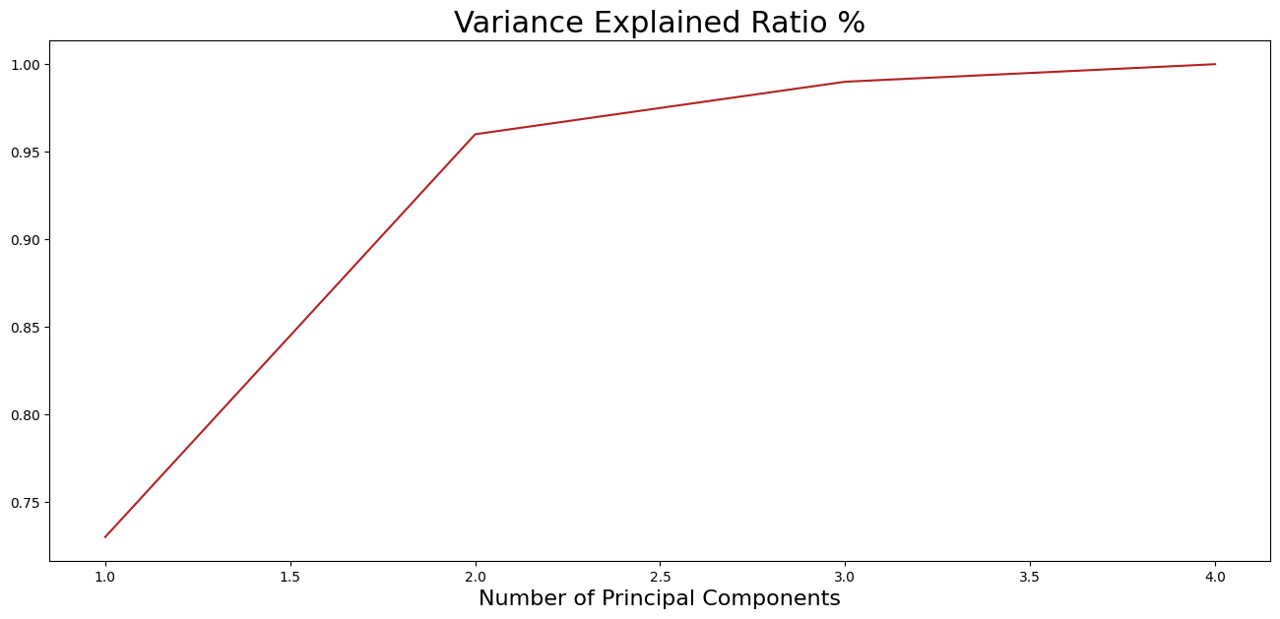
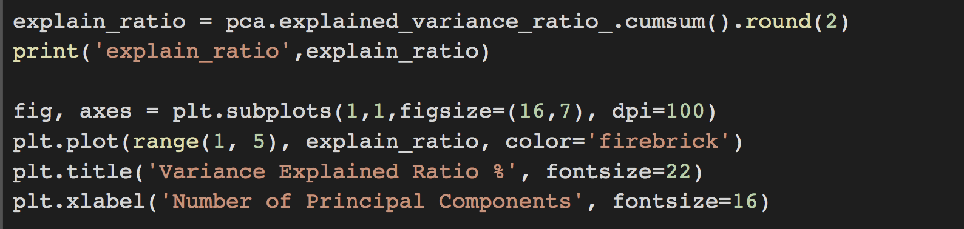
Part 3: PCA Applications
Explained Variance:
Eigenvalues: [2.93035378 0.92740362 0.14834223 0.02074601]
Explain_ratio: [0.72770452 0.23030523 0.03683832 0.00515193]
Accumulated_explain_ratio:
[0.73 0.96 0.99 1. ]

Slide 17
Part 3: PCA Applications
Components:
pca.components_
The value of each (principle) component.
# of components * # of features
Example:
We take the first component:
[-2.26454173 0.5057039 -0.12194335 -0.02307332]
Take the absolute value:
[2.26454173 0.5057039 0.12194335 0.02307332]
Sort them from highest to lowest and find their corresponding features.

Slide 18
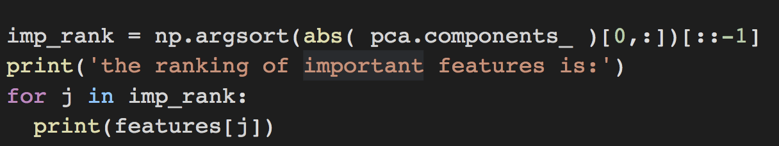
Part 3: PCA Applications
Example (cont.):
Sort them from highest to lowest and find their corresponding features.
the ranking of important features is:
petal length
petal width
sepal length
sepal width

Slide 19
Part 3: PCA Applications
Dimension-reduced data:
pca.fit_transform(x)
Input image
PCA
Classifier
PCA for classification and regression:
The output of pca.fit_transform(x) is also the dimension-reduced data that can be used from the subsequent data mining processing, e.g., classification or regression.

Slide 20
Thanks!

