Slide 1
Introduction to Data Mining (COMP 4331)
Tutorial 5 Part I: Naive Bayes Classifier
Weisen Jiang
wjiangar@connect.ust.hk
HKUST
2021 Oct. 22
Notebook on Google Colab
https://colab.research.google.com/drive/1sjcq7zdNa_5mDs1J2hRhPj2iwYuyY7CG?usp=sharing

Slide 2
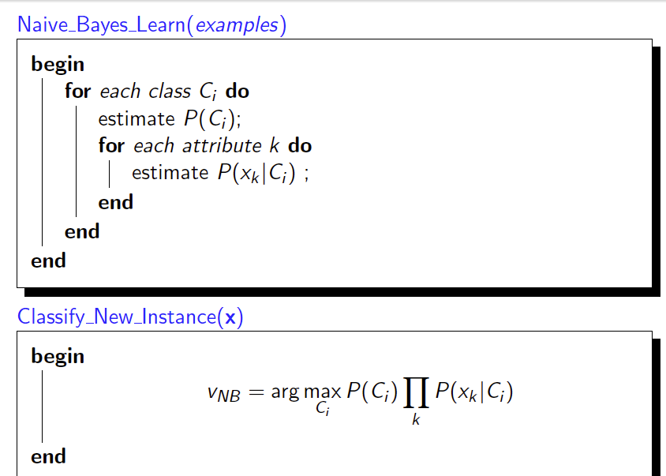
Naive Bayes classifier
Only need these probabilities

Slide 3
Demo: implementation of naïve Bayes classifier
Key steps: computing P(C_{i}) and P(x_{k} | C_{i})

Slide 4
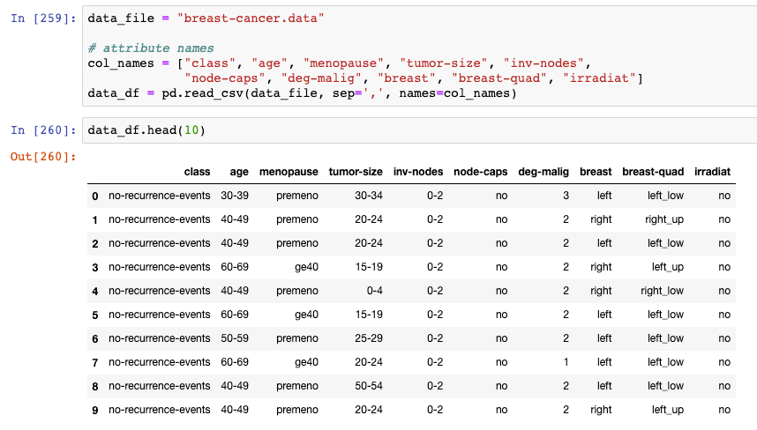
Dataset: Breast Cancer data set
label
attributes
https://archive.ics.uci.edu/ml/datasets/breast+cancer

Slide 5
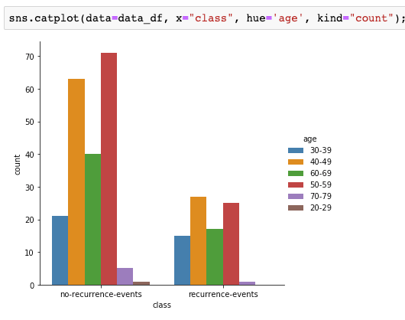
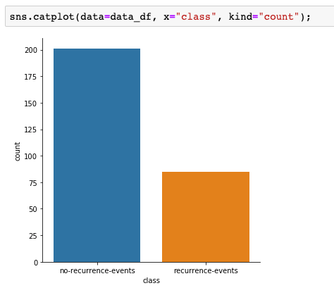
First impression
Label summary

Slide 6
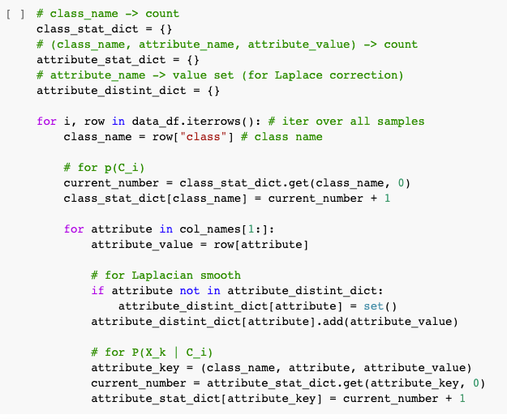

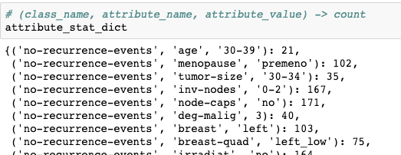

Basic summary for later computing probabilities

Slide 7
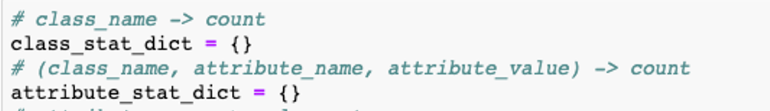
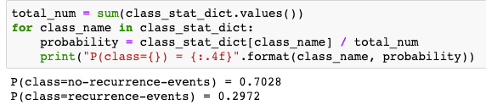
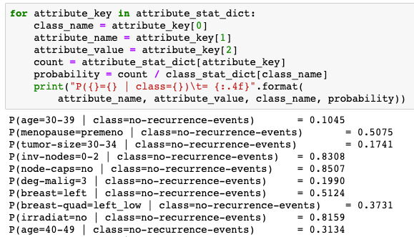
P(C_{i}) and P(x_{k} | C_{i})

Slide 8
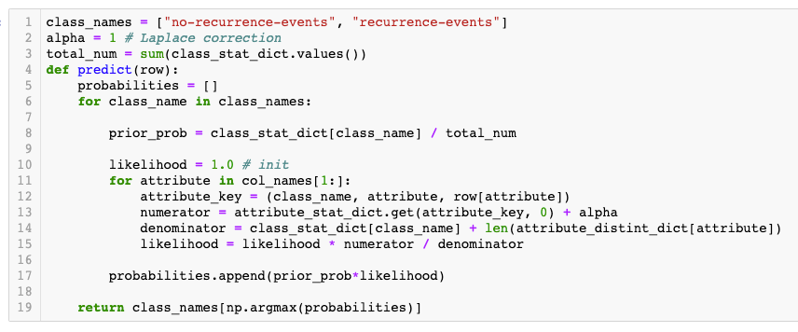


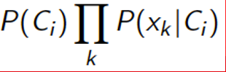

Build naïve Bayes classifier by yourself

Slide 9
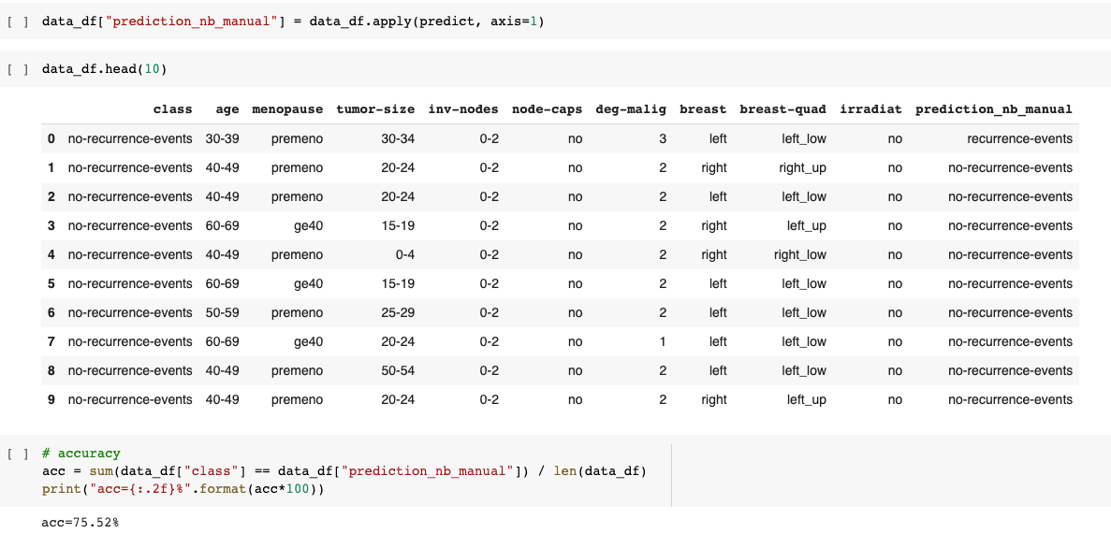
Make prediction

Slide 10
Build the naïve Bayes classifier using scikit-learn

Slide 11
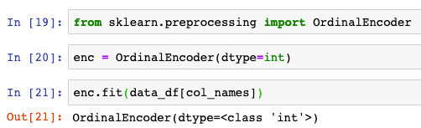
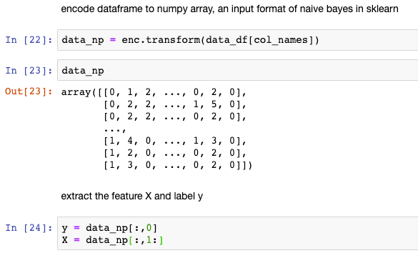
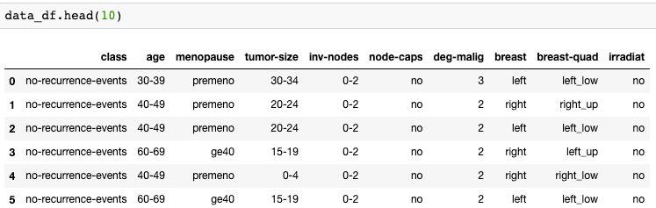
Prepare data for naïve bayes in scikit-learn
OrdinalEncoder: Encode categorical features as an integer array.

Slide 12
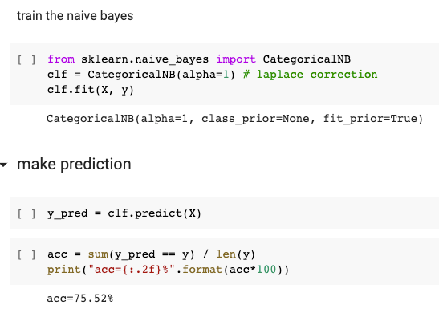
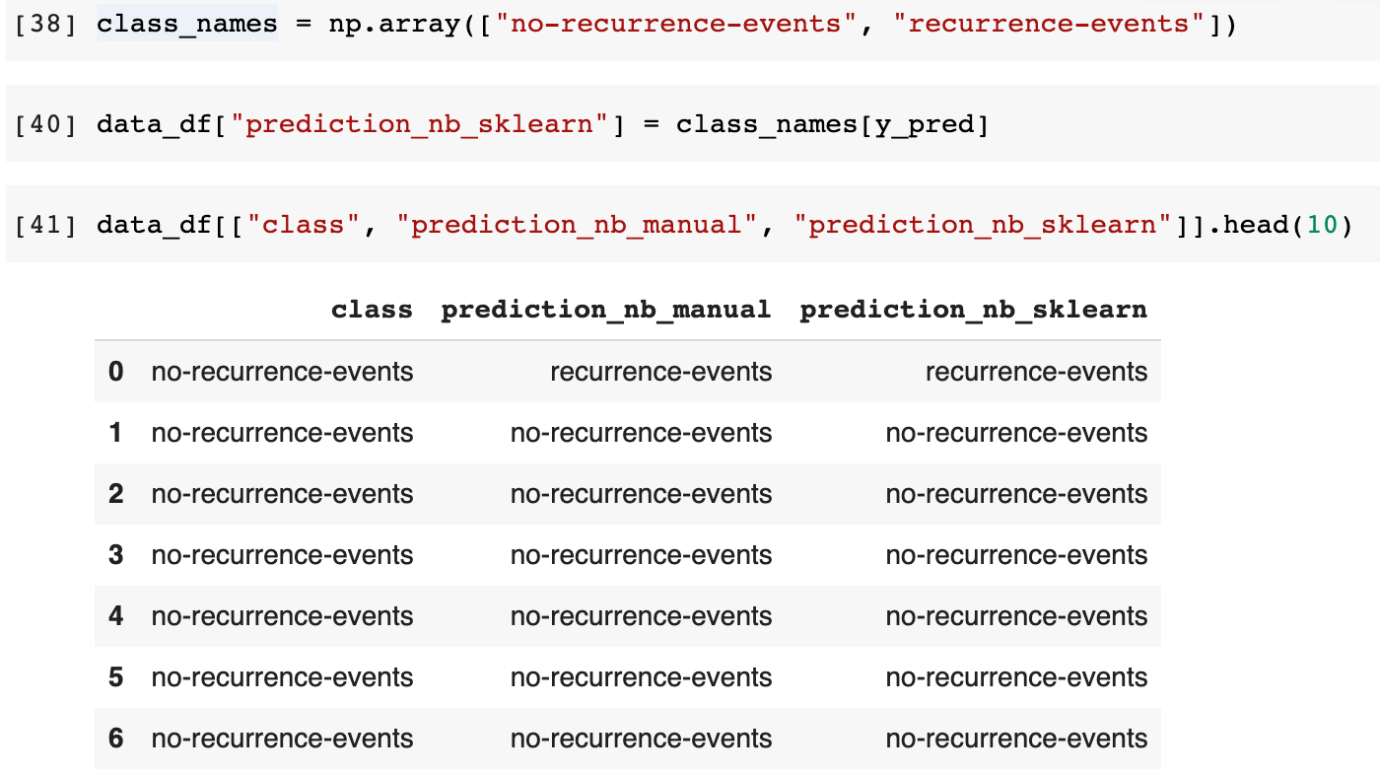
Build the naïve Bayes classifier
The results (75.52%) from `manual` and `sklearn` are consistent.
Q: Is it the testing performance?

Slide 13
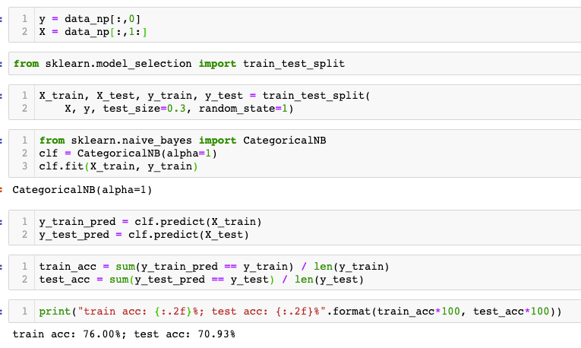
Train-test split: evaluation on hold-out samples

Slide 14
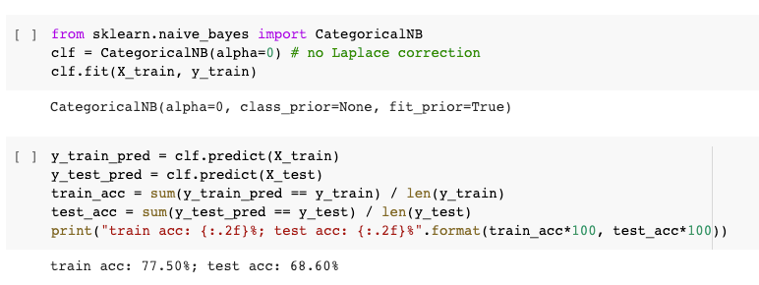
No Laplace correction (alpha=0)
In some cases, setting alpha=0 may cause `divide by zero error`

Slide 15
Summary
Key steps in naïve Bayes classifier: computing P(C_{i}) and P(x_{k} | C_{i}).
Naïve Bayes classifier in scikit-learn.
In scikit-learn, Laplace correction (the default value of alpha is 1).

Slide 16
Introduction to Data Mining (COMP 4331)
Tutorial 5 part II: Assignment 2
RunSheng Yu
ryuah@connect.ust.hk

Slide 17
Information
Due time and date: 11:59pm, Nov 4 (Thursday), 2021.
The dataset can be found on Canvas.
The assignment is on the course website.

Slide 18
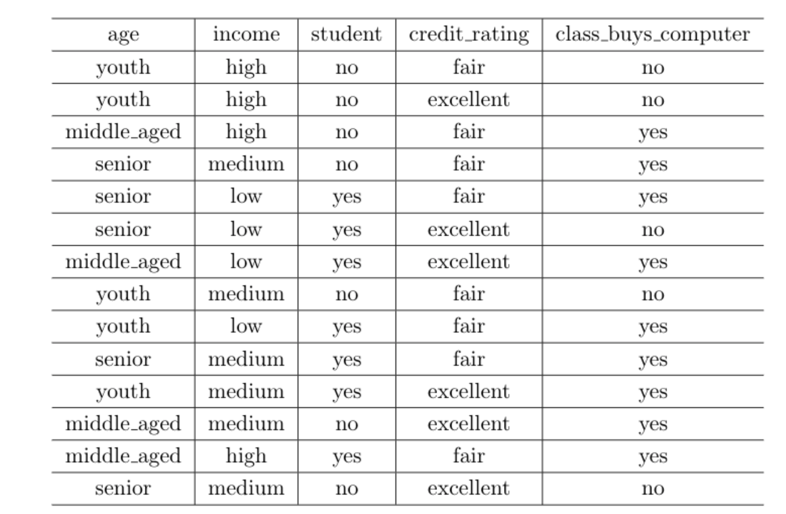
Dataset
The first 4 samples are used for testing while the others are used for training.

Slide 19
Q1 (a)
Learn a decision tree using the information gain, with min_samples_split (the minimum number of samples required to split an internal node) equals 2. Show
(i) the tree obtained;
(ii) training accuracy;
(iii) testing accuracy
Step 1:
Preprocess the dataset:
pandas.get_dummies or sklearn.preprocessing.OneHotEncoder
sklearn.preprocessing.LabelBinarizer()

Slide 20
Q1 (a)
Learn a decision tree using the information gain, with min_samples_split (the minimum number of samples required to split an internal node) equals 2. Show
(i) the tree obtained;
(ii) training accuracy;
(iii) testing accuracy
Step 2:
create a decision tree classifier, and fit the classifier to the dataset.
clf = sklearn.tree.DecisionTreeClassifier()
(Remember to set the parameters criterion, min_samples_split, and random_state.)
fit the classifier to the dataset
clf = clf.fit(X_train, y_train)

Slide 21
Q1 (a)
Learn a decision tree using the information gain, with min_samples_split (the minimum number of samples required to split an internal node) equals 2. Show
(i) the tree obtained;
(ii) training accuracy;
(iii) testing accuracy
Step 3:
Report and plot the results.
sklearn.tree.plot_tree to plot the trees.
clf.predict(X) to predict the class values.
sklearn.metrics.accuracy_score to calculate the training accuracy and testing accuracy.

Slide 22
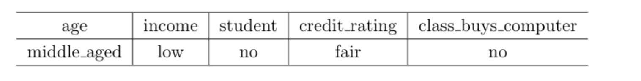
Q1 (b)
Consider adding the following noisy sample to the training set.
Repeat part (a) with the expanded training set. Compare and contrast with the solution you obtained
in part (a).
Add the noise example into the training set.
Follow the steps in Q1 (a).
To see whether the tree will overfit.

Slide 23
Q1 (c)
Repeat part (a) by using the gini index.
Follow the steps 1-3 in Q1 (a).
Don’t forget to change the criterion to gini.

Slide 24
Q2 (a)
Similar to Q1, part (a), learn a naive Bayes classifier on the original data set. Show
(i) training accuracy; and
(ii) testing accuracy.
Step 1:
Preprocess the dataset:
sklearn.preprocessing.OrdinalEncoder
Step 2:
Train a naïve Bayes model.
sklearn.naive_bayes.CategoricalNB
clf = CategoricalNB(alpha=0)
clf.fit(X_train, y_train)
alpha = 0 means no Laplace correction

Slide 25
Q2 (a)
Similar to Q1, part (a), learn a naive Bayes classifier on the original data set. Show
(i) training accuracy; and
(ii) testing accuracy.
Step 3: Report and plot the results.
sklearn.metrics.accuracy_score to calculate the training accuracy and testing accuracy.

Slide 26
Q2 (b)
Similar to Q1, part (b), learn a naive Bayes classifier on the noisy data set. Show the
(i) training accuracy; and
(ii) testing accuracy
Add the noise example into the training set.
Follow the steps in Q2 (a).

Slide 27
Thanks!

