Slide 1
Tutorial 6: Nearest Neighbor Classification
COMP 4331
TA: Runsheng YU
ryuah@connect.ust.hk
HKUST
Notebook on Google Colab:
https://colab.research.google.com/drive/1hkJCNUVf-BdNzLWQpm_fnZreTB_SZWIf?usp=sharing

Slide 2
1. kNN Classifier basics 2. kNN Classifier applications
Outlines

Slide 3
Part 1: KNN Basics
Framework:
0). Preprocessing (min-max normalization), set hyper-parameters and store the training data.
1). Calculate the distance between query example and training tuple (example) in the dataset.
2). Find k training tuples that have smallest distances to the query sample.
3). Count the most frequent ids as the predicted label.

Slide 4
Part 1: KNN Basics
1). Calculate the distance between query example and each tuple in the training dataset.
e.g., Euclidean distance, Manhattan distance…
Known classes:
Unknown example:

Slide 5
Part 1: KNN Basics
2). Find K training tuples that have smallest distances to the query sample.
Known classes:
K=6
Unknown example:
K=3

Slide 6
Part 1: KNN Basics
3). Count the most frequent ids as the predicted label.
e.g., K=6, we have 3 , 2 , 1
So is classified into
Known classes:
K=6
Unknown example:
K=3

Slide 7
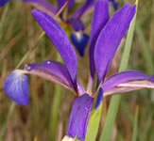
Part 2: KNN Applications
Datasets:
Features:
Sepal Length;
Sepal Width;
Petal Length;
Petal Width.
Classes: 1. Iris Setosa;
2. Iris Versicolour;
3. Iris Virginica.
https://archive.ics.uci.edu/ml/datasets/iris

Slide 8
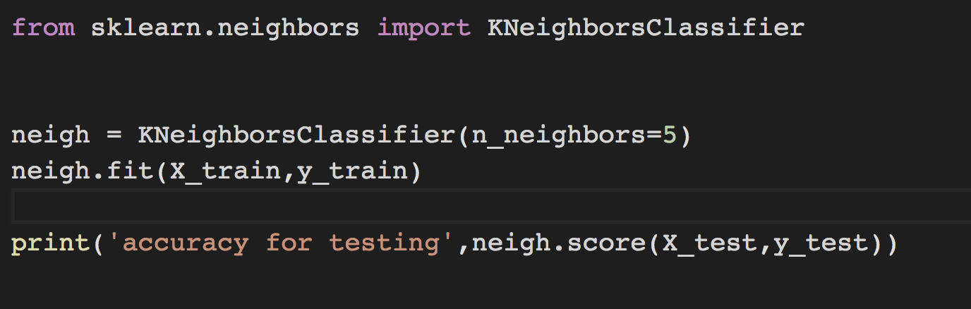

Part 2: KNN Applications
KNN Classifier in SKlearn
n_neighbors: Number of neighbors

Slide 9
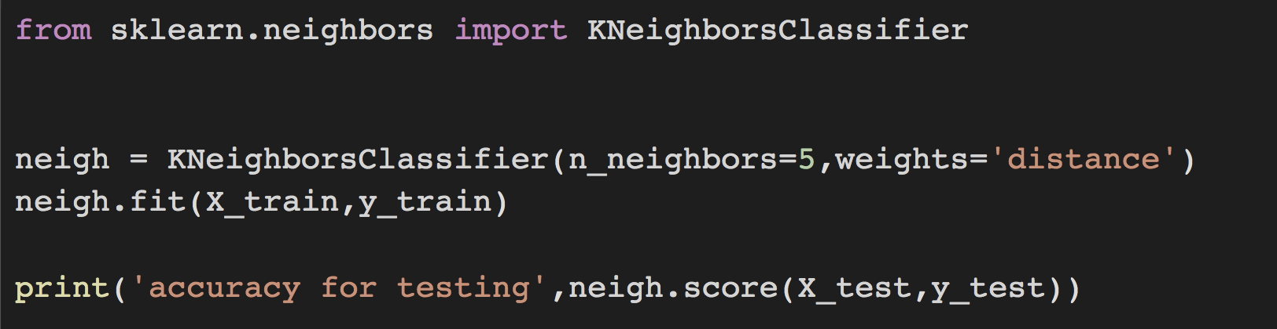
Part 2: KNN Applications
Using weights to alleviate the curse of dimensionality.

Slide 10

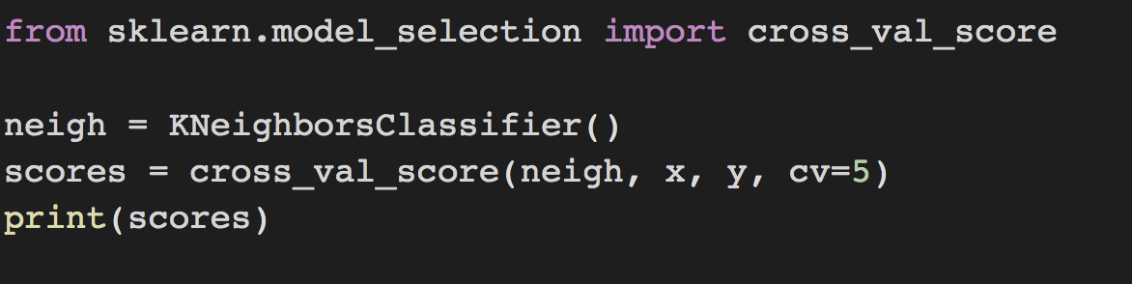
Part 2: KNN Applications
How to tune k by cross-validation
cross-validation: to find the best k

Slide 11
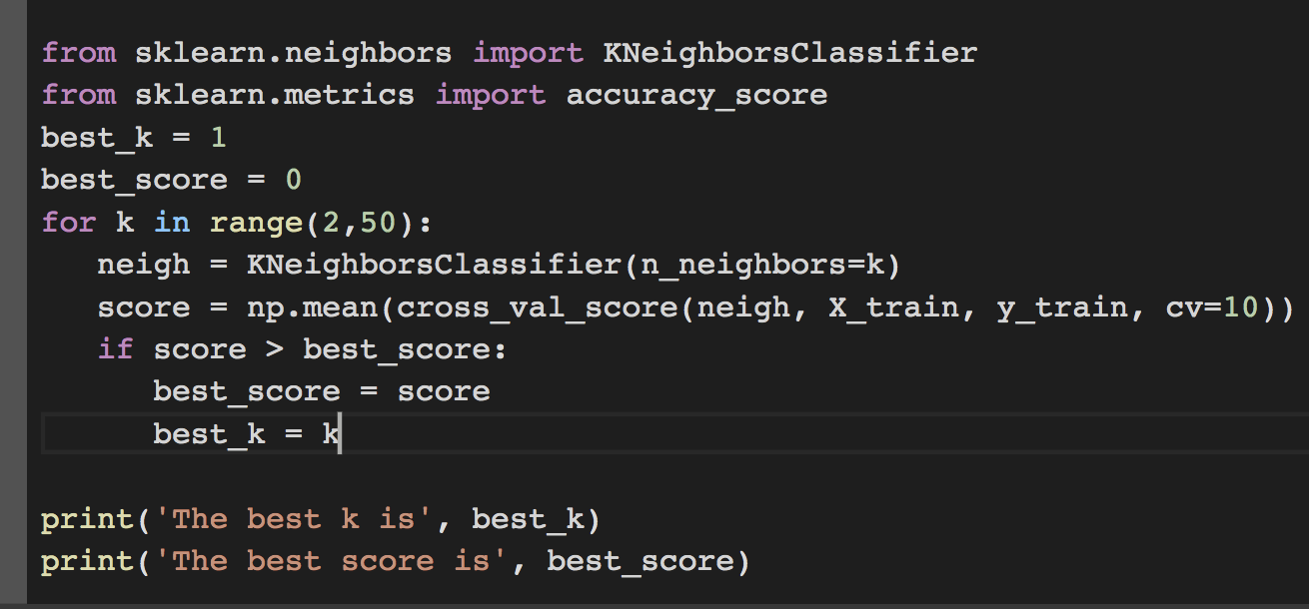
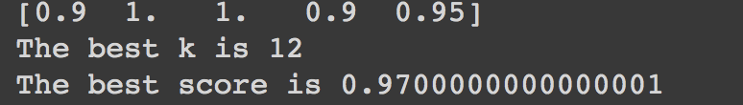
Part 2: KNN Applications
How to tune k by cross-validation

Slide 12
Part 2: KNN Applications
Robustness under different n_neighbors (k)
n_neighbors =2
Testing accuracy: 0.94
n_neighbors =2 on noise dataset
Testing accuracy: 0.92
n_neighbors =6
Testing accuracy: 0.96
n_neighbors =6 on noise dataset
Testing accuracy: 0.96
n_neighbors =60
Testing accuracy: 0.90
n_neighbors =60 on noise dataset
Testing accuracy: 0.90
Small num of neighbors is sensitive to noise.
Large num of neighbors may mix from different classes.

Slide 13
Thanks!

