Slide 1

Sequence-to-Sequence Model with RNN in Pytorch

Slide 2
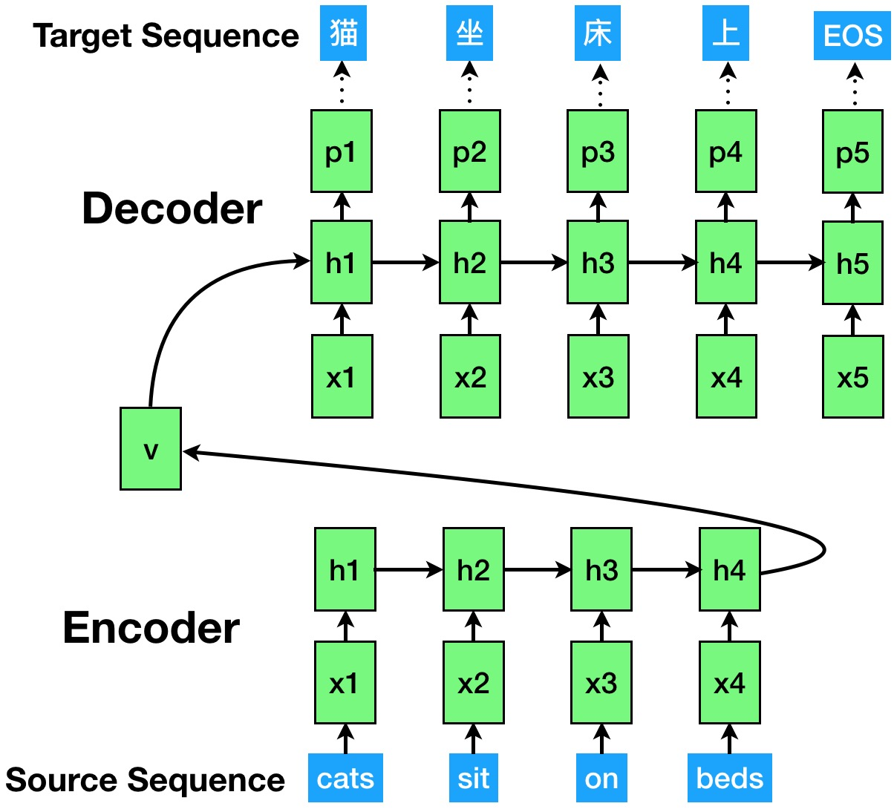
Sequence-to-Sequence Model on Machine Translation

Slide 3
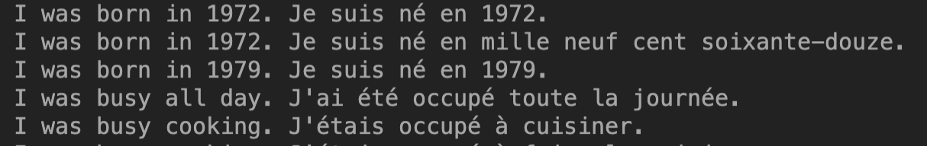
Dataset: Parallel Corpora for Machine Translation
Parallel corpora: provides a sentence pair in both source language and target language
Example dataset
https://download.pytorch.org/tutorial/data.zip
Parallel Corpora Acts as Training Set
Sample: a <source_sentence, target_sentence> pair
English
Franch

Slide 4
Data Processing
Code for Data Processing
Load data and build sample
def load_data():
lines = open('data/eng-fra.txt’, r)
pairs = [[split_sentences(s) for s in l.split('\t')] for l in lines]
return pairs
Split sentences to word lists
def split_sentences(sentences):
return [word2index[word] for word in sentence.split(' ')]

Slide 5
Seq2Seq Model
# phase1: build_model
model.encoder = EncoderRNN(source_vocabulary_size, hidden_size)
model.decoder = DecoderRNN(hidden_size, target_vocabulary_size)
loss_function = nn.NLLLoss()
model_optimizer = optim.SGD(model.parameters(), lr=learning_rate)
# phase2: train the model
for source, target in pairs:
model_optimizer.zero_grad()
loss = 0
for source_word in source:
encoder_output, encoder_hidden = model.encoder(source_word, encoder_hidden)
decoder_input = torch.tensor([[SOS_token]])
decoder_hidden = encoder_hidden
for target_word in range(target):
decoder_output, decoder_hidden = model.decoder(decoder_input, decoder_hidden)
decoder_input = target_word
loss += loss_function(decoder_output, target_word)
loss.backward()
model_optimizer.step()

Slide 6
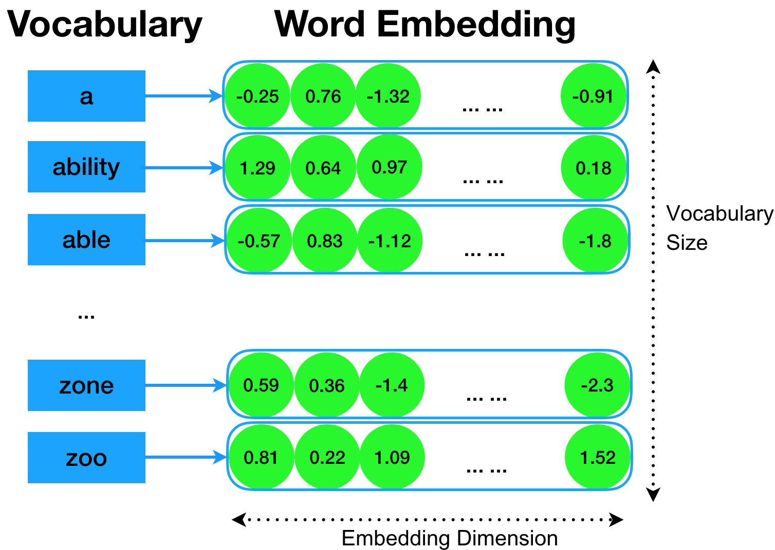
Encoder
Word Embedding Layer for Source Sequence
How to feed words list to neural network?
Word Embedding: transform a word to a vector

Slide 7
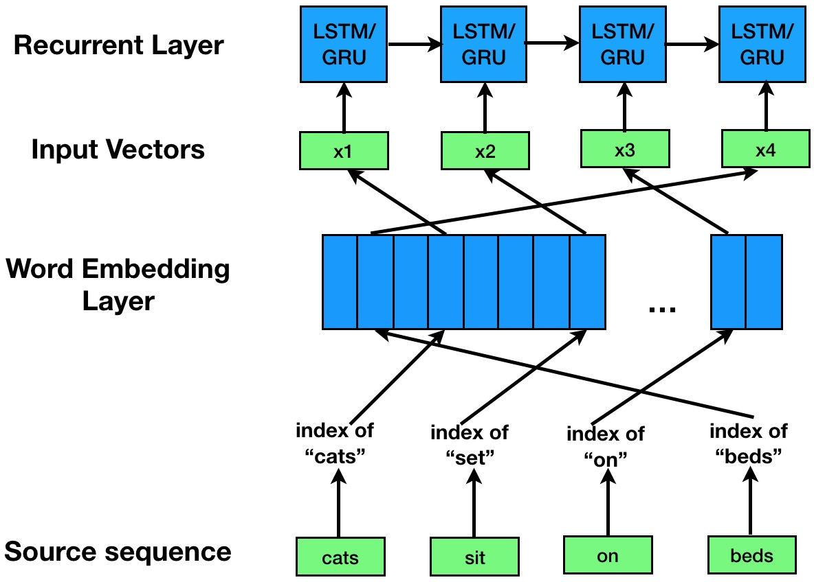
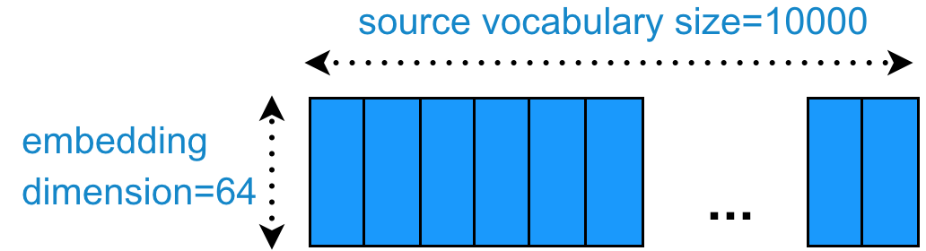
Encoder
Word Embedding Layer for Source Sequence
Embedding: transform a word to a vector
Define embedding operation
self.embedding = nn.Embedding(source_vocabulary_size, hidden_size)

Slide 8
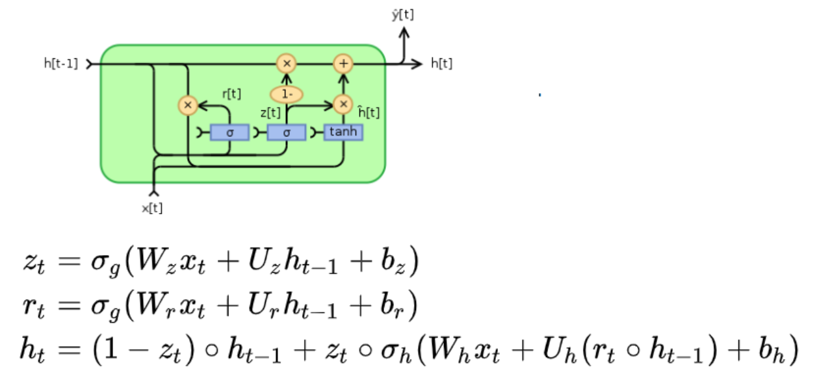
Encoder
Encoding by Recurrent Units
Define GRU operation
self.gru = nn.GRU(hidden_size, hidden_size)

Slide 9
Class Encoder
def __init__(self, source_vocabulary_size, hidden_size):
self.embedding = nn.Embedding(source_vocabulary_size, hidden_size)
self.gru = nn.GRU(hidden_size, hidden_size)
def forward(self, source_word, encoder_hidden):
embedded = self.embedding(source_word)
output = embedded
output, encoder_hidden = self.gru(output, encoder_hidden)
return output, encoder_hidden

Slide 10
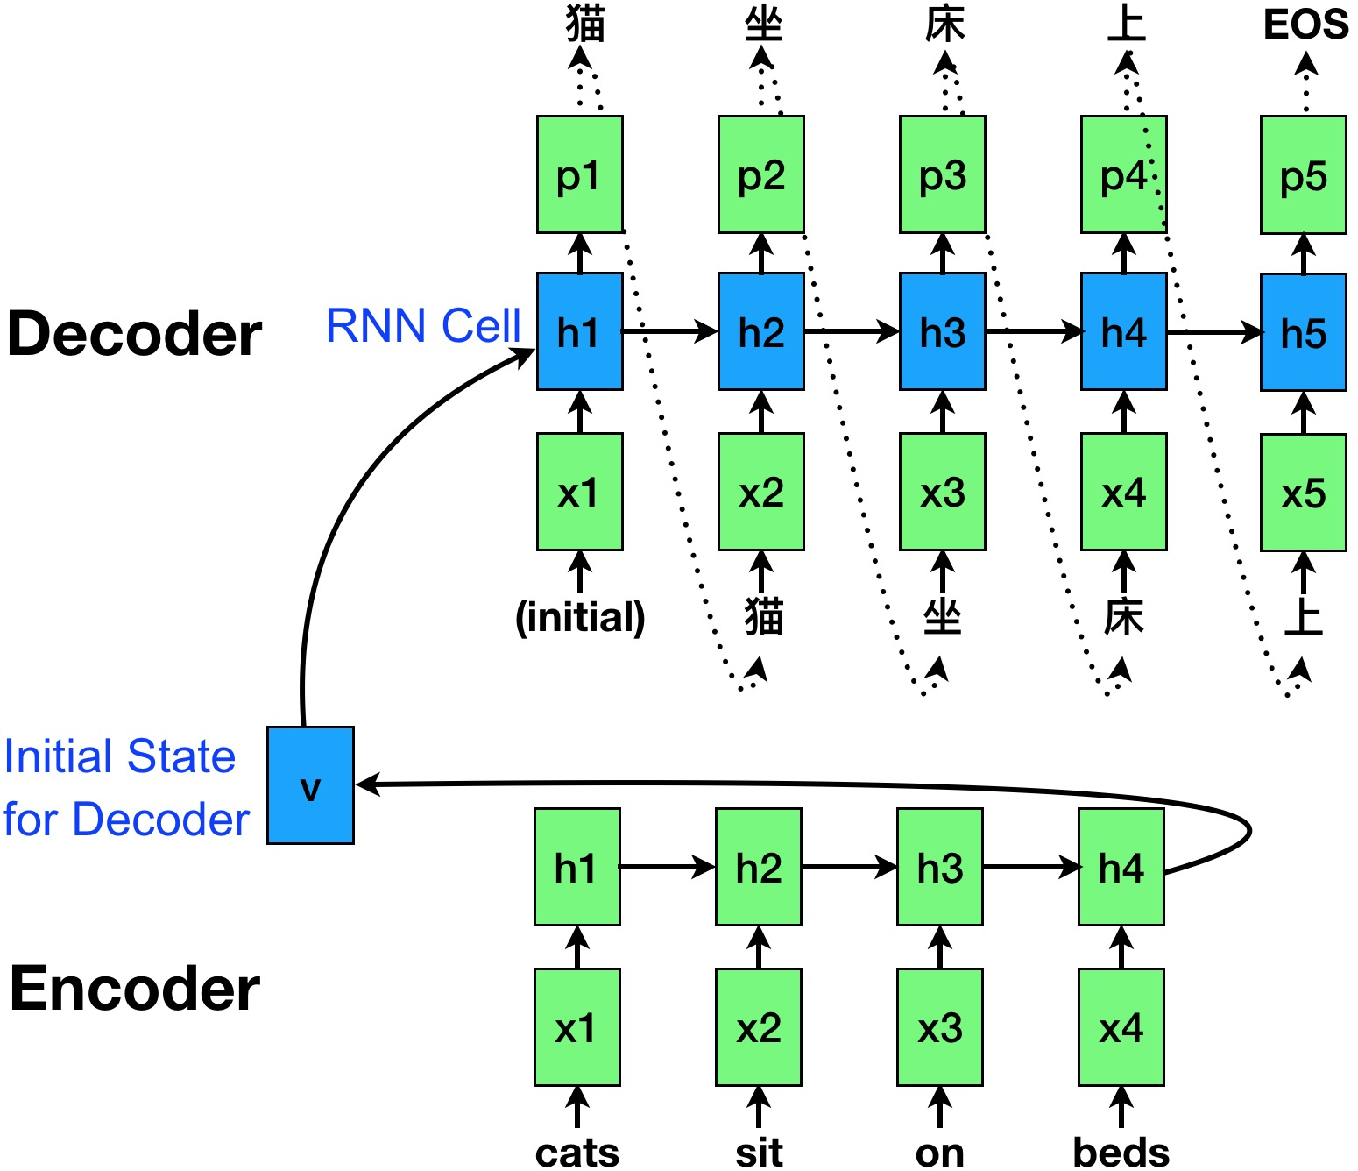
Decoder
Define embedding and GRU operation
self.embedding = nn.Embedding(target_vocabulary_size, hidden_size)
self.gru = nn.GRU(hidden_size, hidden_size)

Slide 11
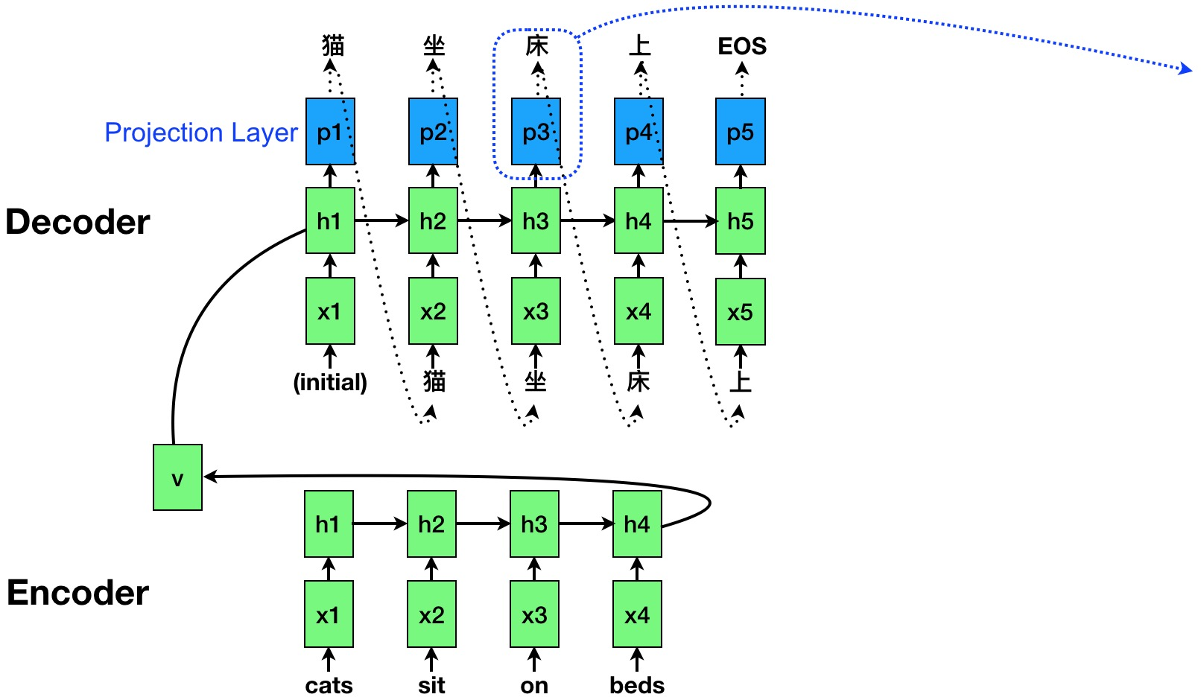

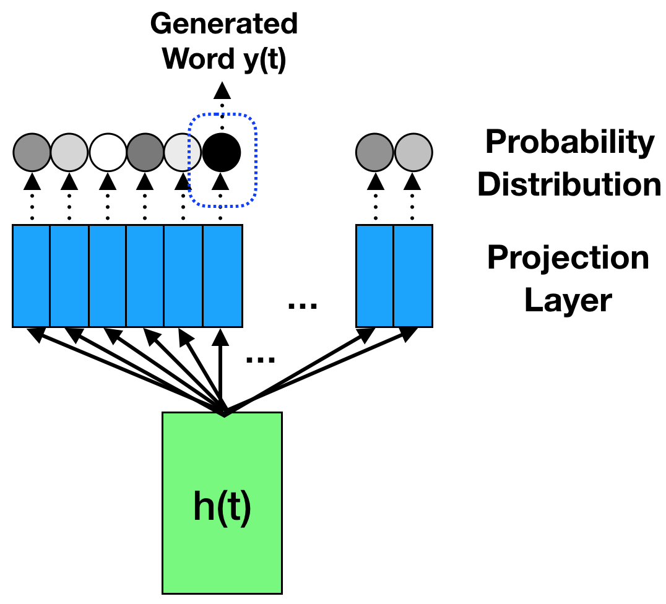

Decoder
Define output layer and softmax for generating target word
Output layer: Transform h(t) to the probability distribution
self.output_layer = nn.Linear(hidden_size, output_vocabulary_size)
self.softmax = nn.LogSoftmax()

Slide 12
Class Decoder
def __init__(self, hidden_size, target_vocabulary_size):
self.embedding = nn.Embedding(target_vocabulary_size, hidden_size)
self.gru = nn.GRU(hidden_size, hidden_size)
self.output_layer = nn.Linear(hidden_size, target_vocabulary_size)
self.softmax = nn.LogSoftmax()
def forward(self, decoder_input, decoder_hidden):
output = self.embedding(decoder_input)
output, hidden = self.gru(output, decoder_hidden)
decoder_output = self.softmax(self.output_layer(output))
return decoder_output, decoder_hidden

Slide 13
Seq2Seq Model
# phase1: build_model
model.encoder = EncoderRNN(source_vocabulary_size, hidden_size)
model.decoder = DecoderRNN(hidden_size, target_vocabulary_size)
loss_function = nn.NLLLoss()
model_optimizer = optim.SGD(model.parameters(), lr=learning_rate)
# phase2: train the model
for source, target in pairs:
model_optimizer.zero_grad()
loss = 0
for source_word in source:
encoder_output, encoder_hidden = model.encoder(source_word, encoder_hidden)
decoder_input = torch.tensor([[SOS_token]])
decoder_hidden = encoder_hidden
for target_word in range(target):
decoder_output, decoder_hidden = model.decoder(decoder_input, decoder_hidden)
decoder_input = target_word
loss += loss_function(decoder_output, target_word)
loss.backward()
model_optimizer.step()

Slide 14
Implementation of Seq2Seq Model on NMT
Code
https://github.com/pytorch/tutorials/blob/master/intermediate_source/seq2seq_translation_tutorial.py
Dataset
https://download.pytorch.org/tutorial/data.zip

Slide 15
Thanks!

