Slide 1

Course Overview
COMP4451 Game Programming

Slide 2


Course staff
Prof. Pedro V. Sander (instructor)
Dept. of Computer Science and Engineering
Email: psander@cse.ust.hk
Office hours: After class or by appointment
Office: Room 3525
Mr. Ligeng Li (teaching assistant)
Mphil student in Computer Graphics
Email: liligeng111@gmail.com
Office hours: Wednesdays 3PM-4PM in room 4214

Slide 3
Creating a computer game
Project-based course
You will learn how to write a computer game
Several areas of computing
Emphasis on computer graphics
Also touch on AI, Networking, Audio, ...
We will use WebGL with Three.js library
Web-based and multi-platform
For your project, use anything that you like
Unless you are experienced, we suggest WebGL
Demo

Slide 4
Game project goals
Creativity
Must do something new, clever, or special
Not present on existing games
Implementation
Must involve sophisticated programming
Playability
The game must be playable (e.g., enjoyable, addictive, appealing)
Not to be played once and then deleted

Slide 5
Game project groups
In groups of 1-2 students
Groups of 3-4 allowed on exceptional basis
Must be substantially larger project (e.g., 3x larger)
Each sub-group of 1-2 students present and have their part of the work graded separately

Slide 6
Important notes
Project must be fully implemented by the group, without code from other students or sources.
It is ok to discuss ideas with other groups. (in fact, it is encouraged!)
It is ok to use external libraries as long as proper credit is given.
It should be clear which complex features/effects are from libraries and which are implemented from scratch.

Slide 7
Required background
Removed the Graphics course requirement
But, require strong programming skills
Learn a new language
JavaScript, potentially shading languages as well
Hacking inclination
Figuring things out on your own
Experimenting and adding innovative features to games
COMP3711 background is ok
Otherwise, please talk to me

Slide 8
Deliverables and grading
Exam (30%)
Game project (70%)
Proposal (15%)
5-min presentation
single-page proposal
Progress (10%)
5-min presentation or recorded video (should include demo)
Final (45%)
5-min recorded video (should include demo)
Poster for a 2-hour poster & demo session
Game source code (with proper comments)
Online discussion forum (up to 5% bonus)

Slide 9
Class schedule
Meeting times: TuTh 12:00PM - 1:20PM Venue: Room 4503
Poster & demo session date: TBD (reading period)
Exam date: TBD (finals week)
*Proposal and Progress may require a second lecture
**Videos for the final are due on May 6 at 23:59
February |  |  |  | March |  |  |  |  | April |  |  |  |  | May
3 | 10 | 17 | 24 | 3 | 10 | 17 | 24 | 31 |  |  | 14 | 21 | 28 | 5
5 | 12 |  | 26 | 5 | 12 | 19 | 26 | 2 |  | 9 | 16 | 23 | 30 | 7
Brainstorming
Proposal*
Progress*
Final**

Slide 10
Resources
Lightweight course setup
No books
No labs with specialized hardware
You only need:
Your own computer (hopefully!)
Free online resources (on web page)
Can your computer run WebGL?
Check at: http://get.webgl.org
If not, use school lab (and borrow a notebook for presentation)

Slide 11
Web page
Mainly announcements and to download slides
Detailed course and project info available on slides
http://course.cse.ust.hk/comp4451
Use your CSD password to login if outside campus
If you do not have a CSD account, apply here: http://cssystem.cs.ust.hk/home.php?docbase=UGuides/hkust_only&req_url=UGuides/hkust_only/activation.html

Slide 12
Online forum
Online discussion forum using Google Groups
Encourage sharing of ideas among groups
Up to 5% in bonus points
Direct “Forum” link from course web page
Use a gmail account to login
If you do not want to sign up for one, you can create a login using your current email
Go to the forum page and apply for access
Important: Sign your posts with your CSD login, e.g., “-Pedro (psander)”

Slide 13
Topics*
Game basics (genres and design process)
Graphics (rendering and modeling)
Physics
Animation
Audio
Artificial Intelligence
Networking
Databases
*Subject to changes/adjustments

Slide 14
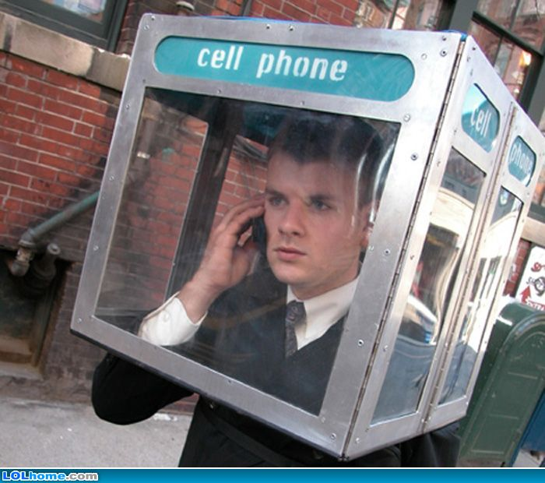


Classroom ettiquette
No phones
No food
Drinks are ok

