Slide 1

Game AI 3: Pathfinding
COMP4451 Game Programming

Slide 2
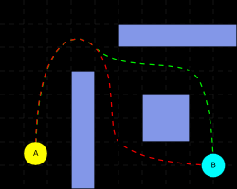
Pathfinding
in
games

Slide 3
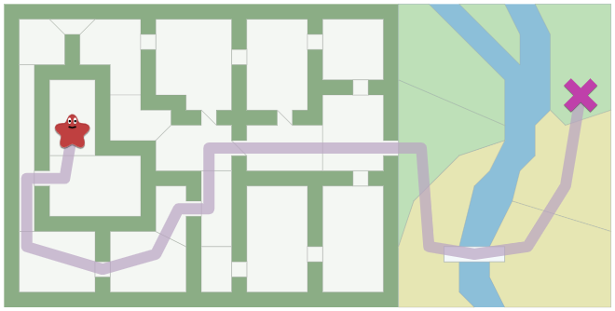
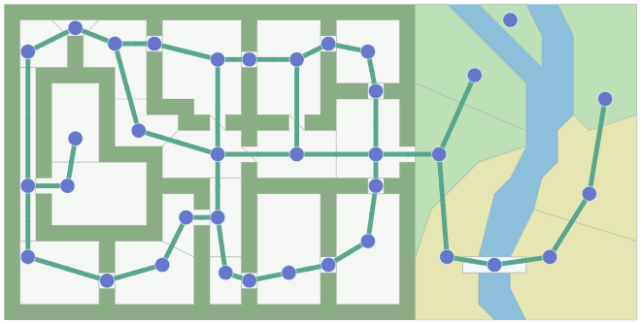
Representing a map as a graph
We focus on undirected graphs
Each “room” is represented by a node in the graph
Edges connect the rooms
Perform a graph search to find a path from * to x
[redblobgames.com B]
Map
Graph

Slide 4
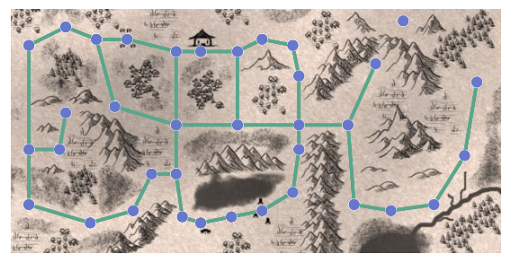
Representing a map as a graph
We focus on undirected graphs
Each “room” is represented by a node in the graph
Edges connect the rooms
Perform a graph search to find a path from * to x
[redblobgames.com B]
Map
Graph
Notes:
Doesn’t knows the difference between the two underlying maps

Slide 5
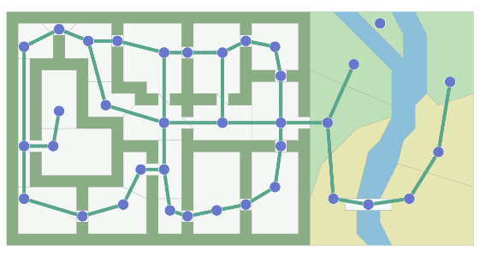
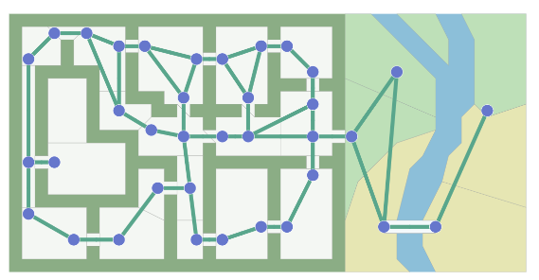
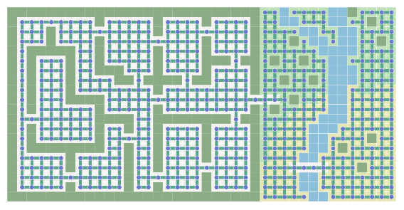
Choice of graph
Many different ways of making a graph
The lower the number of nodes, the lower the memory footprint and computation time it takes to process it
Trade-off granularity of path vs. efficiency
Assume we need to visit all nodes and edges of the graph once
Running time linear on size of graph: O(N + E)
10x more nodes = 10x slower to compute
doorway nodes
[redblobgames.com B]
doorway edges
grid

Slide 6
How do we store graphs?
Several standard techniques
Choice depends on properties (e.g., sparseness), algorithms, language, and data structures
adjacency matrix
adjacency list
 | A | B | C | D | E | F
A | 0 | 12 | 10 | 0 | 0 | 0
B | 12 | 0 | 8 | 11 | 0 | 0
C | 10 | 8 | 0 | 0 | 10 | 19
D | 0 | 11 | 0 | 0 | 6 | 0
E | 0 | 0 | 10 | 6 | 0 | 9
F | 0 | 0 | 19 | 0 | 9 | 0
 | [neighbor, weight]
A | [B, 12], [C, 10]
B | [A, 12], [C, 8], [D, 11]
C | [A, 10], [B, 8], [E, 10], [F, 19]
D | [B, 11], [E, 6]
E | [C, 10], [D, 6], [F, 9]
F | [C, 19], [E, 9]
F
19
A
10
9
C
10
12
E
8
6
B
11
D

Slide 7
How do we store graphs?
Adjacency matrix: 2D array (matrix)
Easy to access specific connections
Easy to perform arithmetic computations
Symmetrical for undirected graphs
Storage is n²
Can take a lot of space in sparse graphs
Adjacency list: Array of linked lists
Good to iterate through neighbors
Bad to find if a particular connection exists
Can take a lot of space in dense graphs
Storage is n+e
Can potentially leverage structure of game scene
 | A | B | C | D | E | F
A | 0 | 12 | 10 | 0 | 0 | 0
B | 12 | 0 | 8 | 11 | 0 | 0
C | 10 | 8 | 0 | 0 | 10 | 19
D | 0 | 11 | 0 | 0 | 6 | 0
E | 0 | 0 | 10 | 6 | 0 | 9
F | 0 | 0 | 19 | 0 | 9 | 0
 | [neighbor, weight]
A | [B, 12], [C, 10]
B | [A, 12], [C, 8], [D, 11]
C | [A, 10], [B, 8], [E, 10], [F, 19]
D | [B, 11], [E, 6]
E | [C, 10], [D, 6], [F, 9]
F | [C, 19], [E, 9]
F
19
A
10
9
C
10
12
E
8
6
B
11
D
Notes:
Both tabular representations
Only include weights for weighted graphs.

Slide 8
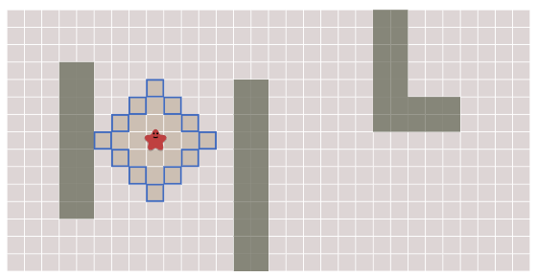
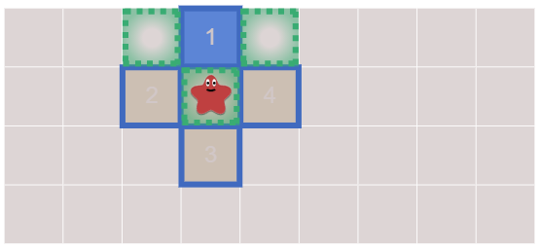
Breadth-First Search (BFS)
frontier = Queue()
frontier.put(start)
reached = set()
reached.add(start)
while not frontier.empty():
current = frontier.get()
for next in graph.neighbors(current):
if next not in reached:
frontier.put(next)
reached.add(next)
[redblobgames.com B]
Notes:
Some instances we may consider a grid

Slide 9
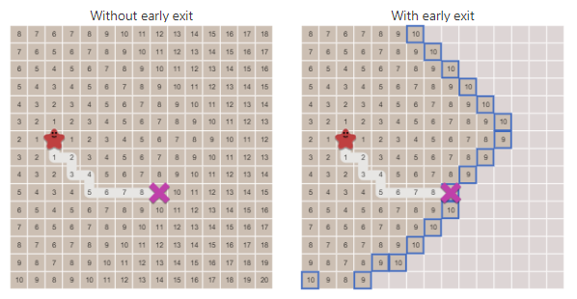
Keeping path and early exit
Algorithm:
frontier = Queue()
frontier.put(start)
came_from = dict()
came_from[start] = None
while not frontier.empty():
current = frontier.get()
if current == goal:
break
for next in graph.neighbors(current):
if next not in came_from:
frontier.put(next)
came_from[next] = current
[redblobgames.com B]

Slide 10
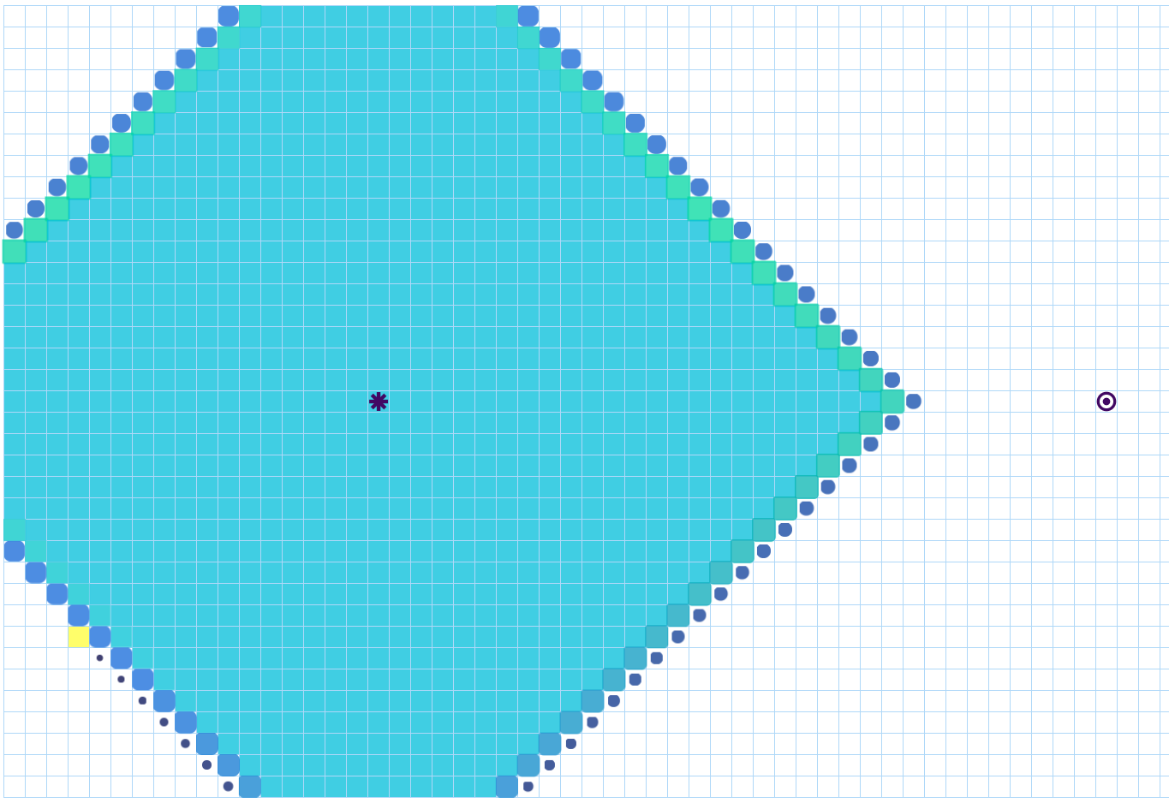
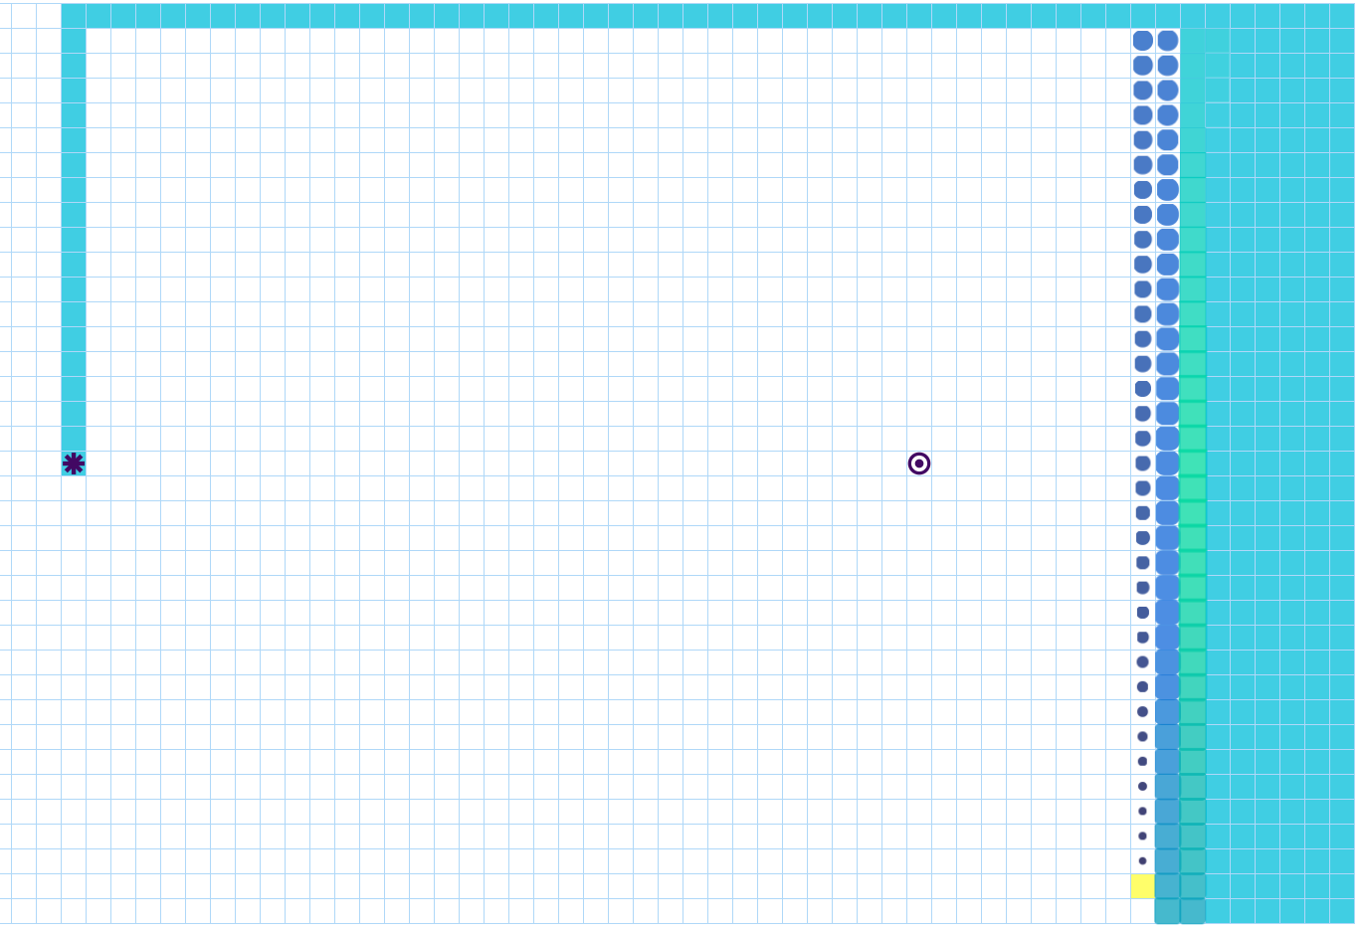
Depth-First Search (DFS)
BFS
DFS

Slide 11
Properties of BFS and DFS
Algorithm | BFS | DFS
Complete | Yes (if b is finite) Tag visited nodes | Yes (if b is finite) Tag visited nodes
Optimal | Yes! (if graph is unweighted) | No (returns first solution it finds)
Time | O(b^{d}) | O(b^{d}), terrible if solution is at very high depth
Space | O(b^{d}), must keep a growing frontier | O(d), i.e., just height of tree!
When to use | When optimal path to solution is needed | When space is an issue
b = branching factor (how many children each node has)
d = depth, or height of the tree

Slide 12
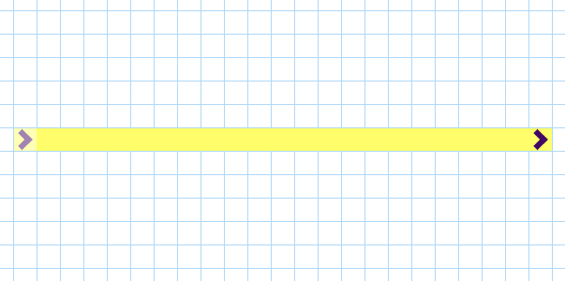
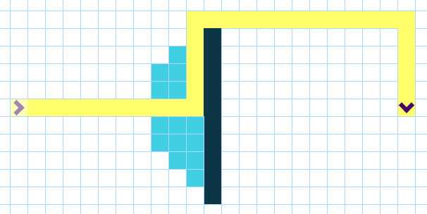
Greedy best-first search
Idea: use an evaluation function f(n) for each node
Estimate of "desirability“ (must be easy to compute)
Expand most desirable unexpanded node
Implementation:
Order nodes based on desirability (e.g., f(n) is straight-line distance to target)
Notes:
Say will introduce notion of a priority queue

Slide 13
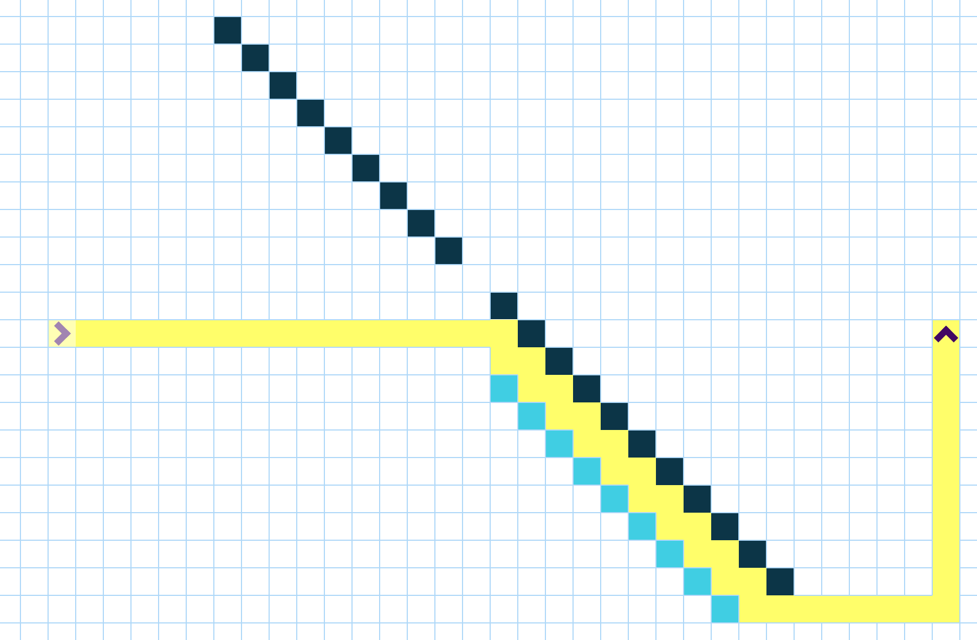
Non-optimality of greedy best-first search
Always tries closest to destination first
May miss optimal path
Solution:
Variants that consider path taken as well

Slide 14
Paths with weights
If all weights are uniform, we have a solution using the graph search algorithms from last time:
BFS achieves the optimal (shortest) path to the goal
DFS finds a path to the goal, which is not necessarily optimal
Greedy Best-First search often finds a path quickly but it is also not necessarily optimal

Slide 15



Optimal pathfinding algorithms
Next we will consider:
the more general case of graphs with weights
more efficient algorithms
BFS
Dijkstra
A*

Slide 16
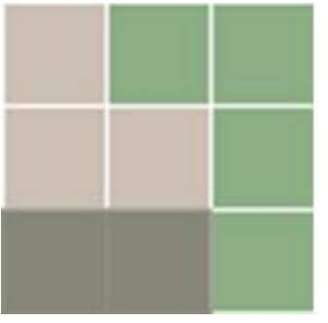
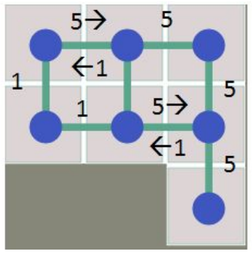

Graphs with weights
Weight of edge = time to travel
Incorporates information like:
length of path and type of terrain
Expected limits due to congestion (enemies)
Other constraints in each room
Now we want the minimum cost path
terrain |  | cost
plain |  | 1
hill |  | 5
wall |  | infinity

Slide 17
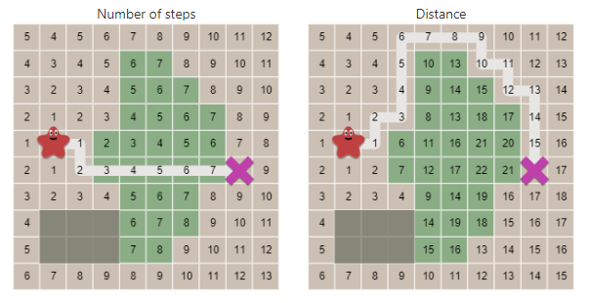
What do we want to minimize?
[redblobgames.com B]
terrain |  | cost
plain |  | 1
hill |  | 5
wall |  | infinity
BFS
Dijkstra

Slide 18
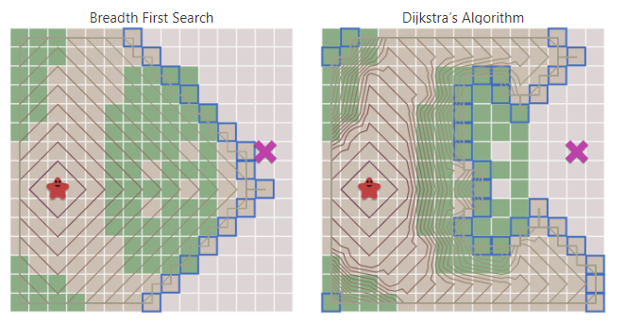
Dijkstra’s algorithm
Same as BFS except for:
Keeps track of total cost so far
In each step, expands lowest cost node
Algorithm:
frontier = PriorityQueue()
frontier.put(start, 0)
came_from = dict()
cost_so_far = dict()
came_from[start] = None
cost_so_far[start] = 0
while not frontier.empty():
current = frontier.get()
if current == goal:
break
for next in graph.neighbors(current):
new_cost = cost_so_far[current] + graph.cost(current, next)
if next not in cost_so_far or new_cost < cost_so_far[next]:
cost_so_far[next] = new_cost
priority = new_cost
frontier.put(next, priority)
came_from[next] = current
[redblobgames.com B]

Slide 19
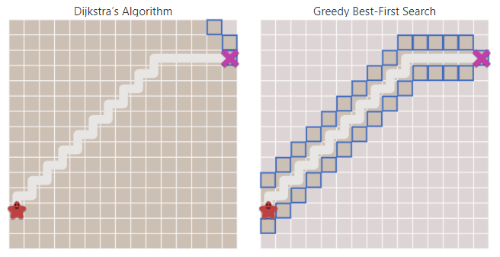
Dijkstra and Greedy Best-First Search
But doesn’t that look a lot like greedy best-first?
Same method, but using priority queue estimating distance to goal!
Replace priority = new_cost with priority = heuristic(goal, next)
[redblobgames.com B]

Slide 20
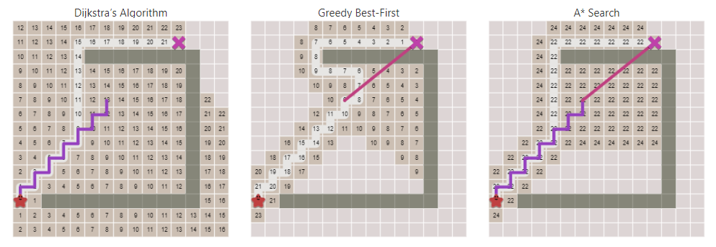
A* Search
Dijkstra uses the cost so far
Greedy Best-First uses the expected cost remaining
How about combining both?
[redblobgames.com B]

Slide 21
A* Search
Each iteration, A* chooses the node with lowest:
current distance to source
similar to BFS
looks at nodes close to source
thorough
+
approximate distance to target
similar to greedy best first
favors nodes closer to goal (approximately)
fast

Slide 22
A* Search
Same as BFS except for:
Keeps track of total cost so far
In each step, expands lowest cost node
Algorithm:
frontier = PriorityQueue()
frontier.put(start, 0)
came_from = dict()
cost_so_far = dict()
came_from[start] = None
cost_so_far[start] = 0
while not frontier.empty():
current = frontier.get()
if current == goal:
break
for next in graph.neighbors(current):
new_cost = cost_so_far[current] + graph.cost(current, next)
if next not in cost_so_far or new_cost < cost_so_far[next]:
cost_so_far[next] = new_cost
priority = new_cost + heuristic(goal, next)
frontier.put(next, priority)
came_from[next] = current
[redblobgames.com B]

Slide 23
Admissible heuristic
If the heuristic function is a lower bound of the true shortest path to the goal:
heuristic(n, goal) ≤ shortest_path(n, goal) for all nodes n
then A* search is optimal (always finds the shortest path)
We call a heuristic with a lower bound guarantee an admissible heuristic
Proof Idea: The heuristic is always optimistic so when the goal is reached through a given path, all possible paths that are shorter than the current path must have been already explored previously.

Slide 24
Lets explore…
Which method was faster?
Which gave best results?
[redblobgames.com B]

Slide 25
Admissible heuristics in the 8-puzzle game
h₁(n): number of misplaced tiles
 | 7 | 2
6 | 1 | 8
5 | 4 | 3
goal state
6 | 7 | 2
 | 1 | 8
5 | 4 | 3
6 | 7 | 2
1 |  | 8
5 | 4 | 3
 | 1 | 2
3 | 4 | 5
6 | 7 | 8
which move minimizes h₁(n)?
6 | 7 | 2
5 | 1 | 8
 | 4 | 3
Notes:
https://murhafsousli.github.io/8puzzle/#/

Slide 26
Admissible heuristics in the 8-puzzle game
h₂(n): total Manhattan distance (i.e., sum of distances between tiles and their goal state destination)
 | 7 | 2
6 | 1 | 8
5 | 4 | 3
goal state
6 | 7 | 2
 | 1 | 8
5 | 4 | 3
6 | 7 | 2
1 |  | 8
5 | 4 | 3
 | 1 | 2
3 | 4 | 5
6 | 7 | 8
which move minimizes h₂(n)?
6 | 7 | 2
5 | 1 | 8
 | 4 | 3

Slide 27
Admissible heuristics in the 8-puzzle game
h₂(n): total Manhattan distance (i.e., sum of distances between tiles and their goal state destination)
 | 7 | 2
6 | 1 | 8
5 | 4 | 3
f₁(n) = 7
f₂(n) = 1+0+3+1+3+1+2+1=12
goal state
6 | 7 | 2
 | 1 | 8
5 | 4 | 3
6 | 7 | 2
1 |  | 8
5 | 4 | 3
 | 1 | 2
3 | 4 | 5
6 | 7 | 8
f₁(n) = 7
f₂(n) = 2+0+3+1+3+2+2+1=14
6 | 7 | 2
5 | 1 | 8
 | 4 | 3
f₁(n) = 7
f₂(n) = 1+0+3+1+2+2+2+1=12

Slide 28
A* heuristic dominance
If h₂(n) ≥ h₁(n) for all n (both admissible)
Then h₂ dominates h₁
h₂ is better for search
Typical search costs (average number of nodes expanded):
Tree depth = 12: A*(h₁) = 227 nodes A*(h₂) = 73 nodes
Tree depth = 24: A*(h₁) = 39,135 nodes A*(h₂) = 1,641 nodes

Slide 29
Further reading
•
https://www.redblobgames.com/
Contains AI/math algorithms for games
2D visibility
Dynamic maps; obstacle motion prediction
Map generation from noise
…

