Slide 1

WebGL Basics
COMP4451 Game Programming

Slide 2
Agenda
Overview of OpenGL and WebGL
Prototype Applications in WebGL
OpenGL Shading Language (GLSL)
Vertex Shaders
Fragment Shaders
Examples with basic geometry and shading

Slide 3
What Is OpenGL?
OpenGL is a computer graphics rendering application programming interface, or API (for short)
Generates high quality images from geometric and image primitives
The basis of many interactive applications that include 3D graphics
Operating system independent

Slide 4
What Is WebGL?
WebGL: JavaScript implementation of OpenGL ES
runs in all recent browsers (Chrome, Firefox, Safari)
operating system independent
PC, Mac, Linux, Android, iOS, …
application can be located on a remote server
rendering is done within browser using local hardware
uses HTML5 canvas element

Slide 5
Needed to get started
Basic Javascript (JS)
Embedded into HTML
Very similar to C
Demonstrate through examples
Setting up an HTML page using JS and WebGL
OpenGL Shading Language (GLSL)
Write vertex and fragment shaders
Every project has set of requirements
Can’t go over background required for all
Concentrate on important algorithms and aspects
Point to directions to learn by example

Slide 6
WebGL Application Development

Slide 7
WebGL Programming in a Nutshell
All WebGL programs must do the following:
Set up canvas to render onto
Generate data in application
Create shader programs
Create buffer objects and load data into them
“Connect” data locations with shader variables
Render

Slide 8
Application Framework
WebGL applications need a place to render into
HTML5 Canvas element
We can put all code into a single HTML file
With WebGL, it is easier to put setup in an HTML file and application in a separate JavaScript file

Slide 9
three.js library
Library for higher-level capabilities
Models
Scenes
Cameras
Lighting, …
Simplifies development considerably
Hides a lot of the setup

Slide 10
A Really Simple Example
Generate one red triangle
Has the elements of a more complex application
vertex shader
fragment shader
HTML canvas
Note: Examples under https://course.cse.ust.hk/comp4451/basics/examples/<filename>

Slide 11
triangle3js-shad.html
<html>
<body>
<script src="three.min.js"></script>
<script id="fragment-shader" type="x-shader/x-fragment">
void main()
{
gl_FragColor = vec4( 1.0, 0.0, 0.0, 1.0 );
}
</script>

Slide 12
triangle3js-shad.html
<script>
var scene = new THREE.Scene();
var camera = new THREE.OrthographicCamera( -1, 1, -1, 1, -1, 1);
var renderer = new THREE.WebGLRenderer();
renderer.setSize( 512, 512 );
renderer.setClearColor( 0xffffff, 1);
document.body.appendChild( renderer.domElement );
var triangle = new THREE.Geometry();
var v1 = new THREE.Vector3(1,1,0);
var v2 = new THREE.Vector3(0,-1,0);
var v3 = new THREE.Vector3(-1,1,0);
triangle.vertices.push( v1 );
triangle.vertices.push( v2 );
triangle.vertices.push( v3 );

Slide 13
triangle3js-shad.html
triangle.faces.push( new THREE.Face3( 0, 1, 2 ) );
var material = new THREE.ShaderMaterial({
fragmentShader: document.getElementById( 'fragment-shader' ).textContent
});
var trimesh = new THREE.Mesh( triangle, material );
scene.add( trimesh );
var render = function () {
requestAnimationFrame( render );
renderer.render(scene, camera);
};
render();
</script>
</body>
</html>

Slide 14
triangle3js.html
Three js provides built in materials and lighting
Replace:
var material = new THREE.ShaderMaterial({
fragmentShader: document.getElementById( 'fragment-shader' ).textContent
});
With:
var material = new THREE.MeshBasicMaterial( { color: 0xff0000 } );
And remove the shader

Slide 15
Shaders and GLSL

Slide 16
GLSL
OpenGL Shading Language
C like language with some C++ features
2-4 dimensional matrix and vector types
Both vertex and fragment shaders are written in GLSL
Each shader has a main()

Slide 17
GLSL Data Types
Scalar types: float, int, bool
Vector types: vec2, vec3, vec4
ivec2, ivec3, ivec4
bvec2, bvec3, bvec4
Matrix types: mat2, mat3, mat4
Texture sampling: sampler1D, sampler2D,
sampler3D, samplerCube
C++ Style Constructors
vec3 a = vec3(1.0, 2.0, 3.0);

Slide 18
Operators
Standard C/C++ arithmetic and logic operators
Overloaded operators for matrix and vector operations
mat4 m;
vec4 a, b;
b = a*m;

Slide 19
Components and Swizzling
Access vector components using either:
[ ] (C-style array indexing)
xyzw, rgba or strq (named components)
For example:
vec3 v; v[1], v.y, v.g, v.t - all refer to the same element
Component swizzling:
vec3 a, b;
a.xy = b.yx;

Slide 20
Qualifiers
attribute
vertex attributes from application
varying
copy vertex attributes and other variables from vertex shaders to fragment shaders
values are interpolated by rasterizer
varying vec2 texCoord;
varying vec4 color;
uniform
shader-constant variable from application
uniform float time;
uniform vec4 rotation;
See usage: http://www.cs.toronto.edu/~jacobson/phong-demo/

Slide 21
Functions
Built in
Arithmetic: sqrt, power, abs
Trigonometric: sin, asin
Graphical: length, reflect
User defined

Slide 22
Built-in Variables
gl_Position
(required) output position from vertex shader
gl_FragColor
(required) output color from fragment shader
gl_FragCoord
input fragment position
gl_FragDepth
input depth value in fragment shader

Slide 23
Simple vertex shader
attribute vec4 vPosition;
attribute vec4 vColor;
varying vec4 fColor;
void main()
{
fColor = vColor;
gl_Position = vPosition;
}

Slide 24
Simple fragment shader
varying vec4 fColor;
void main()
{
gl_FragColor = fColor;
}

Slide 25
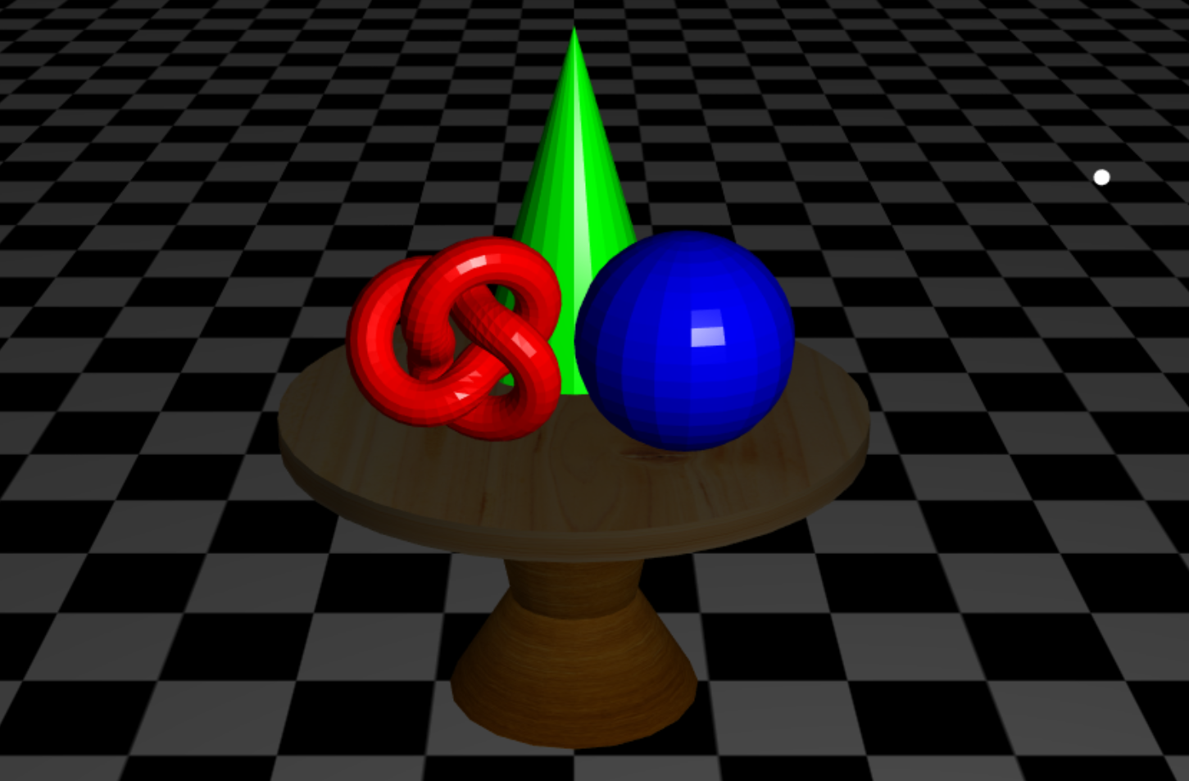
More complex example
Phong Illumination
http://www.cse.ust.hk/~psander/metarenderer/ (see view shaders)

Slide 26
Buffering, Interaction, and Animation

Slide 27
Lets add some animation and interaction
Render a rotating cube with a different color for each face

Slide 28
Event Driven Input
Browser executes code sequentially and then wait for an event to occur
Events can be of many types
mouse and keyboard
menus and buttons
window events
Program responds to events through functions called listeners or callbacks

Slide 29
Adding Buttons
In HTML file
<button id= "xButton">Rotate X</button>
<button id= "yButton">Rotate Y</button>
<button id= "zButton">Rotate Z</button>
<button id = "ButtonT">Toggle Rotation</button>

Slide 30
Event Listeners
During initialization:
document.getElementById( "xButton" ).onclick =
function () { axis = xAxis; }; document.getElementById( "yButton" ).onclick =
function () { axis = yAxis; }; document.getElementById( "zButton" ).onclick =
function () { axis = zAxis;}; document.getElementById("ButtonT").onclick =
function(){ flag = !flag; };
render();

Slide 31
Animation
Suppose we want to change something and render again with new values
We can send new values to the shaders using uniform qualified variables
Ask application to rerender with requestAnimFrame()
Render function will execute next refresh cycle

Slide 32
cube3js-shad.html
Initializing geometry and shader material:
var theta = new THREE.Vector3( 0.0, 0.0, 0.0 );
var cube = new THREE.BoxGeometry( 1, 1, 1 );
for ( var i = 0; i < cube.faces.length; i += 2 ) {
var col = Math.random();
cube.faces[ i ].color.setHex( col * 0xffffff );
cube.faces[ i+1 ].color.setHex( col * 0xffffff );
}
var material = new THREE.ShaderMaterial({
defines: { USE_COLOR: true },
uniforms: { theta: { type: "v3", value: theta }},
vertexShader: document.getElementById( 'vertex-shader' ).textContent,
fragmentShader: document.getElementById( 'fragment-shader' ).textContent
});
var mesh = new THREE.Mesh( cube, material );
scene.add( mesh );

Slide 33
Updating angles in application
In the rendering loop:
if(flag) {
if(axis == 0) {theta.x += 2.0;}
else if(axis == 1) {theta.y += 2.0;}
else if(axis == 2) {theta.z += 2.0;}
}

Slide 34
Resources
BoxGeometry:
https://threejs.org/docs/?q=boxgeometry#api/geometries/BoxGeometry
ShaderMaterial:
https://threejs.org/docs/?q=shadermaterial#api/materials/ShaderMaterial

Slide 35
cube3js.html
Lets remove shaders altogether
var material = new THREE.MeshBasicMaterial( { color: 0xffffff, vertexColors: THREE.FaceColors } );
Instead of:
/* replaced by above
var material = new THREE.ShaderMaterial({
defines: { USE_COLOR: true },
uniforms: { theta: { type: "v3", value: theta }},
vertexShader: document.getElementById( 'vertex-shader' ).textContent,
fragmentShader: document.getElementById( 'fragment-shader' ).textContent
});
*/

Slide 36
cube3js.html
Rotate using three.js functions instead of shader
if(flag) {
if(axis == 0) {mesh.rotation.x += 0.03;}
else if(axis == 1) {mesh.rotation.y += 0.03;}
else if(axis == 2) {mesh.rotation.z += 0.03;}
}

Slide 37
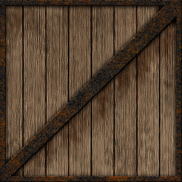
Cube3js-tex.html
Lets add a wooden texture:
var texture1 = THREE.ImageUtils.loadTexture( 'crate.gif' );
texture1.anisotropy = renderer.getMaxAnisotropy();
var material = new THREE.MeshBasicMaterial( { map: texture1 } );

Slide 38
cube3js-tex-shad.html
Use shader material
Must specify texture as a uniform
var uniforms = {
texture1: { type: "t", value: texture1 },
time: { type: "f", value: 0.0 }
};
var material = new THREE.ShaderMaterial({
uniforms: uniforms,
vertexShader: document.getElementById( 'vertex-shader' ).textContent, fragmentShader: document.getElementById( 'fragment-shader' ).textContent
});

Slide 39
cube3js-tex-shad.html
<script id="vertex-shader" type="x-shader/x-vertex">
varying vec2 vUv;
void main() {
vUv = uv; //pass the UVs to shader
//modelViewMatrix applies the rotation
gl_Position = modelViewMatrix * vec4(position,1.0);
}
</script>
<script id="fragment-shader" type="x-shader/x-fragment">
uniform sampler2D texture1;
varying vec2 vUv;
void main() {
gl_FragColor = texture2D(texture1, vUv);
}
</script>

Slide 40
cube3js-tex-shad.html
Allows for custom adjustment of texture lookup
Eg., Sliding textures
Easy to specify standard transformations
Many built-in variables on GLSL and provided by basic geometry

Slide 41
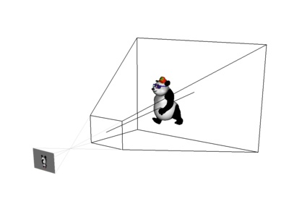
cube3js-tex-shad-pers
Perspective camera
var camera = new THREE.PerspectiveCamera( 60, window.innerWidth/window.innerHeight, 0.1, 1000 );
Then must use projection matrix on shader
//modelViewMatrix applies the rotation, projection matrix applies perspective gl_Position = projectionMatrix * modelViewMatrix * vec4(position,1.0);
Changing FOV affects how the objects get mapped
https://threejs.org/docs/?q=perspectivecamera#api/cameras/PerspectiveCamera

Slide 42
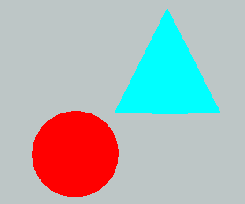
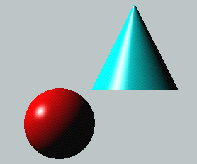
Lighting
Lighting simulates how objects reflect light
material composition of object
light’s color and position
global lighting parameters
Usually implemented in
vertex shader for faster speed
fragment shader for nicer shading
Phong illumination model most widely used
Discussed earlier in course

Slide 43
Phong model: Material Properties
Define the surface properties of a primitive
you can have separate materials for front and back
Property | Description
Diffuse | Base object color
Specular | Highlight color
Ambient | Low-light color
Emission | Glow color
Shininess | Surface smoothness
Notes:
Material properties describe the color and surface properties of a material (dull, shiny, etc). The properties described above are components of the Phong lighting model, a simple model that yields reasonable results with little computation. Each of the material components would be passed into a vertex shader, for example, to be used in the lighting computation along with the vertex’s position and lighting normal.

Slide 44
cube3js-light.html
Simple example without face colors and textures
Add three types of lights:
var ambientLight = new THREE.AmbientLight(0x666666);
scene.add(ambientLight);
var directionalLight = new THREE.DirectionalLight(0x0000ff);
directionalLight.position.set(-1, -1, -1).normalize();
scene.add(directionalLight);
var pointLight = new THREE.PointLight( 0xff0000, 1, 100 );
pointLight.position.set( 1, 1, -1 );
scene.add( pointLight );

Slide 45
MeshPhongMaterial
Detailed example of Phong shading in 3js:
https://threejs.org/docs/?q=meshphongmaterial#api/materials/MeshPhongMaterial

Slide 46
Useful additional examples
Phong shading in shaders:
http://www.cs.toronto.edu/~jacobson/phong-demo/
http://www.cse.ust.hk/~psander/metarenderer/
Full game example:
http://buildnewgames.com/webgl-threejs/
My prototype foosball game:
http://www.cse.ust.hk/~psander/foosball/foosball4.html

Slide 47
Good additional learning resources
JavaScript Crash Course:
https://cs.wellesley.edu/~cs307/readings/JavaScript-crash-course.html
3js slide set from RTR:
http://www.realtimerendering.com/basics3js/#1

Slide 48
WebGL summary
GPU and rendering
Basics and theory
Introduction to WebGL
Examples to demonstrate flexibility
Introduction to Three.js
Examples to demonstrate ease of use

Slide 49
Acknowledgment
Part of the material in the slides and some of the demos adapted from SIGGRAPH 2014 WebGL introduction by Ed Angel and Dave Shreiner

