Slide 1

Game Audio
COMP4451 Game Programming

Slide 2
Importance of sound
Hitchcock in his 1944 film 'Lifeboat' was not keen on having music, where would the music come from in the middle of an ocean?
The composer David Raksin's response was "Go back and ask him where the camera comes from and I'll tell him where the music comes from!"*
*http://filmsound.org/articles/horrorsound/horrorsound.htm

Slide 3
Outline
Motivation
Digital Audio background
Game sound and music
Audio teams

Slide 4
Experiment
Experiment:
Play a game 15-20 minutes normally with sound.
Then without warning 15-20 minutes with sound turned off.
2 games:
Warcraft III (real time strategy)
Hitman Contracts (avatar, tactical, assassin)

Slide 5
Results
Players felt they had lost control when the sound was turned off.
“Like playing in the dark.”
“Like losing a leg.”
“I never thought playing without sound would affect a game so much.”

Slide 6
Immersiveness
Sound effects give information on events out of line of sight (and behind you).
Lose ability to locate enemies.
Sound of a door opening behind the avatar may contain crucial information.
Sense of position disappears.

Slide 7
Being lost
One player reported feeling more scared and even a little paranoid when the sound was removed.
Could not receive auditory warnings about the dangers around
Felt that dangers might be lurking in the shadows all around.

Slide 8
Channel redundancy
Sound gives extra information.
“In chaotic situations, it is not easy to see what is going on.”
“I repeatedly clicked a unit because the game gave no feedback that an object had been selected.”
Player noticed an increased reaction time, because he was dependent on seeing what was going on before he was certain that the system has accepted his order.
Channel redundancy increases the likelihood that the information will be received.

Slide 9
Results
When sound was turned off the usability of the system decreased
Players experienced problems receiving important information
Players didn’t have the same sense of immersiveness, position, and presence
Specific sound objects can aurally identify and define specific areas in the game environment.
Music is often connected to specific locations.

Slide 10
What Game Audio achieves
Gameplay cues
Immersion
Reinforce interface
Convey physical/tactile sensation
Atmosphere and mood
Player satisfaction
Enhance quality of a game

Slide 11
Outline
Motivation
Digital Audio background
Game sound and music
Audio teams

Slide 12
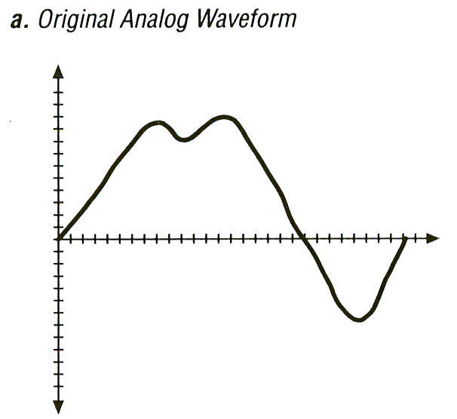
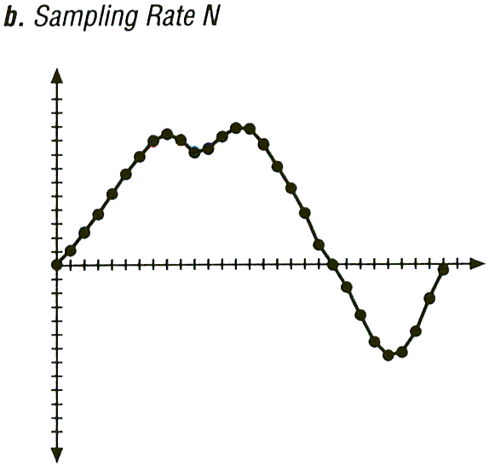
Digital Sampling of Audio
Audio waveforms are analog
Sample rate determines number of discrete values
Notes:
Audo based on air pressure variations, voltage vs. time

Slide 13
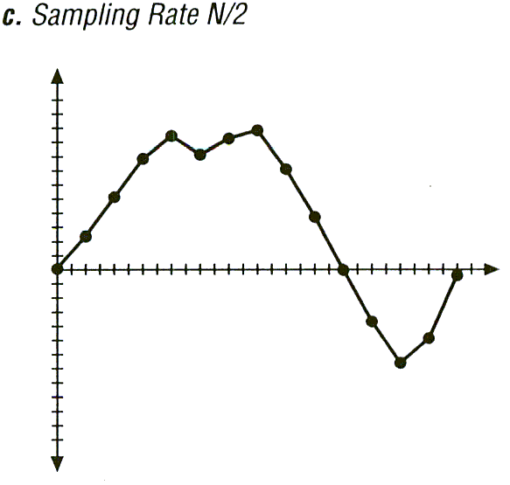
Digital Sampling
Half the sample rate

Slide 14
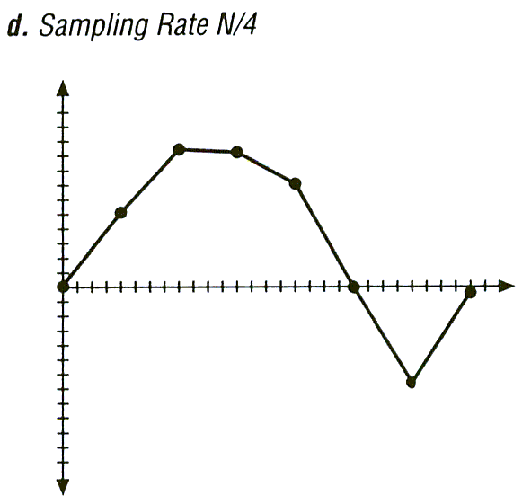
Digital Sampling
Quarter the sample rate

Slide 15
Sample Rate
Why not always use high sampling rate?
Requires more storage
Human’s can’t always perceive
Ex: dog whistle
Typically want an adequate sampling rate
What is “adequate” depends upon use …

Slide 16
Sample Size
Samples have discrete values
How many possible values?
Sample Size
Common is 256 values from 8 bits

Slide 17
Sample Size
Quantization error from rounding
Ex: 28.3 rounded to 28
Why not always have large sample size?
Storage increases per sample
Analog to digital hardware becomes more expensive

Slide 18
Audio
Encode/decode devices are called codecs
Compression is the complicated part
Ex: for voice compression, can take advantage of speech:
“Smith”
Many similarities between adjacent samples
Send differences (ADPCM)
Use understanding of speech
Can ‘predict’ (CELP)

Slide 19
Spatialized Audio
Making audio provide physical location clues
Mono – one channel, no chance for spatialization
Stereo – two channels, left and right, like the ear works
Different volumes create illusion of sounds in space
Gradual changes give illusion of “moving”
Surround sound - 5.1 – 5 main, 1 subwoofer
Usually, dialog center, music left and right and specialized sound effects behind
Environment can often effect
Bounce off walls, objects – door open and in next room?
Material matters (wood, metal, plastic)
Climate matters (temp, humidity)

Slide 20
8D Audio
Postprocess
Impression of a moving sound source
https://www.youtube.com/watch?v=O5ooPGEiXkg
Where did you hear the sound from?

Slide 21
Sound File Formats
Raw data has samples
Need way to ‘parse’ raw audio file
Typically a header
Sample rate, sample size, number of channels, coding format…
Uncompressed examples:
.wav for IBM/Microsoft
.aiff for MAC
Compressed examples:
.mp3 for MPEG-3
.ra for Real Audio
.au for Sun µ-law
.midi has instrument commands

Slide 22
MP3
‘MP3' abbreviation of MPEG 1 audio layer 3
'MPEG' abbrev of 'Moving Picture Experts Group‘
MP3 differs in that it does not try to accurately reproduce PCM (waveform)
Instead, uses theory of 'perceptual coding‘
PCM attempts to capture a waveform 'as it is‘
MP3 attempts to capture it 'as it sounds'.

Slide 23
MP3
Ears and brains imperfect and biased measuring devices, interpret external phenomena
Ex: doubling amplitude does not always mean double perceived loudness
Factors affect (frequency content, presence of background noise…)
Set of judgments as to what is/not meaningful
Psychoacoustic model
Relies upon 'redundancy' and 'irrelevance‘
Ex: frequencies beyond 22 KHz redundant (some audiophiles think it does matter, gives “color”!)
Discard part of signal because will not be noticed

Slide 24
MP3 - Masking
Listener prioritizes sounds ahead of others according to context (hearing is adaptive)
Ex: a sudden hand-clap in a quiet room seems loud. Same hand-clap after a gunshot, less loud (time domain)
Ex: guitar may dominate until cymbal, when guitar briefly drowned (frequency domain)
Above examples of time-domain and frequency-domain masking respectively
Two sounds occur (near) simultaneously, one may be partially masked by the other
Depending relative volumes and frequency content
MP3 doesn’t just toss masked sound (would sound weird) but uses fewer bits for masked sounds

Slide 25
MP3 – Sub-Bands (1 of 2)
MP3 not method of digital recording
It simply encodes the result
Removes irrelevant data from existing recording
First, short sections of waveform filtered
How, not specified by standard.
Typically Fast Fourier Transformation or Discrete Cosine Transformation
Method of reformatting signal data into spectral sub-bands of differing importance

Slide 26
MP3 – Sub-Bands (2 of 2)
Divide into 32 'sub-bands‘, represent different parts of frequency spectrum
Why frequency bands? So MP3 can prioritize bits for each
Ex:
Low-frequency bass drum, a high-frequency ride cymbal, and a vocal in-between, all at once
If bass drum irrelevant, use fewer bits and more for cymbal or vocals

Slide 27
MP3 – Frames
Sub-band sections are grouped into 'frames‘
Determine where there is masking in frequency and time domains
Which frames can safely be allowed to distort
Calculate mask-to-noise ratio for each frame
Use in the final stage of the process: bit allocation.

Slide 28
MP3 – Bit Allocation
Decides how many bits to use for each frame
More bits where little masking (low ratio)
Fewer bits where more masking (high ratio)
Total number of bits depends upon desired bit rate
Chosen before encoding by user
For quality, a high priority (music) 128 kbps common
Note, CD was about 1400 kbps, so 10x less!

Slide 29
MP3 – Playout and Beyond
Save frames (header data for each frame). Can then play with MP3 decoder.
MP3 decoder performs reverse, but simpler since bit-allocation decisions are given
MP3 decoders cheap, fast (old ipod!)

Slide 30
Outline
Motivation
Digital Audio background
Game sound and music
Audio teams

Slide 31
Sound Design (1 of 2)
Critical is interactive audio component
Sound when event occurs (gunshot when trigger pulled, dialog when character spoken to, …)
Well done, sounds great. Poorly done, ruin all.
Need to avoid repetition
One footstep for 20+ hours of play annoying
Need 6-20 (depending upon budget)
Dynamics can help (pitch, volume, stereo…)
Mix pre-existing sounds with own sounds
Provides “custom” identity for game

Slide 32
Sound Design (2 of 2)
Example – Street Basketball soundscape
Need individual sounds, but want footsteps primarily
Sounds from different courts: wood, dirt, asphalt
Vary volumes depending upon location of player
Stereo or surround depending upon location of 10 players
Random scuffs, scrapes, squeaks in addition to steps
Need others: jumps, dribble, ball on backboard, swishes …
Need to mix all these together in realistic fashion

Slide 33
Music in Games
Despite technology improvements, emotional intensity in computer games not that of films
How often do you cry when you play games?
Many reasons, but one facet that could contribute has been consistently underutilized: music

Slide 34
Can just give control to user
Since Xbox 360, some consoles allow players to add their own music into a game
Grand Theft Auto allows player to change in-game radio stations
Golden rule: never let the player become annoyed or bored by the repetitiveness of the sound
Can be achieved by allowing player to be in charge, may avoid player turning off the music

Slide 35
Games are not Film
Game designers "filmize" games
Set up cut scenes with orchestral cues
Add drama to in-game fights with battle music
Add music to areas and levels to give identity and emotional backdrop
It would seem this approach makes sense, but games are not film
Film is linear, so composer knows exactly what’s coming, sets up the perfect emotional "hook“
Games relativity can't be foreseen, calculated, or controlled
However... some concepts you can take away from film soundtracks apply to games

Slide 36
Mini-Outline
First, dispel some myths
Music Mistakes (4)
Second, briefly describe some techniques
Good Music Rules (4)
Based on Enhancing the Impact of Music in Drama Oriented-Games, by Scott Morton http://www.gamasutra.com/features/20050124/morton_01.shtml

Slide 37
Music Mistake #1 (1 of 2)
"Watering down my music and making it 'subtle' will help it to fit in and work in multiple situations.“
Ambient in nature, play straight through and repeat
Ex: common in an RPG
Enter a dark dungeon? Music doesn't change
Finished a battle and am inches from death? Music doesn't reflect the critical nature of the situation at all
Why is the music even playing!? Doesn’t make immersive. Just white noise. Detracts from immersive feeling
Better to have soundscape (wildlife or city bustling noise) since draw into reality

Slide 38
Music Mistake #1 (2 of 2)
So why do game makers make this mistake?
1) It's the norm. There has always been “level music”.
Ex: something to hum to while jumping from pipe to pipe, squashing mushroom people
Not comfortable with musical silences in games
But irony is that film doesn’t always have music!
Need to understand "less is more" factor in music for games...
2) Don’t trust player to form own emotional picture
Ex: entering dark forest just as immersive and spooky with only audio backdrop, as it is with music
Try turning off the music next time you play!
Use music to augment emotions
Don’t have that opportunity when ambient music always on

Slide 39
Music Mistake #2
“Adaptive music will solve emotional detachment issues and tie players into my game because it will follow what is actually happening”
Opposite problem: adaptive music can be too reactive
A great power of film is that can choose different types of music in single scene to change emotion
Ex: humorous music to a physically violent scene, versus agitated music (or no music)
Let music keep emotional independence, not solely dependent upon literal events in game
If adaptive music follows gameplay all the time and triggers "appropriate" music, can’t speak independently

Slide 40
Music Mistake #3
“Cut scenes with live orchestral music will get players more emotionally involved in my game.“
Cut-scenes before and after game are brilliant
Ones in middle don’t have "full movie splendor“
Watching film is a passive experience.
Watching Matrix. “Cool when Neo kung-fu’d Mr. Smith”
Games are active.
Don’t say “cool when Joe lobbed the grenade” but “cool when I lobbed the grenade”
Player “is” the avatar
During cut-scenes, lose direct emotional involvement.
Making it more grandiose can potentially take it away

Slide 41
Music Mistake #4 (1 of 2)
"Let's just loop the music once it reaches the end.“
Very prevalent from Final Fantasy to Zelda
Many reasons why bad idea
Looping hand-in-hand with "watered-down, ambient music" approach (no emotional connection)
Worse, detached the player from even registering it
And becomes annoying
Moved from "why should we even have music playing here" to "why shouldn't we turn off the music altogether and listen to MP3s?"

Slide 42
Music Mistake #4 (2 of 2)
Why do we fall into this trap?
It's familiar, done in most games
If small music budget might "want to make the best of what we have."
Maybe Mr. Programmer said “I don't know what else to do besides looping” and “Mr. Producer told me to stick Music A into Level B."
Above reasons not for AAA titles

Slide 43
Good Music Rule #1
“Follow the dramatic arc with the game's soundtrack”
Create a musical climax in your game
Don't use most intense music until critical points in dramatic arc
Is final boss battle more important than miniboss battle? → Show it in the music.
Let player (subconsciously) interpret importance of events based on accompanying music

Slide 44
Good Music Rule #2
“Never use music unless it is making a specific emotional statement to the player.”
Music playing should mean something
In a film, music never plays just to play.
Good guideline to remember “The less you use something, the more effective it is when you do use it."
Don’t be afraid of musical silences in games
Use the sounds of forests or dripping caves or crowded streets to immerse a player
Trigger music to bring to next level of emotion
Keep music more sparse
Will retain its special element of influence
Will not simply be "tuned out”

Slide 45
Good Music Rule #3 (1 of 2)
“Get the composer involved early in the process!”
Film composers can more easily be given fixed and final product, since it is a fixed linear sequence.
Games are more intricate. Composer needs:
Designer's motivations from dramatic and story perspective
How story is presented
What kind of influence player has on story
Bottom line: “hiring the composer when we're done with the game" is not a good idea

Slide 46
Good Music Rule #3 (2 of 2)
Also, important that composer do at least some (if not all) of the music implementation.
Needs the ability to experiment and find what works best to match vision
Could be
Team-up with an audio programmer
Tools for inserting music

Slide 47
Good Music Rule #4
“The more content, the better”
A piece of music more impactful if played in one place
Identifies single, critical moment or event
The more musical content created, the more room for dedicating unique cues to certain places
Reality of music budget and cost-per-minute of composer can get in way
Get composer involved early
Dedicate more budget to music and sound
Awareness of how much influence a well-written and well-implemented musical score can have in a game, hopefully, will raise the priority of a game's soundtrack in the budget

Slide 48
Guidelines for All Videogames (1 of 2)
Address audio early, in pre-production
Publisher or developer hire audio director to oversee audio production
Create budget and schedule
Game audio tasks specialized
Ex: composers do not do sound effects
Ex: producers do not direct voice actors

Slide 49
Guidelines for All Videogames (2 of 2)
Don’t repeat audio unless musical theme re-instated
In that case, variation
Pace conversations properly, with voice acting
Game soundtracks adaptive to player actions (makes games different than film)
Appropriate soundtracks (consider player choice for driving, fighting, puzzle games)

Slide 50
Guidelines for Fighting Games
No repetition
Dozens, hundreds of injury sounds
It is ok to have lyrics for music here
Music adaptive to players moves, fight situation

Slide 51
Guidelines for Driving Games
Adaptive sound tracks already used for some
Ex: Need for Speed 3: Hot Pursuit when cop approaches, tension filled
Trick: can activate a music track (bass, guitar drums) at checkpoint
Player could choose sound like radio in car
Ex: Sega’s Out Run and Out Run 2
Real sounds merged with music

Slide 52
Guidelines for Puzzle Games
Adaptive soundtracks based on difficulty
Avoid repetition, even for sound effects that designate puzzle moves
Vary slightly

Slide 53
Guidelines for Sports Games
Music transitions based on game conditions (penalty, score)
Music from PA of system (like at real game)
Ex: Madden NFL
Crowd sound effects, reactions to action
Audio commentary if depicted as broadcast

Slide 54
Guidelines for Action/Adventure Games
Use ambient (background) sounds
Sounds should paint “sonic landscape”
Surround sound to aid immersiveness

Slide 55
Outline
Motivation
Digital Audio background
Game sound and music
Audio teams

Slide 56
Music Team
(Only most common roles)
Composer
Write custom music (writing, recording, mixing)
Recording Engineer
Enables production of sound through mechanical means
Gets best sounds out of each component
May often be a sound designer (coming next)
Mix Engineer
Takes completed tracks and balances sound characteristics (volumes)
Tempting to combine with recording engineer, but good mix engineer provides “new level”

Slide 57
Sound Team
Audio Director/Manager
Manage sound design teams
Keep track of resources and schedules
Execute vision of game producer on sound and dialog
Sound Designer
Bring life-like (and beyond life) sound to game
Critical member, as audio has more importance
Implementer
Work with production tools to attach sounds to events, characters, etc.
“Level designers” of the audio department
Not too common (may often be “just” a programmer with no audio training), but increasingly more common

Slide 58
Summary
Motivation
Digital Audio background
Game sound and music
Audio teams

Slide 59
Videos
27 Game noises
https://www.buzzfeednews.com/article/josephbernstein/27-video-game-noises-that-you-will-never-be-able-to-forget
History of gaming’s iconic sounds
https://www.wired.com/story/psychology-iconic-video-game-sounds/

Slide 60
Sources
WPI “The Game Development Process” course
BEHIND THE MASK - Perceptual Coding: How Mp3 Compression Works, by Paul Sellers
Enhancing the Impact of Music in Drama Oriented-Games, by Scott Morton
Audio for Games, by Alexander Brandon
Introduction to Game Development, by Steve Rabin

