Slide 1
COMP 170
Example of Probability Theory – the Aloha Protocol
Version 3
Last modified 11/23/2005

Slide 2
Background
Communication
medium
Modern Local Area Networks (LANs) operate according to the following principle
  Machines are connected to communication medium, e.g. a wire, radio spectrum, etc.
  When machine A sends message to machine B, the message is broadcast to the medium and
    If no one else is broadcasting at the same time, every machine on the LAN hears the message.
    If another machine is broadcasting at the same time, then the message interfere (collide) with each other and no machine on the LAN receives the individual message.
A
B
C
No collision
Collision

Slide 3
Communication Protocol
Q: If there is a collision then there are (at least) two machines that want to broadcast. How can we set up a protocol such that the machines will rebroadcast and will not collide with each other again.
A: Machines wait a “random” amount of time before trying to rebroadcast.
  There are different variants of this protocol.
  One of the earliest is the Aloha Protocol. We will see the Slotted Aloha Protocol (which assumes that all machines share synchronized clocks).
  Many modern protocols in use today, e.g., Ethernet and WiFi, are actually very similar to Aloha.

Slide 4
Slotted Aloha
Setup:
  n machines (with synchronized clock)
  time is divided into equal length slots
  a message fits perfectly into one time slot
  a number p, 0<p<1
Protocol: send_message(t)
  Machine A wants to send a message at time t.
    It flips a p-biased coin. (Pr(H) = p)
  If A sees T, it waits until time t+1 and then send_message(t+1).
  Else A sees H, it sends the message.
    If no collision, it finishes.
    If collision occurs, it waits until time t+1 and resends using send_message(t+1).

Slide 5
Example of Slotted Aloha
A
1
2
2
3
B
1
2
2
2
C
1
2
2
Communication
channel
s
s
c
s
c
s
s
s
s
s = success, c = collision
We want to calculate the probability that a message is successfully sent at time t.
Assume every machine is always trying to send a message.
at time t, message is successfully sent
iff
exactly one of the machines sends & all others wait
iff
exactly one of the machines flips H & all others see T

Slide 6
Analysis of Slotted Aloha
The H’s & T’s flipped by the n machines are the result of n independent (Bernoulli) trials
Let E_{i} be the event that machine i gets H and all others get T.
Then Pr(E_{i}) = p(1-p)^{n-1}
We find (this is from the binomial distribution)
Pr(E₁ U E₂ U … U E_{n}) = np(1-p)^{n-1}
Q: How good (bad) can this be?
A: Let F(p) = np(1-p)^{n-1} to find p that maximizes F(p).
  By setting the first derivative
  F’(p) = np(1-p)^{n-2}[(1-p)-p(n-1)] = 0 p = 1/n
  So the best performance occurs when p = 1/n, and
  Pr(E₁ U E₂ U … U E_{n}) = (1-1/n)^{n-1}.

Slide 7
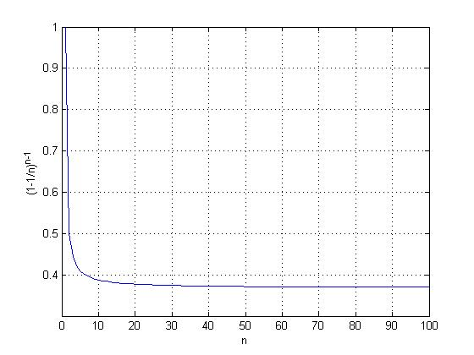
More on the Analysis
From Calculus, we have that
So the best utilization we can get is about .367 of the bandwidth.

