Slide 1
Introduction to UNIX
Learning Objectives:
To introduce the background of Unix
To understand the features provided by Unix
To understand the application of Unix
Acknowledgement: Thanks to Dr Andrew Horner for the original version of this set of slides.
All trademarks are the properties of their respective owners.

Slide 2
Introduction to Unix
Table of Content
What is Unix
Unix Versions
PC Unix
Who uses Unix
The most important features of Unix

Slide 3

What is UNIX? (1)
UNIX is an Operating System (OS).
  An operating system is a control program that helps the user communicate with the computer hardware.
The most popular operating systems: Windows 95/98/NT/2000/XP, DOS -- all from Microsoft.
UNIX was developed long before Windows, about 30 years ago at AT&T Bell Labs in the US (95% written in “C” programming language).

Slide 4


What is UNIX? (2)
UNIX was designed as an operating system for experts, used on high-end workstations, servers and hosts.
UNIX provides some powerful features:
  Security - private and shared files
  Multi-user support
  Inter-process communication
  Extensive network support
  Data sent to display, files, or printers in same way

Slide 5

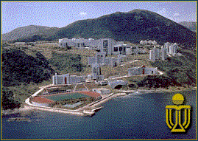


Most Important Feature of UNIX
Most important feature of UNIX: STABILITY
  30 years to get the bugs out
  Important in shared environments and critical applications
Shared Environments Example: University
  Windows98/NT crashes at least once a day in labs
  UNIX servers crash about once a semester
  (usually due to hard disk failure)
  UNIX more than 100 times more reliable than Windows!
Critical Applications
  Hospital - Don’t want to wait for reboot during operation!
  Airport - Air traffic control landing planes.
  HK Telecom - Don’t want phone system going down!

Slide 6




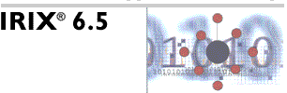
UNIX Versions
There are two main types of UNIX:
  BSD (Berkeley Software Distribution)
  System V (developed at AT&T)
Our book covers UNIX System V
There are many different versions of
UNIX for different hardware:
  Sun Microsystem’s Solaris (and SunOS)
  Hewlett-Packard’s HP-UX
  IBM’s AIX
  SGI’s IRIX
Many UNIX dialects for PCs
  “Free”: Linux (distributions such as Red Hat, Caldera,Corel, SuSE, TurboLinux, WinLinux), FreeBSD
  (see http://www.linux.org/; http://www.linux.org/dist/index.html)
  Commercial: SCO UNIX (Xenix), Sun OS

Slide 7

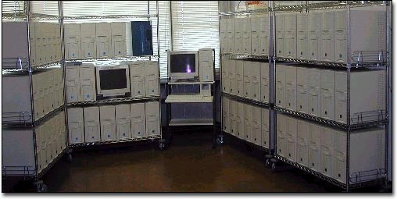
PC UNIX
Linux basically free
Many free, reliable software & development tools with source code (GNU’s not UNIX - http://www.gnu.org), e.g.,Web/Mail Server, Database Server, File Server (NFS for UNIX, Samba for Windows clients), Firewall, Dialup
Extremely fast PC for hosts and servers
  Multiple (2,4,8) CPUs in one PC – Symmetric Multi-Processing (SMP)
  PC clusters for scientific computing
  (see: http://www.insanehardware.com/scoopage.php?i=00013
  short version: http://www.cs.ust.hk/~kwchiu/comp111/cluster2.ppt)
  UST: Center for Coastal and Atmospheric Research

Slide 8




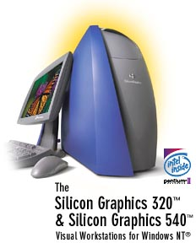


Who Uses UNIX?
Computer manufacturers such as
Sun, SGI, IBM, and HP
Computer chip manufacturers
like Motorola & Intel
Software companies
Banks
Hong Kong Government
Hospital Authority
Universities
Internet Service Providers (ISP)
Web Companies
Web servers of many organization and for personal use

Slide 9
Tips for Learning UNIX
Understand the lecture slides and examples
Do all the lab exercises
Compare the model lab solutions with yours
Feel free to experiment with commands and their options
Use online manual pages
Use command summary and help with individual commands
Read text books for more examples
Search more information from the web
You need the commands taught in this course and a text editor (though a bit awkward to use) to survive when you work remotely from your office or client’s UNIX computer
A broadband Internet connection … ☺

Slide 10
Marking Scheme
Labs 30%
  10 labs
  Due three days later
  Two labs per week
Midterm Exam: 30 %
  Covers Unix material
Final Exam: 40%
  Unix and Perl material

