Slide 1
CGI programming in Perl
Learning Objectives:
To understand how a CGI program works in Perl and how to make it runnable in
web browsers
To learn how to retrieve & process input
through web page interface
To learn how to generate a web page from a Perl CGI program

Slide 2
CGI Programming (1)
A CGI program allows the user
  to interact with a web page by generating HTML code that depends on the user input.
  For example, web pages with an entry form or buttons use a CGI program to get the input from the user, and display appropriate results.
Perl is one of the most popular language for CGI programming
  because it is good at text manipulation.

Slide 3
CGI Programming (2)
ihome
  You can place your CGI programs in a directory called cgi-bin ihome directory ihome.ust.hk
  http://www.ust.hk/itsc/webguide/home/cgi/
  you can place your CGI programs under your ihome web directory /cgi-bin
  the URL to access your CGI program is:
http://ihome.ust.hk/~username/cgi-bin/filename.pl (or .cgi)
CS System: use the following URL pattern:
  http://cgi.cs.ust.hk/~qyang/cgi-bin/hello.pl
Your CGI program should have execute permission set:
  chmod a+x program.cgi
(*) If you encountered “Internal Server Error”, you may need to transfer (FTP) your program in ASCII mode

Slide 4
The CGI Module
Perl has a CGI module to make it easier.
  include the following line near the top of your program:
use CGI qw(:standard);
  The use statement is like #include in C++; it brings in predefined functions from another file at compile time.

Slide 5
Simpler Hello World (1)
Below is the “Hello World” program using the CGI module:
#!/usr/local/bin/perl5 -w
print "Content-type:text/html\n\n";
use CGI qw(:standard);
start_html("Hello World Program");
print h1("Hello world");
print start_form;
print end_form;
print end-html();
title

Slide 6
Simpler Hello World (2)
In the previous program,
  header() returns a string containing the Content-type line with a following blank line
  start_html(string) returns string as an HTML title
  h1(string) returns string as a first-level HTML heading, and
  p(string) would return string as a new HTML paragraph.

Slide 7
Adding Textfields
CGI provides various widgets for accepting user input in forms.
  textfield widget: allows the user to enter text in a box
  need start_form() before textfield
textfield() is often called inside a p() function.
  The first argument is the name of the textfield
  The second argument is the default value.
print start_form;
print p("Bill is: ", textfield("bill","cheap"));
print end_form;

Slide 8
Hello Gates
A form with a textfield widget:
#!/usr/local/bin/perl5 -w
# Bill Gates CGI program
use CGI qw(:standard);
$billvalue = param("bill"); # get value from bill-field
print header(), start_html("Hello Bill Gates");
print h1("Hello Gates Lovers!");
if($billvalue){ # display, if user has hit Return
print p("Yes, Bill is $billvalue.");
}else{ # otherwise, ask for user-input
print hr, start_form; # hr() is <HR> HTML
print p("Bill is: ", textfield("bill","cheap"));
print end_form, hr;
}
print end_html();

Slide 9
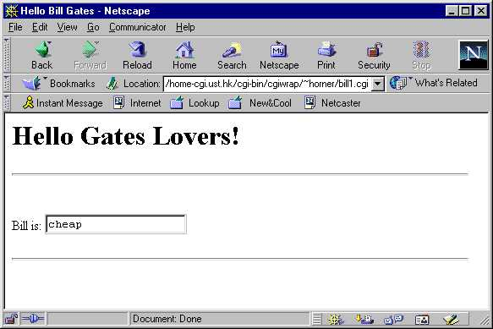
Hello Gates Initial Screen
When we click on a link that points to this program, you will see the below screen.
The text field is initially filled with the default value.

Slide 10
Hello Gates Initial Screen (in HTML)
In your browser, select View -> Source, you get the HTML listing:

Slide 11
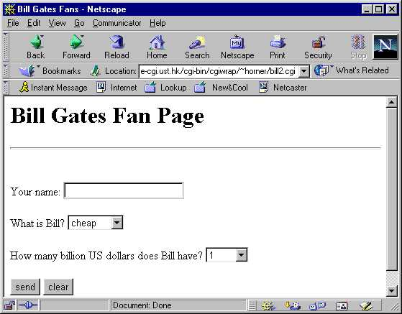
Bill’s Fans Initial Screen (1)
Here is the initial screen and default values the user sees:

Slide 12
Bill’s Fans page 1 (Perl)
#!/usr/local/bin/perl5 -w
# Bill Gates CGI program v. 2
use strict;
use CGI qw(:standard);
print header(), start_html("Bill Gates Fans");
print h1("Bill Gates Fan Page");
if(param()){ # if the form has already been filled out
my $who = param("name");
my $what = param("billWord");
my $howmuch = param("money");
if($howmuch == 100){
print p("Yes $who, Bill is $what, and he has 100,000,000
times more money than you!");
}else{
print p("Incorrect $who! Bill has US\$100 billion.");
} → CONT…

Slide 13
Bill’s Fans page 2 (Perl)
}else{ # first time, so display clean form
print hr(), start_form();
print p("Your name: ", textfield("name"));
print p("What is Bill? ",
popup_menu("billWord", ["cheap", "rich", "powerful"]));
print p("How many billion US dollars does Bill have? ",
popup_menu("money", [1,10,100,1000]));
print p(submit("send"), reset("clear"));
print end_form;
}
print end_html();

Slide 14
Array references/pointers
Why the square brackets around the arrays in the previous example?
["cheap", "rich", "powerful"]
[1,10,100,1000]
  pointers to arrays
  popup_menu() expects an array reference as its second argument.
You can also create an array reference by using a backslash in front of a named array, as in \@choices:
my @choices = qw(cheap, rich, powerful);
print p("What is Bill? ", popup_menu("billWord", \@choices));

