Slide 1
Near-Optimal Network Design
With Selfish Agents
Elliot Anshelevich, Anirban Dasgupta,
Éva Tardos, Tom Wexler
STOC’03, June 9–11, 2003, San Diego, California, USA
Presented by XU, Jing
For COMP670O, Spring 2006, HKUST
Notes:
Some pictures are excerpted from http://www.cs.cornell.edu/~wexler/CMUtalk.ppt,
And www.cs.tau.ac.il/~fiat/gtnetwork/Optimal_Network_Design_With_Selfish_Agents.ppt

Slide 2
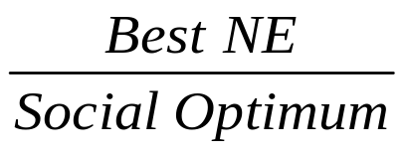
Network Design Game
Problem
  Selfish agents share network building cost
  to make their sets of terminals connected
Focus
  Behavior of selfish agents
  Structure of the network generated
  Optimistic Price of anarchy =
s₁
t₃
s₂
t₂
s₃
t₁

Slide 3
Outline
Model & Basic Results
Single Source Game
  Optimistic price of anarchy = 1
  (1+ε)-approximate NE
General Connection Game
  Optimistic price of anarchy ≤ N
  Some approximate NEs
NE existence: NP-Complete

Slide 4
Problem Modeling
Graph G=(V,E)
  Undirected
  Cost of an edge e: c(e)
  To purchase a subgraph G_{p} of G
Selfish Agents
  N players
  Strategy:
    Strategy of player i: p_{i}={p_{i}(e)}
    p={p₁, …, p_{N}}
    G_{p}={e | ∑_{i}p_{i}(e) ≥ c(e)}
  Player i ’s goal:
    His set of terminals are connected in G_{p}
    Minimize his total payoff: ∑_{e∈E} p_{i}(e)
s₁
t₃
s₂
t₂
bought
edges
s₃
t₁

Slide 5
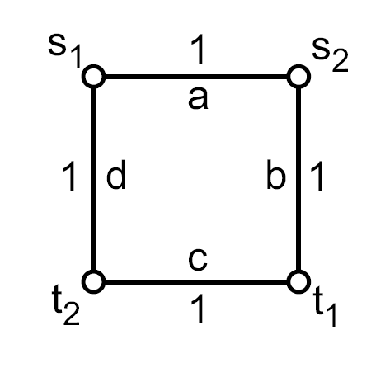
Basic Results
Property of NE:
  G_{p} is a forest
  Player i only pays for the edges he uses
  Each edge is paid either fully or not
NE may not exist:
  E.g.:
Price of anarchy = N
  Upper bound = N
  Lower bound (by e.g.):
1
s t
N
Notes:
A Nash Equilibrium p: ∀i, if p_{j}(j≠i) fixed, then p_{i} minimize player i’s total payoff
A (1+ε)-approximate NE p: No player I can decrease his payoff by more than a facter of (1+ ε) using p_{i}’
Let T^{i} be the smallest tree in G_{p} connecting terminals of player i, then

Slide 6
Single Source Games
Definition:
  Players share a common terminal: s
  Each player has one other terminal: t_{i}
  G_{p} is a tree + unused vertices
Social Optimum:
  Minimum Cost Steiner Tree (NP-Complete)
Nash Equilibrium:
  Always exists
  Optimum social cost ⇐ share cost of SO
Notes:
Terminals don’t have to be distinct

Slide 7
Simple Case: MST
It’s easy if all nodes are terminals…
Best NE ⇐ OPT T*
Player i buy edge above t_{i} in T*.
Notes:
This slide can be skipped, if everyone is familiar with Steiner Tree.

Slide 8
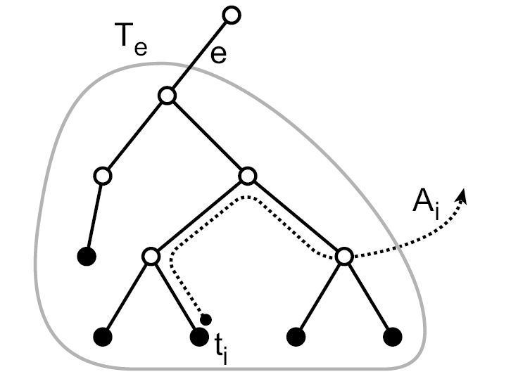
Single Source Games (Cont’)
Cost Sharing Algorithm: (given T*)
  Initialize p_{i}(e) = 0 for players i and edges e.
  Loop through edges e in T∗ in reverse BFS order.
    Loop through i with t_{i} ∈ T_{e}, until e is paid fully.
      If e is a cut in G, then set p_{i}(e) = c(e).
      Otherwise
        Define modified costs:
        c’(f) = p_{i}(f), ∀f∈T∗
        c’(f) = c(f), ∀f∉T∗.
        Define χ_{i} to be the cost of the cheapest path from s to t_{i} in G\{e} under c’.
        Define p_{i}(T∗) = ∑_{f∈T∗} p_{i}(f).
        Define p(e) = ∑_{j} p_{j}(e).
        Set p_{i}(e) = min{χ_{i} − p_{i}(T∗), c(e) − p(e)}.

Slide 9
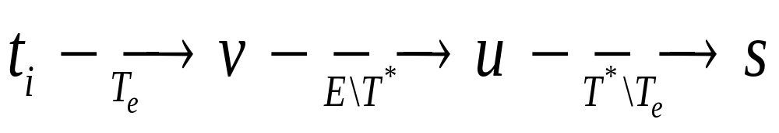
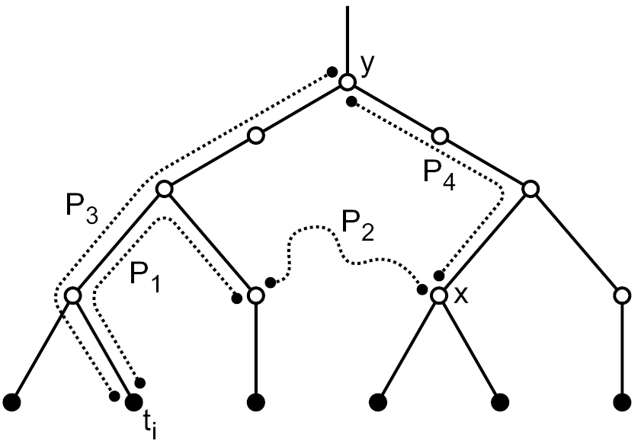
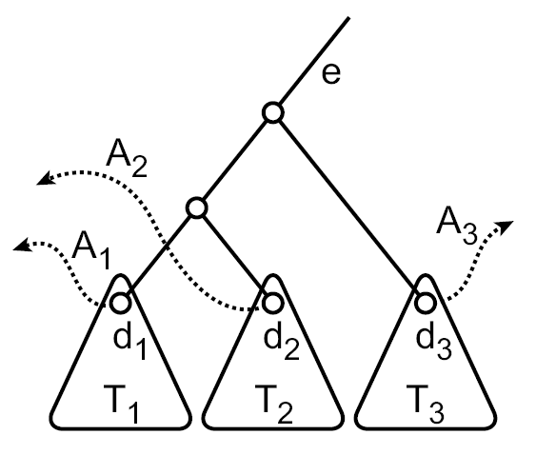
Single Source Games (Cont’)
Lemma 3.4:
Lemma 3.5: All edges will be paid fully.

Slide 10
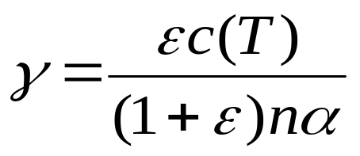
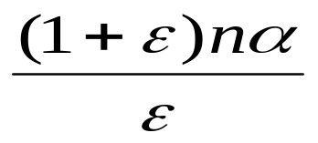
Single Source Games (Cont’)
Theorem 3.6: Given a α-approximate minimum cost Steiner Tree T, for any ε>0, there’s a poly-time algorithm that returns a (1+ε)-approximate NE on T’, where C(T’)≤ C(T).
  Pay for 1-γ of each edge in T,
  Run for at most times.
  It is a (1+ε)-approximate NE:

Slide 11
Single Source Games (Cont’)
Extensions
  G is directed.
  Each player has a maximum acceptable cost max(i).

Slide 12
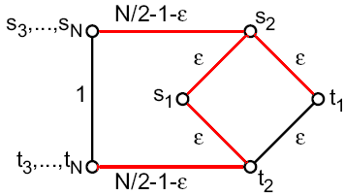
General Connection Games
Basic Results:
  NE may not exist.
  Price of anarchy can be as large as N.
Optimistic Price of anarchy:
  E.g. with optimal
  social cost 1+3ε,
  and best NE cost
  N-2+ ε .

Slide 13
General Connection Games (Cont’)
Theorem 4.1: For any game, there is a 3-approximate NE that buys OPT.
  Connection Set S of player i:
    A subset of T^{i}, ∀C is connected component in T*\S, either player i has a terminal in C, or all player j’s terminals are in C if any appears.
  Ideas:
  Player i pays for 3 connection sets of his:
    Edges belonging only to T^{i}
    Decompose OPT hierarchically into paths to get another 2 connection sets.
Notes:
Connection set: best choice of i

Slide 14
General Connection Games (Cont’)
Paths R(t):
4
4
4
4
1
1
1
1
3
3
3
3
2
2
2
2
2
2
2
2
3
3
3
3
1
1
1
1
5
5
5
5
5
5
5
5
4
4
4
4

Slide 15
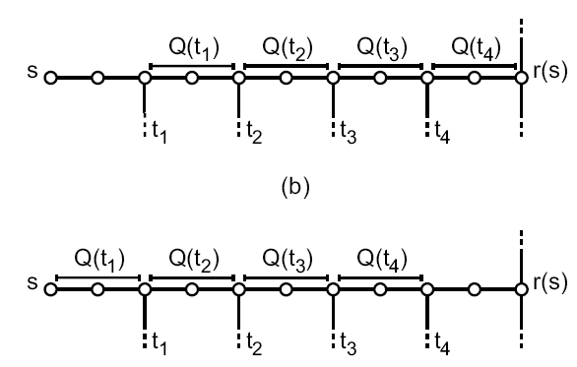
General Connection Games (Cont’)
Path Q(t) for player i:
2
2
1
3
4

Slide 16
General Connection Games (Cont’)
Given α-approximate Steiner forest T
  A (3+ε)-approximate NE can be found, if there is a polynomial-time optimal Steiner tree finder.
  α=2, use a 1.55-approximate optimal Steiner tree finder, a (4.65+ ε)-approximate NE T’ can be found with C(T’)≤2OPT, in time polynomial in n and ε⁻¹.

Slide 17
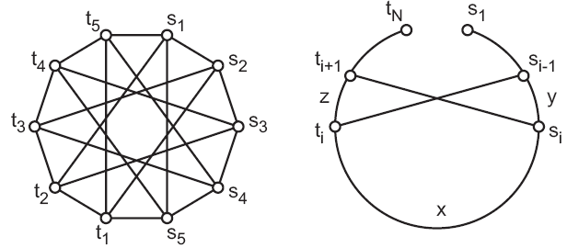
General Connection Games (Cont’)
How far is the best NE from the OPT?
How far is the OPT form NE?
  Lower Bounds for approximate Nash:
    For any ε> 0, there is a game such that any equilibrium which purchases the optimal network is at least a (3/2−ε)-approximate Nash equilibrium.

Slide 18
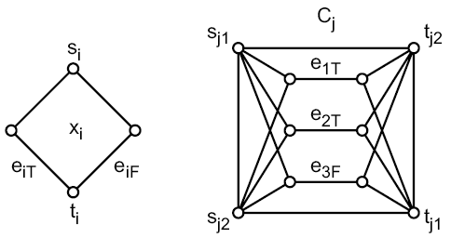
NP-Completeness
Determining the existence of Nash equilibria is NP-complete, if the number of players is O(n).
  Proof by reduction from 3-SAT.

Slide 19
NP-Completeness (Cont’)
Two player game:
  Each player has only two terminals
  Existence of NE in this game can be solved by enumerating possible NE structures.
    Two disjoint paths
    Two paths with merge-nodes {u,v}

Slide 20
Thank you!

