Slide 1
Sharing the Cost of Multicast Transmissions
COMP670O — Game Theoretic Applications in CS
Course Presentation
Joan Feigenbaum
Christos H. Papadimitriou
Scott Shenker
Conference version:
STOC 2000
Journal version:
JCSS 2001
Presented by: Yan Zhang
May 12, 2006
HKUST

Slide 2
Outline
Problem Definition
Requirements of Mechanisms
  Budget-balance
  Efficiency (Social Welfare)
Shapley-value Mechanism
  Budget-balance, but not efficient
Marginal-cost Mechanism (VCG Mechanism)
  Efficient, but not Budget-balance
Computation for Marginal-cost Mechanism
Main Part of the Presentation

Slide 3
Reference
Herve Moulin, Scott Shenker.
Strategyproof Sharing of Submodular Costs: Budget Balance versus Efficiency.
Economic Theory, 18(3): 511-533, 2001.
Joan Feigenbaum, Christos H. Papadimitriou, Scott Shenker.
Sharing the Cost of Multicast Transmissions.
Journal of Computer and System Sciences, 63(1): 21-41, 2001.
Tim Roughgarden, Mukund Sundararajan.
New Trade-Offs in Cost-Sharing Mechanisms.
STOC 2006: 38th Annual ACM Symposium on Theory of Computing, (to appear).

Slide 4
Outline
Problem Definition
Requirements of Mechanisms
  Budget-balance
  Efficiency (Social Welfare)
Shapley-value Mechanism
  Budget-balance, but not efficient
Marginal-cost Mechanism (VCG Mechanism)
  Efficient, but not Budget-balance
Computation for Marginal-cost Mechanism

Slide 5
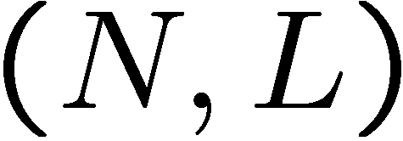
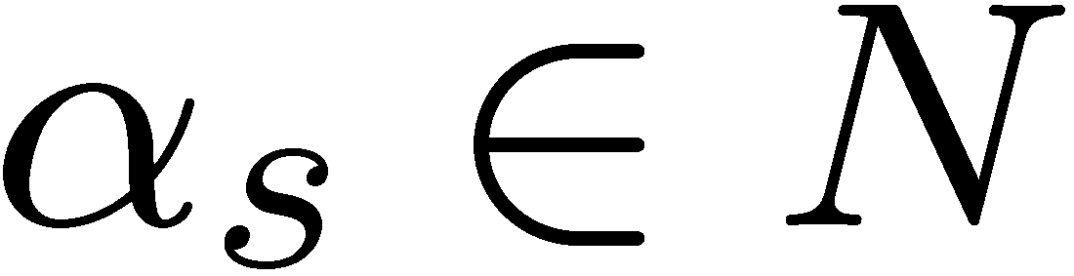



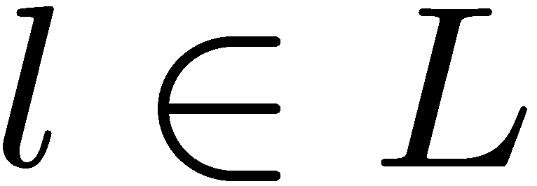
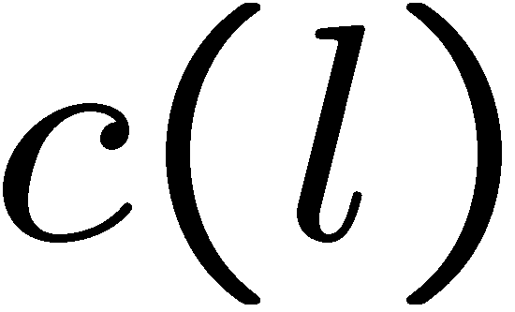
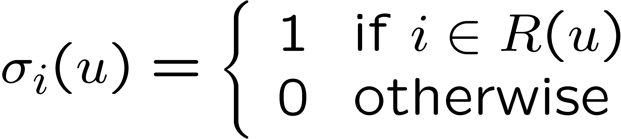


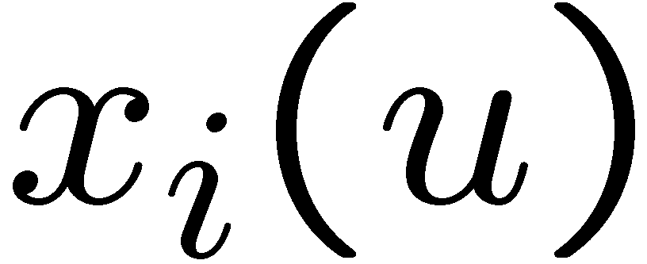
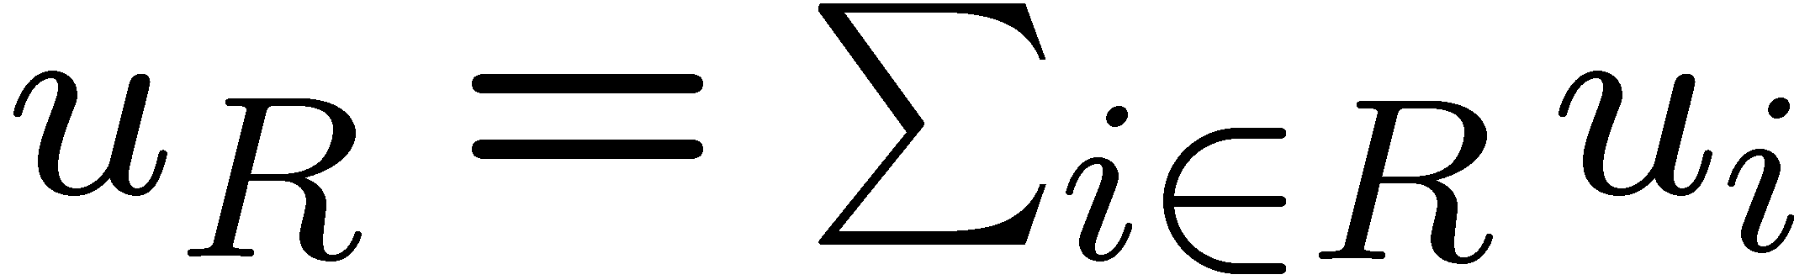
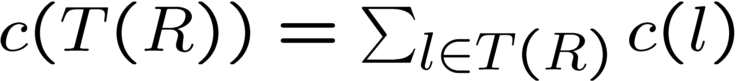

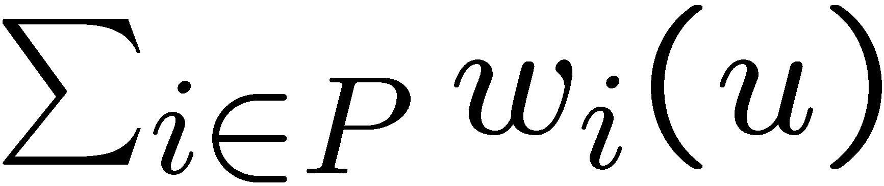
Problem Definition
Fixed-tree Multicast (compared to “Steiner-tree Multicast” [Jain, Vazirani, STOC 2001])
  Tree network: , Source:
  Set of users (Players):
  Each user has a utility (Private information)
  Each link has a cost (Public information, but need communications for non-adjacent nodes to know.)
Goal — “Mechanism”
  The receiver set: ,
  Multicast tree:
  For each user , compute the charge
  Individual welfare:
Social Welfare:
  where and .
  , not necessarily .

Slide 6
Outline
Problem Definition
Requirements of Mechanisms
  Budget-balance
  Efficiency (Social Welfare)
Shapley-value Mechanism
  Budget-balance, but not efficient
Marginal-cost Mechanism (VCG Mechanism)
  Efficient, but not Budget-balance
Computation for Marginal-cost Mechanism

Slide 7
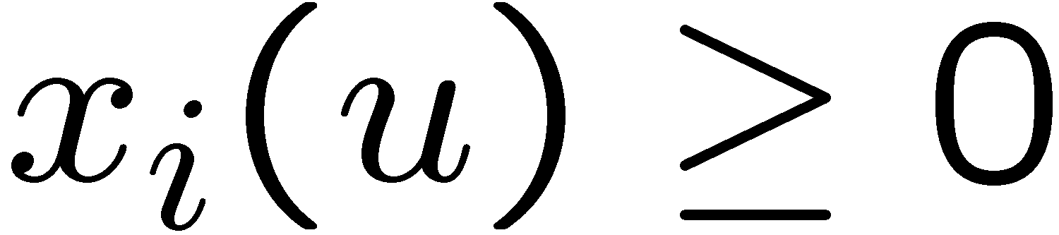
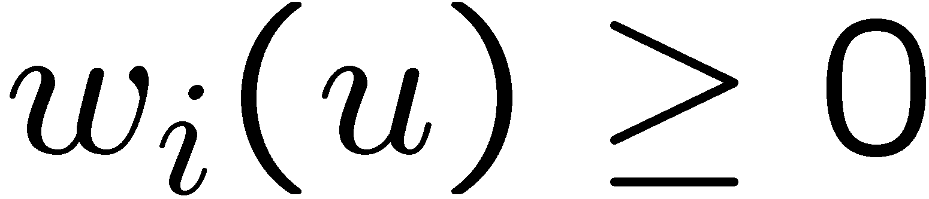
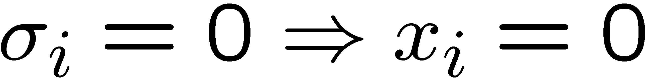
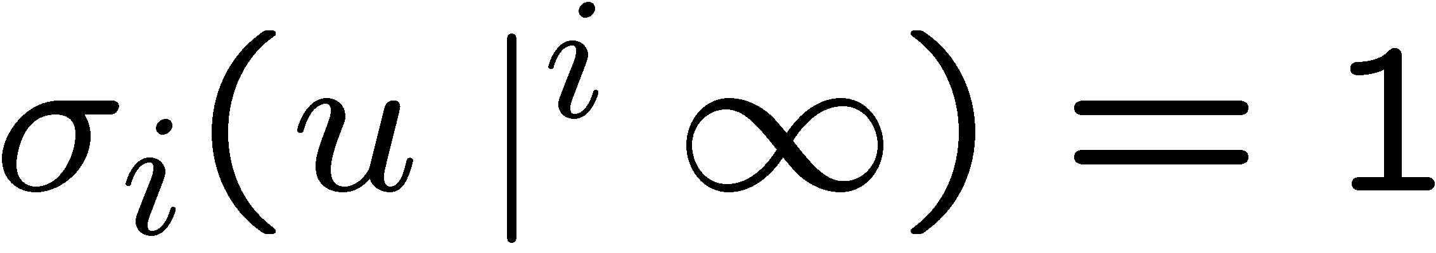
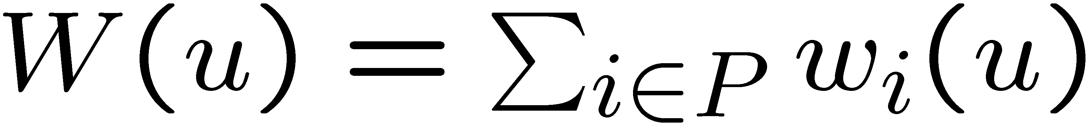
Requirements of Mechanisms
“Strategyproof” — Truthful:
Basic requirements
  No Positive Transfer (NPT):
  Voluntary Participation (VP): ( )
  Consumer Sovereignty (CS):
Main requirements
  Budget-balance:
  (If Budget-balance, )
  Efficiency:
  (i.e., Maximize Social-welfare)

Slide 8
On the Requirements
[Moulin, Shenker, 2001]
There is no mechanism that is
(1) strategyproof,
(2) budget-balanced, and
(3) efficient.
  Unfortunately, doing something absolutely good for the society is always bad for the individuals.

Slide 9
On the Requirements
Marginal-cost Mechanism (VCG)
  Strategyproof [OK]
  No Positive Transfer (NPT) [OK]
  Voluntary Participation (VP) [OK]
  Consumer Sovereignty (CS) [OK]
  Budget-balance [Can be arbitrarily bad, total charge can be zero]
  Efficiency [OK]
[Moulin, Shenker, 2001]
The Marginal-cost mechanism is the only one that is (1) strategyproof, (2) NPT, (3) VP, and (4) efficient.

Slide 10
On the Requirements
Shapley-value Mechanism
  Strategyproof [OK]
  No Positive Transfer (NPT) [OK]
  Voluntary Participation (VP) [OK]
  Consumer Sovereignty (CS) [OK]
  Budget-balance [OK]
  Efficiency [Bad, but not too bad in some sense …]

Slide 11

On the Requirements
Group Strategyproof:
  No group of users can increase their welfares by lying.
[Moulin, Shenker, 2001]
Of all the mechanisms that is (1) group strategyproof, (2) NPT, (3) VP, (4) CS, and (5) budget-balanced, the Sharpley-value mechanism minimize the worst-case efficiency loss:
[Roughgarden, Sundararajan, 2006]
Of all the mechanisms that is (1) group strategyproof, (2) NPT, (3) VP, (4) CS, and (5) budget-balanced, the Sharpley-value mechanism minimize the worst-case efficiency ratio:

Slide 12
Outline
Problem Definition
Requirements of Mechanisms
  Budget-balance
  Efficiency (Social Welfare)
Shapley-value Mechanism
  Budget-balance, but not efficient
Marginal-cost Mechanism (VCG Mechanism)
  Efficient, but not Budget-balance
Computation for Marginal-cost Mechanism

Slide 13
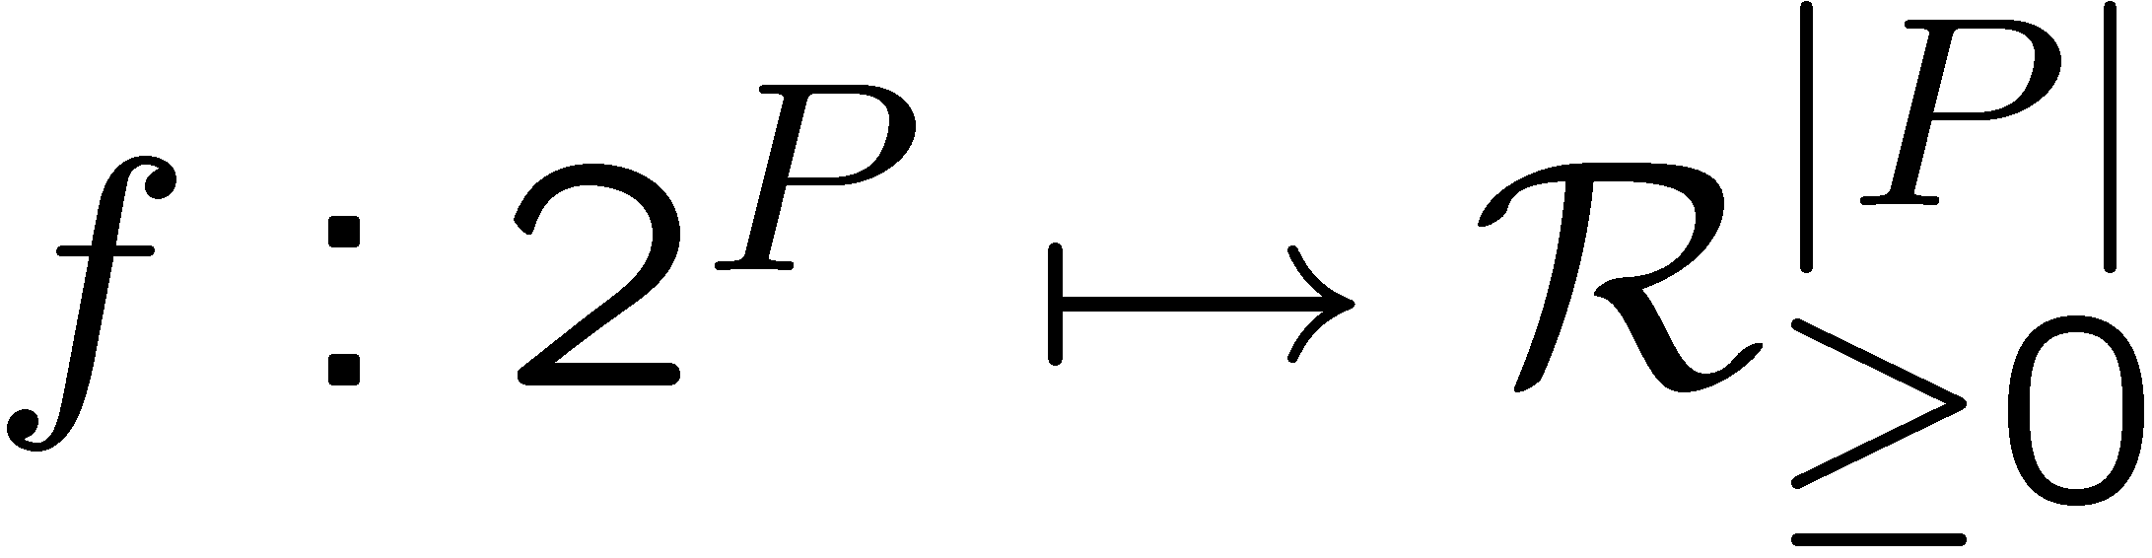

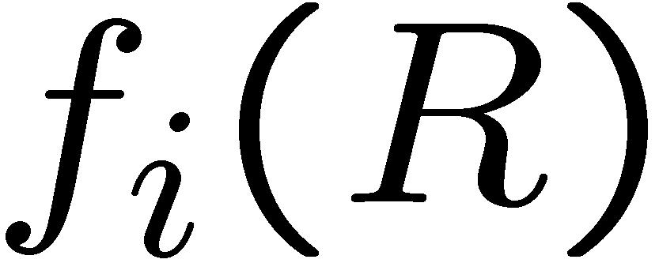


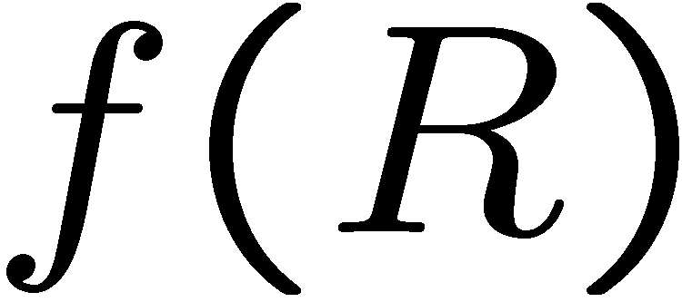
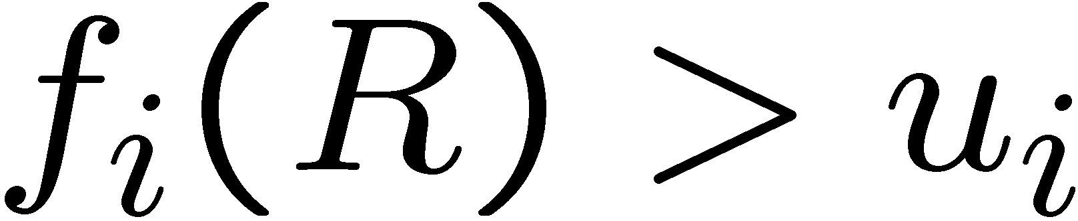
Shapley-value Mechanism
[Moulin, Shenker, 2001]
All the mechanisms that is (1) group strategyproof, (2) NPT, (3) VP, (4) CS, and (5) budget-balanced, is a Moulin Mechanism.
Moulin Mechanism
  Define a charge function:
  such that
  If the receiver set is known, then charge from user .
  Iteratively decide as follows:
    Initially,
    Repeat
    Compute
    If , remove from
    Until does not change

Slide 14

Shapley-value Mechanism
Shapley-value Mechanism is a Moulin Mechanism.
  is defined such that the cost of a link is equally shared by all receivers who use the link.

Slide 15
Outline
Problem Definition
Requirements of Mechanisms
  Budget-balance
  Efficiency (Social Welfare)
Shapley-value Mechanism
  Budget-balance, but not efficient
Marginal-cost Mechanism (VCG Mechanism)
  Efficient, but not Budget-balance
Computation for Marginal-cost Mechanism

Slide 16
Marginal-Cost Mechanism
General scheme for VCG Mechanism
  Step 1: define “social welfare”.
  Step 2: find the set of player that optimize the social welfare.
  Step 3: compute the optimal social welfare when a player join the game, and when he does not join the game.
  Step 4: the player should be charged such that his individual welfare is the increase he brings to the social welfare.

Slide 17
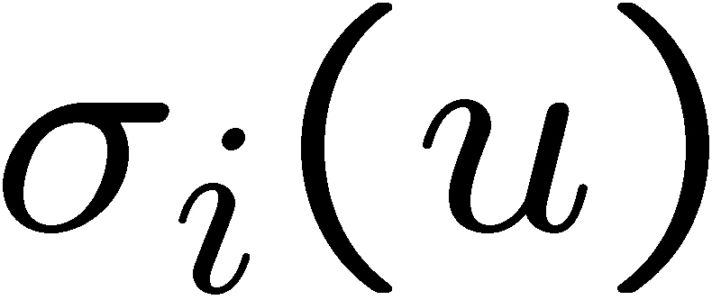
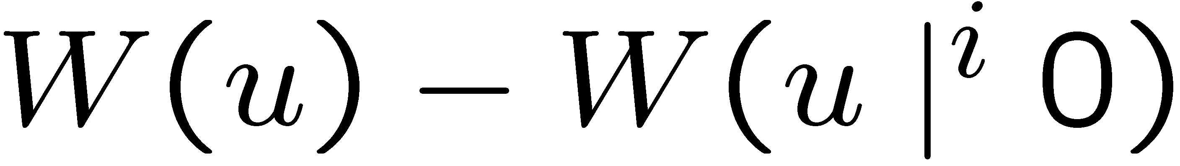
Marginal-Cost Mechanism
For the Fixed-tree Multicast Problem
  Step 1: define “social welfare”.
  Step 2: find the set of player that optimize the social welfare.
    Compute
  Step 3: compute the difference of optimal social welfare when a player join the game, and when he does not join the game.
    Compute
  Step 4: the player should be charged such that his individual welfare is the increase he brings to the social welfare.
    The charge

Slide 18
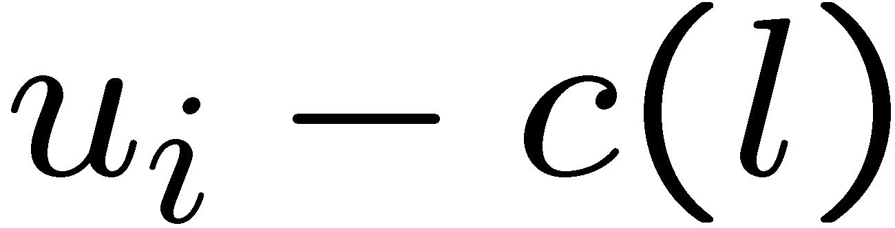
An Example
Assume the parent of already has flow.
Then if join, the increase in the social welfare is .
So, is charged .

Slide 19
Outline
Problem Definition
Requirements of Mechanisms
  Budget-balance
  Efficiency (Social Welfare)
Shapley-value Mechanism
  Budget-balance, but not efficient
Marginal-cost Mechanism (VCG Mechanism)
  Efficient, but not Budget-balance
Computation for Marginal-cost Mechanism

Slide 20

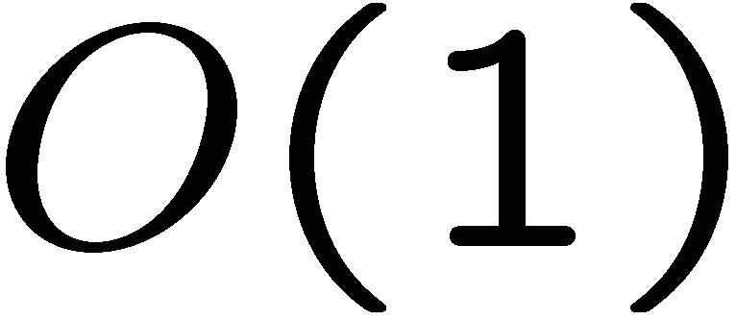
Communication Cost
Ideal Goal
  Total communication cost:
  Communication on each edge:
Both of them will be satisfied by the algorithm for Marginal-cost Mechanism.

Slide 21
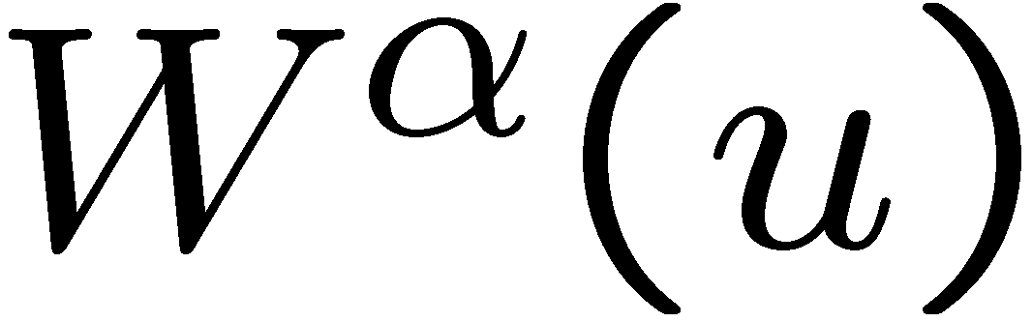

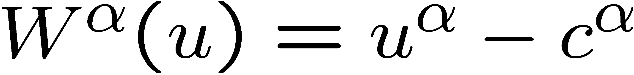

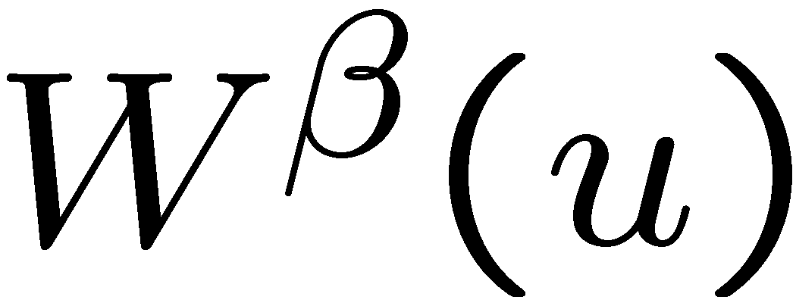

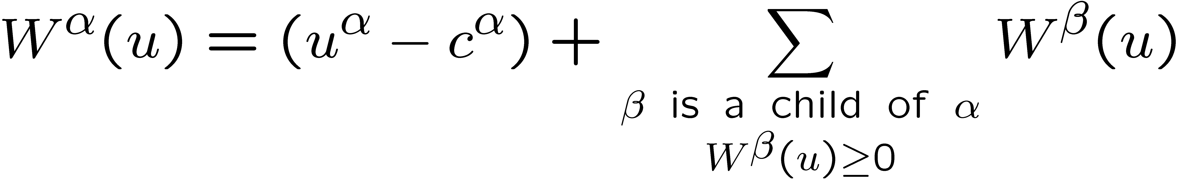
The Algorithm
Step 1: Compute the receiver set
  Bottom-up traversal (DFS is enough)
  Denote by the maximum increase of social welfare if the subtree rooted at joins the game and does receives.
  If is a leaf, , where is the cost of the link from to its parent.
  If is an internal node, we can assume the values of for all that is a child of is present, then

Slide 22
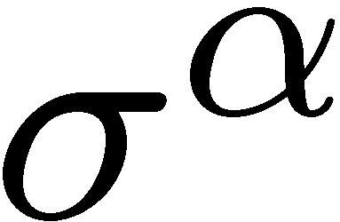
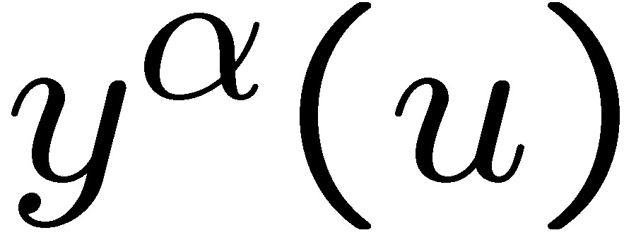
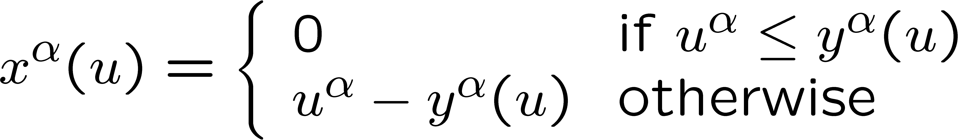
The Algorithm
Step 2: Compute the charge
  Top-down traversal (also DFS)
  Along with the information, the parent of also send another information to : , which is the smallest over all nodes on the path from to the root (including ).
  It turns out

Slide 23
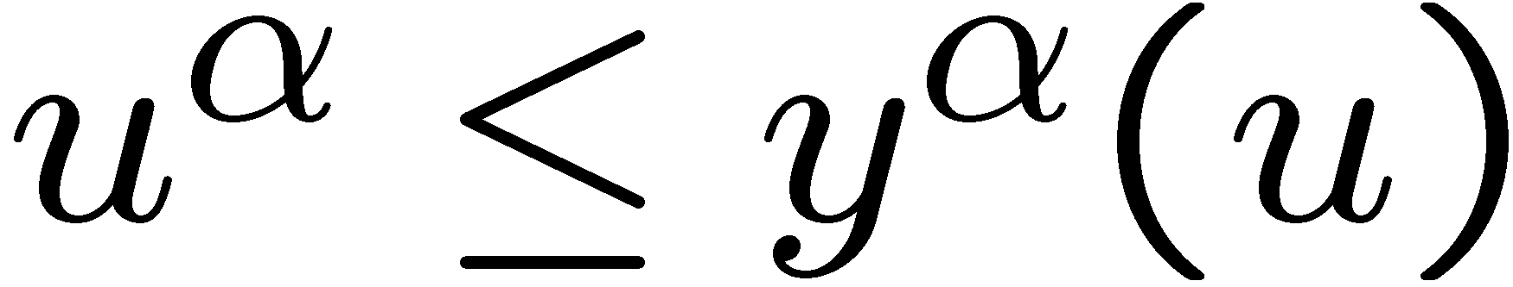
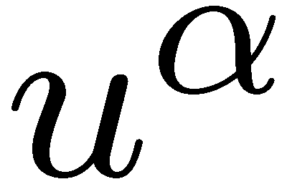
Proof
If
  If leaves the game, all from to the root decreases
  , hence the total welfare decreases , and the multicast tree does not change.
  So, .

Slide 24
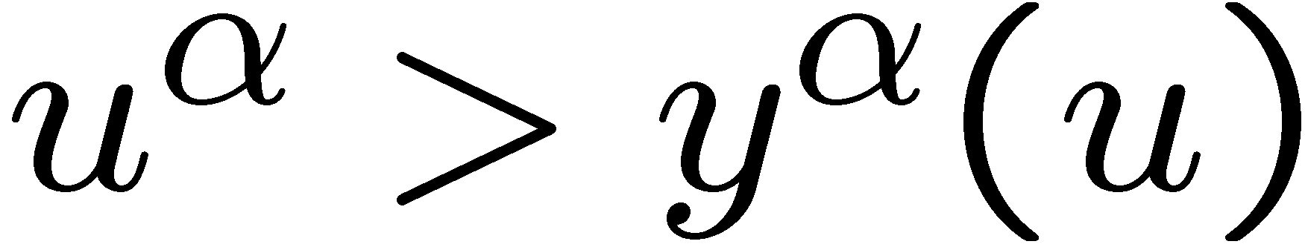

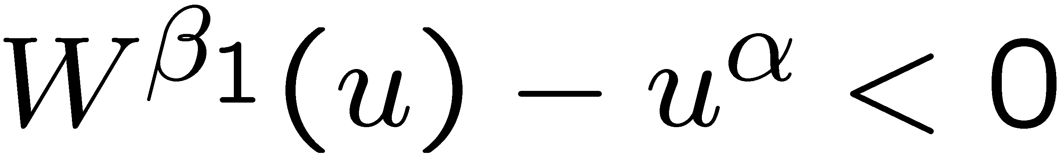
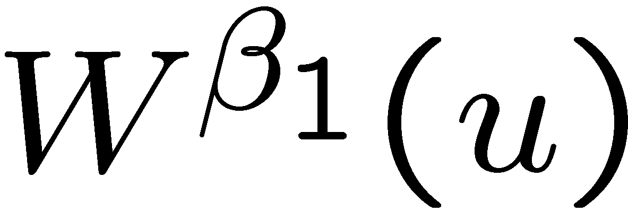
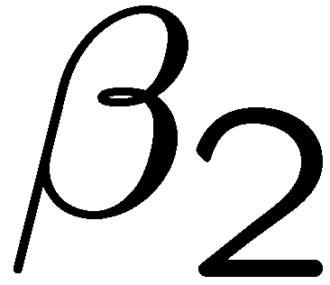
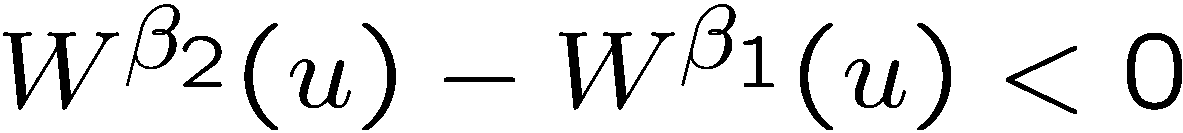
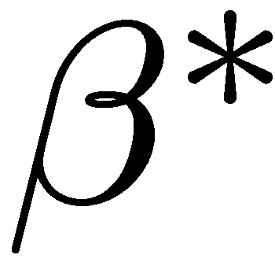
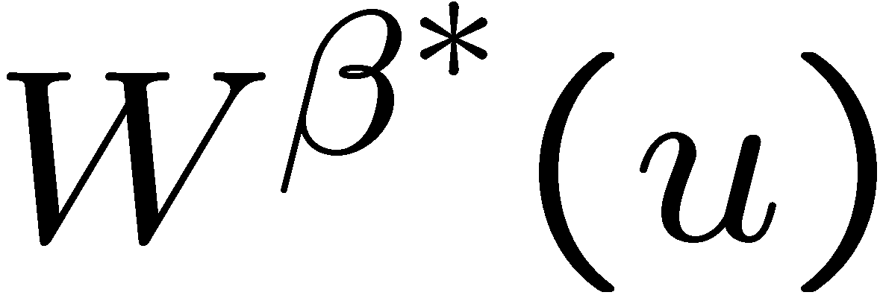
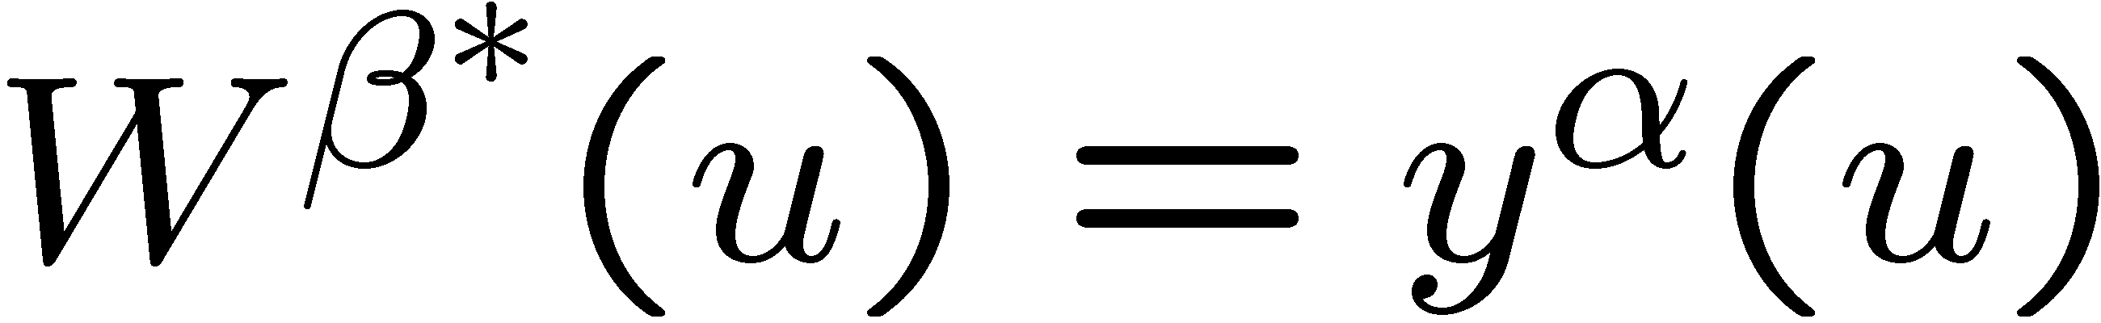
Proof
If
  Consider leaves the game, and we repeat the bottom-up step on the path from to the root.
  All values of decreases , until we find some such that .
  Then from to the root, all values of decreases until we find such that .
  This process continues until we reach the with smallest value of on the path from to the root. Then all nodes from to the root decreases .
  So, the social welfare decreases .

