Slide 1
Vickrey Prices and Shortest Paths: What is an edge worth?
COMP670O — Game Theoretic Applications in CS_x000b_Course Presentation
John Hershberger, Subhash Suri
FOCS 2001
Presented by: Yan Zhang
March 22, 2006
HKUST

Slide 2






Problem Overview
1. An undirected graph
(Known to everybody)
2. Source , Destination
(Known to everybody)
3. Cost of an edge
The ”absolute fair” payment for using the edge,
including all kinds of expense and appropriate profit.
— The “Truth”
— If the payment is greater than the cost, it is unfair to the customer
— If the payment is less than the cost, it is unfair to the owner of the edge
(Known only to the owner of the edge)
The problem: We want to route using the lease cost path, and pay the true cost,
but the owners may not tell us the true cost.

Slide 3
Problem Overview
The problem: We want to route using the lease cost path, and pay the true cost,
but the owners may not tell us the true cost.
Goal: Design a “mechanism”, such that the owners will tell the true cost.
— Truthful Mechanism
Notes about truthful mechanisms:
— It says that we can know the true cost, and “that is all”, which means …
— The mechanism may not choose the least cost path.
(Actually the truthful mechanism in this paper does.)
— The mechanism may not pay the true cost.
(Actually the truthful mechanism in this paper overpays.)

Slide 4

Truthful Mechanism
1. – Player Game
: the number of edges
2. Strategy of a player: the cost of the edge to tell (not necessarily the true cost)
The strategy space can be continuous, we may just treat it as discrete.
3. “Mechanism”: the payoff function
4. Truthful mechanism:
A mechanism such that telling the true cost is the dominant strategy
for every player.

Slide 5
Dominant Strategy
Truthful mechanism:
A mechanism such that telling the true cost is the dominant strategy
for every player.
Dominant strategy:
A strategy that is always a best one regardless whatever other players’
strategies are.
Example: “Prisoners Dilemma”
Dominant strategy
for Player 2
Player 2
Player 1
(3,3) | (0,4)
(4,0) | (1,1)
Dominant strategy
for Player 1

Slide 6
Dominant Strategy
Truthful mechanism:
A mechanism such that telling the true cost is the dominant strategy.
“Prisoners Dilemma”:
Dominant strategy
for Player 2
Player 2
Player 1
(3,3) | (0,4)
(4,0) | (1,1)
Dominant strategy
for Player 1
Belief: Selfish players always choose dominant strategies.
Note: In practice, players may not always choose (1,1).

Slide 7
VCG Mechanism
VCG Mechanism — A truthful mechanism
William Vickrey.
Counterspeculation, Auctions, and Competitive Sealed Tenders.
The Journal of Finance, 16(1): 8-37, 1961.
Edward H. Clarke.
Multipart Pricing of Public Goods.
Public Choice, 11(1): 17-33, 1971.
Theodore Groves.
Incentives in Teams.
Econometrica, 41(4): 617-631, 1973.

Slide 8

VCG Mechanism
Shortest path without using edge e
How much
can I lie?
Shortest path
Maximum cost e can lie
= Shortest path without using edge e
– Costs of other edges on the shortest path
= (3 + 4) – 1 = 6
It is OK as long as I am on the shortest path
Exactly the VCG mechanism will pay

Slide 9
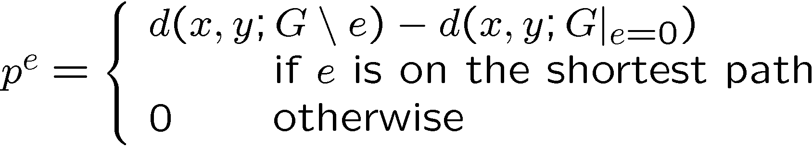
VCG Mechanism
Payoff of edge e (e is on the shortest path)
= Maximum cost e can lie
= Shortest path without using edge e
– Costs of other edges on the shortest path
Graph without
edge e
Graph where
cost of e is zero

Slide 10



VCG is Truthful
Edge (e): If I am on the
shortest path, do I have a
reason to lie?
VCG Payment
1. It is useless to decrease.
True
Cost
2. It is useless to increase
just a little bit.
3. It can only be worse if
increase too much.

Slide 11
VCG is Truthful
Edge (e): If I am not on the
shortest path, do I have a
reason to lie?
True
Cost
1. Increasing the cost can
only benefit others.
lied
payoff if lied
2. To decrease, the payoff
cannot even compensate
my cost.

Slide 12





Return to this paper
How to compute the Vickrey price?
Straightforward approach:
At most Single Source Shortest Path (SSSP) computation
— Compute : 1 SSSP
— For each edge in , compute : SSSP
Running time:
This paper improves to:

Slide 13







Basic Idea
Fix an edge on
Cut
Consider
An – cut, or a cut:
Observation:
For any cut
Note: 1. can be any cut, it may not contains . (In this paper, they do.)
2. and may cross arbitrary times.

Slide 14




Basic Idea
Basic idea: Find a cut for each , such that
1. for each
for each
2. The difference between and can be computed efficiently.
Structure of the paper:
Special case: includes all vertices.
Part 1 is easy to satisfy, and the main purpose is to illustrate part 2.
General case:
Main purpose is to satisfy part 1, part 2 is the same as the special case.

Slide 15










Special Case
includes all vertices.
The cut is such that
1. for each
— Obvious
for each
2. The difference between and can be computed efficiently.

Slide 16







Special Case
The difference between and
1. It will not affect edges that does
not adjacent to
2. The edges whose right ends is
will be removed.
3. The edges whose left ends is
will be added.
So,

Slide 17




Special Case
Naïve implementation: A priority queue (Initially empty, maximum elements)
Each edge corresponds to an element
Running time:
Insertion:
Deletion:
GetMin:

Slide 18


Special Case
Clever implementation: A priority queue (Initially infinity elements, finally empty)
Each vertex represents all edges whose right endpoint is .
Running time:
Make heap:
DecreaseKey:
Deletion:
GetMin:

Slide 19
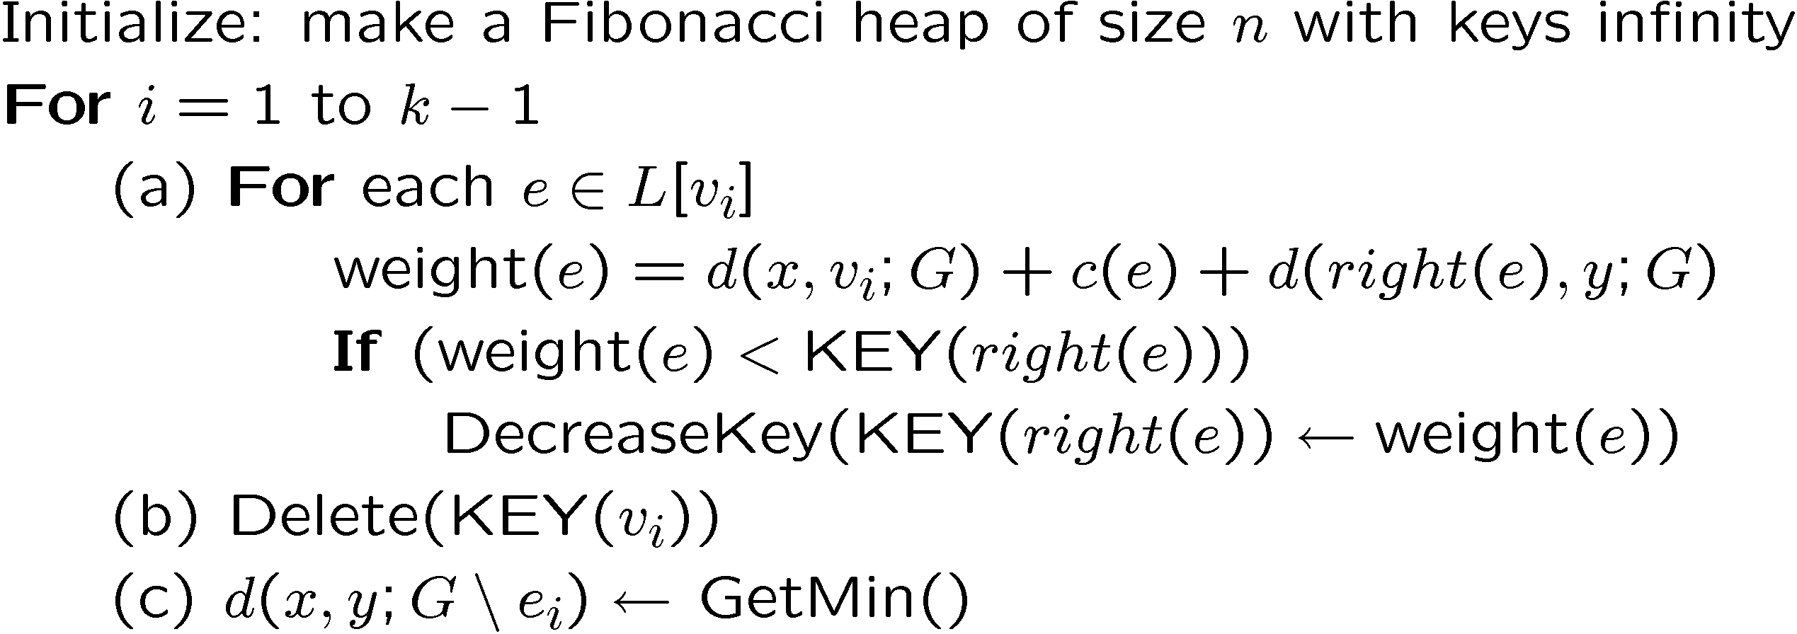
Special Case
Pseudo code:

Slide 20
General Case
An undirected graph:
Basic idea: Find a cut for each , such that
1. for each
for each
2. The difference between and can be computed efficiently.
— The same as the special case.

Slide 21






General Case
1. for each
for each
Construct the shortest path
tree from :
is the cut induced by
removing from .
For each
Observation:
The sub-tree in is the shortest path tree from
The shortest path from to any vertex lies entirely in

Slide 22


General Case
To do: for each
Is that possible that
crosses from to ?
No, the shortest path from to
lies entirely in
Observation:
The shortest path from to any vertex lies entirely in

Slide 23
General Case
To do: for each
Is that possible that
crosses from to ?
No, the shortest path from to
lies entirely in
Observation:
The shortest path from to any vertex lies entirely in

Slide 24


Directed Graph
John Hershberger, Subhash Suri, Amit Bhosle.
On the Difficulty of Some Shortest Path Problems.
STACS 2003, Pages 343-354.
Lower Bound: , when

Slide 25
Thank you
March 22, 2006

