Slide 1
Rational Learning Leads to Nash Equilibrium
Ehud Kalai and Ehud Lehrer
Econometrica, Vol. 61 No. 5 (Sep 1993), 1019-1045
Presented by Vincent Mak (wsvmak@ust.hk)
for Comp670O, Game Theoretic Applications in CS,
Spring 2006, HKUST

Slide 2
Introduction
How do players learn to reach Nash equilibrium in a repeated game, or do they?
Experiments show that they sometimes do, but hope to find general theory of learning
Hope to allow for wide range of learning processes and identify minimal conditions for convergence
Fudenberg and Kreps (1988), Milgrom and Roberts (1991) etc.
The present paper is another attack on the problem
Companion paper: Kalai and Lehrer (1993), Econometrica, Vol. 61, 1231-1240

Slide 3


Model
n players, infinitely repeated game
The stage game (i.e. game at each round) is normal form and consists of:
  n finite sets of actions, Σ₁ , Σ₂ , Σ₃ … Σ_{n} with
  denoting the set of action combinations
  2. n payoff functions u_{i} : Σ →
Perfect monitoring: players are fully informed about all realised past action combinations at each stage

Slide 4
Model
Denote as H_{t} the set of histories up to round t and thus of length t, t = 0, 1, 2, … i.e. H_{t} = Σ ^{t} and Σ⁰ = {Ø}
Behaviour strategy of player i is f_{i} : U_{t} H_{t} → Δ(Σ_{i} ) i.e. a mapping from every possible finite history to a mixed stage game strategy of i
Thus f_{i} (Ø) is the i ’s first round mixed strategy
Denote by z^{t} = (z₁^{t} , z₂^{t} , … ) the realised action combination at round t, giving payoff u_{i} (z^{t}) to player i at that round
The infinite vector (z¹, z², …) is the realised play path of the game

Slide 5
Model
Behaviour strategy vector f = (f₁ , f₂ , … ) induces a probability distribution μ_{f} on the set of play paths, defined inductively for finite paths:
μ_{f} (Ø) = 1 for Ø denoting the null history
μ_{f} (ha) = μ_{f} (h) x_{i} f_{i}(h)(a_{i}) = probability of observing history h followed by action vector a consisting of a_{i} s, actions selected by i s

Slide 6
Model
In the limit of Σ ∞, the finite play path h needs be replaced by cylinder set C(h) consisting of all elements in the infinite play path set with initial segment h; then f induces μ_{f} (C(h))
Let F _{t} denote the σ-algebra generated by the cylinder sets of histories of length t, and F the smallest σ-algebra containing all of F _{t} s
μ_{f} defined on (Σ ∞, F ) is the unique extension of μ_{f} from F _{t} to F

Slide 7
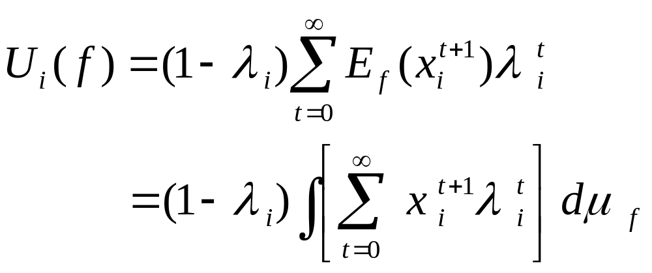
Model
Let λ_{i} є (0,1) be the discount factor of player i ; let x_{i}^{t} = i ’s payoff at round t. If the behaviour strategy vector f is played, then the payoff of i in the repeated game is

Slide 8
Model
For each player i, in addition to her own behaviour strategy f_{i} , she has a belief f ^{i} = (f_{i}¹ , f_{i}² , … f_{i}^{n}) of the joint behaviour strategies of all players, with f_{i}^{i} = f_{i} (i.e. i knows her own strategy correctly)
f_{i} is an ε best response to f_{-i} ^{i} (combination of behaviour strategies from all players other than i as believed by i ) if U_{i} (f_{-i} ^{i} , b_{i} ) - U_{i} (f_{-i} ^{i} , f_{i} ) ≤ ε for all behaviour strategies b_{i} of player I, ε ≥ 0. ε = 0 corresponds to the usual notion of best response

Slide 9
Model
Consider behaviour strategy vectors f and g inducing probability measures μ_{f} and μ_{g}
μ_{f} is absolutely continuous with respect to μ_{g} , denoted as μ_{f} << μ_{g} , if for all measurable sets A, μ_{f} (A) > 0 ➔ μ_{g} (A) > 0
Call f << f ^{i} if μ_{f} << μ_{f}^{i}
Major assumption:
If μ_{f} is the probability for realised play paths and μ_{f}^{i} is the probability for play paths as believed by player i, μ << μ_{f}^{i}

Slide 10
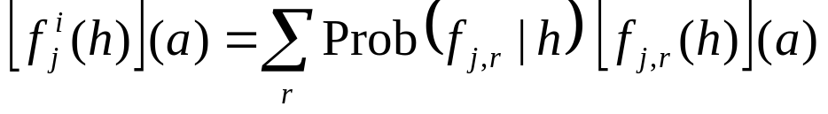
Kuhn’s Theorem
Player i may hold probabilistic beliefs of what behaviour strategies j ≠ i may use (i assumes other players choose strategies independently)
Suppose i believes that j plays behaviour strategy f_{j,r} with probability p_{r} (r is an index for elements of the support of j ’s possible behaviour strategies according to i ’s belief)
Kuhn’s equivalent behaviour strategy f_{j}^{i} is:
where the conditional probability is calculated according to i ’s prior beliefs, i.e. p_{r} , for all the r s in the support – a Bayesian updating process, important throughout the paper

Slide 11
Definitions
Definition 1: Let ε > 0 and let μ and μ be two probability measures defined on the same space. μ is ε-close to μ if there exists measurable set Q such that:
1. μ(Q) and μ(Q) are greater than 1- ε
2. For every measurable subset A of Q,
(1-ε) μ(A) ≤ μ(A) ≤ (1+ε) μ(A)
-- A stronger notion of closeness than
|μ(A) - μ(A)| ≤ ε

Slide 12
Definitions
Definition 2: Let ε ≥ 0. The behaviour strategy vector f plays ε-like g if μ_{f} is ε-close to μ_{g}
Definition 3: Let f be a behaviour strategy vector, t denote a time period and h a history of length t . Denote by hh’ the concatenation of h with h’ , a history of length r (say) to form a history of length t + r. The induced strategy f_{h} is defined as f_{h} (h’ ) = f (hh’ )

Slide 13
Main Results: Theorem 1
Theorem 1: Let f and f ^{i} denote the real behaviour strategy vector and that believed by i respectively. Assume f << f ^{i} . Then for every ε > 0 and almost every play path z according to μ_{f} , there is a time T (= T(z, ε)) such that for all t ≥ T, f_{z(t)} plays ε-like f_{z(t)}^{i}
Note the induced μ for f_{z(t)} etc. are obtained by Bayesian updating
“Almost every” means convergence of belief and reality only happens for the realisable play paths according to f

Slide 14
Subjective equilibrium
Definition 4: A behaviour strategy vector g is a subjective ε-equilibrium if there is a matrix of behaviour strategies (g_{j}^{i} )_{1≤i,j≤n} with g_{j}^{i} = g_{j} such that
i) g_{j} is a best response to g_{-i}^{i} for all i = 1,2 …n
ii) g plays ε-like g^{j} for all i = 1,2 …n
ε = 0 ➔ subjective equilibrium; but μ_{g} is not necessarily identical to μ_{g}^{i} off the realisable play paths and the equilibrium is not necessarily identical to Nash equilibrium (e.g. one-person multi-arm bandit game)

Slide 15
Main Results: Corollary 1
Corollary 1: Let f and {f ^{i} } denote the real behaviour strategy vector and that believed by i respectively, for i = 1,2... n. Suppose that, for every i :
  i) f_{j}^{i} = f_{j} is a best response to f_{-i}^{i}
  ii) f << f ^{i}
  Then for every ε > 0 and almost every play path z according to μ_{f} , there is a time T (= T(z, ε)) such that for all t ≥ T, {f_{z(t)}^{i} , i = 1,2…n} is a subjective ε-equilibrium
This corollary is a direct result of Theorem 1

Slide 16
Main Results: Proposition 1
Proposition 1: For every ε > 0 there is η > 0 such that if g is a subjective η-equilibrium then there exists f such that:
i) g plays ε-like f
ii) f is an ε-Nash equilibrium
Proved in the companion paper, Kalai and Lehrer (1993)

Slide 17
Main Results: Theorem 2
Theorem 2: Let f and {f ^{i} } denote the real behaviour strategy vector and that believed by i respectively, for i = 1,2... n. Suppose that, for every i :
  i) f_{j}^{i} = f_{j} is a best response to f_{-i}^{i}
  ii) f << f ^{i}
Then for every ε > 0 and almost every play path z according to μ_{f} , there is a time T (= T(z, ε)) such that for all t ≥ T, there exists an ε-Nash equilibrium f of the repeated game satisfying f_{z(t)} plays ε-like f
This theorem is a direct result of Corollary 1 and Proposition 1

Slide 18
Alternative to Theorem 2
Alternative, weaker definition of closeness: for ε > 0 and positive integer l, μ is (ε,l)-close to μ if for every history h of length l or less, |μ(h)-μ(h)| ≤ ε
f plays (ε,l)-close to g if μ_{f} is (ε,l)-close to μ_{g}
“Playing ε the same up to a horizon of l periods”
With results from Kalai and Lehrer (1993), can replace last part of Theorem 2 by:
… Then for every ε > 0 and a positive integer l, there is a time T (= T(z, ε, l)) such that for all t ≥ T, there exists a Nash equilibrium f of the repeated game satisfying f_{z(t)} plays (ε,l)-like f

Slide 19
Theorem 3
Define information partition series {P _{t} }_{t} as increasing sequence (i.e. P _{t+1} refines P _{t} ) of finite or countable partitions of a state space Ω (with elements ω ); agent knows the partition element P_{t}(ω) є P_{t} she is in at time t but not the exact state ω
Assume Ω has σ-algebra F that is the smallest that contains all elements of {P _{t} }_{t} ; let F _{t} be the σ-algebra generated by P _{t}
Theorem 3: Let μ << μ. With μ-probability 1, for every ε > 0 there is a random time t(ε) such that for all r ≥ r(ε), μ (.|P_{r}(ω)) is ε-close to μ (.|P_{r}(ω))
Essentially the same as Theorem 1 in context

Slide 20
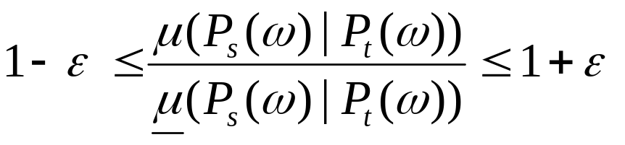
Proposition 2
Proposition 2: Let μ << μ. With μ-probability 1, for every ε > 0 there is a random time t (ε) such that for all s ≥ t ≥ t (ε),
Proved by applying Radon-Nikodym theorem and Levy’s theorem
This proposition satisfies part of the definition of closeness that is needed for Theorem 3

Slide 21
Lemma 1
Let { W_{t} } be an increasing sequence of events satisfying μ(W_{t} )↑ 1. For every ε > 0 there is a random time t (ε) such that any random t ≥ t (ε) satisfies
μ { ω; μ(W_{t} | P_{t} (ω)) ≥ 1- ε} = 1
With W_{t} = {ω ; | E(φ|F _{s} )(ω)/ E(φ|F _{t} )(ω)-1|< ε for all s ≥ t }, Lemma 1 together with Proposition 2 imply Theorem 3

