Slide 1
COMP 171
Data Structures and Algorithms
Tutorial 5
Heapsort

Slide 2
Heapsort
Array A is from 0 to n-1
For particular A[i]:
  Left(i) = 2i + 1
  A[Left(i)] is the left child of A[i]
  Right(i) = 2i + 2
  A[Right(i)] is the right child of A[i]
  Parent(i) = ⎣ (i-1)/2 ⎦
  A[Parent(i)] is the parent of A[i]

Slide 3
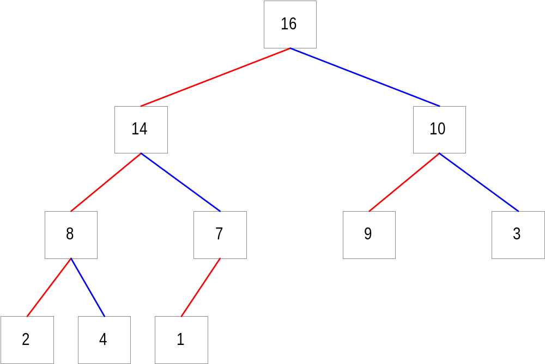
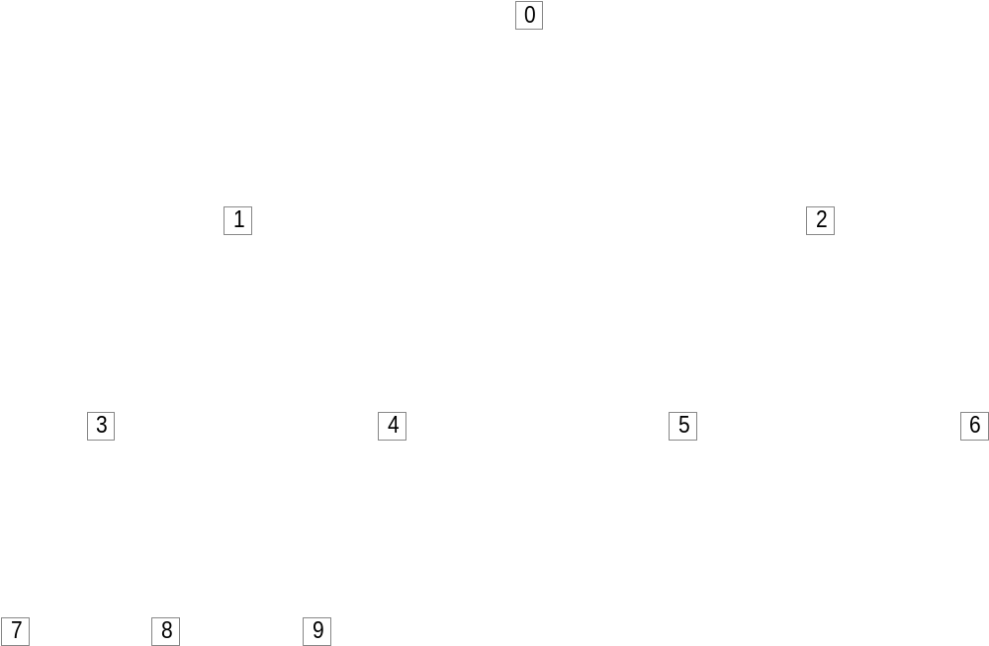
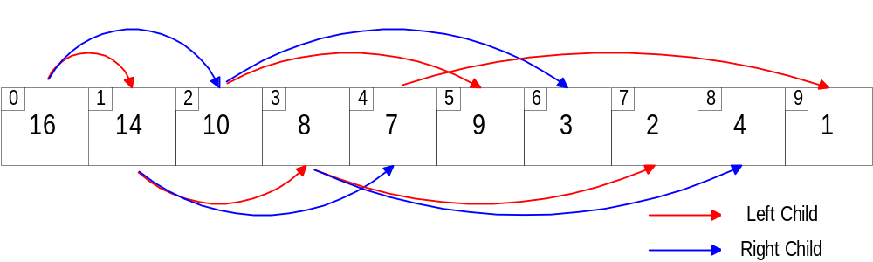

Slide 4
Max-heap property
  ∀ i, if i≠root, A[i] ≦A[Parent(i)]
  The root stores the largest value
Min-heap property
  ∀ i, if i≠root, A[i] ≧A[Parent(i)]
  The root stores the smallest value
Max or Min Heap?
  {16, 14, 10, 8, 7, 9, 3, 2, 4, 1}
  {1, 2, 4, 3, 9, 7, 8, 10, 14, 16}
  Reverse of max-heap array = min-heap array?

Slide 5
BuildMaxHeap(A)
HeapSize = SizeOf(A)
for i ← ⎣ HeapSize/2 ⎦ -1 downto 0
MaxHeapify(A, i)
end for i
end BuildMaxHeap
Why ⎣ HeapSize/2 ⎦ -1

Slide 6
MaxHeapify(A, i)
l ← Left(i)
r ← Right(i)
largest ← i
if l < HeapSize and A[l] > A[largest] then
largest ← l
end if
if r < HeapSize and A[r] > A[largest] then
largest ← r
end if
if largest ≠ i then
swap(A[i], A[largest])
MaxHeapify(A, largest)
end if
end MaxHeapify

Slide 7
Heapsort(A)
BuildMaxHeap(A)
for i ← HeapSize-1 to 1
swap(A[0], A[i])
HeapSize = HeapSize – 1
MaxHeapify(A, 0)
end for i
end Heapsort
Running timeΟ(n㏒n)
A = {17, 2, 54, 66, 61, 65, 72, 11, 40, 75}
Heapsort(A)

