Slide 1
COMP171 Data Structure & Algorithm
Tutorial 1
TA: M.Y.Chan

Slide 2
Outline of Today’s Tutorial
Objective
Introduction to C++
Function
Pointer
Class
Summary

Slide 3
Objective of tutorials
To acquire adequate programming knowledge for the coming assignments
To be able to turn ideas into codes
Programming in C++ (VC++ in Windows environment)
I assume that most of you do not have any experience in programming. I will start from those fundamental knowledge.

Slide 4
Objective of tutorials
Attendance will not be counted towards your final score of the course, but you are strongly encourage to attend.
Guidance and hints are provided for assignments and test preparation
If you have any question, please post it on the newsgroup or approach to the TAs.

Slide 5
TA of COMP171
Chan Ming-yuen pazuchan@ust.hk 4204
Yihai SHEN shenyh@cs.ust.hk
He Junfeng hejf@cs.ust.hk 4204

Slide 6
What’s C++
A programming language
Data abstraction
Object-oriented programming
Generic programming
Compiler translate C++ codes to a machine specific executable program (eg. VC++ in Windows)

Slide 7
Ideas to codes
The art of programming
From problems to solutions
Problem solving technique
Programming technique and style
How to develop a program
Use of various tools to help programming
Practice makes perfect

Slide 8
How to create a Program
Specify the problem – eg. Remove ambiguity and identify constraints
Develop algorithms and design classes (OOP)
Implementation – design, coding, debug.
Documentation, testing, maintenance of programs.

Slide 9
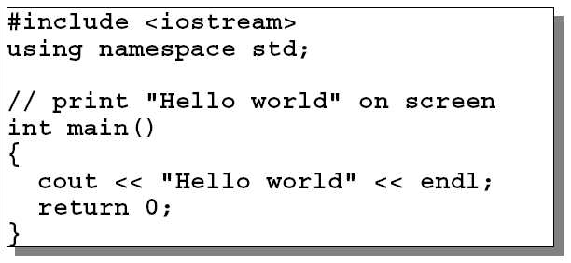
Hello World
Example: a “Hello World” program

Slide 10
Hello World
#include statement makes libraries of classes & functions accessible to the program
Compile needs access to interface, what the functions look like, but not the implementation.
Documentation – comments on codes increase the readability. Cost of maintenance is always higher than that of development.

Slide 11
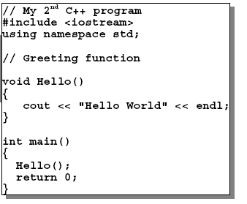
A More General C++ program

Slide 12
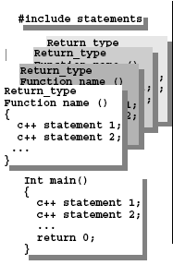
Functions
Reason: functions are abstractions that help you to reuse ideas and codes – make the code clearer, more logical and comprehensible

Slide 13
Functions
function prototyping: a description of the types of arguments when declaring and defining a function
void funct(float x, float y, float z);
Of course, you can choose not to have any arguments, void funct(void)

Slide 14
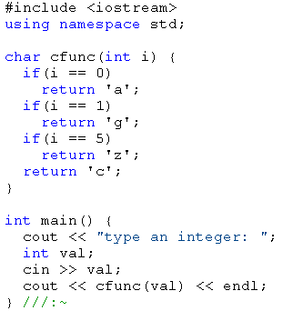
Functions
Return values
Example →

Slide 15
Execution and Flow
Execution of C++ program is organized around statements
Statements execute sequentially
Or governed by control that repeats a group of statement (loop). Eg. For, while..
Or selected one of several groups to execute. (if…else)
A statement executes, it cause other statements to execute (function calls)

Slide 16
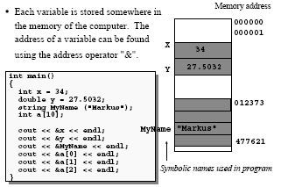
Pointers & Dynamic Data

Slide 17
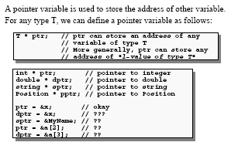
Pointer Variable

Slide 18
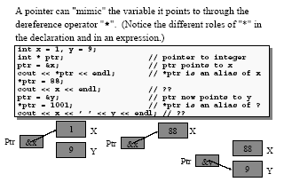
Dereference Operator

Slide 19
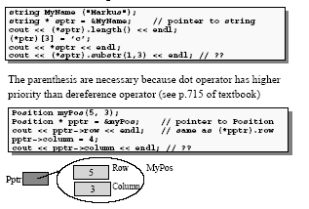
More Example

Slide 20
Pointer & Array
Pointer and array are closely related in C++
We can use a pointer to access the elements of an array

Slide 21
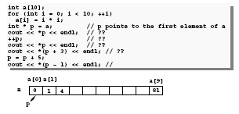
Pointer & array

Slide 22
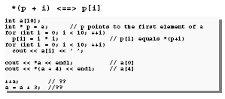
Pointer & Array

Slide 23
Pointers & Constants
When using a pointer, two objects are involved: the pointer itself and the object pointed to.
Consider the difference between pointer to constant, constant pointer and constant pointer to constant

Slide 24
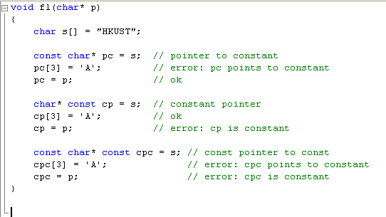
Pointers & Constants

Slide 25

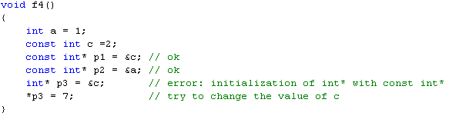
Pointers and Constants
Besides, the address of a constant cannot be assigned to an unrestricted pointer

Slide 26
References
A reference is an alternative name for an object.
The notation X& means reference to X
Different from the previous ‘&’ which indicates the address

Slide 27
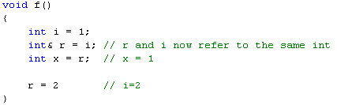
References
Example

Slide 28

Reference
To ensure that a reference is a name for something, the reference must be initialized
Example

Slide 29
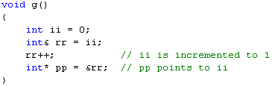
References
Another example
Note that rr++ does not increment the reference rr (comparing with pointer),
rather, it is applied to an int that happens to be ii

Slide 30
Reference
Value of a reference cannot be changed after initialization
Similar to a constant pointer (but cannot be manipulated the way that a pointer is)
In the previous case, pp is a pointer and rr is a reference to ii

Slide 31
Function Revisited
Usually, arguments are passed to function as input for manipulation
Knowledge on pointers and references can be employed
The manner that parameters are passed to the function can lead to different results

Slide 32
Parameter Passing
Different ways to pass parameters into a function
Pass-by-value, pass-by-address, and pass-by reference
Ordinarily, arguments are passed by value to a function – a copy of the argument is made inside the function

Slide 33
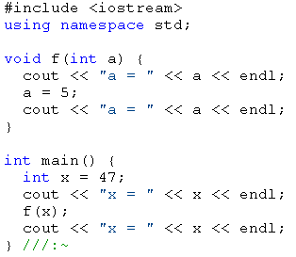

Pass-by-value

Slide 34
Pass-by-address
A pointer is passed instead of a value
Pointer acts as an alias to an outside object
Any changes to the alias in the function will be reflect to “outside” object

Slide 35
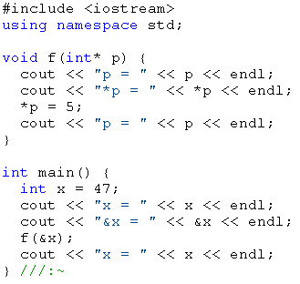
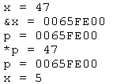
Pass-by-address

Slide 36
Pass-by-reference
C++ provide another way to pass an address into a function – reference
Similar to pass-by-address
The effect of the reference is that it actually takes the address and passes it in, rather than making a copy of the value

Slide 37
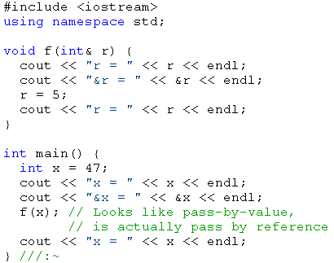
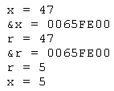
Pass-by-reference

Slide 38
Class
A tool for creating new types
Conveniently used as if the built-in type, but user-defined
Derived classes and templates – related classes are organized in a specific way according to their relationships
Remember: Class is an abstraction of a group of objects, while an object is an instance of the class

Slide 39
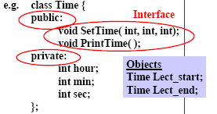
Class

Slide 40
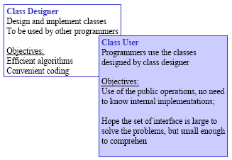
Class

Slide 41
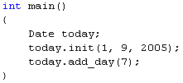
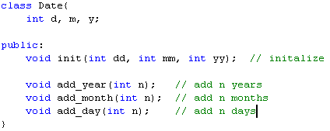
Class – Member Functions
Functions declared within a class definition
Invoked only for a specific variable of the appropriate type

Slide 42
Class – Constructor
A special function for the initialization of class objects
It has the same name as the class itself
Default or user-defined constructors

Slide 43
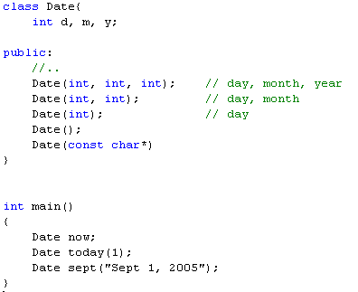
Class - Constructor

Slide 44
Class – Access Control
Three keywords/categories: public, private and protected
public means all member declarations that follow are available to everyone
The private keyword, means that no one can access that member except you, the creator of the type, inside function members of that type

Slide 45
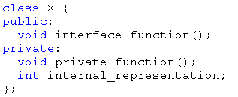
Class – Access Control
Protected acts just like Private, except that it allow the inherited class to gain access.
Example

Slide 46
Summary
Topics covered in this tutorial: Function, Class, Pointer, Reference, etc
For more details, please refer to your lecture notes ,texture book and references
Of course, I am looking forward to having your feedback on the tutorials (for example, Is there any interesting problem that you want me to address in the tutorial)

