Slide 1
COMP171 Data Structures and Algorithm
Tutorial 2
TA: M.Y.Chan

Slide 2
A few words…
Materials will be posted on the course homepage before the tutorials
Please have a glance before the tutorials
Please interrupt me if I’ve gone too fast
Please don’t hesitate to ask questions in the tutorials

Slide 3
Today’s Outline
A short revision (10 minutes)
More on Class (15 minutes)
Simple dynamic list (15 minutes)
Recursion (40 minutes)
Break (10 minutes)
Template (10 minutes)
Coding conventions (10 minutes)

Slide 4
A Short Revision
Question on Pointer:
What is printed by the following program?
void PrintEquality(bool isEqual) {
if (isEqual) cout << "Yes" << endl;
else cout << "No" << endl;
}
int main(){
int * * p = new int * (new int(4));
int * q = *p;
*q = 5;
PrintEquality(p == &q);
PrintEquality(*p == q);
PrintEquality(**p == *q);
}
Easy question – you should be
able to answer this within 2min

Slide 5
A Short Revision
The answer is:
1) No 2) Yes 3) Yes
But why?

Slide 6
More on Class
From requirement to Implementation
Example: a Dice class
State & behavior
State: depends on the physical properties
Behavior: what the class does

Slide 7
More on Class
This header file is an interface to the class. It describe the behavior
of the class, but not on how it is implemented
Class Dice{
Public:
Dice(int sides); // constructor
int Roll(); // return the random roll
int NumSides() const // how many sides this dies has
Private:
int myRollCount; // time die rolled
int mySides; // sides on die
}
Behavior = public member function
State = private data

Slide 8
More on Class
Header file provide information that programmers need to know to call a function & compiler can verify the correctness of the function call
Implementation file (.cpp files) contains the details about implementation (function bodies)

Slide 9
More on Class
#include “dice.h”
#include “randgen.h”
// implementation of dice class
Dice::Dice(int sides)
// postcondition: all private fields initialized
{
myRollCount = 0;
mySide = sides;
}
Int Dice::Roll()
// postcondition: number of rolls updated
// random ‘die’ roll returned
{
RandGen gen; // random number generator
myRollCount = myRollCount + 1; // update # of times die rolled
return gen.RandInt(1,mySides); // in range [1.. mySide]
}

Slide 10
More on Class
Int Dice::NumSides() const
// postcondition: return # of sides of die
{
return mySides;
}
Int Dice:: NumRolls() const
// postcondition: return # of times die has been rolled
{
return myRollCount;
}

Slide 11
More on Class
Create object by constructor
Eg. Dice cube(6), Dice Dodeca(12)
Dice (int sides)
Int Roll()
Int NumSides() const
Int NumRolls() const
________________
myRollCount
mySides
Dice (int sides)
Int Roll()
Int NumSides() const
Int NumRolls() const
________________
myRollCount
mySides
Behavior
Behavior
Public
Public
Private
0
State
Private
0
State
6
12
Cube(6)
Dodeca(12)

Slide 12
More on Class
Accessor functions – access the states but do not alter the state
E.g. NumSides(), NumRolls()
Always come with the keyword “const”
Mutator functions – alter the state
E.g. Roll()
Tips: All state or instance variables in a class
should be private

Slide 13
More on Class
Inherit from other classes (base classes & derived classes)
Allow easy software reuse (instead of re-inventing the wheels)
Eg. extending the features of string such that it supports the "tokenizing“ feature (chop the string into words).
Additional features:
void Tokenize(); −−− chop the string into words
int argSize(); −−−−− returns no. of words
string arg(int k); −−−− returns the kth words

Slide 14
More on Class
Expected behaviors:
myString input;
getline(cin, input);
input.Tokenize();
for (int i = 0; i < input.argSize(); ++i)
cout << input.arg(i) << endl;

Slide 15
More on Class
Base Class
Derived Class
class myString : public string {
public:
void Tokenize();
int argSize();
string arg(int k);
private:
vector<string> arglist;
}
void myString::Tokenize() {
istrstream s ( c_str() );
string temp;
while (s >> temp)
arglist.push_back(temp);
}
int myString::argSize() {
return arglist.size();
}
string myString::arg(int k) {
return arglist[k];
}
Inherits from string class and
behaves like a string
Additional member functions
Additional data member
c_str() is a member function
of string that returns a "string
literal“ version of itself.
Note that myString inherits
all the features of string; i.e., it
can be used just like an ordinary
string

Slide 16
A Simple Dynamic List Example
cout << "Enter list size: ";
int n;
cin >> n;
int *A = new int[n];
if(n<=0){
cout << "bad size" << endl;
return 0;
}
initialize(A, n, 0); // initialize the array A with value 0
print(A, n);
A = addElement(A,n,5); //add an element of value 5 at the end of A
print(A, n);
A = deleteFirst(A,n); // delete the first element from A
print(A, n);
selectionSort(A, n); // sort the array (not shown)
print(A, n);
delete [] A;

Slide 17
Initialize
void initialize(int list[], int size, int value){
for(int i=0; i<size; i++)
list[i] = value;
}

Slide 18
print()
  void print(int list[], int size) {
  cout << "[ ";
  for(int i=0; i<size; i++)
  cout << list[i] << " ";
  cout << "]" << endl;
  }

Slide 19
Adding Elements
// for adding a new element to end of array
int* addElement(int list[], int& size, int value){
int* newList = new int [size+1]; // make new array
if(newList==0){
cout << "Memory allocation error for addElement!" << endl;
exit(-1);
}
for(int i=0; i<size; i++)
newList[i] = list[i];
if(size) delete [] list;
newList[size] = value;
size++;
return newList;
}

Slide 20
Delete the first element
// for deleting the first element of the array
int* deleteFirst(int list[], int& size){
if(size <= 1){
if( size) delete list;
size = 0;
return NULL;
}
int* newList = new int [size-1]; // make new array
if(newList==0){
cout << "Memory allocation error for deleteFirst!" << endl;
exit(-1);
}
for(int i=0; i<size-1; i++) // copy and delete old array
newList[i] = list[i+1];
delete [] list;
size--;
return newList;
}

Slide 21
Adding Element (version 2)
// for adding a new element to end of array
void addElement( int * & list, int & size, const int value ){
int * newList = new int [size + 1];
if( newList == NULL ){
cout << "Memory allocation error for addElement!" << endl;
exit(-1);
}
for( int i = 0; i < size; i++ )
newList[ i ] = list[ i ];
if( size ) delete [] list;
newList[ size ] = value;
size++;
list = newList;
return;
}

Slide 22
Deleting Element (version 2)
void deleteFirst( int * & list, int & size ){
if( size <= 1 ){
if( size )
delete list;
list = NULL;
size = 0;
return;
}
delete list; // delete the first element
list++;
size--;
return;
}

Slide 23
Another Main program
int main(){
int * A = NULL;
int size = 0;
int i;
for( i = 0; i < 10; i++ )
addElement( A, size, i );
for( i = 0; i < 10; i++ )
cout << A[i] << " ";
cout << endl;
for( i = 0; i < 4; i++ )
deleteFirst( A, size );
for( i = 0; i < 6; i++ )
cout << A[i] << " ";
cout << endl;
return 0;
}
0 1 2 3 4 5 6 7 8 9
4 5 6 7 8 9

Slide 24
Recursion
Recursion is an indispensable tool in programmer’s toolkit
It allow many complex problems to be solved simply
Elegance and understanding in code often leads to better programs: easy to modify, extend and verify

Slide 25
Recursion
Idea: to get help solving a problem from “coworkers” (clones) who work and act like you do
Ask clone to solve a simpler (smaller) but similar problem
Use clone’s result to put together your answer
Need both concepts: call on the clone and use the result

Slide 26
Recursive function design principle
Recursive functions have two key attributes
There is a base case, which does not make a recursive call
All other cases make a recursive call, with some parameter or other measure that decreases or moves towards the base case
Ensure that sequence of calls eventually reaches the base case (converge)
"Measure" can be tricky, but usually it’s straightforward

Slide 27
Recursive function design principle
int recur_fn(parameters){
if(stopping condition)
return stopping value;
// other stopping conditions if needed
return function of recur_fn(revised parameters)
}
Note: you can have more than one stopping condition and additional task can be done before or after the invocation of clone

Slide 28
Recursion
Theoretically speaking, you can replace all the for- and while- loops by recursions
However, it may not be the most efficient solution

Slide 29
Recursion
Example 1: How to print words entered, but in reverse order?
Possible solution: we can use a array to store all the words and print in reverse order.
The array is probably the best approach, but recursion works too…

Slide 30
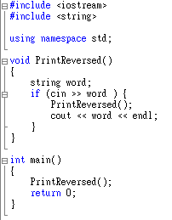
Recursion
Explanation: Deploy the task to the coworker. Ask the clone to deliver the result first and we print the current word later.

Slide 31
Recursion
Sometime recursion is not appropriate, when it is bad, it can be very bad – every tool requires knowledge and experience in how to use it
Example: Fibonacci numbers

Slide 32
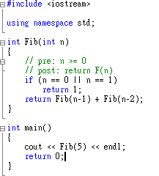
Recursion
Example 2: Fibonacci numbers (discussed in the lecture)
How many clone/calls to compute Fib(5)?

Slide 33
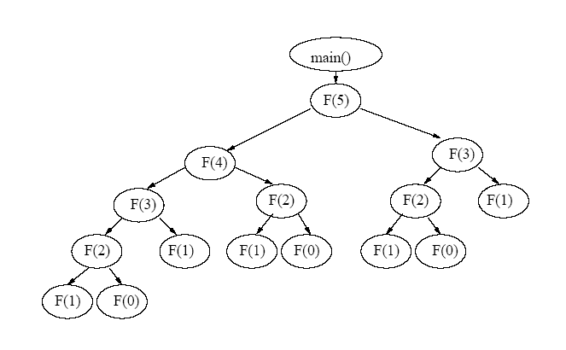
Recursion
Answer: 15
A Huge number of function invocations result in overhead and memory usage
Iterative approach is preferred

Slide 34
Break
10 minutes break
Remember to come back !! Don’t escape from this tutorials !! Thanks

Slide 35
Recursion
Recursion is not that bad !!!!!
Can you still remember the example of Exponential fun ?
int exp(int numb, int power){
if(power ==0)
return 1;
return numb * exp(numb, power -1);
}

Slide 36
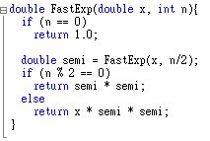
Recursion
Is it the best? …
How about this

Slide 37
Recursion
Much faster than the previous solution
How about iterative method?
The power of recursion !!!
It is different from our conventional way of calculation (ie. Iterative approach)
Later, you will learn more about algorithm analysis -> how “good” the method is.
The most efficient way to do recursion is to break down the task evenly and distribute to the coworkers and significantly “decrease” the size of the task in each recursion

Slide 38
Recursion
Another example from your textbook (P.38 Ex.1.5)
Question: Write a recursive function that returns the number of 1’s in the binary representation of N. Use the fact that this is equal to the number of 1’s in the representation of N/2, plus 1, if N is odd.

Slide 39
Recursion
Consider:
Long Division
Binary representation
→ You will get some idea of the hint and know more about how to change the iterative approach to recursions

Slide 40
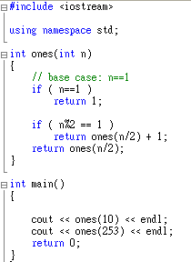
Recursion
Straight-forward
How to print the binary representation of a given integer?

Slide 41
Recursion
void print(int n)
{
// base case
if ( n==1 )
{
cout << 1;
return;
}
print(n/2);
if ( n%2 == 1 )
cout << 1;
else
cout << 0;
}

Slide 42
Recursion
You can try out the questions in your textbook
Get enough practices

Slide 43
Recursion
Sometimes you may be asked to tell the meaning of a given recursive function
What is the output of the function call f(3429)?
void f(int x)
{
if (x < 10)
cout << x;
else
{
cout << x % 10;
f( x / 10 );
}
}

Slide 44
Recursion
Another Question:
What is the value of the function call g(29039)?
int g(int x)
{
if ( x < 10 )
return 1;
else
return g( x / 10 ) + 1;
}
The question can be more complicated if it involves two different recursive
function which invoke each other recursively. Hope you will find this interesting
questions in the future, but not in the exam.

Slide 45
Template
Problem: We wrote a function for adding two integer values. However, if we want other functions for adding two values of other types, do we need to write a function for each of them?
Of course, Reinventing your source code every time doesn’t seem like a very intelligent approach with a language that touts reusability

Slide 46
Template
no longer holds a generic base class, but instead it holds an unspecified parameter.
When you use a template, the parameter is substituted by the compiler

Slide 47
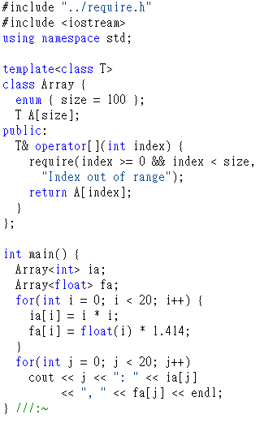
Template
Template syntax
The template keyword tells the compiler that the class definition that follows will manipulate one or more unspecified types

Slide 48
Coding Convention
Programming style
Useful link: http://www.possibility.com/Cpp/CppCodingStandard.html

