Slide 1
Analysis of Algorithms
Review
COMP171
Fall 2005
Adapted from Notes of S. Sarkar of UPenn, Skiena of Stony Brook, etc.

Slide 2
Outline
Why Does Growth Rate Matter?
Properties of the Big-Oh Notation
Logarithmic Algorithms
Polynomial and Intractable Algorithms
Compare complexity

Slide 3
Why Does Growth Rate Matter?
Complexity 10 20 30
n 0.00001 sec 0.00002 sec 0.00003 sec
n² 0.0001 sec 0.0004 sec 0.0009 sec
n³ 0.001 sec 0.008 sec 0.027 sec
n⁵ 0.1 sec 3.2 sec 24.3 sec
2^{n} 0.001 sec 1.0 sec 17.9 min
3^{n} 0.59 sec 58 min 6.5 years

Slide 4
Why Does Growth Rate Matter?
Complexity 40 50 60
n 0.00004 sec 0.00005 sec 0.00006 sec
n² 0.016 sec 0.025 sec 0.036 sec
n³ 0.064 sec 0.125 sec 0.216 sec
n⁵ 1.7 min 5.2 min 13.0 min
2^{n} 12.7 days 35.7 years 366 cent
3^{n} 3855 cent 2 x 10⁸ cent 1.3 x 10¹³ cent

Slide 5
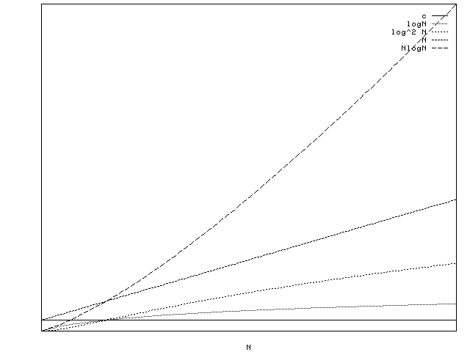

Slide 6
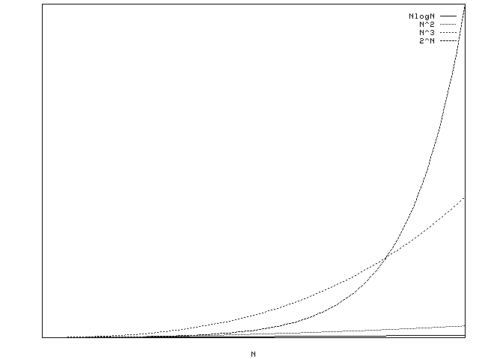

Slide 7
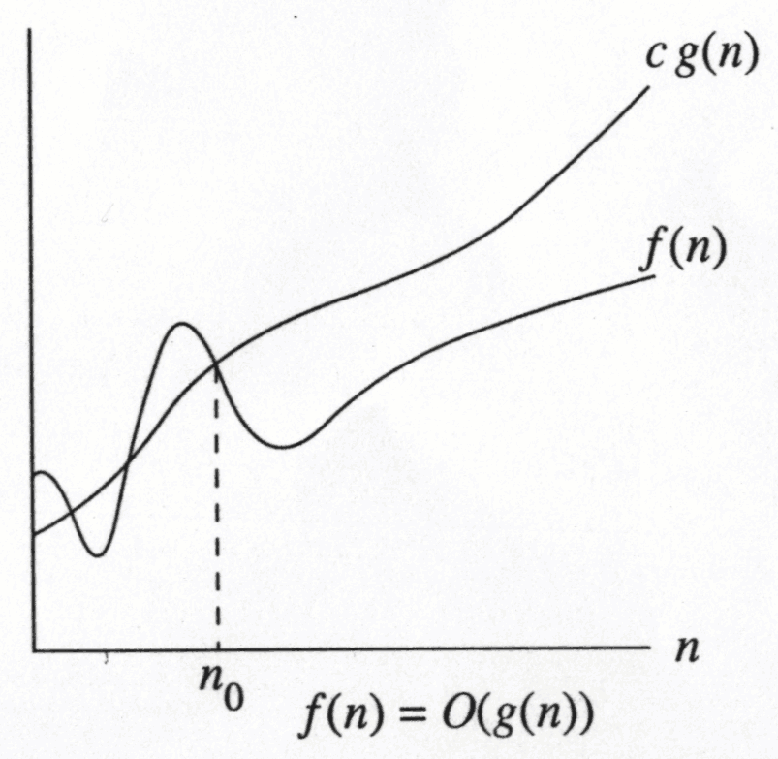
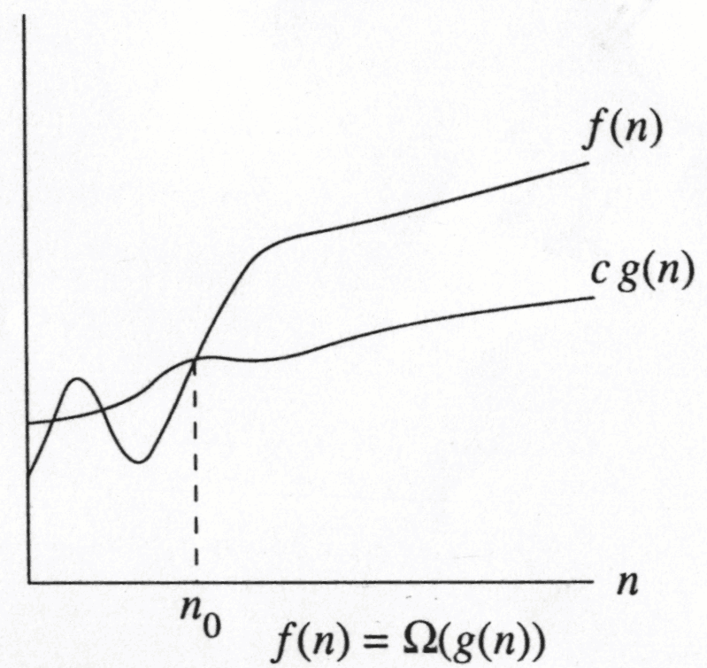
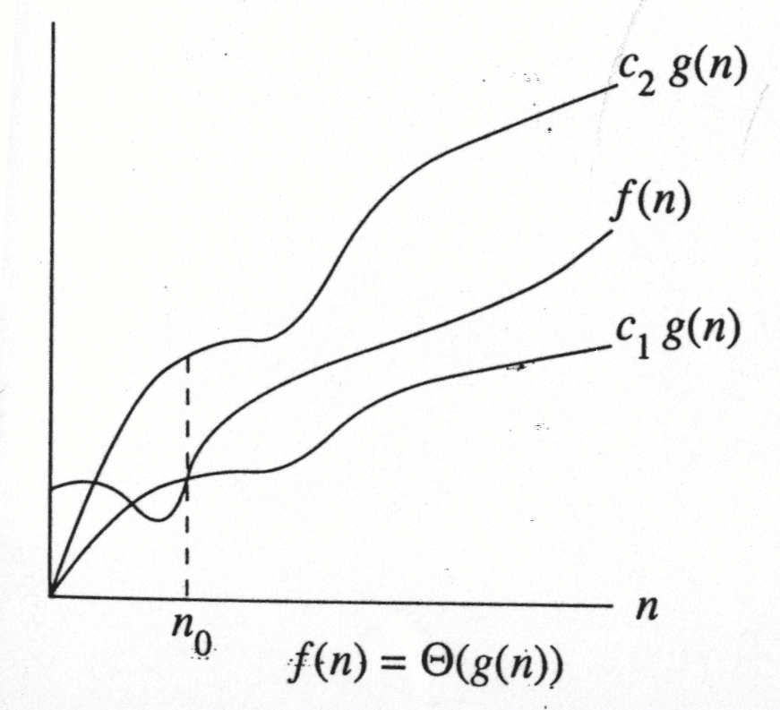
Notations
Asymptotically less than or equal to O (Big-Oh)
Asymptotically greater than or equal to Ω (Big-Omega)
Asymptotically equal to θ (Big-Theta)
Asymptotically strictly less o (Little-Oh)

Slide 8
Why is the big Oh a Big Deal?
Suppose I find two algorithms, one of which does twice as many operations in solving the same problem. I could get the same job done as fast with the slower algorithm if I buy a machine which is twice as fast.
But if my algorithm is faster by a big Oh factor - No matter how much faster you make the machine running the slow algorithm the fast-algorithm, slow machine combination will eventually beat the slow algorithm, fast machine combination.

Slide 9
Properties of the Big-Oh Notation (I)
Constant factors may be ignored:
For all k > 0, k*f is O(f ).
e.g. a*n² and b*n² are both O(n²)
Higher powers of n grow faster than lower powers:
n^{r} is O(n^{s} ) if 0 < r < s.
The growth rate of a sum of terms is the growth rate of its fastest growing term:
If f is O(g), then f + g is O(g).
e.g. a*n³ + b*n² is O(n³ ).

Slide 10
Properties of the Big-Oh Notation (II)
The growth rate of a polynomial is given by the
growth rate of its leading term
If f is a polynomial of degree d, then f is O(n^{d}).
If f grows faster than g, which grows faster than
h, then f grows faster than h
The product of upper bounds of functions gives an upper bound for the product of the functions
If f is O(g) and h is O(r), then f*h is O(g*r)
e.g. if f is O(n²) and g is O(log n), then f*g is
O(n² log n).

Slide 11
Properties of the Big-Oh Notation (III)
Exponential functions grow faster than powers:
n ^{k} is O(b ^{n} ), for all b > 1, k > 0,
e.g. n ⁴ is O(2 ^{n} ) and n ⁴ is O(exp(n)).
Logarithms grow more slowly than powers:
log _{b} n is O(n ^{k} ) for all b > 1, k > 0
e.g. log ₂ n is O(n ^{0:5} ).
All logarithms grow at the same rate:
log _{b} n is θ(log _{d} n) for all b, d > 1.

Slide 12
Properties of the Big-Oh Notation (IV)
The sum of the first n r^{th} powers grows as the
(r + 1) ^{th} power:
  1 + 2 + 3 + ……. N = N(N+1)/2 (arithmetic series)
1 + 2² + 3² +………N² = N(N + 1)(2N + 1)/6

Slide 13
Logarithms
A logarithm is an inverse exponential function
- Exponential functions grow distressingly fast
- Logarithm functions grow refreshingly show
Binary search is an example of an O(logn) algorithm
- Anything is halved on each iteration, then
you usually get O(logn)
If you have an algorithm which runs in O(logn) time, take it because it will be very fast

Slide 14
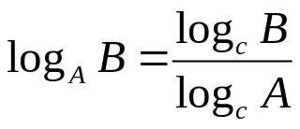
Properties of Logarithms
Asymptotically, the base of the log does not matter
log₂n = (1/log₁₀₀2) x log₁₀₀n
1/log₁₀₀2 = 6.643 is just a constant
Asymptotically, any polynomial function of n does not matter
log(n⁴⁷⁵ + n² + n + 96) = O(logn)
since n⁴⁷⁵ + n² + n + 96 = O(n⁴⁷⁵) and
log(n⁴⁷⁵⁾ = 475*logn

Slide 15
Binary Search
You have a sorted list of numbers
You need to search the list for the number
If the number exists find its position.
If the number does not exist you need to detect that

Slide 16
Binary Search with Recursion
// Searches an ordered array of integers using recursion
int bsearchr(const int data[], // input: array
int first, // input: lower bound
int last, // input: upper bound
int value // input: value to find
)// output: index if found, otherwise return –1
{ int middle = (first + last) / 2;
if (data[middle] == value)
return middle;
else if (first >= last)
return -1;
else if (value < data[middle])
return bsearchr(data, first, middle-1, value);
else
return bsearchr(data, middle+1, last, value);
}

Slide 17
Complexity Analysis
T(n) = T(n/2) + c
O(?) complexity

Slide 18
Polynomial and Intractable Algorithms
Polynomial time complexity
An algorithm is said to have polynomial time
complexity iff it is O(n^{d}) for some integer d.
Intractable Algorithms
A problem is said to be intractable if no
algorithm with polynomial time complexity is
known for it

Slide 19
Compare Complexity
Method 1:
A function f(n) is O(g(n)) if there exists a number n0 and a nonnegative c such that for all n ≥ n0 , f(n) ≤ cg(n).
Method 2:
If lim _{n→∝} f(n)/g(n) exists and is finite, then f(n) is O(g(n))!

Slide 20
kf(n) is O(f(n)) for any positive constant k
kf(n) ≤ kf(n) , for all n, k > 0
f(n) is O(g(n)), g(n) is O(h(n)), Is f(n) O(h(n)) ?
f(n) ≤ cg(n) , for some c > 0, n ≥ m
g(n) ≤ dh(n) , for some d > 0, n ≥ p
f(n) ≤ (cd)h(n) , for some cd > 0, n ≥ max(p,m)
n^{r} is O(n^{p}) if r ≤ p since lim_{n→∝} n^{r}/n^{p} = 0, if r < p
= 1 if r = p
n^{r} is O(exp(n)) for any r > 0
since lim_{n→∝} n^{r} /exp(n) = 0,

Slide 21
log n is O (n^{r}) if r > 0,
since lim_{n→∝}log(n)/ n^{r} = 0,
Is kn O(n²) ?
kn is O(n)
n is O(n²)
f(n) + g(n) is O(h(n)) if f(n), g(n) are O(h(n))
f(n) ≤ ch(n) , for some c > 0, n ≥ m
g(n) ≤ dh(n) , for some d > 0, n ≥ p
f(n) + g(n) ≤ ch(n) + dh(n) , n ≥ max(m,p)
≤ (c+d)h(n) , c + d > 0, n ≥ max(m,p)

Slide 22
T₁(n) is O(f(n)), T₂(n) is O(g(n))
  T₁(n) T₂(n) is O(f(n)g(n))
T₁(n) ≤ cf(n) , for some c > 0, n ≥ m
T₂(n) ≤ dg(n) , for some d > 0, n ≥ p
T₁(n) T₂(n) ≤ (cd)f(n)g(n) , for some cd > 0, n ≥ max(p,m)
T₁(n) is O(f(n)), T₂(n) is O(g(n))
T₁(n) + T₂(n) is O(max(f(n),g(n)))
Let h(n) = max(f(n),g(n)),
T₁(n) is O(f(n)), f(n) is O(h(n)), so T₁(n) is O(h(n)),
T₂(n) is O(g(n)), g(n) is O(h(n) ), so T₂(n) is O(h(n)),
Thus T₁(n) + T₂(n) is O(h(n))

Slide 23
Maximum Subsequence Problem
There is an array of N elements
Need to find i, j such that the sum of all elements between the ith and jth position is maximum for all such sums
Algorithm 1:
Maxsum = 0;
For (i=0; i < N; i++)
For (j=i; j < N; j++)
{ Thissum = sum of all elements between ith and jth positions;
Maxsum = max(Thissum, Maxsum);}

Slide 24
Analysis
Inner loop:
∑_{j=i}^{N-1} (j-i + 1) = (N – i + 1)(N-i)/2
Outer Loop:
∑_{i=0}^{N-1} (N – i + 1)(N-i)/2 = (N³ + 3N² + 2N)/6
Overall: O(N^3 )

Slide 25
Algorithm 2
Maxsum = 0;
For (i=0; i < N; i++)
For (Thissum=0;j=i; j < N; j++)
{ Thissum = Thissum + A[j];
Maxsum = max(Thissum, Maxsum);}
Complexity?
∑_{i=0}^{N-1} (N-i) = N² – N(N+1)/2 = (N² – N)/2
O(N² )

Slide 26
Algorithm 3: Divide and Conquer
Step 1: Break a big problem into two small sub-problems
Step 2: Solve each of them efficiently.
Step 3: Combine the sub solutions

Slide 27
Maximum subsequence sum by divide and conquer
Step 1: Divide the array into two parts: left part, right part
Max. subsequence lies completely in left, or completely in right or spans the middle.
If it spans the middle, then it includes the max subsequence in the left ending at the center and the max subsequence in the right starting from the center!

Slide 28
Example: 8 numbers in a sequence,
4 –3 5 –2 -1 2 6 -2
Max subsequence sum for first half =6 (“4, -3, 5”)
second half =8 (“2, 6”)
Max subsequence sum for first half ending at the last element is 4 (“4, -3, 5, -2”)
Max subsequence sum for sum second half starting at the first element is 7 (“-1, 2, 6”)
Max subsequence sum spanning the middle is 11?
Max subsequence spans the middle “4, -3, 5, -2, -1, 2, 6”

Slide 29
Maxsubsum(A[], left, right)
{
if left = right, maxsum = max(A[left], 0);
Center =⎣ (left + right)/2⎦
maxleftsum = Maxsubsum(A[],left, center);
maxrightsum = Maxsubsum(A[],center+1,right);
maxleftbordersum = 0;
leftbordersum = 0;
for (i=center; i>=left; i--)
leftbordersum+=A[i];
Maxleftbordersum=max(maxleftbordersum, leftbordersum);

Slide 30
Find maxrightbordersum…..
return(max(maxleftsum, maxrightsum, maxrightbordersum + maxleftbordersum);

Slide 31
Complexity Analysis
T(1)=1
T(n) = 2T(n/2) + cn
= 2(2T(n/4)+cn/2)+cn=2^2T(n/2^2)+2cn
=2^2(2T(n/2^3)+cn/2^2)+2cn = 2^3T(n/2^3)+3cn
= … = (2^k)T(n/2^k) + k*cn
(let n=2^k, then k=log n)
T(n)= n*T(1)+k*cn = n*1+c*n*log n = O(n log n)

Slide 32
Algorithm 4
Maxsum = 0; Thissum = 0;
For (j=0; j<N; j++)
{
Thissum = Thissum + A[j];
If (Thissum < 0), Thissum = 0;
If (Maxsum < Thissum),
Maxsum = Thissum;
}
O(?)

