Slide 1
Deletion
To delete a key target, we find it at a leaf x, and remove it.
Two situations to worry about:
  (1) target is a key in some internal node (needs to be replaced, according to our convention)
  (2) After deleting target from leaf x, x contains less than ⎡M/2⎤ - 1 keys (needs to merge nodes)

Slide 2
Situation (1)
By our convention, target can appear in at most one ancestor y of x as a key. Moreover, we must have visited node y and seen target in it when we searched down the tree. So after deleting from node x, we can access y directly and replace target by the new smallest key in x.

Slide 3
Situation (2): handling leaves with too few keys
Suppose we delete the record with key target from a leaf.
Let u be the leaf that has ⎡M/2⎤ - 2 keys (too few)
Let v be a sibling of u
Let k be the key in the parent of u and v that separates the pointers to u and v.
There are two cases

Slide 4
handling leaves with too few keys
Case 1: v contains ⎡M/2⎤ keys or more and v is the right sibling of u
  Move the leftmost record from v to u
  Set the key in parent of u that separates u and v to be the new smallest key in v
Case 2: v contains ⎡M/2⎤ keys or more and v is the left sibling of u
  Move the rightmost record from v to u
  Set the key in parent of u that separates u and v to be the new smallest key in u

Slide 5
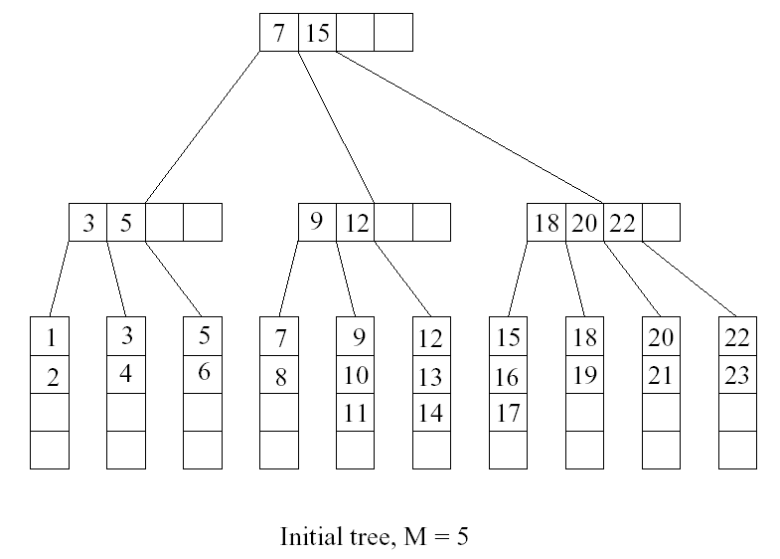
Deletion example
Want to delete 15

Slide 6
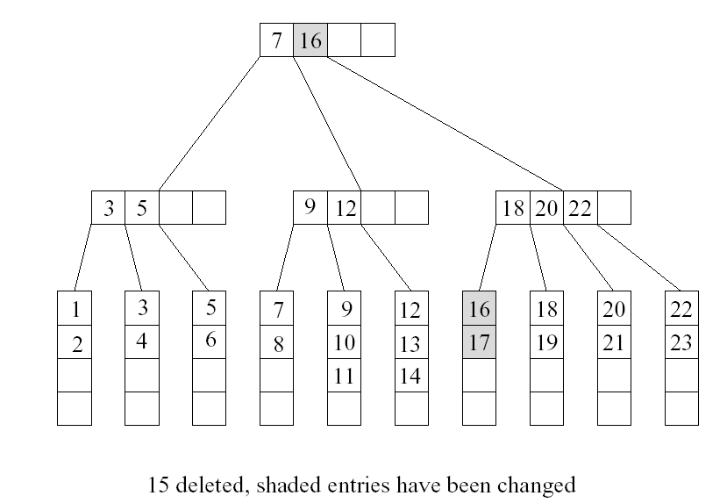
Want to delete 9

Slide 7
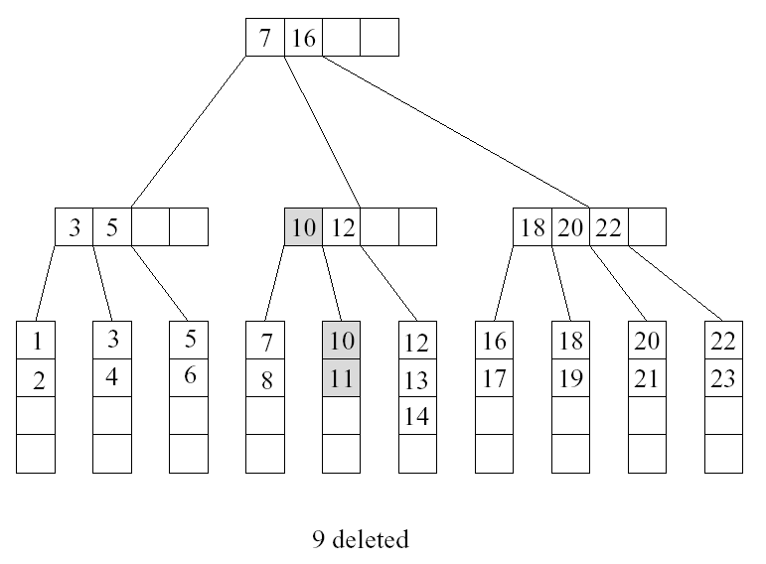
Want to delete 10

Slide 8
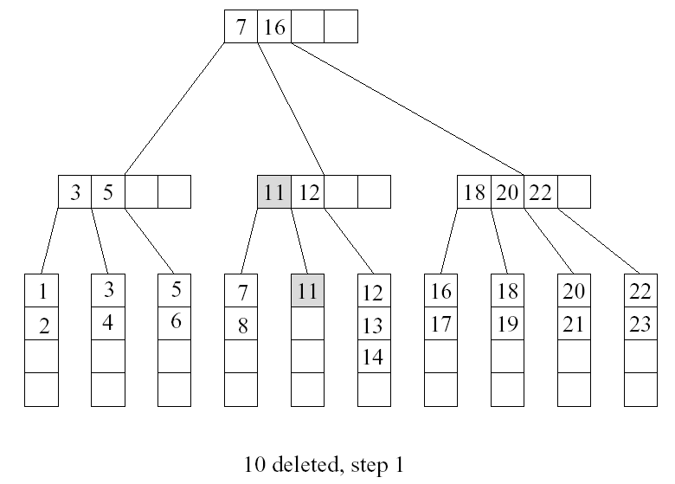

Slide 9
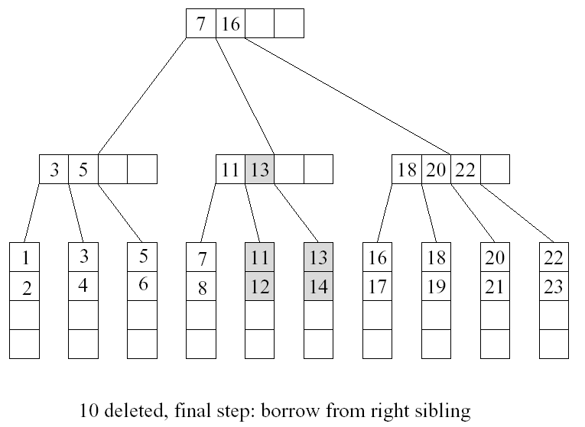

Slide 10
Merging two leaves
If no sibling leaf with at least ⎡M/2⎤ keys exists, then merge two leaves.
Case (1): Suppose that the right sibling v of u contains exactly ⎡M/2⎤ -1 keys. Merge u and v
  Move the keys in u to v
  Remove the pointer to u at parent
  Delete the separating key between u and v from the parent of u

Slide 11
Merging two leaves
Case (2): Suppose that the left sibling v of u contains exactly ⎡M/2⎤ -1 keys. Merge u and v
  Move the keys in u to v
  Remove the pointer to u at parent
  Delete the separating key between u and v from the parent of u

Slide 12
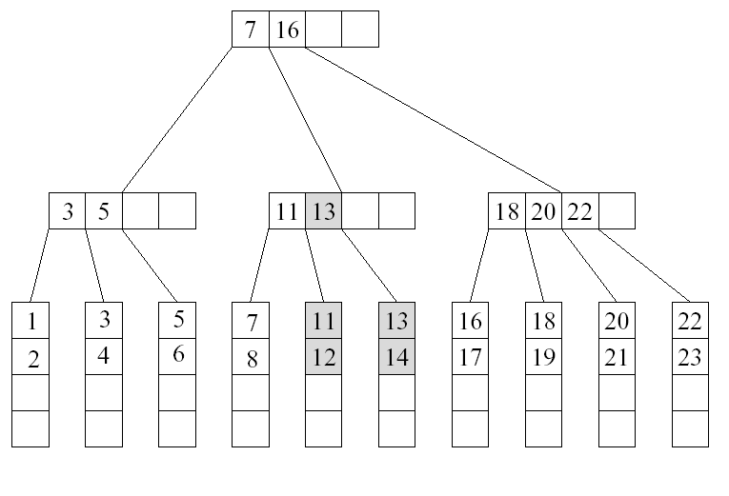
Example
Want to delete 12

Slide 13
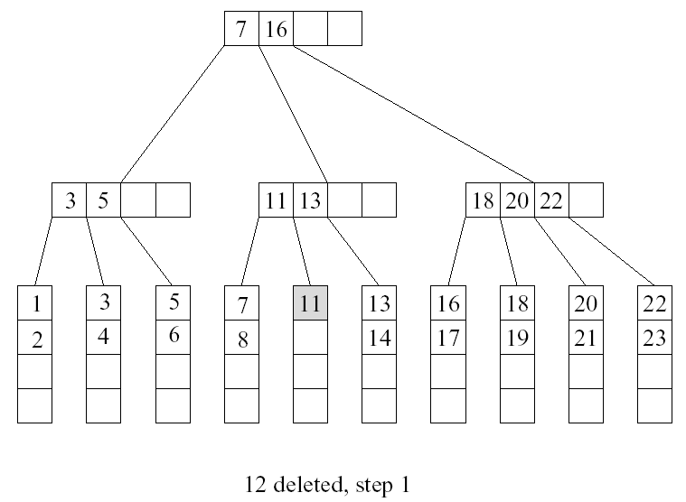
Cont’d
u
v

Slide 14
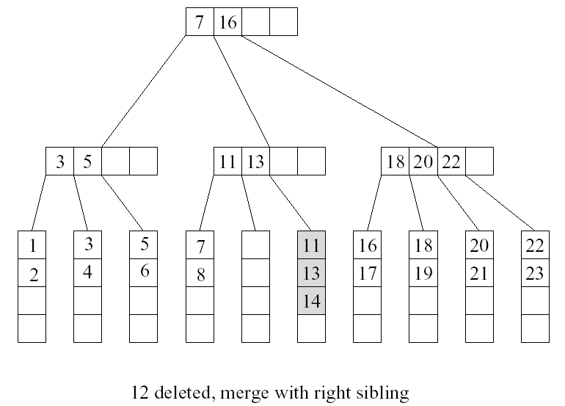
Cont’d

Slide 15
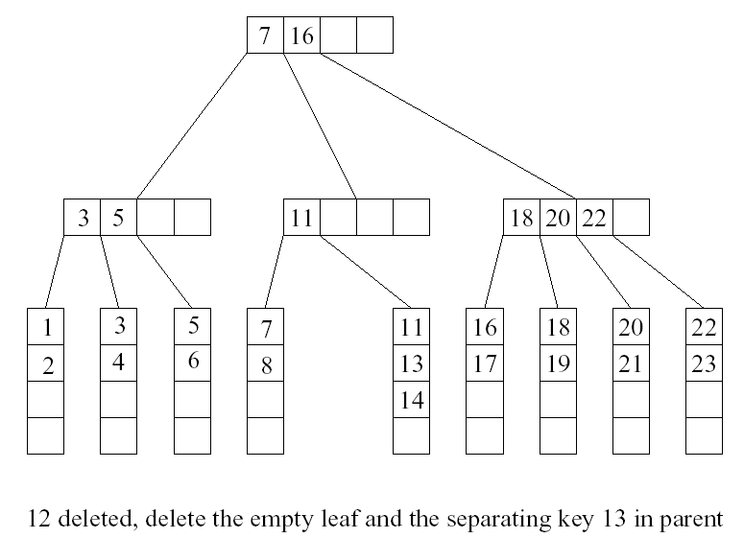
Cont’d
too few keys! …

Slide 16
Deleting a key in an internal node
Suppose we remove a key from an internal node u, and u has less than ⎡M/2⎤ -1 keys afterwards.
Case (1): u is a root
  If u is empty, then remove u and make its child the new root

Slide 17
Deleting a key in an internal node
Case (2): the right sibling v of u has ⎡M/2⎤ keys or more
  Move the separating key between u and v in the parent of u and v down to u.
  Make the leftmost child of v the rightmost child of u
  Move the leftmost key in v to become the separating key between u and v in the parent of u and v.
Case (2): the left sibling v of u has ⎡M/2⎤ keys or more
  Move the separating key between u and v in the parent of u and v down to u.
  Make the rightmost child of v the leftmost child of u
  Move the rightmost key in v to become the separating key between u and v in the parent of u and v.

Slide 18
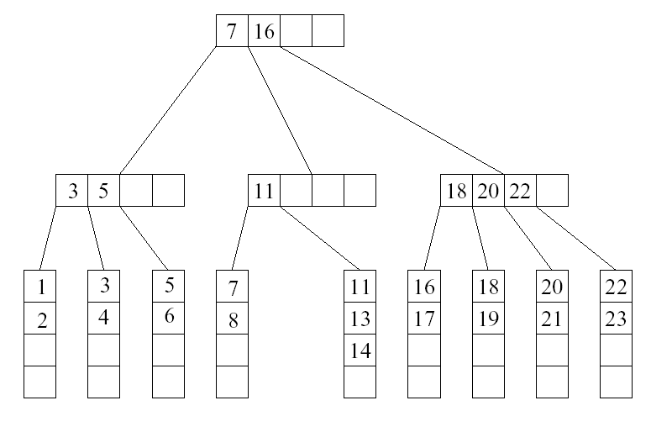
…continue from previous example
case 2
u
v

Slide 19
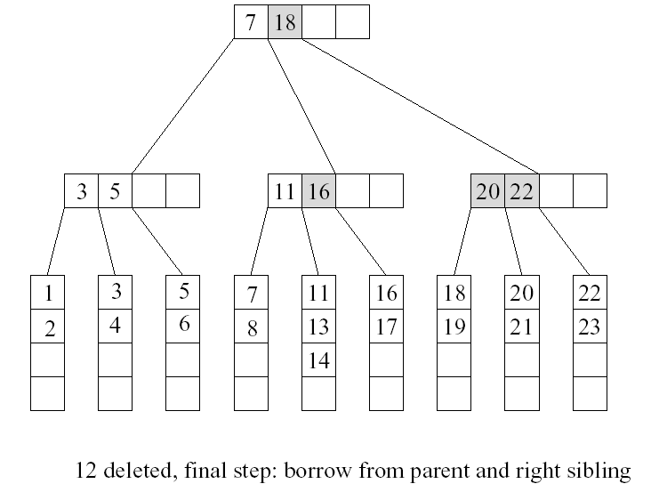
Cont’d

Slide 20
Case (3): all sibling v of u contains exactly ⎡M/2⎤ - 1 keys
  Move the separating key between u and v in the parent of u and v down to u.
  Move the keys and child pointers in u to v
  Remove the pointer to u at parent.

Slide 21
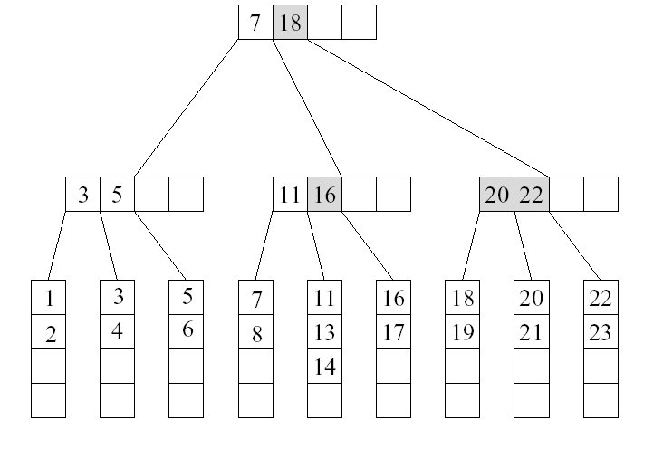
Example
Want to delete 5

Slide 22
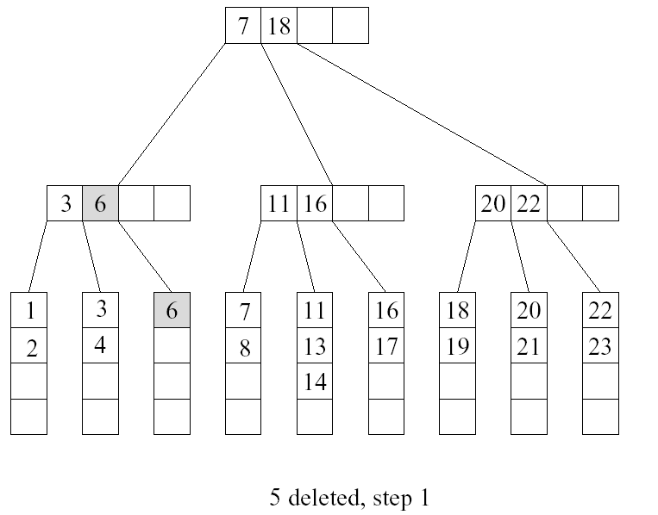
Cont’d
u
v

Slide 23
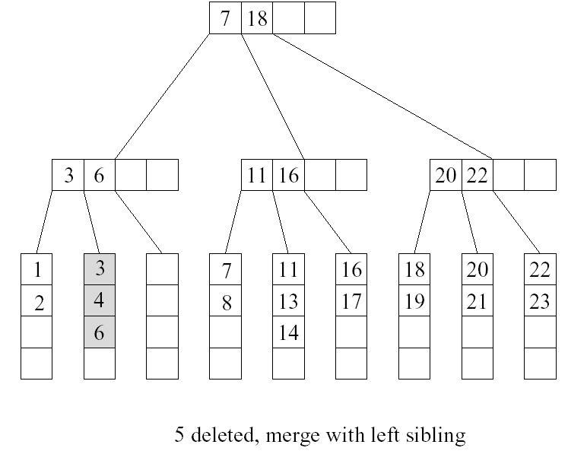
Cont’d

Slide 24
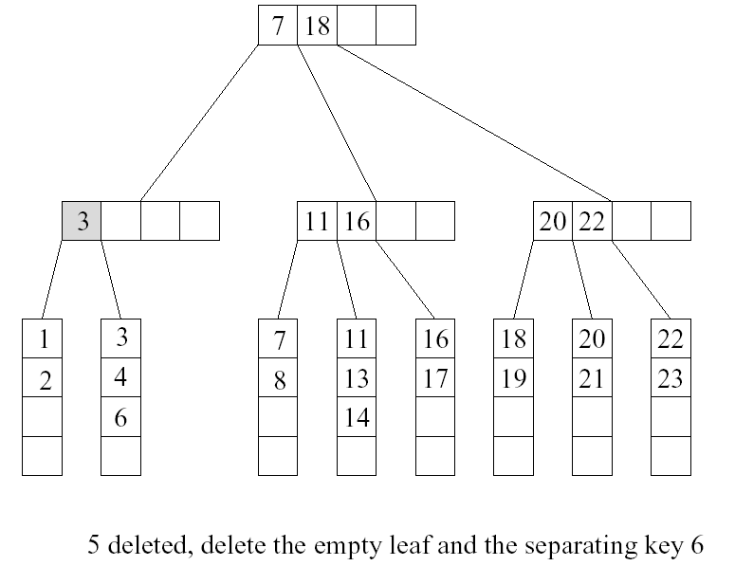
Cont’d
case 3
u
v

Slide 25
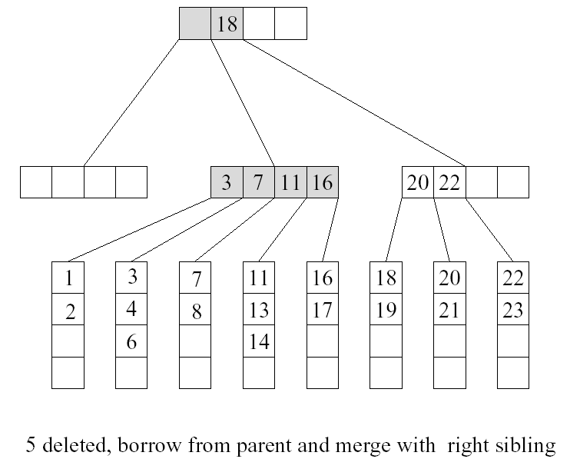
Cont’d

Slide 26
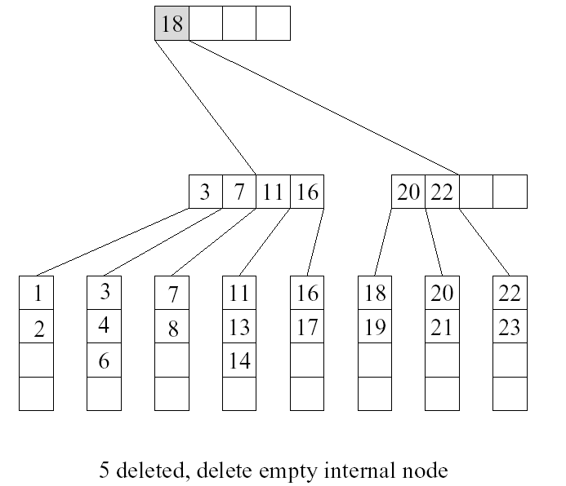
Cont’d

