Slide 1
Quicksort
COMP171
Fall 2005

Slide 2
Introduction
Fastest known sorting algorithm in practice
Average case: O(N log N)
Worst case: O(N²)
  But, the worst case seldom happens.
Another divide-and-conquer recursive algorithm like mergesort

Slide 3
Quicksort
S
Divide step:
  Pick any element (pivot) v in S
  Partition S – {v} into two disjoint groups
  S1 = {x ∈ S – {v} | x ≤ v}
  S2 = {x ∈ S – {v} | x ≥ v}
Conquer step: recursively sort S1 and S2
Combine step: combine the sorted S1, followed by v, followed by the sorted S2
v
v
S1
S2

Slide 4
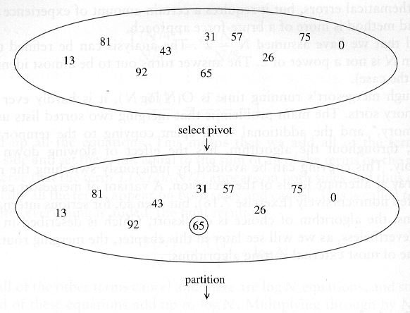
Example: Quicksort

Slide 5
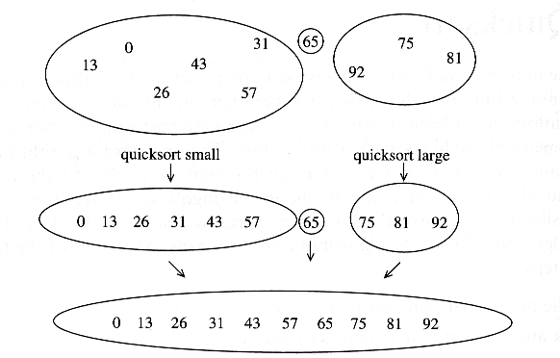
Example: Quicksort...

Slide 6
Pseudocode
Input: an array A[p, r]
Quicksort (A, p, r) {
if (p < r) {
q = Partition (A, p, r) //q is the position of the pivot element
Quicksort (A, p, q-1)
Quicksort (A, q+1, r)
}
}

Slide 7
Partitioning
Partitioning
  Key step of quicksort algorithm
  Goal: given the picked pivot, partition the remaining elements into two smaller sets
  Many ways to implement
  Even the slightest deviations may cause surprisingly bad results.
We will learn an easy and efficient partitioning strategy here.
How to pick a pivot will be discussed later

Slide 8
Partitioning Strategy
Want to partition an array A[left .. right]
First, get the pivot element out of the way by swapping it with the last element. (Swap pivot and A[right])
Let i start at the first element and j start at the next-to-last element (i = left, j = right – 1)
swap
5
6
4
6
3
12
19
5
6
4
19
3
12
6
pivot
i
j

Slide 9
Partitioning Strategy
Want to have
  A[p] <= pivot, for p < i
  A[p] >= pivot, for p > j
When i < j
  Move i right, skipping over elements smaller than the pivot
  Move j left, skipping over elements greater than the pivot
  When both i and j have stopped
    A[i] >= pivot
    A[j] <= pivot
5
6
4
19
3
12
6
5
6
4
19
3
12
6
i
j
i
j

Slide 10
Partitioning Strategy
When i and j have stopped and i is to the left of j
  Swap A[i] and A[j]
    The large element is pushed to the right and the small element is pushed to the left
  After swapping
    A[i] <= pivot
    A[j] >= pivot
  Repeat the process until i and j cross
swap
5
6
4
19
3
12
6
5
3
4
19
6
12
6
i
j
i
j

Slide 11
Partitioning Strategy
When i and j have crossed
  Swap A[i] and pivot
Result:
  A[p] <= pivot, for p < i
  A[p] >= pivot, for p > i
5
3
4
19
6
12
6
i
j
5
3
4
19
6
12
6
j
i
5
3
4
6
6
12
19
j
i

Slide 12
Small arrays
For very small arrays, quicksort does not perform as well as insertion sort
  how small depends on many factors, such as the time spent making a recursive call, the compiler, etc
Do not use quicksort recursively for small arrays
  Instead, use a sorting algorithm that is efficient for small arrays, such as insertion sort

Slide 13
Picking the Pivot
Use the first element as pivot
  if the input is random, ok
  if the input is presorted (or in reverse order)
    all the elements go into S2 (or S1)
    this happens consistently throughout the recursive calls
    Results in O(n²) behavior (Analyze this case later)
Choose the pivot randomly
  generally safe
  random number generation can be expensive

Slide 14
Picking the Pivot
Use the median of the array
  Partitioning always cuts the array into roughly half
  An optimal quicksort (O(N log N))
  However, hard to find the exact median
    e.g., sort an array to pick the value in the middle

Slide 15
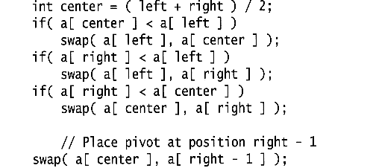
Pivot: median of three
We will use median of three
  Compare just three elements: the leftmost, rightmost and center
  Swap these elements if necessary so that
    A[left] = Smallest
    A[right] = Largest
    A[center] = Median of three
  Pick A[center] as the pivot
  Swap A[center] and A[right – 1] so that pivot is at second last position (why?)
median3

Slide 16
Pivot: median of three
2
5
6
4
13
3
12
19
6
A[left] = 2, A[center] = 13, A[right] = 6
2
5
6
4
6
3
12
19
13
Swap A[center] and A[right]
2
5
6
4
6
3
12
19
13
Choose A[center] as pivot
pivot
2
5
6
4
19
3
12
6
13
Swap pivot and A[right – 1]
pivot
Note we only need to partition A[left + 1, …, right – 2]. Why?

Slide 17
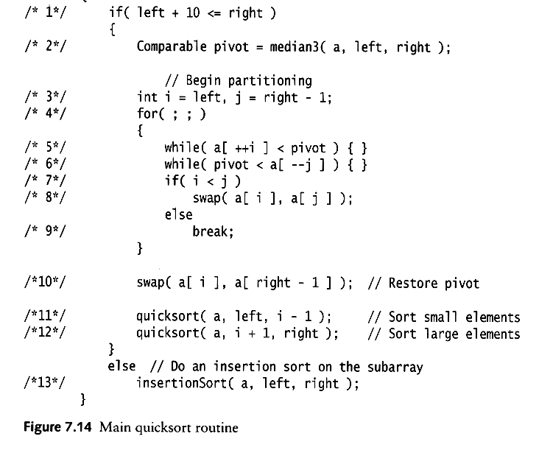
Main Quicksort Routine
Choose pivot
Partitioning
Recursion
For small arrays

Slide 18
Partitioning Part
Works only if pivot is picked as median-of-three.
  A[left] <= pivot and A[right] >= pivot
  Thus, only need to partition A[left + 1, …, right – 2]
j will not run past the end
  because a[left] <= pivot
i will not run past the end
  because a[right-1] = pivot

Slide 19
Quicksort Faster than Mergesort
Both quicksort and mergesort take O(N log N) in the average case.
Why is quicksort faster than mergesort?
  The inner loop consists of an increment/decrement (by 1, which is fast), a test and a jump.
  There is no extra juggling as in mergesort.
inner loop

Slide 20
Analysis
Assumptions:
  A random pivot (no median-of-three partitioning
  No cutoff for small arrays
Running time
  pivot selection: constant time O(1)
  partitioning: linear time O(N)
  running time of the two recursive calls
T(N)=T(i)+T(N-i-1)+cN where c is a constant
  i: number of elements in S1

Slide 21
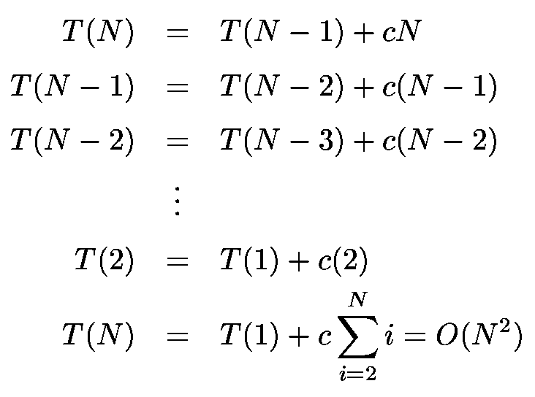
Worst-Case Analysis
What will be the worst case?
  The pivot is the smallest element, all the time
  Partition is always unbalanced

Slide 22
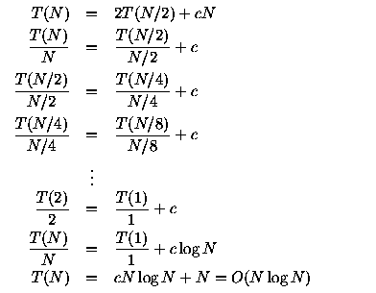
Best-case Analysis
What will be the best case?
  Partition is perfectly balanced.
  Pivot is always in the middle (median of the array)

Slide 23
Average-Case Analysis
Assume
  Each of the sizes for S1 is equally likely
This assumption is valid for our pivoting (median-of-three) and partitioning strategy
On average, the running time is O(N log N) (covered in comp271)

