Slide 1
AVL-Trees (Part 2: Double Rotations)
COMP171
Fall 2006
Lecture 19

Slide 2
Review of Rotations
When the AVL property is lost we can rebalance the tree via rotations
Single Right Rotation (SRR)
  Performed when A is unbalanced to the left (the left subtree is 2 higher than the right subtree) and B is left-heavy (the left subtree of B is 1 higher than the right subtree of B).
A
SRR at A
B
B
T3
T1
A
T1
T2
T2
T3

Slide 3
Rotations
Single Left Rotation (SLR)
  performed when A is unbalanced to the right (the right subtree is 2 higher than the left subtree) and B is right-heavy (the right subtree of B is 1 higher than the left subtree of B).
A
SLR at A
B
T1
B
A
T3
T2
T3
T1
T2

Slide 4
Rotations
Double Left Rotation (DLR)
  Performed when C is unbalanced to the left (the left subtree is 2 higher than the right subtree), A is right-heavy (the right subtree of A is 1 higher than the left subtree of A)
  Consists of a single left rotation at node A, followed by a single right at node C
C
SLR at A
C
SRR at C
B
A
T4
B
T4
A
C
T1
B
A
T3
T1
T2
T3
T4
T2
T3
T1
T2
Note: this is case 1
DLR = SLR + SRR

Slide 5
Rotations
Double Right Rotation (DRR)
  Performed when A is unbalanced to the right (the right subtree is 2 higher than the left subtree), C is left heavy (the left subtree of C is 1 higher than the right subtree of C)
  Consists of a single right rotation at node C, followed by a single left rotation at node A
A
SRR at C
A
SLR at A
B
T1
C
T1
B
A
C
B
T4
T2
C
T1
T2
T3
T4
T2
T3
T3
T4
DRR = SRR + SLR
Note: this is case 4!

Slide 6
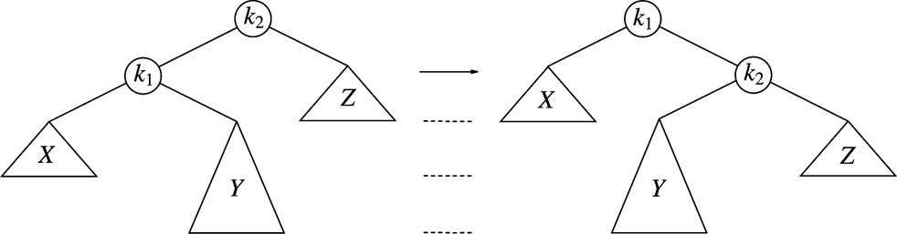
Recall Cases 2&3
Case 2: violation in k2 because of
insertion in subtree Y
Single rotation fails
Single rotation fails to fix case 2&3
Take case 2 as an example (case 3 is a symmetric to it )
  The problem is that the subtree Y is too deep
  Single rotation doesn’t make Y any less deep…

Slide 7
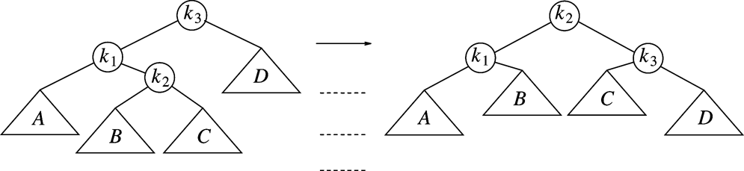
Double Rotation
Double rotation to fix case 2
Facts
  The new key is inserted in the subtree B or C
  The AVL-property is violated at k₃
  k₃-k₁-k₂ forms a zig-zag shape: LR case
Solution
  place k₂ as the new root

Slide 8
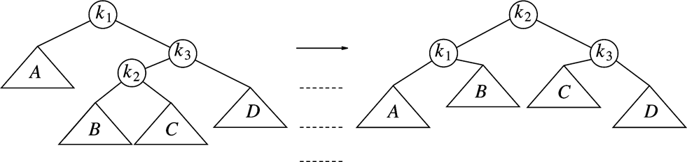
Double Rotation to fix Case 3(right-left)
Double rotation to fix case 3
Facts
  The new key is inserted in the subtree B or C
  The AVL-property is violated at k₁
  k₁-k₃-k₂ forms a zig-zag shape
Case 3 is a symmetric case to case 2

Slide 9
Restart our example
We’ve inserted 3, 2, 1, 4, 5, 6, 7, 16
We’ll insert 15, 14, 13, 12, 11, 10, 8, 9
4
4
2
6
2
6
1
3
5
7
k1
1
3
5
15
k2
Insert 16, fine
Insert 15
violation at node 7
16
k3
7
16
Double rotation
k1
k3
15
k2

Slide 10
4
4
2
6
k1
2
7
k2
A
1
3
5
15
k3
1
3
6
k1
15
k3
k2
7
16
D
5
14
16
Insert 14
14
C
Double rotation
4
k1
7
X
2
7
k2
4
15
1
3
6
15
2
6
14
16
Insert 13
5
14
16
1
3
5
13
Y
Z
Single rotation
13

Slide 11
7
7
4
15
4
15
2
6
14
16
2
6
13
16
1
3
5
13
1
3
5
12
14
Insert 12
12
Single rotation
7
7
4
13
4
15
2
6
12
15
2
6
13
16
1
3
5
11
14
16
1
3
5
12
14
Insert 11
Single rotation
11

Slide 12

7
7
4
13
4
13
2
6
12
15
2
6
11
15
1
3
5
11
14
16
1
3
5
10
12
14
16
Insert 10
10
Single rotation
7
7
4
13
4
13
2
6
11
15
2
6
11
15
1
3
5
8
12
14
16
1
3
5
10
12
14
16
9
10
8
Insert 8, fine
then insert 9
9
Double rotation

Slide 13

Insertion Analysis
logN
Insert the new key as a new leaf just as in ordinary binary search tree: O(logN)
Then trace the path from the new leaf towards the root, for each node x encountered: O(logN)
  Check height difference: O(1)
  If satisfies AVL property, proceed to next node: O(1)
  If not, perform a rotation: O(1)
The insertion stops when
  A rotation is performed
  Or, we’ve checked all nodes in the path
Time complexity for insertion O(logN)

Slide 14
Deletion from AVL Tree
Delete a node x as in ordinary binary search tree
  Note that the last (deepest) node in a tree deleted is a leaf or a node with one child
Then trace the path from the new leaf towards the root
For each node x encountered, check if heights of left(x) and right(x) differ by at most 1.
  If yes, proceed to parent(x)
  If no, perform an appropriate rotation at x Continue to trace the path until we reach the root

Slide 15
Deletion Example 1
20
20
10
35
15
35
5
15
25
40
10
18
25
40
18
30
38
45
30
38
45
50
50
Single Rotation
Delete 5, Node 10 is unbalanced

Slide 16
Cont’d
20
35
15
35
20
40
10
18
25
40
15
25
38
45
30
38
45
10
18
30
50
Continue to check parents
Oops!! Node 20 is unbalanced!!
50
Single Rotation
For deletion, after rotation, we need to continue tracing upward to see if AVL-tree property is violated at other node.

Slide 17
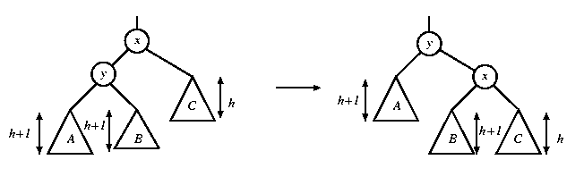
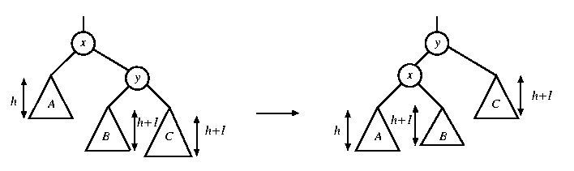
Rotation in Deletion
The rotation strategies (single or double) we learned can be reused here
Except for one new case: two subtrees of y are of the same height ➔ in that case, a single rotation is ok
rotate with left child
rotate with right child

Slide 18
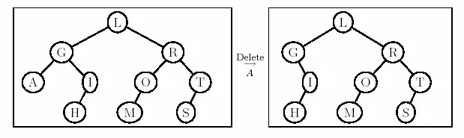
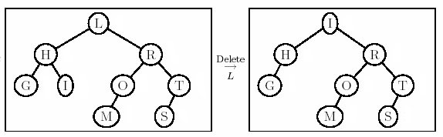
Deletion Example 2
Right most child of left subtree = I
Double rotation
Ok here!

Slide 19
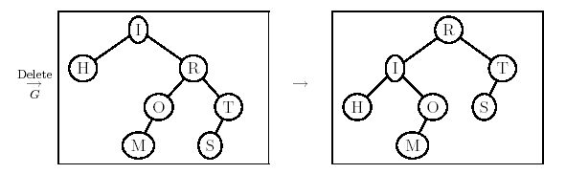
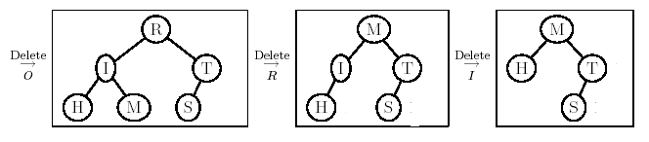
Example 2 Cont’d
New case

