Slide 1
Priority Queue (Heap) &
Heapsort
COMP171
Fall 2006
Lecture 11 & 12

Slide 2

Motivating Example
3 jobs have been submitted to a printer in the order A, B, C.
Sizes: Job A – 100 pages
Job B – 10 pages
Job C -- 1 page
Average waiting time with FIFO service:
(100+110+111) / 3 = 107 time units
Average waiting time for shortest-job-first service:
(1+11+111) / 3 = 41 time units
A queue be capable to insert and deletemin?
Priority Queue

Slide 3
Priority Queue
Priority queue is a data structure which allows at least two operations
  insert
  deleteMin: finds, returns and removes the minimum elements in the priority queue
Applications: external sorting, greedy algorithms
deleteMin
Priority Queue
insert

Slide 4

Possible Implementations
Linked list
  Insert in O(1)
  Find the minimum element in O(n), thus deleteMin is O(n)
Binary search tree (AVL tree, to be covered later)
  Insert in O(log n)
  Delete in O(log n)
  Search tree is an overkill as it does many other operations
Eerr, neither fit quite well…

Slide 5

Background: Binary Trees
root
Has a root at the topmost level
Each node has zero, one or two children
A node that has no child is called a leaf
For a node x, we denote the left child, right child and the parent of x as left(x), right(x) and parent(x), respectively.
Parent(x)
x
leaf
leaf
left(x)
right(x)
leaf

Slide 6
Height (Depth) of a Binary Tree
The number of edges on the longest path from the root to a leaf.
Height = 4

Slide 7
Background: Complete Binary Trees
A complete binary tree is the tree
  Where a node can have 0 (for the leaves) or 2 children and
  All leaves are at the same depth
No. of nodes and height
  A complete binary tree with N nodes has height O(logN)
  A complete binary tree with height d has 2^{d+1}-1 nodes
height
no. of nodes
0
1
1
2
2
4
3
8
d
2^{d}

Slide 8

Proof: O(logN) Height
Proof: a complete binary tree with N nodes has height of O(logN)
  Prove by induction that number of nodes at depth d is 2^{d}
  Total number of nodes of a complete binary tree of depth d is 1 + 2 + 4 +…… 2^{d} = 2^{d+1} - 1
  Thus 2^{d+1} - 1 = N
  d = log(N+1)-1 = O(logN)
Side notes: the largest depth of a binary
tree of N nodes is O(N) (what is the shape of the tree?)

Slide 9

Binary Heap
Heaps are “almost complete binary trees”
  All levels are full except possibly the lowest level
  If the lowest level is not full, then nodes must be packed to the left
Structure properties
  Has 2^{h} to 2^{h+1}-1 nodes with height h
  The structure is so regular, it can be represented in an array and no links are necessary !!!
Pack to the left

Slide 10

Array Implementation of Binary Heap
A
B
C
A
B
C
D
E
F
G
H
I
J
0
1
2
3
4
5
6
7
8
…
D
E
F
G
H
I
J
For any element in array position i
  The left child is in position 2i
  The right child is in position 2i+1
  The parent is in position floor(i/2)
A possible problem: an estimate of the maximum heap size is required in advance (but normally we can resize if needed)
Note: we will draw the heaps as trees, with the implication that an actual implementation will use simple arrays
Side notes: it’s not wise to store normal binary trees in arrays, coz it may generate many holes

Slide 11
Back to Priority Queues
1
4
2
5
2
5
4
3
6
1
3
6
A heap
Not a heap
Heap-order property: the value at each node is less than or equal to the values at both its descendants
  It is easy (both conceptually and practically) to perform insert and deleteMin in heap if the heap-order property is maintained
Use of binary heap is so common for priority queue implemen-tations, thus the word heap is usually assumed to be the implementation of the data structure

Slide 12
Heap Properties
Heap supports the following operations efficiently
  Insert in O(logN) time
  Locate the current minimum in O(1) time
  Delete the current minimum in O(log N) time

Slide 13
Insertion
Algorithm
  Add the new element to the next available position at the lowest level
  Restore the min-heap property if violated
    General strategy is percolate up (or bubble up): if the parent of the element is larger than the element, then interchange the parent and child.
1
1
1
2
5
2
5
2
2.5
swap
4
3
6
4
3
6
2.5
4
3
6
5
Insert 2.5
Percolate up to maintain
the heap property

Slide 14
An Implementation Trick
Implementation of percolation in the insert routine
  by performing repeated swaps: 3 assignment state-ments for a swap. 3d assignments if an element is percolated up d levels
  An enhancement: Hole digging with d+1 assignments
Insert 4…
7
7
7
4
9
8
9
4
8
8
17
16
4
14
10
17
14
10
17
9
14
10
20
18
20
18
16
20
18
16
Dig a hole
Compare 4 with 16
Compare 4 with 9
Compare 4 with 7

Slide 15

Insertion Complexity
4
7
8
A heap!
17
9
14
10
20
18
16
Time Complexity = O(height) = O(logN)

Slide 16
Insertion PseudoCode
void insert(const Comparable &x)
{
//resize the array if needed
if (currentSize == array.size()-1
array.resize(array.size()*2)
//percolate up
int hole = ++currentSize;
for (; hole>1 && x<array[hole/2]; hole/=2)
array[hole] = array[hole/2];
array[hole]= x;
}

Slide 17
deleteMin: First Attempt=percolate down
Algorithm
  Delete the root.
  Compare the two children of the root
  Make the lesser of the two the root.
  An empty spot is created.
  Bring the lesser of the two children of the empty spot to the empty spot.
  A new empty spot is created.
  Continue

Slide 18

Example for First Attempt
1
2
5
2
5
4
3
6
4
3
6
2
1
5
3
5
4
3
6
4
6
Heap property is preserved, but completeness is not preserved!

Slide 19
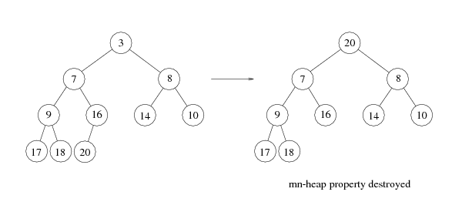
deleteMin
Copy the last number to the root (i.e. overwrite the minimum element stored there)
Restore the min-heap property by percolate down (or bubble down)

Slide 20
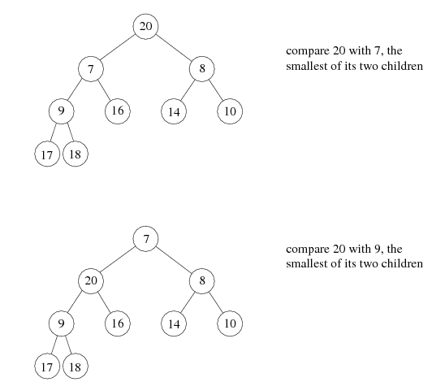
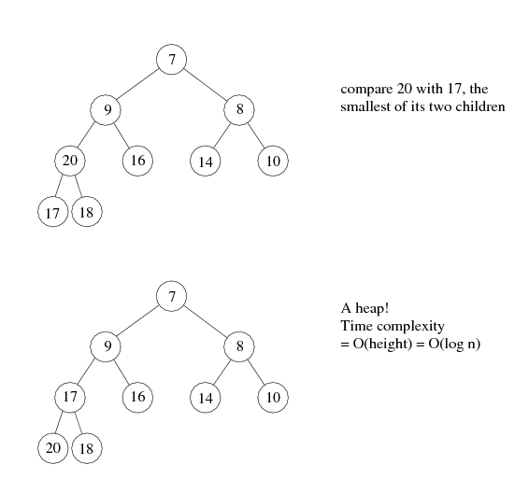
The same ‘hole’ trick used in insertion can be used here too

Slide 21
deleteMin with ‘Hole Trick’
2
2
5
5
4
3
6
4
3
6
1. create hole
tmp = 6 (last element)
2. Compare children and tmp
bubble down if necessary
2
2
3
5
3
5
4
6
4
6
3. Continue step 2 until
reaches lowest level
4. Fill the hole

Slide 22
deleteMin PseudoCode
void deleteMin()
{
if (isEmpty()) throw UnderflowException();
//copy the last number to the root, decrease array size by 1
array[1] = array[currentSize--]
percolateDown(1); //percolateDown from root
}
void percolateDown(int hole) //int hole is the root position
{
int child;
Comparable tmp = array[hole]; //create a hole at root
for( ; hold*2 <= currentSize; hole=child){ //identify child position
child = hole*2;
//compare left and right child, select the smaller one
if (child != currentSize && array[child+1] <array[child]
child++;
if(array[child]<tmp) //compare the smaller child with tmp
array[hole] = array[child]; //bubble down if child is smaller
else
break; //bubble stops movement
}
array[hole] = tmp; //fill the hole
}

Slide 23

Heapsort
(1) Build a binary heap of N elements
  the minimum element is at the top of the heap
(2) Perform N DeleteMin operations
  the elements are extracted in sorted order
(3) Record these elements in a second array and then copy the array back

Slide 24
Build Heap
Input: N elements
Output: A heap with heap-order property
Method 1: obviously, N successive insertions
Complexity: O(NlogN) worst case

Slide 25
Heapsort – Running Time Analysis
(1) Build a binary heap of N elements
  repeatedly insert N elements ⇒ O(N log N) time
  (there is a more efficient way, check textbook p223 if interested)
(2) Perform N DeleteMin operations
  Each DeleteMin operation takes O(log N) ⇒ O(N log N)
(3) Record these elements in a second array and then copy the array back
  O(N)
Total time complexity: O(N log N)
Memory requirement: uses an extra array, O(N)

Slide 26
Heapsort: No Extra Storage
Observation: after each deleteMin, the size of heap shrinks by 1
  We can use the last cell just freed up to store the element that was just deleted
  ⇒ after the last deleteMin, the array will contain the elements in decreasing sorted order
To sort the elements in the decreasing order, use a min heap
To sort the elements in the increasing order, use a max heap
  the parent has a larger element than the child

Slide 27
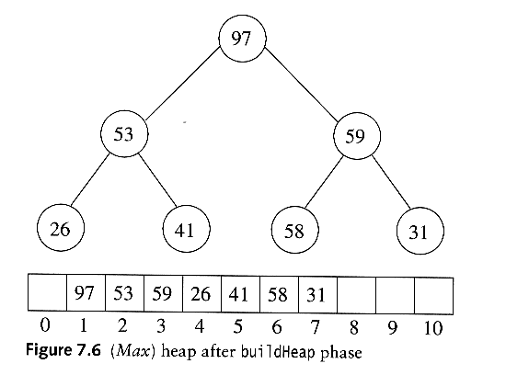
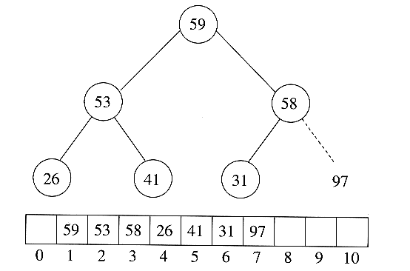
Heapsort Example: No Extra Storage
Sort in increasing order: use max heap
Delete 97

Slide 28
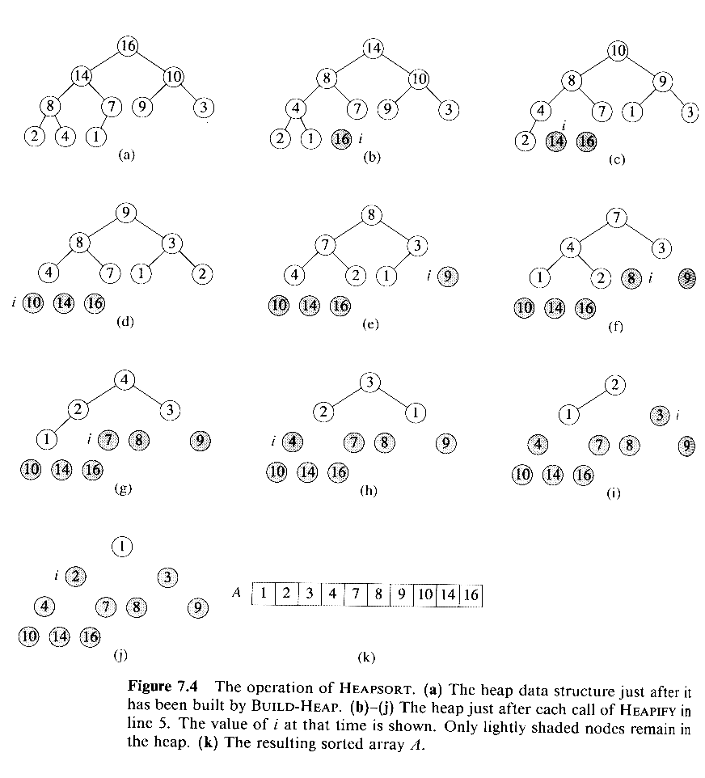
Another Heapsort Example
Delete 16
Delete 14
Delete 10
Delete 9
Delete 8

Slide 29
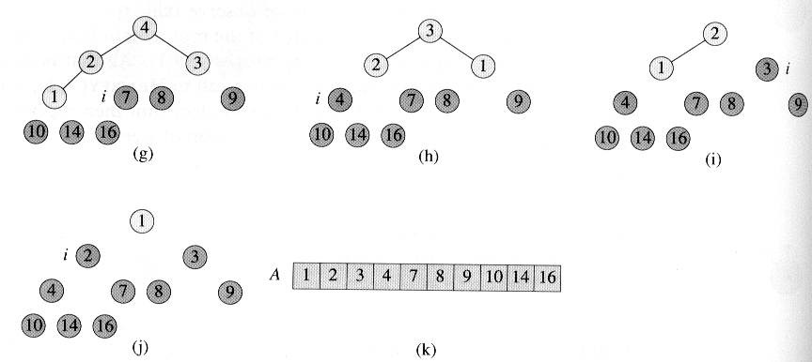
Example (cont’d)

Slide 30
Preliminary Heap ADT
class BinaryHeap
{
public:
BinaryHeap(int capacity=100);
explicit BinaryHeap(const vector &items);
bool isEmpty() const;
void insert(const float &x);
void deleteMin();
void deleteMin(float &minItem);
void makeEmpty();
private:
int currentSize; //number of elements in heap
vector array; //the heap array
void buildHeap();
void percolateDown(int hole);
}

