Slide 1
Insertion sort,
Merge sort
COMP171
Fall 2006

Slide 2

Insertion sort
1) Initially p = 1
2) Let the first p elements be sorted.
3) Insert the (p+1)th element properly in the list so that now p+1 elements are sorted.
4) increment p and go to step (3)

Slide 3
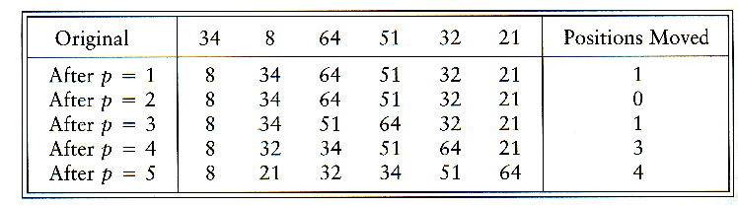
Insertion Sort

Slide 4
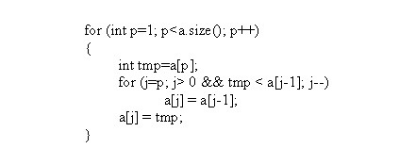
Insertion Sort...
see applet
http://www.cis.upenn.edu/~matuszek/cse121-2003/Applets/Chap03/Insertion/InsertSort.html
Consists of N - 1 passes
For pass p = 1 through N - 1, ensures that the elements in positions 0 through p are in sorted order
  elements in positions 0 through p - 1 are already sorted
  move the element in position p left until its correct place is found among the first p + 1 elements

Slide 5
Extended Example
To sort the following numbers in increasing order:
34 8 64 51 32 21
p = 1; tmp = 8;
34 > tmp, so second element a[1] is set to 34: {8, 34}…
We have reached the front of the list. Thus, 1st position a[0] = tmp=8
After 1st pass: 8 34 64 51 32 21
(first 2 elements are sorted)

Slide 6
P = 2; tmp = 64;
34 < 64, so stop at 3rd position and set 3rd position = 64
After 2nd pass: 8 34 64 51 32 21
(first 3 elements are sorted)
P = 3; tmp = 51;
51 < 64, so we have 8 34 64 64 32 21,
34 < 51, so stop at 2nd position, set 3rd position = tmp,
After 3rd pass: 8 34 51 64 32 21
(first 4 elements are sorted)
P = 4; tmp = 32,
32 < 64, so 8 34 51 64 64 21,
32 < 51, so 8 34 51 51 64 21,
next 32 < 34, so 8 34 34, 51 64 21,
next 32 > 8, so stop at 1st position and set 2nd position = 32,
After 4th pass: 8 32 34 51 64 21
P = 5; tmp = 21, . . .
After 5th pass: 8 21 32 34 51 64

Slide 7
Analysis: worst-case running time
Inner loop is executed p times, for each p=1..N-1
⇒ Overall: 1 + 2 + 3 + . . . + N-1 = …= O(N²)
Space requirement is O(?)

Slide 8
Analysis
The bound is tight Θ(N²)
That is, there exists some input which actually uses Ω(N²) time
Consider input as a reversed sorted list
  When a[p] is inserted into the sorted a[0..p-1], we need to compare a[p] with all elements in a[0..p-1] and move each element one position to the right
  ⇒ Ω(i) steps
  the total number of steps is Ω(Σ₁^{N-1} i) = Ω(N(N-1)/2) = Ω(N²)

Slide 9
Analysis: best case
The input is already sorted in increasing order
  When inserting A[p] into the sorted A[0..p-1], only need to compare A[p] with A[p-1] and there is no data movement
  For each iteration of the outer for-loop, the inner for-loop terminates after checking the loop condition once => O(N) time
If input is nearly sorted, insertion sort runs fast

Slide 10
Some Revision
How do we revise insertion sort, so that the insertion of a new element at the p-th index is done using binary search (since the sub-array A[0..p-1] is already sorted?)
  Question: what is the worst case time complexity then?
  Binary Search Code: (see next page)
  Question: how to revise insertion sort to use this function?

Slide 11
Binary search code (from recursion lecture)
// Searches an ordered array of integers using recursion
int bsearchr(const int data[], // input: array
int first, // input: lower bound
int last, // input: upper bound
int value // input: value to find
)// output: index if found, otherwise return –1
{ int middle = (first + last) / 2;
if (data[middle] == value)
return middle;
else if (first >= last)
return -1;
else if (value < data[middle])
return bsearchr(data, first, middle-1, value);
else
return bsearchr(data, middle+1, last, value);
}

Slide 12
New code for insertion sort: fill out the … part:
{
int tmp=a[p];
int index = bsearchr(…);
for (j=p; … ; j--)
…;
a[j] = tmp;
}

