Slide 1
Past Midterm Review
COMP171
Fall 2006

Slide 2
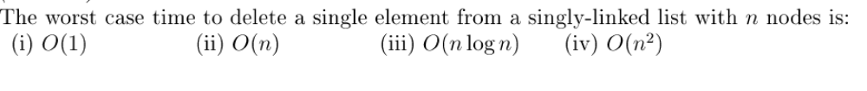
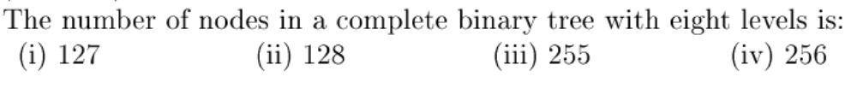
Multiple Choices
(1)
(2)

Slide 3
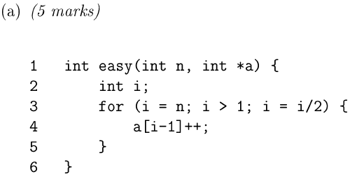
Complexity (1)
Line 3: i=n, i=n/2, i=n/(2)^2,….i=n/(2)^k, where k=log n. Thus O(logn)

Slide 4
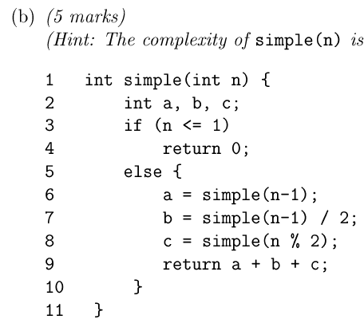
Complexity (2)
T(n)=

Slide 5
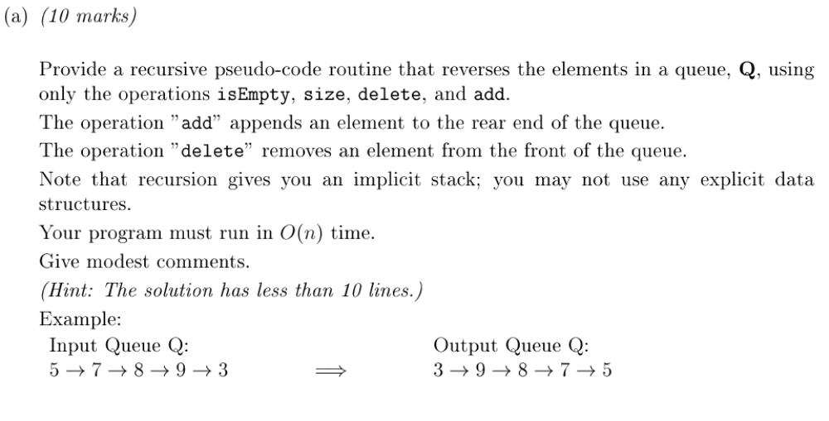
Stack and Queues (1)

Slide 6
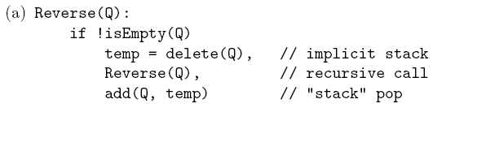
Stack and Queue (2)

Slide 7
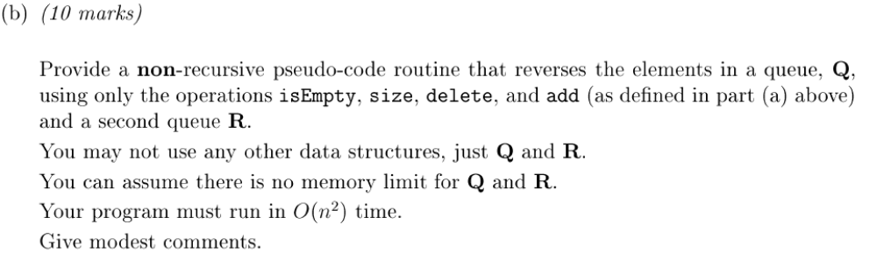
Stack and Queue (3)

Slide 8
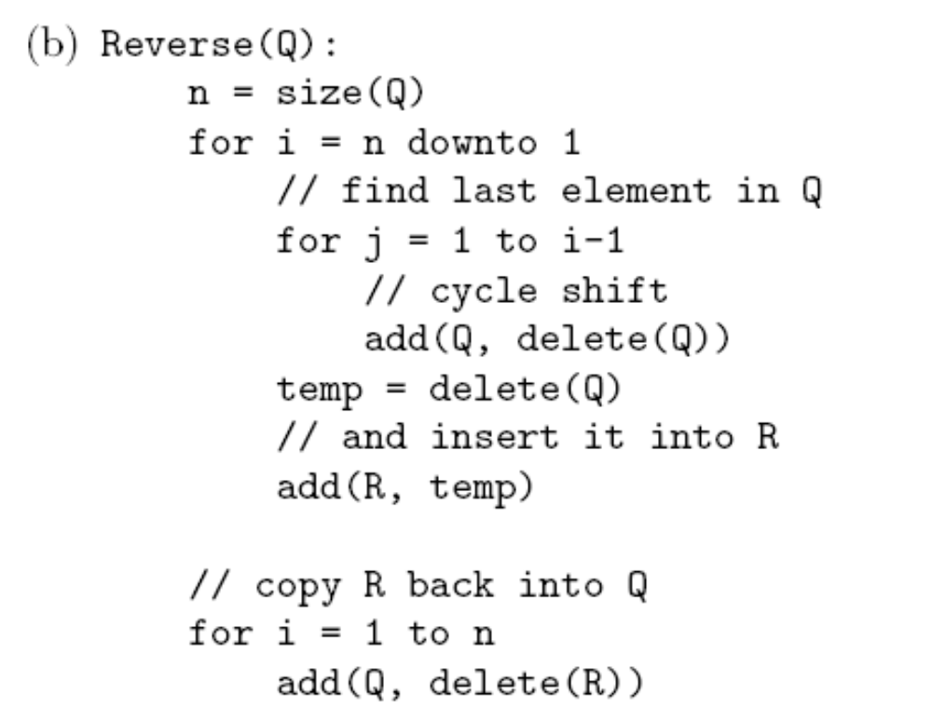
Stack and Queue (4)

Slide 9
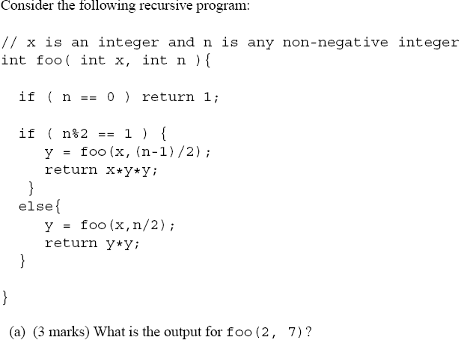
Recursive

Slide 10
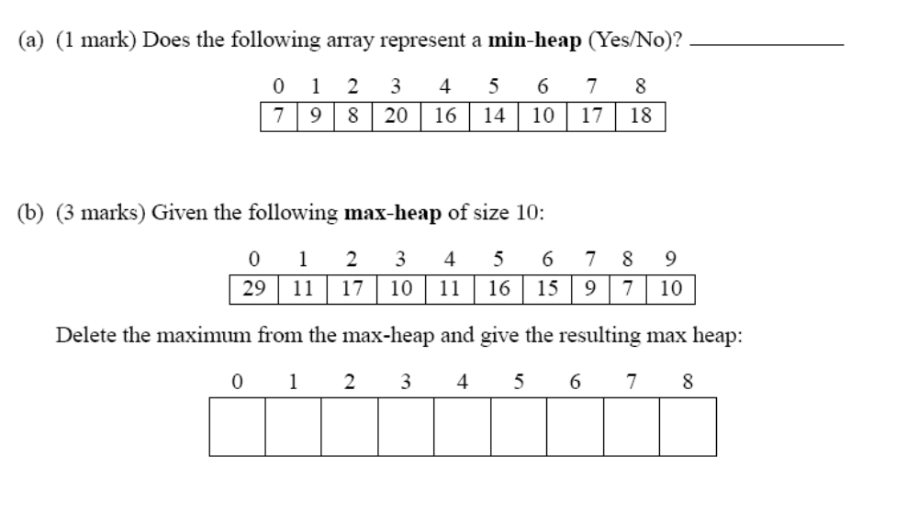
Heap

