Slide 1
COMP171
Fall 2006
Recursion

Slide 2
Recursion
In some problems, it may be natural to define the problem in terms of the problem itself.
Recursion is useful for problems that can be represented by a simpler version of the same problem.
Example: the factorial function
6! = 6 * 5 * 4 * 3 * 2 * 1
We could write:
6! = 6 * 5!

Slide 3
Example 1: factorial function
In general, we can express the factorial function as follows:
n! = n * (n-1)!
Is this correct? Well… almost.
The factorial function is only defined for positive integers. So we should be a bit more precise:
n! = 1 (if n is equal to 1)
n! = n * (n-1)! (if n is larger than 1)

Slide 4


factorial function
The C++ equivalent of this definition:
int fac(int numb){
if(numb<=1)
return 1;
else
return numb * fac(numb-1);
}
recursion means that a function calls itself

Slide 5
factorial function
Assume the number typed is 3, that is, numb=3.
fac(3) :
  3 <= 1 ? No.
  fac(3) = 3 * fac(2)
  fac(2) :
    2 <= 1 ? No.
    fac(2) = 2 * fac(1)
    fac(1) :
      1 <= 1 ? Yes.
      return 1
int fac(int numb){
if(numb<=1)
return 1;
else
return numb * fac(numb-1);
}
    fac(2) = 2 * 1 = 2
    return fac(2)
  fac(3) = 3 * 2 = 6
  return fac(3)
fac(3) has the value 6

Slide 6
factorial function
For certain problems (such as the factorial function), a recursive solution often leads to short and elegant code. Compare the recursive solution with the iterative solution:
Iterative solution
int fac(int numb){
int product=1;
while(numb>1){
product *= numb;
numb--;
}
return product;
}
Recursive solution
int fac(int numb){
if(numb<=1)
return 1;
else
return numb*fac(numb-1);
}

Slide 7
Recursion
To trace recursion, recall that function calls operate as a stack – the new function is put on top of the caller
We have to pay a price for recursion:
  calling a function consumes more time and memory than adjusting a loop counter.
  high performance applications (graphic action games, simulations of nuclear explosions) hardly ever use recursion.
In less demanding applications recursion is an attractive alternative for iteration (for the right problems!)

Slide 8
Recursion
If we use iteration, we must be careful not to create an infinite loop by accident:
for(int incr=1; incr!=10;incr+=2)
...
int result = 1;
while(result >0){
...
result++;
}
Oops!
Oops!

Slide 9
Recursion
Similarly, if we use recursion we must be careful not to create an infinite chain of function calls:
int fac(int numb){
return numb * fac(numb-1);
}
Or:
int fac(int numb){
if (numb<=1)
return 1;
else
return numb * fac(numb+1);
}
Oops!
No termination condition
Oops!

Slide 10
Recursion
We must always make sure that the recursion bottoms out:
A recursive function must contain at least one non-recursive branch.
The recursive calls must eventually lead to a non-recursive branch.

Slide 11
Recursion
Recursion is one way to decompose a task into smaller subtasks. At least one of the subtasks is a smaller example of the same task.
The smallest example of the same task has a non-recursive solution.
  Example: The factorial function
  n! = n * (n-1)! and 1! = 1

Slide 12
Example 2: Fibonacci numbers
Fibonacci numbers:
  0, 1, 1, 2, 3, 5, 8, 13, 21, 34, ...
where each number is the sum of the preceding two.
Recursive definition:
  F(0) = 0;
  F(1) = 1;
  F(number) = F(number-1)+ F(number-2);

Slide 13
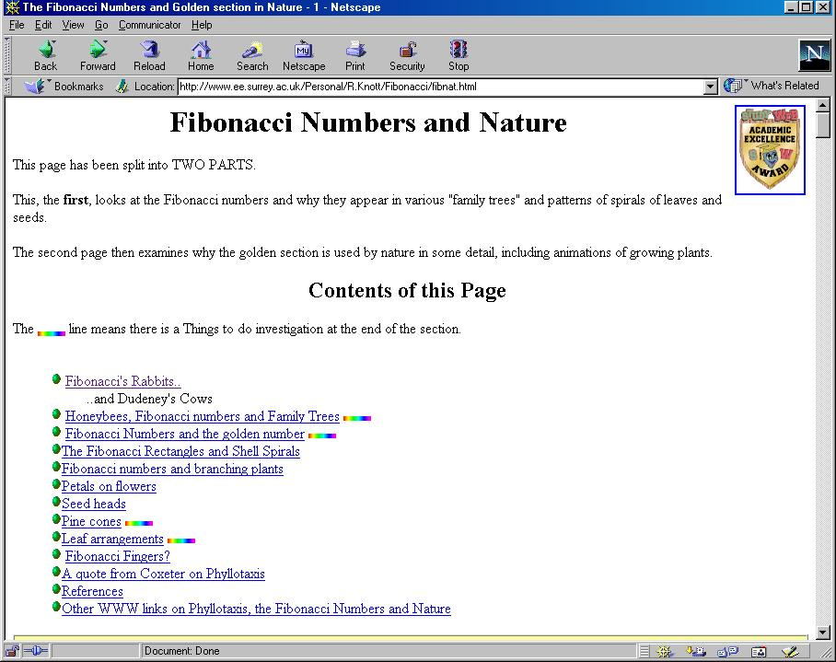

Slide 14
Example 3: Fibonacci numbers
//Calculate Fibonacci numbers using recursive function.
//A very inefficient way, but illustrates recursion well
int fib(int number)
{
if (number == 0) return 0;
if (number == 1) return 1;
return (fib(number-1) + fib(number-2));
}
int main(){ // driver function
int inp_number;
cout << "Please enter an integer: ";
cin >> inp_number;
cout << "The Fibonacci number for "<< inp_number
<< " is "<< fib(inp_number)<<endl;
return 0;
}

Slide 15
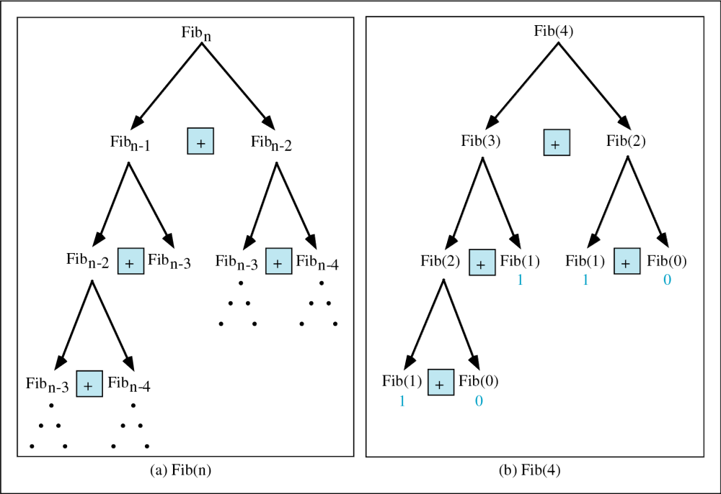
Copyright © 2000 by Brooks/Cole Publishing Company
A division of International Thomson Publishing Inc.

Slide 16
Trace a Fibonacci Number
int fib(int num)
{
if (num == 0) return 0;
if (num == 1) return 1;
return
(fib(num-1)+fib(num-2));
}
Assume the input number is 4, that is, num=4:
fib(4):
  4 == 0 ? No; 4 == 1? No.
  fib(4) = fib(3) + fib(2)
  fib(3):
    3 == 0 ? No; 3 == 1? No.
    fib(3) = fib(2) + fib(1)
    fib(2):
      2 == 0? No; 2==1? No.
      fib(2) = fib(1)+fib(0)
    fib(1):
    1== 0 ? No; 1 == 1? Yes.
    fib(1) = 1;
    return fib(1);

Slide 17
Trace a Fibonacci Number
fib(0):
    0 == 0 ? Yes.
    fib(0) = 0;
    return fib(0);
    fib(2) = 1 + 0 = 1;
    return fib(2);
  fib(3) = 1 + fib(1)
fib(1):
    1 == 0 ? No; 1 == 1? Yes
    fib(1) = 1;
    return fib(1);
  fib(3) = 1 + 1 = 2;
  return fib(3)

Slide 18
Trace a Fibonacci Number
fib(2):
      2 == 0 ? No; 2 == 1? No.
      fib(2) = fib(1) + fib(0)
      fib(1):
    1== 0 ? No; 1 == 1? Yes.
    fib(1) = 1;
    return fib(1);
    fib(0):
    0 == 0 ? Yes.
    fib(0) = 0;
    return fib(0);
    fib(2) = 1 + 0 = 1;
    return fib(2);
  fib(4) = fib(3) + fib(2)
  = 2 + 1 = 3;
  return fib(4);

Slide 19
Fibonacci number w/o recursion
//Calculate Fibonacci numbers iteratively
//much more efficient than recursive solution
int fib(int n)
{
int f[n+1];
f[0] = 0; f[1] = 1;
for (int i=2; i<= n; i++)
f[i] = f[i-1] + f[i-2];
return f[n];
}

Slide 20
Example 3: Binary Search
  Search for an element in an array
    Sequential search
    Binary search
  Binary search
    Compare the search element with the middle element of the array
    If not equal, then apply binary search to half of the array (if not empty) where the search element would be.
see applet

Slide 21
Binary Search with Recursion
// Searches an ordered array of integers using recursion
int bsearchr(const int data[], // input: array
int first, // input: lower bound
int last, // input: upper bound
int value // input: value to find
)// output: index if found, otherwise return –1
{ int middle = (first + last) / 2;
if (data[middle] == value)
return middle;
else if (first >= last)
return -1;
else if (value < data[middle])
return bsearchr(data, first, middle-1, value);
else
return bsearchr(data, middle+1, last, value);
}

Slide 22
Binary Search
int main() {
const int array_size = 8;
int list[array_size]={1, 2, 3, 5, 7, 10, 14, 17};
int search_value;
cout << "Enter search value: ";
cin >> search_value;
cout << bsearchr(list,0,array_size-1,search_value)
<< endl;
return 0;
}

Slide 23
Binary Search w/o recursion
// Searches an ordered array of integers
int bsearch(const int data[], // input: array
int size, // input: array size
int value // input: value to find
){ // output: if found,return
// index; otherwise, return -1
int first, last, upper;
first = 0;
last = size - 1;
while (true) {
middle = (first + last) / 2;
if (data[middle] == value)
return middle;
else if (first >= last)
return -1;
else if (value < data[middle])
last = middle - 1;
else
first = middle + 1;
}
}

Slide 24
Recursion General Form
How to write recursively?
int recur_fn(parameters){
if(stopping condition)
return stopping value;
// other stopping conditions if needed
return function of recur_fn(revised parameters)
}

Slide 25

Example 4: exponential func
How to write exp(int numb, int power) recursively?
int exp(int numb, int power){
if(power ==0)
return 1;
return numb * exp(numb, power -1);
}

Slide 26
Example 5: number of zero
Write a recursive function that counts the number of zero digits in an integer
zeros(10200) returns 3.
int zeros(int numb){
if(numb==0) // 1 digit (zero/non-zero):
return 1; // bottom out.
else if(numb < 10 && numb > -10)
return 0;
else // > 1 digits: recursion
return zeros(numb/10) + zeros(numb%10);
}
zeros(10200)
zeros(1020) + zeros(0)
zeros(102) + zeros(0) + zeros(0)
zeros(10) + zeros(2) + zeros(0) + zeros(0)
zeros(1) + zeros(0) + zeros(2) + zeros(0) + zeros(0)

Slide 27
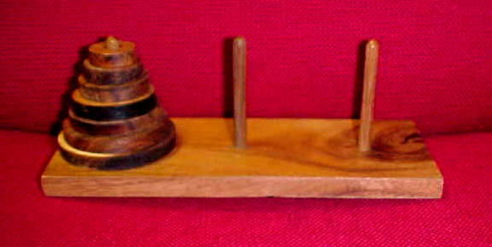
Example 6: Towers of Hanoi
  Only one disc could be moved at a time
  A larger disc must never be stacked above a smaller one
  One and only one extra needle could be used for intermediate storage of discs
see applet

Slide 28
Towers of Hanoi
void hanoi(int from, int to, int num)
{
int temp = 6 - from - to; //find the temporary
//storage column
if (num == 1){
cout << "move disc 1 from " << from
<< " to " << to << endl;
}
else {
hanoi(from, temp, num - 1);
cout << "move disc " << num << " from " << from
<< " to " << to << endl;
hanoi(temp, to, num - 1);
}
}

Slide 29
Towers of Hanoi
int main() {
int num_disc; //number of discs
cout << "Please enter a positive number (0 to quit)";
cin >> num_disc;
while (num_disc > 0){
hanoi(1, 3, num_disc);
cout << "Please enter a positive number ";
cin >> num_disc;
}
return 0;
}

Slide 30
Basic Mathematics
Chapter 1 (1.2 and 1.3) Weiss

Slide 31


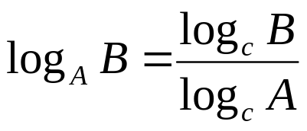
Logarithms
Definition: if and only if
Theorem 1.1:
  Proof: apply the definition
Theorem 1.2: log AB = log A + log B
  Proof: again apply the definition
log A : default is base 2
  log 2 = 1, log 1 = 0, …
a^{mn} = (a^{m} )^{n} = (a^{n})^{m}
a^{m+n} = a^{m} a^{n}
a^{log n} = n^{log a}
log (a/b ) = log a - log b

Slide 32
Mathematical Foundation
Series and summation:
  1 + 2 + 3 + ……. N = N(N+1)/2 (arithmetic series)
  1 + r+ r² + r³ +………r^{N-1} = (1- r^{N})/(1-r), (geometric series)
  ≤ 1/(1-r) , r < 1, large N
Sum of squares:
1 + 2² + 3² +………N² = N(N + 1)(2N + 1)/6
(proof by induction)

Slide 33
Proof By Induction
(2πn)^{0.5} (n/e)^{n} ≤ n! ≤ (2πn)^{0.5} (n/e)^{n + (1/12n)} ?
Prove that a property holds for input n= 1 (base case)
Assume that the property holds for input size 1,…n. Show that the property holds for input size n+1.
Then, the property holds for all input sizes, n.

Slide 34
Try this: Prove that the sum of 1+2+…..+n = n(n+1)/2
Proof: 1(1+1)/2 = 1
Thus the property holds for n = 1 (base case)
Assume that the property holds for n=1,…,m,
Thus 1 + 2 +…..+m = m(m+1)/2
We will show that the property holds for n = m + 1, that is 1 + 2 + ….. + m + m + 1 = (m+1)(m+2)/2
This means that the property holds for n=2 since we have shown it for n=1
Again this means that the property holds for n=3 and then for n=4 and so on.

Slide 35
Now we show that the property holds for n = m + 1, that is 1 + 2 + ….. + m + m + 1 = (m+1)(m+2)/2
assuming that 1 + 2 +…..+m = m(m+1)/2
1 + 2 +…..+m + (m+1) = m(m+1)/2 + (m+1)
= (m+1)(m/2 + 1)
= (m+1)(m+2)/2

Slide 36
Sum of Squares
Now we show that
1 + 2² + 3² +………n² = n(n + 1)(2n + 1)/6
1(1+1)(2+1)/6 = 1
Thus the property holds for n = 1 (base case)
Assume that the property holds for n=1,..m, Thus 1 + 2² + 3² +………m² = m(m + 1)(2m + 1)/6
and show the property for m + 1, that is show that 1 + 2² + 3² +………m² +(m+1)² = (m+1)(m + 2)(2m + 3)/6

Slide 37
1 + 2² + 3² +………m² + (m+1)² = m(m + 1)(2m + 1)/6 + (m+1)²
=(m+1)[m(2m+1)/6 +m+1]
= (m+1)[2m² + m + 6m +6]/6
= (m+1)(m + 2)(2m + 3)/6

Slide 38
Fibonacci Numbers
Sequence of numbers, F₀ F₁ , F₂ , F₃ ,…….
F₀ = 1, F₁ = 1,
F_{i} = F_{i-1} + F_{i-2} ,
F₂ = 2, F₃ = 3, F₄ = 5, F₅ = 8

Slide 39
Prove that F_{n+1} < (5/3)^{n+1} ,
F₂ < (5/3 )²
Assume that the property holds for 1,…k
Thus F_{k+1} < (5/3)^{k+1}, F_{k} < (5/3)^{k}
F_{k+2} = F_{k} + F_{k+1} ,
< (5/3)^{k} + (5/3)^{k+1}
= (5/3)^{k} (5/3 + 1)
< (5/3)^{k} (5/3)²

Slide 40
Math used in 171
These math functions and techniques will be useful for later, when we study how to analyze the program complexity

