Slide 1
Comp 3311 Database Management Systems
2. Entity Relationship (ER) Model
Exercises

Slide 2
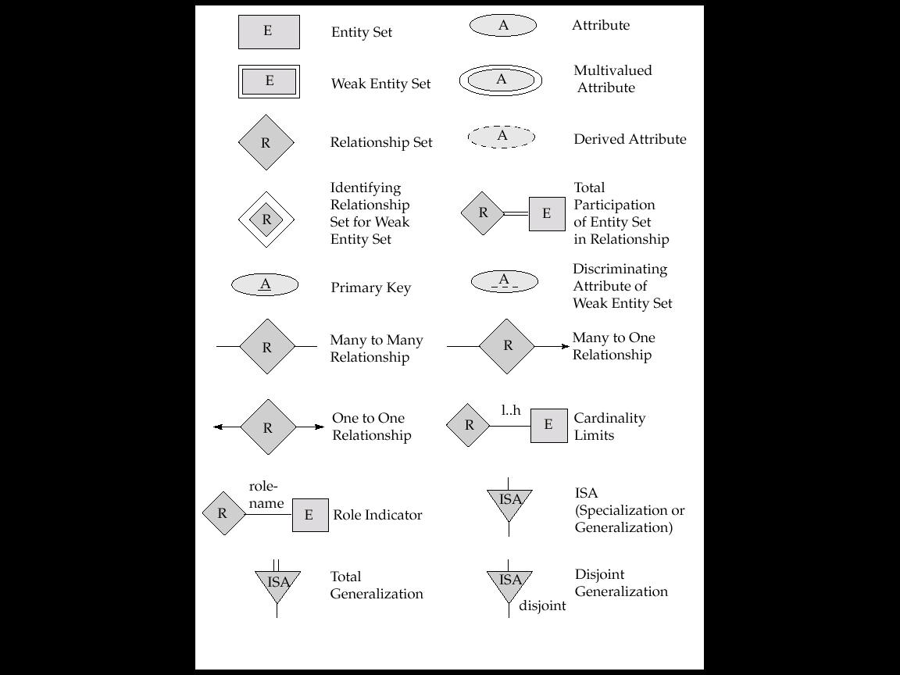
Summary of Symbols Used in E-R Notation

Slide 3
Summary of Symbols Used in E-R Notation

Slide 4
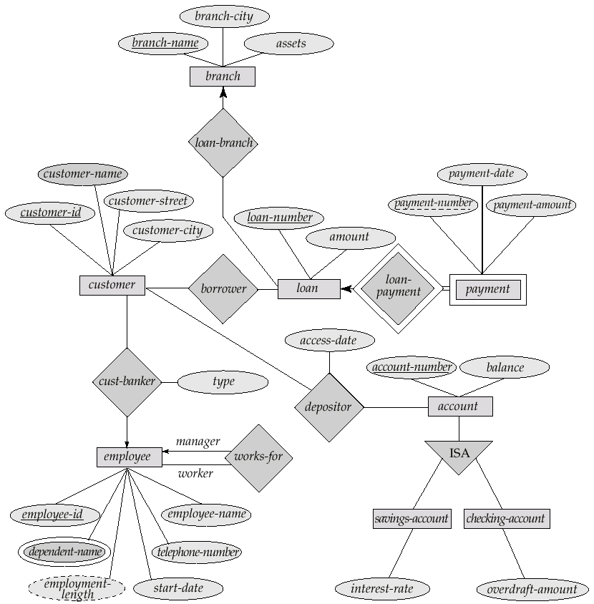
E-R Diagram for a Banking Enterprise

Slide 5
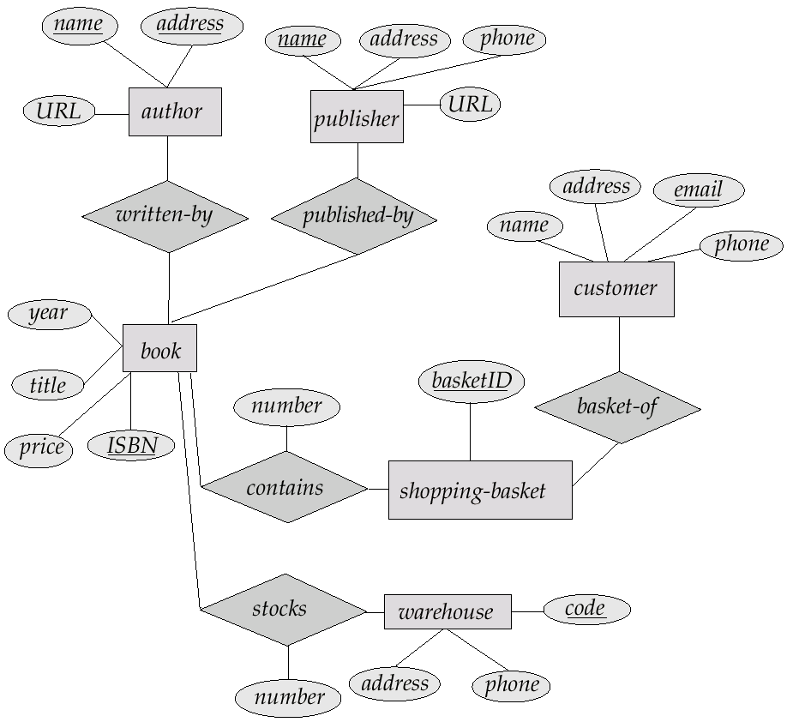
E-R Diagram for Exercise 2.12
E-R Diagram for a Publisher Enterprise

Slide 6
E-R Diagram for Company Database
Number
Fname
Minit
Lname
Locations
WORKS_FOR
Name
Address
Name
Sex
Salary
Ssn
Number Of Employees
DEPARTMENT
EMPLOYEE
Startdate
Bdate
MANAGES
CONTROLS
supervisor
supervisee
SUPERVISION
Hours
WORKS_ON
PROJECT
DEPENDENTS_OF
Name
Location
Number
DEPENDENT
Can you translate it back into English?
Name
Sex
Birthdate
Relationship

Slide 7
Example
We want to create a very simple database for HKUST to record information about professors, students and classes.
For each professor we need to store the HK-id, name and office number.
For each student we need to store the student-id and name.
For each class a unique cid and the name.
Each class is taught by exactly one professor.
Each student must take at least one class.
For each class that a student took we need to store the grade.

Slide 8
Solution
Is there any additional assumption in the diagram?
Does a professor have to teach a class?

Slide 9
Example
A bus company wants to keep track of its bus routes and schedules. Design an ER diagram for the database according to the following description. Identify all constraints and keys:
Each bus route has a unique route number, a departure station and a destination station.
For each bus route, there is a schedule, which records the departure times of buses.
For each departure time of each route, a driver and a bus can be assigned (however information about the driver or the bus may sometimes be missing)
A driver has a unique employee Id, a name and a phone number.
A bus is identified by its license number. The database also records the seating capacity of each bus.

Slide 10
Solution

