Slide 1
Comp 3311 Database Management Systems
17. Query Processing - Other Operations, Pipelining and Materialization

Slide 2
Main Content
Other Operations
Duplication Elimination and Projection
Set Operations
Aggregation
Materialization and Pipelining

Slide 3
Other Operations: Duplicate Elimination and Projection
Duplicate elimination can be implemented via hashing or sorting
  On sorting duplicates adjacent to each other → duplicates can be deleted
  Optimization: duplicates can be deleted during run generation as well as at intermediate merge steps in external sort-merge
  Hashing is similar → duplicates in the same bucket
High cost to eliminate duplication – DISTINCT should be explicitly specified in SQL
Projection:
  perform projection on each tuple followed by duplicate elimination, not necessary if projection involving candidate keys

Slide 4
Other Operations: Set Operations
Set operations can be handled by join algorithms: can either use variant of merge-join after sorting, or variant of hash-join
Sorting based approach:
  Sort both relations (on the same attribute)
  The merging phase depends on the operation
    Intersection: report a tuple only if it belongs to both files
    Union: report all tuples except for the ones that belong to both files
    Set difference: report the tuples that belong to the first file but not the second one
Hash based approach:
  Partition R and S using hash function h (on all attributes)
  For each S-partition, build in-memory hash table (using h2), scan corresponding R-partition and for each tuple t of R
    Intersection : report t only if it also belongs to S
    Union: report t if it does not belong to S. At the end report all tuples of S
    Set difference : report t only if it does not belong to S (computes R-S; how to compute S-R?)
Notes:
19

Slide 5
Evaluation of Expressions
So far: we have seen algorithms for individual operations
Alternatives for evaluating an entire expression tree
  Materialization: generate results of an expression whose inputs are relations or are already computed, materialize (store) it on disk Repeat
  Pipelining: pass on tuples to parent operations even as an operation is being executed

Slide 6

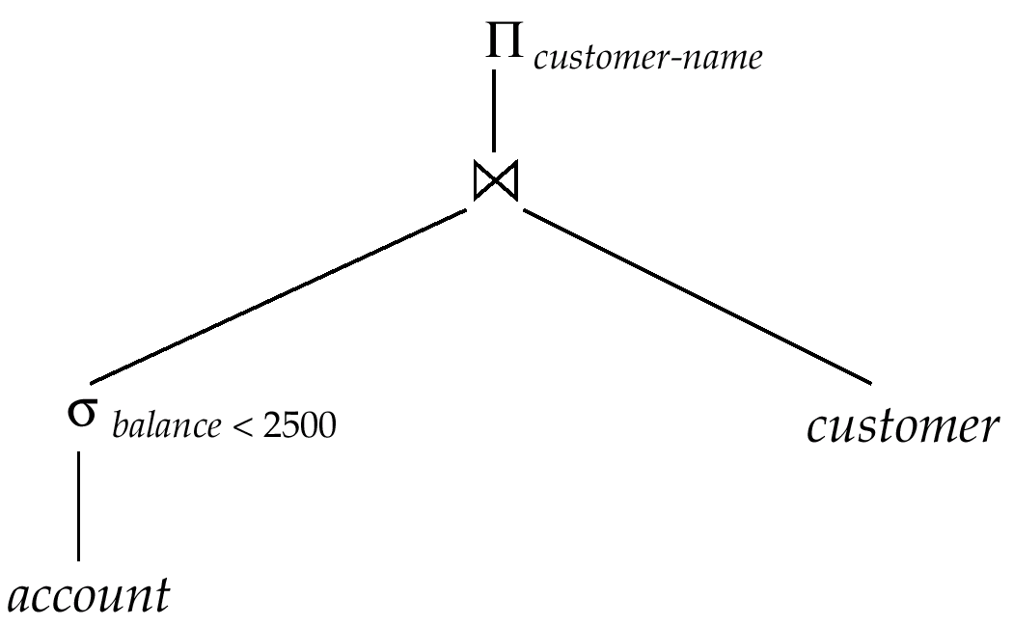
Materialization
Materialized evaluation: evaluate one operation at a time, starting at the lowest-level. Use intermediate results materialized into temporary relations to evaluate next-level operations
Example: find the names of customers who have an account with balance below 2500. Compute and store
Then compute the store its join with customer, and finally compute the projections on customer-name

Slide 7
Materialization (Cont.)
Materialized evaluation is always applicable
Cost of writing intermediate results to disk and reading them back can be quite high
  Our cost formulas for operations ignore cost of writing final results to disk, so
    Overall cost = Sum of costs of individual operations +
    cost of writing intermediate results to disk
Double buffering: use two output buffers for each operation, when one is full write it to disk while the other is getting filled
  Allows overlap of disk writes with computation and reduces execution time

Slide 8

Pipelining
Pipelined evaluation : evaluate several operations simultaneously, passing the results of one operation on to the next
E.g., in previous expression tree, don’t store result of
  instead, pass tuples directly to the join. Similarly, don’t store result of join, pass tuples directly to projection
Much cheaper than materialization: no need to store a temporary relation to disk
For pipelining to be effective, use evaluation algorithms that generate output tuples even as tuples are received for inputs to the operation
Pipelines can be executed in two ways: demand driven and producer driven

Slide 9
Pipelining (Cont.)
In demand driven or lazy evaluation (pull model)
  System repeatedly requests next tuple from top level operation
  Each operation requests next tuple from children operations as required, in order to output its next tuple
  In between calls, operation has to maintain the “state” of executions so it knows what to return next
In produce-driven or eager pipelining (push model)
  Operators produce tuples eagerly and pass them up to their parents
    Buffer maintained between operators, child puts tuples in buffer, parent removes tuples from buffer
    If buffer is full, child waits till there is space in the buffer, and then generates more tuples

Slide 10
Evaluation Algorithms for Pipelining
Some algorithms are not able to output results even as they get input tuples. They are called blocking
  E.g. sort merge join, or hash join
  These leads to intermediate results being written to disk and then read back always
Algorithm variants are possible to generate (at least some) results on the fly, as input tuples are read in
  E.g. hybrid hash join generates output tuples even as probe relation tuples in the in-memory partition (partition 0) are read in
  Pipelined join technique: Hybrid hash join, modified to buffer partition 0 tuples of both relations in-memory, reading them as they become available, and output results of any matches between partition 0 tuples
    When a new r₀ tuple is found, match it with existing s₀ tuples, output matches, and save it in r₀
    Symmetrically for s₀ tuples

Slide 11
Query Optimization - Motivation
Consider the relations R1(A,B,C), R2(C,D,E), and R3(E,F). Primary keys are underlined and foreign keys in italics. Foreign keys are not NULL
Assume that :
  R1 has 1000 tuples
  R2 has 10000 tuples
  R3 has 100000 tuples
What is the best way to join R_{1,} R_{2,} and R₃?
(R₁ JOIN_{C} R₂) JOIN_{E} R₃ or R₁ JOIN_{C} (R₂ JOIN_{E} R₃ )
What is the size (number of records) in intermediate result R₁ JOIN_{C} R₂?
What is the size (number of records) in intermediate result R₂ JOIN_{E} R₃?
What is the size (number of records) in the final result?
Cost difference between a good and a bad way of evaluating a query can be enormous
How the optimizer can choose the best evaluation plan for processing the query?
Different plans for a given query involve
  Different but equivalent algebra expressions
  Different algorithms for each operation

Slide 12
Join Ordering Example
For all relations r_{1,} r_{2,} and r₃,
(r₁ r₂) r₃ = r₁ (r₂ r₃ )
(Join Associativity)
If r₂ r₃ is quite large and r₁ r₂ is small, we choose
(r₁ r₂) r₃
so that we compute and store a smaller temporary relation

Slide 13
Join Ordering Example (Cont.)
Consider the expression
Π_{customer_name} ((σ_{branch_city = “Brooklyn”} (branch))
(account depositor))
Could compute account depositor first, and join result with
σ_{branch_city = “Brooklyn”} (branch)
but account depositor is likely to be a large relation
Only a small fraction of the bank’s customers are likely to have accounts in branches located in Brooklyn
  it is better to compute
σ_{branch_city = “Brooklyn”} (branch) account
first

Slide 14
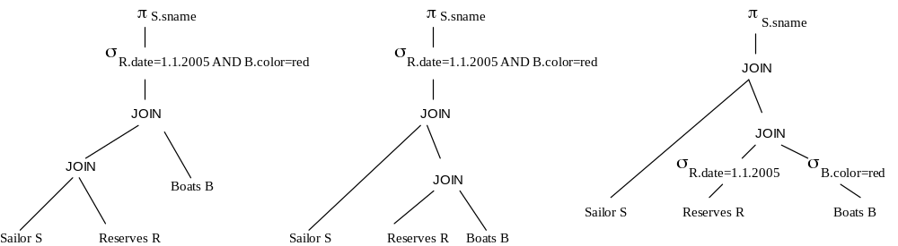
Different Algebra Expressions
Given a query, the optimizer will first generate an algebra expression (tree)
SELECT sname
FROM Sailor S, Reserves R, Boats B
WHERE S.sid=R.sid and R.bid = B.bid and R.date=1.1.2005 and B.color=red

Slide 15
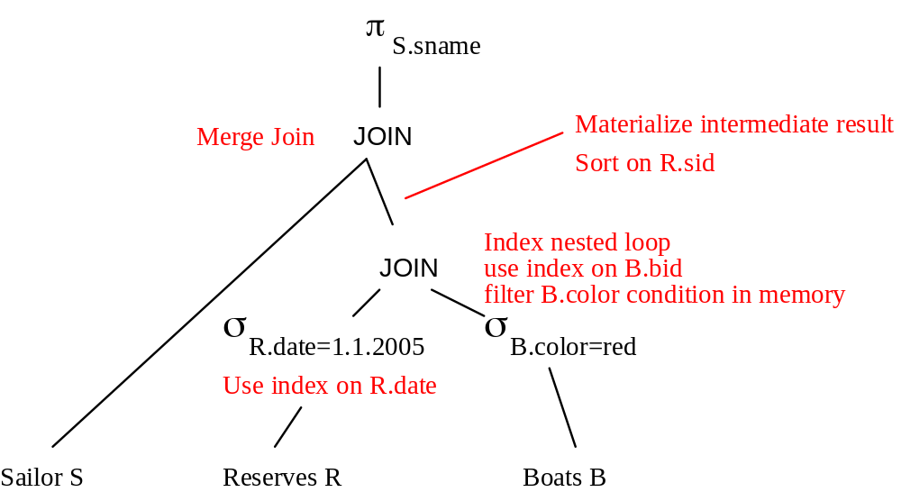
Evaluation Plan
An evaluation plan defines
what algorithm is used for each operation
how the execution of the operations is coordinated
Example: assuming that Sailor is sorted on sid

