Slide 1
BCNF,
Memory Hierarchy & File Structures
COMP3311 Spring 2015
Tutorial 6

Slide 2
Exercise: BCNF
BCNF: Boyce-Codd Normal Form
R is in BCNF if and only if
for each FD: X → {A} in F+,
A ∈ X (trivial FD), or
X is a superkey for R
In other words: For every FD that does not contain extraneous (useless) attributes, the LHS of every FD is a candidate key.

Slide 3
Exercise: BCNF (cont)
R =(A, B, C, D).
F = {C → D, C → A, B → C}.
Decompose R into a set of BCNF relations.
S={R}. When we find a schema R with BCNF violation X → Y we:
1. Remove R from S
2. Add a schema that has the same attributes as R except for Y
3. Add a second schema that contains the attributes in X and Y

Slide 4
Exercise: BCNF (cont)
R =(A, B, C, D).
F = {C → D, C → A, B → C}.
Decompose R into a set of BCNF relations.
List all candidate keys of R.
{B}
C → D, C → A violates BCNF. Because C is not a super key for R.
Take C → D: decompose R to
R₁= {A, B, C} , R₂={C, D}.
C → A in R₁ violates BCNF. C is not a super key for R₁.
Decompose R₁ to
R₁₁ = {B, C} R₁₂ = {C, A}.
Final decomposition:
R₂ = {C, D}, R₁₁ = {B, C}, R₁₂ = {C, A}.

Slide 5
Memory Hierarchy
 | Cost (money) | Access (time) | volatile | Capacity
Cache | Very expensive | Very Fast | Yes | KB -> MB
Main memory | Expensive | Fast | Yes | MB -> GB
Disk | Inexpensive | Slow | No | GB -> TB
Tape | Very inexpensive | Very slow | No | TB -> PB
Database
ref: numbers

Slide 6
Accessing Disk
Access unit: disk blocks or pages
(typically a block is 1K-16Kbytes)
Physical movement, random access
Time to access (read/write) a disk block
seek time + rotational delay + transfer time

Slide 7
Data File Organization
Database<->a collection of files
File<->a sequence of records
Record<->a sequence of fields
Storing records in files
Fixed-Length Records
Free Lists
Variable-Length Records
Byte String Representation
Reserved space
Pointer Method
Slotted Page Structure

Slide 8
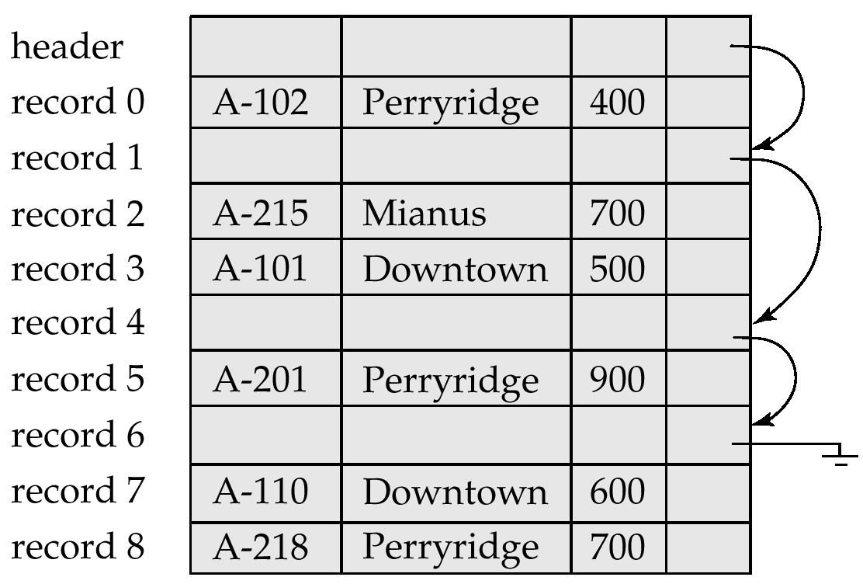
Fixed-Length Records
Fixed-Length Records
Record access is simple: n*(i-1)
Problem: what if deletion?
Free list
i

Slide 9
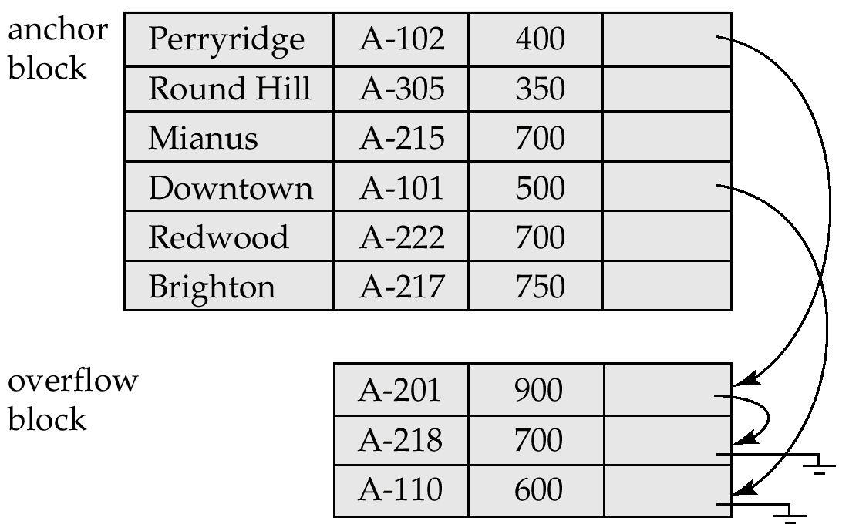
Data File Organization
Variable-Length Records
Byte String Representation : Attach an end-of-record (⊥) control character to the end of each record
Problem: deletion & record growth
Reserved space : use fixed-length records of a known maximum length
Problem: waste storage space
Pointer Method : Anchor block + Overflow block

Slide 10
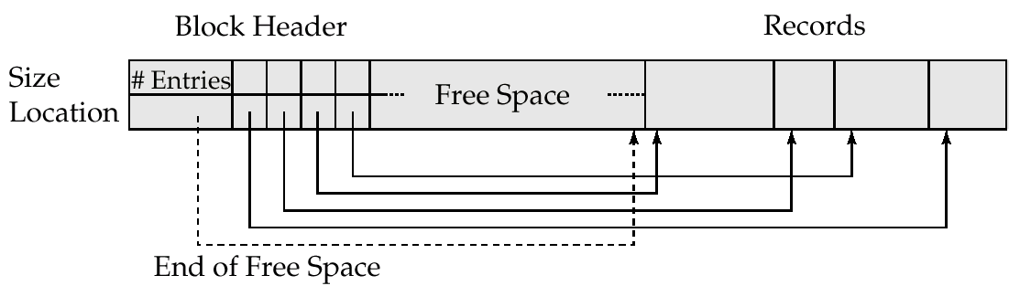
Data File Organization
Variable-Length Records
Byte String Representation : Attach an end-of-record (⊥) control character to the end of each record
Problem: deletion & record growth
Reserved space : use fixed-length records of a known maximum length
Problem: waste storage space
Pointer Method : Anchor block + Overflow block
Slotted Page Structure :
Low cost for data movement within a page

Slide 11
Data File Organization
Database<->a collection of files
File<->a sequence of records
Record<->a sequence of fields
Heap
record can be placed anywhere in the file where there is space
Sequential
store records in sequential order
Hashing
a hash function computed on some attribute of each record

Slide 12
Exercise 1
Assume that a school keeps a file with the records of its students: Student (sid:4 bytes, sname: 10 bytes, dept-id: 4 bytes), dept-id is the department id where a student belongs to.
There exist 10,000 student records and 50 departments. A page is 128 bytes and a pointer is 4 bytes. The data file is sorted sequentially on sid.
Q1: What’s the size of a record?
Q2: How many pages do we need to store these student records?
Q3: Given this data file, what’s the cost to find a particular student by sid?

Slide 13
Exercise 1
Student (sid:4 bytes, sname: 10 bytes, dept-id: 4 bytes)
There exist 10,000 student records and 50 departments. A page is 128 bytes and a pointer is 4 bytes. The data file is sorted sequentially on sid.
What’s the size of a record?
4 + 10 + 4 = 18

Slide 14
Exercise 1
Student (sid:4 bytes, sname: 10 bytes, dept-id: 4 bytes)
There exist 10,000 student records and 50 departments. A page is 128 bytes and a pointer is 4 bytes. The data file is sorted sequentially on sid.
How many pages do we need to store these student records?
(#records * size of record) / size of page =
10,000 * 18 / 128 = 1406.25 ≈ 1407
7 records, of size 18*7=126 bytes
Do not allow records to cross page boundaries
18 bytes
18 bytes
…
18 bytes
18 bytes
…
18 bytes
18 bytes
Page size: 128 bytes

Slide 15
Exercise 1
Student (sid:4 bytes, sname: 10 bytes, dept-id: 4 bytes)
There exist 10,000 student records and 50 departments. A page is 128 bytes and a pointer is 4 bytes. The data file is sorted sequentially on sid.
How many pages do we need to store these student records?
⎡(# of records / ⎣ size of page / size of record ⎦) ⎤ =
⎡ (10,000 / ⎣ 128 / 18 ⎦ )⎤ = 1429
7 records, of size 18*7=126 bytes
7 records
18 bytes
18 bytes
…
18 bytes
18 bytes
…
18 bytes
Page size: 128 bytes

Slide 16
Exercise 1
Student (sid:4 bytes, sname: 10 bytes, dept-id: 4 bytes)
There exist 10,000 student records and 50 departments. A page is 128 bytes and a pointer is 4 bytes. The data file is sorted sequentially on sid.
Q3: Given this data file, what’s the cost to find a particular student by sid?
# of pages required: 1429
Binary search on sid:
⎡ log₂(# of pages) ⎤ = ⎡ log₂1429 ⎤ = 11

