Slide 1
COMP3311 Spring 2015
Tutorial 8
Other Indices, External Sorting, and Join Algorithms

Slide 2
Part 1: Index and External Sorting
Bitmap indices
Grid files
Merge sort

Slide 3
Review: Bitmap Indices
  Bitmap has as many bits as records
Bitmap indices are useful for queries on multiple attributes
Queries are answered using bitmap operations
  Intersection (AND)
  Union (OR)
  Complementation (NOT)

Slide 4
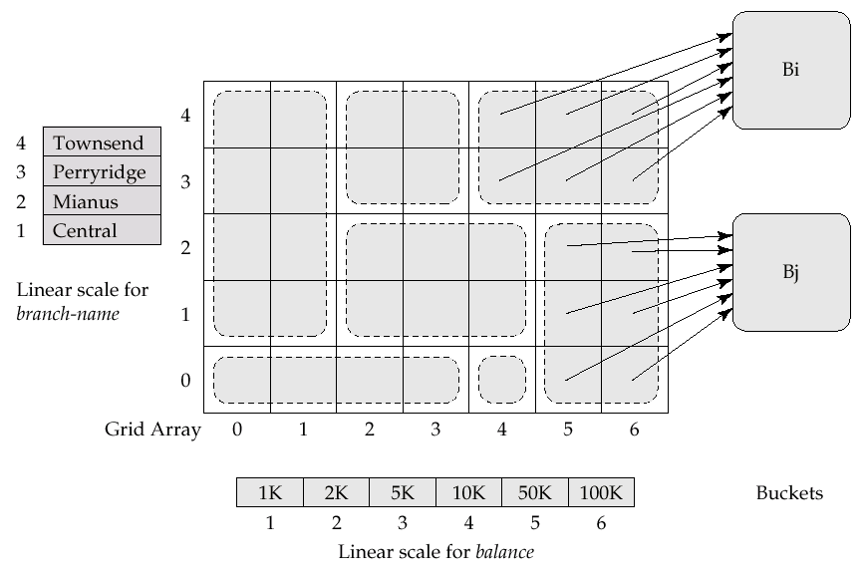
Review: Grid Files
Speed up multi-dimensional range search
A grid file on two attributes A and B can handle queries of all following forms with reasonable efficiency
  (a1 ≤ A ≤ a2)
  (b1 ≤ B ≤ b2)
  (a1 ≤ A ≤ a2 ∧ b1 ≤ B ≤ b2)

Slide 5
Review: Merge Sort
Algorithm:
  Create sorted runs
  N-way merge:
    Read the first page of each run into buffer page
    REPEAT
      Select the first record (in sorted order) among all buffer pages
      Write the record to the output buffer. If the output buffer is full write it to disk.
      Delete the record from its input buffer page.
      IF the buffer page becomes empty THEN
      read the next page (if any) of the run into the buffer.
    UNTIL all input buffer pages are empty

Slide 6
Exercise 1: Merge Sort
Given:
  800 pages of a file
  10 pages of main memory
  Sort this file by merging
How many passes you need at least?
What is the total cost (page access)?
How many pages of main memory you need at least, in order to sort this file in two passes?

Slide 7
Exercise 1: Merge Sort (1/3)
Given:
  800 pages of a file
  10 pages of main memory
How many passes you need at least?
pass0
1
2
10
11
12
20
…
791
792
800
sorted run 1
sorted run 2
sorted run 80
pass1
run 1
run 2
run 9
10*9 pages
…
10*8 pages
sorted run 1
sorted run 9
pass2
sorted file
800 pages

Slide 8
Exercise 1: Merge Sort (2/3)
Given:
  800 pages of a file
  10 pages of main memory
What is the total cost (page access)?
Cost = b_{r}(2⎡log_{M-1}(b_{r}/M)⎤+1)
= 800 * (2 * ⎡log₉(800/10)⎤ + 1)
= 4,000

Slide 9
Exercise 1: Merge Sort (3/3)
Given:
  800 pages of a file
How many pages of main memory you need at least, in order to sort this file in two passes?
Suppose we have M pages of main memory.
At pass 0, ⎡800/M⎤ runs are created.
At pass 1, we have M-1 pages of main memory as buffer.
So M-1 ≥ ⎡800/M⎤.
M = 29.

Slide 10
Part 2: Join Algorithms
Block Nested-Loop Join
Indexed Nested-Loop Join
Sort-Merge Join
Hash Join

Slide 11
Review: Block Nested-Loop Join
Read in the outer relation r page by page
For each page of r, scan the entire inner relation s.
Best cost: b_{r} + b_{s} (if s is small enough to fit in memory)
  b_{r} (b_{s}): no. of pages of r (s)
Buffer needed at least: 3 pages (1 for r, 1 for s, 1 for output)
  If memory has M pages, read M – 2 pages of r at a time and use the remaining two pages for s and the output.
  Cost = ⎡b_{r} / (M – 2)⎤ ∗ b_{s} + b_{r}
r
s
0005
0005
0002
0002
0004
0002
0002
0003
0002
0002
0001
0005
0005

Slide 12
Review: Indexed Nested-Loop Join
Index lookup can replace file scan if an index is available on the join attribute of inner relation
For each tuple t_{r} in the outer relation r, use the index to look up tuples in s that satisfy the join condition with tuple t_{r}.
Cost of the join: b_{r} + n_{r} ∗ c
    n_{r}: no. of tuples in r
    c is the cost to traverse index
    and fetch all matching s tuples
    for one t_{r}.
    c can be estimated as cost of
    a single selection on s using
    the join condition.
r
index on s
s
0005
0005
0002
0002
0004
0002
0002
0003
0002
0002
0001
0005
0005
If indices are available on the join attribute of both r and s,
use the relation with fewer tuples as the outer relation.

Slide 13
Review: Sort-Merge Join
Sort both relations on the join attribute (if not already sorted)
Merge the sorted relations to join them
    Join step is similar to the merge stage of the MergeSort algorithm
    Main difference is the handling of duplicate values in join attribute — every pair with the same value on join attribute must be matched
Can be used only for equal-joins and natural joins
Each block needs to be read only once
    Cost = b_{r} + b_{s} + the cost of sorting if relations are unsorted
0001
0002
0002
0002
0002
0002
0002
0003
0004
0005
0005
0005
0005

Slide 14
Review: Hash Join
Applicable for equi-joins and natural joins
A hash function h is used to partition tuples of both relations
    h maps JoinAttrs values to {0, 1, ..., n}, where JoinAttrs denotes the common attributes of r and s used in the natural join.
    r0, r1, . . ., rn denote partitions of r tuples; each tuple tr ∈ r is put in partition ri,
  where i = h(tr [JoinAttrs]).
  s0,, s1. . ., sn denotes partitions of s tuples; each tuple ts ∈s is put in partition si, where i = h(ts [JoinAttrs]).
0001
0002
0002
0002
0004
0001
0002
0003
0004
0005
0005
0002
0005
0005
0002
0005
0002
0002
0005
0002
0002
0002
0002
0003
0005
0005

Slide 15
Exercise 2: Join Algorithms
Relations: R1(A,B,C) and R2(C,D,E)
  R1 has 20,000 tuples.
  R2 has 45,000 tuples.
  25 tuples of R1 fit in one block (blocking factor): 800 pages.
  30 tuples of R2 fit in one block (blocking factor): 1,500 pages.
Estimate the number of disk accesses required, using each of the following join algorithms for R1⋈R2:
  Block nested-loop join
  Indexed nested-loop join
  Sort-merge join
  Hash join
  Hybrid hash join
Assume 100 pages of main memory (buffer)

Slide 16
Exercise 2: Block Nested Loop Join
Cost: b_{r} + ⎡b_{r} / (M – 2)⎤ * b_{s}
  M=100 buffer pages available
When R1 is the outer relation
  Cost = ⎡800 / (100 – 2)⎤ * 1,500 + 800 = 14300
When R2 is the outer relation
  Cost = ⎡1,500 / (100 – 2)⎤ * 800 + 1,500 = 14300

Slide 17
Exercise 2: Indexed Nested Loop Join
Question: Let R2 have a primary B+-tree index with 3 levels on the join attribute C (which is also the primary key of R2). To compute R1⋈R2, we need to compute:
Number of R1’s pages: b_{r} = 800
Number of R1’s tuples: n_{r} = 20000
The cost is b_{r} + c*n_{r} = 800 + (3+1)*20000
= 80800

Slide 18
Exercise 2: Sort-Merge Join
Assume R1 and R2 are not initially sorted on the join attribute. We want to compute R1⋈R2.
Cost = sorting cost + b_{r} + b_{s}
The merge sorting cost of R1 is
  800*(2⎡log₁₀₀₋₁(800/100)⎤+1) = 2400.
The merge sorting cost of R1 is
  1500*(2⎡log₁₀₀₋₁(1500/100)⎤+1) = 4500.
The total cost is 2400 + 4500 + 1,500 + 800 = 9200
Any improvements?

Slide 19
Exercise 2: Sort-Merge Join (cont.)
Create 8 sorted runs of R1 and write it out: 800 + 800
Create 15 sorted runs of R2 and write it out: 1500 + 1500
Read 8 sorted runs of R1 and 15 sorted runs of R2 using one buffer page per run and merge them: 800+1500.
The total cost is 3*(800+1500)=6900

Slide 20
Exercise 2: Hash Join
The memory size is M=100 pages
b_{r}= 800 and b_{s} = 1500.
R1 is the build input. Partition R1 into 10 buckets, each of size 80 pages. This partitioning can be done in one pass.
R2 is the probe input. Partition R2 into 10 buckets, each of size 150 pages. This is also done in one pass.
Read each bucket in turn of the build input in memory, and probe against records of the corresponding probe bucket.
Therefore total cost: 3*(800 + 1500) = 6900 page transfers
Ignore cost of writing partially filled pages
Any improvements?

Slide 21
Exercise 2: Hybrid Hash Join
Since we partition R1 into 10 partitions with 80 pages per partition. We can keep one partition in memory and give one page per partition for the other 9 partitions. Cost of writing the 9 partitions out: 800+800-80.
When partitioning R2, we probe the first partition of R1 in memory with R2 tuples to immediately output join results on the first partition. For the other 9 partitions of R2, give them one memory page per partition. Cost of writing the 9 partitions of R2 out: 1500+1500-150.
For the 9 partitions of R1 and R2, read each partition of R1 and probe with the corresponding partition of R2: 800-80+1500-150.
The total cost is 3*(800+1500) - 2*(80+150) = 6440.

