Slide 1
Complexity Results about Nash Equilibria
Vincent Conitzer, Tuomas Sandholm
International Joint Conferences on Artificial Intelligence 2003 (IJCAI’03)
Presented by XU, Jing
For COMP670O, Spring 2006, HKUST

Slide 2
Problems of interests
Noncooperative games
  Good Equilibria
  Good Mechanisms
  Most existence questions are NP-hard for general normal form games.
  Designing Algorithms depends on problem structure.

Slide 3
Agenda
Literature
A symmetric 2-player game and results on mixed-strategy NE in this game
Complexity results on pure-strategy Bayes-Nash Equilibria
Pure-strategy Nash Equilibria in stochastic (Markov) games

Slide 4
Literature
2-player zero-sum games can be solved using LP in polynomial time (R.D.Luce, H.Raiffa '57)
In 2-player general-sum normal form games, determining the existence of NE with certain properties is NP-hard (I.Gilboa, E.Zemel '89)
In repeated and sequential games (E. Ben-Porath '90, D. Koller & N. Megiddo '92, Michael Littman & Peter Stone'03, etc.)
  Best-responding
  Guaranteeing payoffs
  Finding an equilibrium

Slide 5
A Symmetric 2-player Game
Given a Boolean formula φ in conjunctive normal form, e.g. (x₁Vx₂)Λ(-x₁V-x₂)
V={x_{i}}, φ's set of variables, let |V|=n
L={x_{i}, -x_{i}}, corresponding literals
C: φ's clauses, e.g. x₁Vx₂, -x₁V-x₂
v: L→V, i.e. v(x_{i})=v(-x_{i})= x_{i}
G(φ ):
  Σ=Σ₁=Σ₂= L∪V∪C∪{f}
Notes:
A statement is in conjunctive normal form if it is a conjunction (sequence of ANDs) consisting of one or more conjuncts, each of which is a disjunction (OR) of one or more literals (i.e., statement letters and negations of statement letters, Mendelson 1997, p. 30).

Slide 6
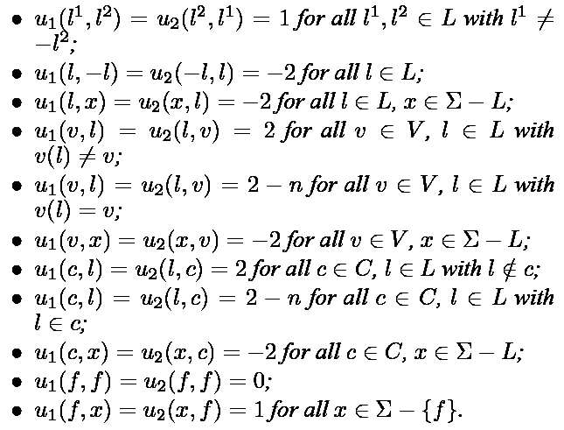
A Symmetric 2-player Game
  Utility function

Slide 7
A Symmetric 2-player Game
P2 P1 | L | V | C | f
L | 1, l_{i}≠-l_{j} -2, l_{i}=-l_{j} | -2 | -2 | -2
V | 2, v(l)≠x 2-n, v(l)=x | -2 | -2 | -2
C | 2, l∉c 2-n, l∈c | -2 | -2 | -2
f | 1 | 1 | 1 | 0
  u₁(a,b) =u₂(b,a)
 | x₁ | -x₁ | x₂ | -x₂
x₁ | 1 | -2 | 1 | 1
-x₁ | -2 | 1 | 1 | 1
x₂ | 1 | 1 | 1 | -2
-x₂ | 1 | 1 | -2 | 1

Slide 8
Theorem 1
If (l₁,l₂,…,l_{n}) satisfies φ and v(l_{i}) = x_{i}, then
  There is a NE of G(φ) where both players play l_{i} with probability 1/n, with E(u_{i})=1.
  The only other Nash equilibrium is the one where both players play f, with E(u_{i})=0.
Proof:
  If player 2 plays l_{i} with p₂(l_{i})=1/n, then player 1
    Plays any of l_{i}, E(u₁)=1
    Plays –l_{i}, E(u₁)=1-3/n<1
    Plays v, E(u₁)=1
    Plays c, E(u₁)≤1, since every clause c is satisfied.

Slide 9
Theorem 1
  No other NE:
    If player 2 always plays f, then player 1 plays f.
    If player 1 and 2 play an element of V or C, then at least one player had better strictly choose f.
    If player 2 plays within L∪{f}, then player 1 plays f.
    If player 2 plays within L and either p₂(l)+p₂(-l) <1/n, then player 1 would play v(l), with E(u₁)>2*(1-1/n)+(2-n)*(1/n)=1.
    Both players can only play l or -l simultaneously with probability 1/n, which corresponds to an assignment of the variables.
    If an assignment doesn’t satisfy φ, then no NE.

Slide 10
A Symmetric 2-player Game
P2 P1 | L | V | C | f
L | 1, l_{i}≠-l_{j} -2, l_{i}=-l_{j} | -2 | -2 | -2
V | 2, v(l)≠x 2-n, v(l)=x | -2 | -2 | -2
C | 2, l∉c 2-n, l∈c | -2 | -2 | -2
f | 1 | 1 | 1 | 0
  u₁(a,b) =u₂(b,a)
 | x₁ | -x₁ | x₂ | -x₂
x₁ | 1 | -2 | 1 | 1
-x₁ | -2 | 1 | 1 | 1
x₂ | 1 | 1 | 1 | -2
-x₂ | 1 | 1 | -2 | 1

Slide 11
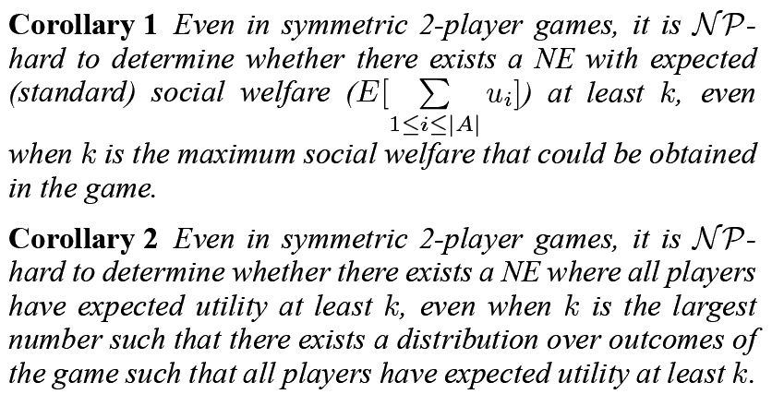
Corollaries
Theorem1: Good NE ⇔ φ is satisfiable.

Slide 12
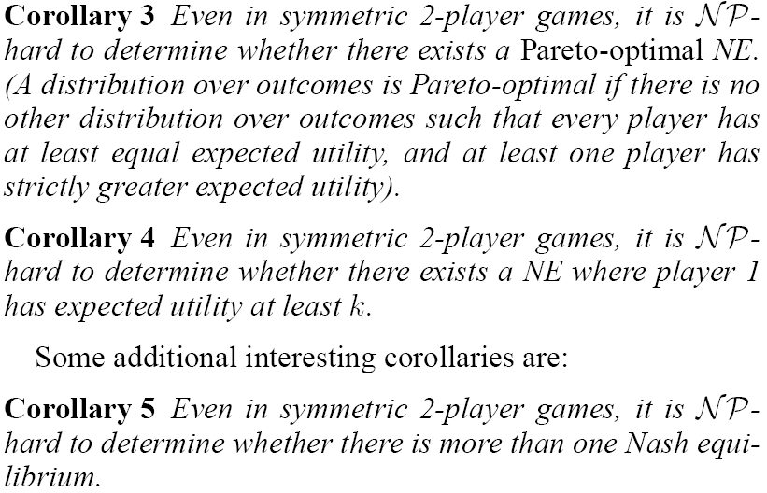
Corollaries

Slide 13
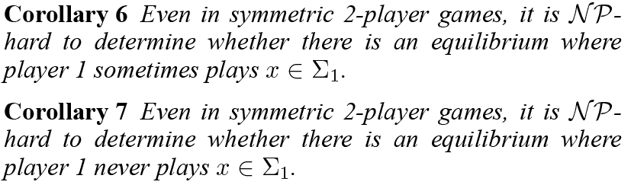
Corollaries
Hard to obtain summary info about a game’s NE, or to get a NE with certain properties.
Some results were first proven by I. Gilboa and E. Zemel ('89).

Slide 14

Corollaries
A NE always exists, but counting them is hard, while searching them remains open.

Slide 15
Bayesian Game
Set of types Θ_{i} , for agent i (i∈A)
Known prior dist. φ over Θ₁× Θ₂×…×Θ_{|A|}
Utility func. u_{i}: Θ_{i}×Σ₁×Σ₂×…×Σ_{|A|} → R
Bayes-NE:
  Mixed-strategy BNE always exists (D. Fudenberg, J. Tirole '91).
  Constructing one BNE remains open.

Slide 16
Complexity results
SET-COVER Problem
  S={s₁,s₂,…, s_{n}}
  S₁, S₂, …, S_{m} ⊆S, ∪S_{i}=S
  Whether exist S_{c1}, S_{c2}, … , S_{ck} s.t. ∪S_{ci}=S ?
Reduction to a symmetric 2-player game
  Θ= Θ₁= Θ₂={θ¹, θ²,…, θ^{k},} (k types each)
  φ is uniform
  Σ= Σ₁= Σ₂={S₁, S₂, …, S_{m}, s₁,s₂,…, s_{n}}
  Omit type in utility functions

Slide 17
Complexity results
Theorem 2: Pure-Strategy-BNE is NP-hard, even in symmetric 2-player games where φ is uniform.
Proof:
  If there exist S_{ci}, then
  both player play S_{ci} when
  their type is θ^{i}. (NE)
  If there is a pure-BNE,
    No one plays s_{i}
    {S_{i} (for θ^{i})} covers S.
P2 P1 | S_{j} | s_{j}
S_{i} | 1 | 1, s_{j}∉S_{i} 2, s_{j}∈S_{i}
s_{i} | 3, s_{i}∉S_{j} -3k,s_{i}∈S_{j} | -3k

Slide 18
Theorem 3
PURE-STRATEGY-INVISIBLE-MARKOV-NE is PSPACE-hard, even when the game is symmetric, 2-player, and the transition process is deterministic. (P⊆NP⊆PSPACE⊆EXPSPACE)

