Slide 1
Worst-Case Equilibria
Elias Koutsoupias and Christos Papadimitriou
Proceedings of the 16th Annual Symposium on
Theoretical Aspects of Computer Science (STACS), 1999, pp. 404-413
Presentation by Vincent Mak for COMP670O
Game-Theoretic Applications in CS
HKUST, Spring 2006

Slide 2
Introduction
Nash equilibria are generally not “socially optimal”
Authors of this paper look at this issue for a class of problems
Investigate the upper (and lower) bounds for the loss of “social welfare” in the worst Nash equilibria compared with the social optimal arrangement

Slide 3
The Model
n agents
Each agent has a load (amount of traffic) w_{i},
i= 1, … , n
m parallel links from an origin to a destination with effectively no capacity constraints
Agents independently select link to put on load; no splitting of load
Pure strategies for agent i is {1, …, m}; mixed strategies are considered

Slide 4
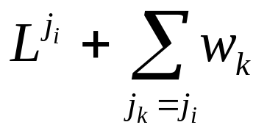
The Model
Traffic cost is linear in the loads
Cost (time delay) for agent i who chooses link j_{i} is
L^{j} = initial task load that has to be executed before the agents’ load
Standard model: assume tasks broken in packets, then sent in round-robin way, then above expression
Random batch order execution: a factor of ½ before the w_{i} summation in cost expression

Slide 5
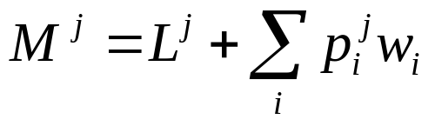
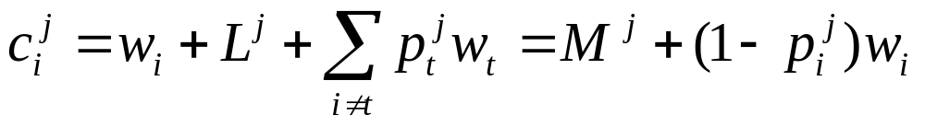
Nash Equilibria
Mixed strategy probabilities denoted by p_{i}^{j} – the probability that agent i selects link j
Expected traffic on link j is
Expected traffic cost to i for choosing link j:

Slide 6
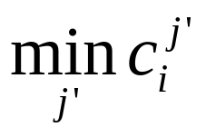
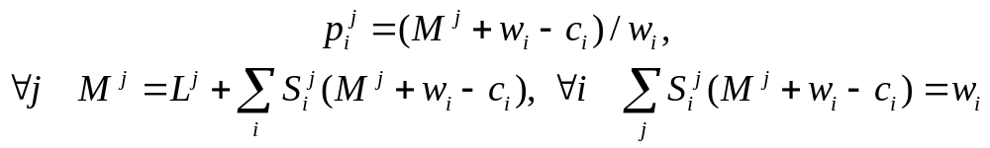
Nash Equilibria
Mixed strategy Nash Equilibria satisfy
If c_{i}^{j} > c_{i} = then p_{i}^{j}= 0
Denote support for i in an equilibrium as
S_{i} = {j: p_{i}^{j}>0}; define S_{i}^{j} =1 when p_{i}^{j} > 0, else S_{i}^{j} =0
Given S_{i} s for all i s, a Nash Equilibrium is the unique solution (if feasible) of

Slide 7
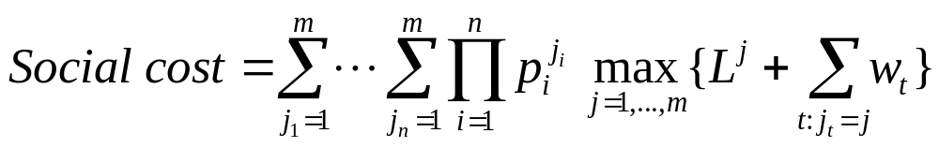
Social Cost
Define social cost as expected maximum traffic:
Coordination Ratio = R = max {Nash equilibrium social cost / social optimal cost (opt)}, max is over all equilibria
Note that (ordering loads so that w₁≥ w₂ ≥ … ≥ w_{n})
opt ≥ max{w₁, Σ_{j} M ^{j} /m} = max{w₁, (Σ_{j} L ^{j}+Σ_{i} w _{i}) / m}

Slide 8
Two Links: Lower Bound
Assume L^{j} = 0 for all j
Theorem 1. R ≥ 3/2 for 2 links.
Proof: consider n=2 with w₁= w₂= 1;
compare Nash equilibrium p_{i}^{j}= ½ for all i, j (social cost = 3/2) with social optimum of placing one load on each link (opt cost = 1)

Slide 9
Two Links
Upper bound for any n for two links?
First define contribution probability:
q_{i} = probability that agent i’s job goes to the link of maximum load
Social cost = Σ_{i} q_{i} w _{i}
Next, define collision probability:
t_{ik} = probability that the traffic of i and k go to the same link
Note that q_{i} + q_{k} ≤ 1 + t_{ik}

Slide 10
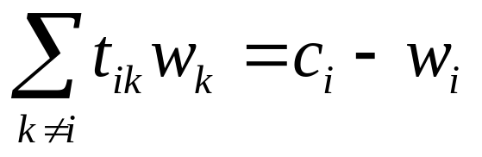
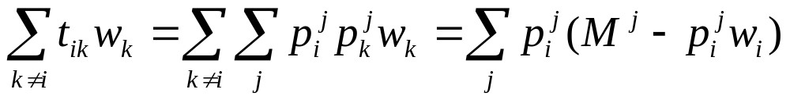
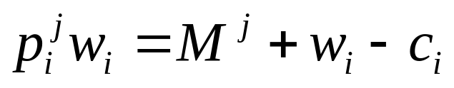
Two Links
Lemma 1.
Proof:
Then use

Slide 11
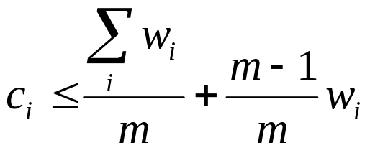
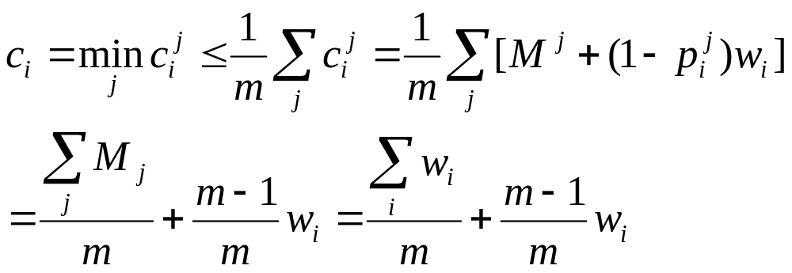
Two Links
An upper bound for c_{i} (true for all m, not only m=2):
Proof:

Slide 12
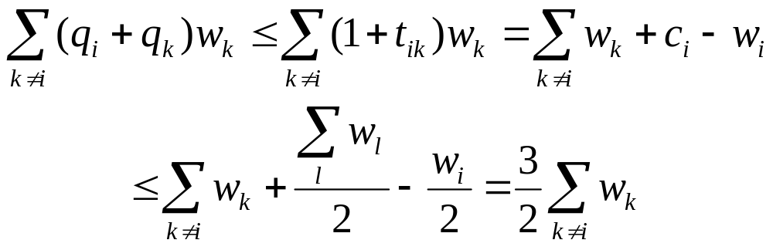
Two Links: Upper Bound
Theorem 2. R ≤ 3/2 for m=2 and any n.
Proof:

Slide 13
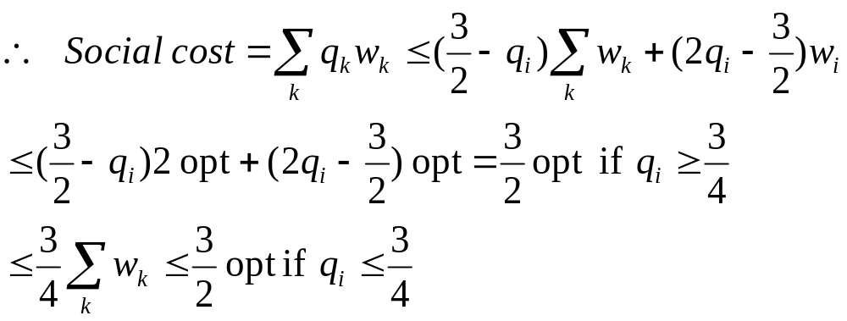
Two Links: Upper Bound
Proof of Theorem 2 (cont’d):

Slide 14
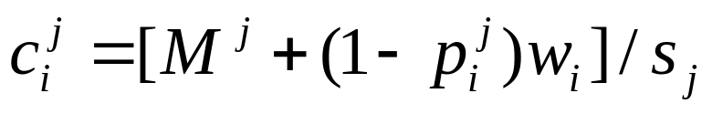
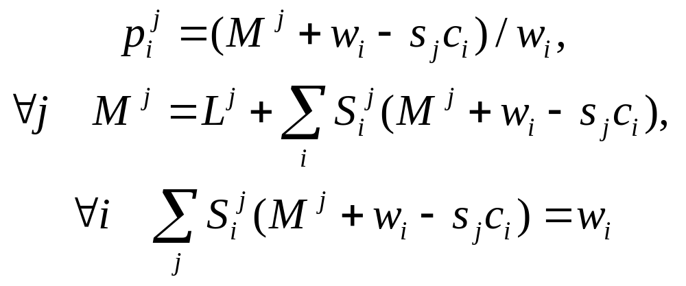
Links with Different Speeds
Order speeds s_{j} so that s₁≤ s₂ ≤ … ≤ s_{m}
Then
The Nash Equilibria equations become:

Slide 15
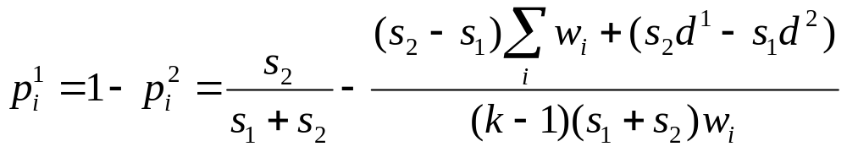
Two Links with Different Speeds
Let d^{j} be the sum of all traffic assigned to link j by agents playing pure strategies
Then if there are k>1 stochastic or mixed strategy agents, their probabilities satisfy:

Slide 16
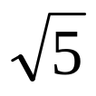
Two Links with Different Speeds
Theorem 3. R for two links with speeds s₁≤ s₂ is at least 1+ s₂/ (s₁+ s₂) when s₂/s₁≤ φ = (1+ )/2. R achieves its maximum value φ when s₂/s₁= φ.
Proof: consider L^{j} = 0, n=2, w₁= s₂ and w₂= s₁.
Opt = 1 (place w₁ on link with speed s₂)
Mixed strategy equilibrium solutions can be found from formula on previous slide (with d^{j} = 0). Compute cost and find R.
Mixed equilibrium is feasible iff s₂/s₁≤ φ

Slide 17
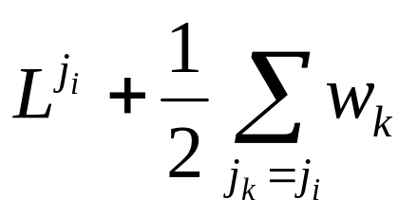
The Batch Model for Two Links
Random batch order execution of loads
Cost for agent i who chooses link j_{i} :
Theorem 4. In the batch model with two identical links, R is between 29/18 = 1.61 and 2. The lower bound 29/18 is also an upper bound when n=2.

Slide 18
The Batch Model for Two Links
Batch and standard models have same equilibria and R when there is no initial load
Theorem 5. For m links and any n, the Rs of the batch model and the standard model differ by at most a factor of 2.
Theorem 5 can be intuited by seeing initial loads L^{j} in batch model as pure strategy agents with loads 2L^{j} in standard model
=> preserves equilibria and changes opt by at most a factor of 2

Slide 19
Worst Equilibria for m Links
Theorem 6. R for m identical links is
Ω(log m / log log m)
Proof: consider m agents each with w_{i}=1
An equilibrium is p_{i}^{j} =1/m for all i, all j
Social cost problem is equivalent to the problem of throwing m balls into m bins and asking for the expected maximum number of balls in a bin
Answer is known to be Θ(log m / log log m)

Slide 20
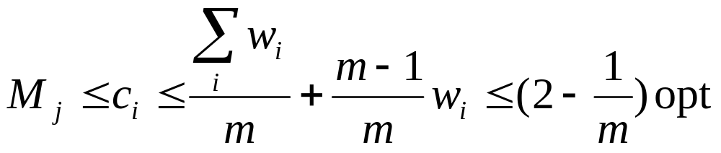
Worst Equilibria for m Links
Theorem 7. For m identical links, the expected load M^{j} of any link j is at most (2-1/m)opt. For links with different speeds, M^{j} is at most s_{j} (1+(m-1)^{1/2}) opt.
Proof for identical links:

Slide 21
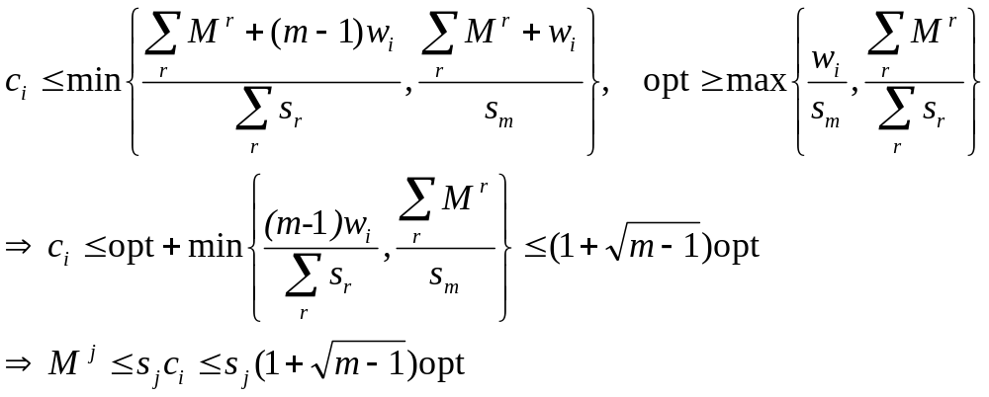
Worst Equilibria for m Links
Proof of Theorem 7 (cont’d)
For links with different speeds:

Slide 22
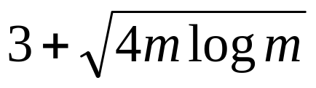
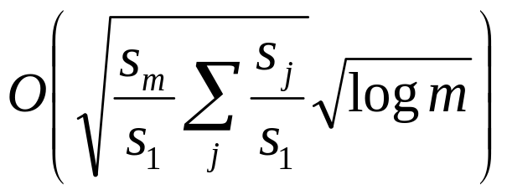
Worst Equilibria for m Links
Theorem 8. For any n and m identical links, R is at most
Theorem 9. For any n and m different links,
R is

