Slide 1
An Approximate Truthful Mechanism for Combinatorial Auctions
An Internet Mathematics paper by Aaron Archer, Christos Papadimitriou, Kunal Talwar and Éva Tardos
Presented by Yin Yang, Apr06

Slide 2
Background: VCG Auction
We sell an item g. n bidders come to the auction, each bidder i
  has its valuation v_{i} for g
  bids b_{i}, if b_{i} ≠ v_{i}, we say bidder i lies
Convention auction: the bidder with highest bid b¹ wins g, and pays b¹
VCG Auction: the bidder with highest bid b¹ still wins g, but only pays the second highest bid b².

Slide 3
Background: VCG Auction
VCG Auction is truthful, meaning that for each bidder i, his/her dominant strategy is to bid exactly v_{i}.
  If i overbids, s/he may end up paying more than vi.
  If i underbids, s/he may not get g
VCG Auction maximizes winner valuation instead of revenue
The problem is to design a similar mechanism (i.e. truthful and maximizes total valuation) for combinatorial auctions.

Slide 4
Background: Combinatorial Auction
We sell a set G of items, each item j has m_{j} identical copies.
n bidders come to the auction, each bidder i
  wants a set S_{i} of items (publicly known, i. e. the bidder is single-minded)
  has a valuation v_{i} for S_{i} (private)
  bids b_{i} for S_{i} (may lie about b_{i})
If a bidder loses, s/he does not pay, otherwise, s/he pays P_{i}, and profits v_{i}-P_{i}. The goal of a bidder is to maximize his/her profit.
Example:
5 Items for sale:
G = {A×1, B×2, C×2}
3 bidders
  Bidder 1: wants S₁ = {A, B}, values v₁, bids b₁
  Bidder 2: {A, C}, v₂, b₂
  Bidder 3: {B, C}, v₃, b₃
  A possible set of winners: {1, 3}
  Total valuation: v₁ + v₃

Slide 5
Background: Truthful CA
For a randomized mechanism, there are different definitions of “truthfulness”, a mechanism is
  universally truthful iff. for all possible outcomes of all random variables, truth telling always maximizes a bidder’s profit. [very difficult]
  truthful in expectation iff. truth telling maximizes a bidder’s expected profit.
  truthful with high probability iff. the probability that truth telling does not maximizes profit is less than ε
The goal is to satisfy the second and the third definitions, i. e. an approximate truthful solution

Slide 6
Truthful CA (Cont.)
Previous work shows that a mechanism is truthful iff.
  The item allocation rule is monotone, meaning that for a bidder i, if it increases its bid b_{i}, its probability of winning cannot decrease
  The (expected) payment of the winner equals its “threshold”, the minimum bid to win

Slide 7
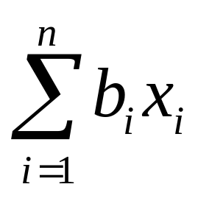
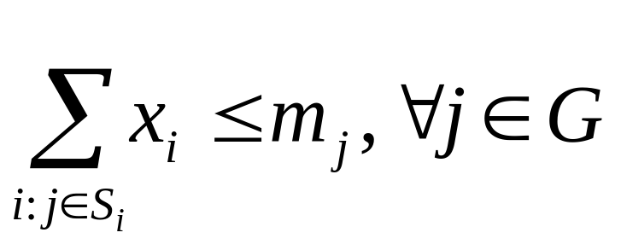
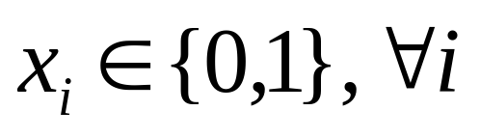
Choosing Winners
Choosing winners to maximize total valuation:
maximize
Subject to:
This is NP hard! We are forced to consider approximate solutions

Slide 8
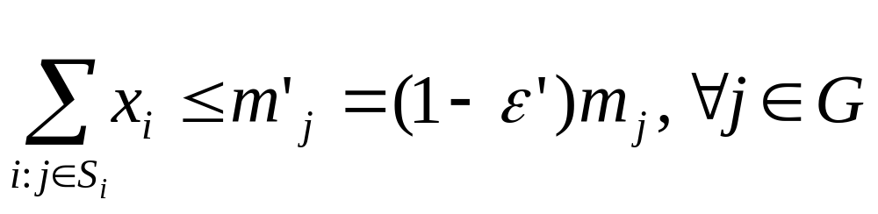
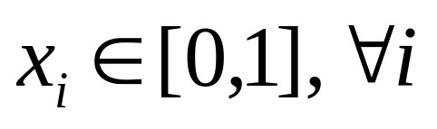
Choosing Winners (Cont.)
Choosing winners to approximately maximize total valuation: first we solve x from
maximize
Subject to:

Slide 9
Choosing Winners (Cont.)
Second, treat x_{i} as the probability that i wins.
  generate a random value y_{i} that is uniformly distributed in the range [0..1]
  Bidder i wins its bid iff. y_{i} ≤ x_{i}
Last, drop bidders who conflicts with others
  Some items may be “oversold”
Question: is this mechanism monotone?

Slide 10
Monotonous Item Allocation
Lemma 3.2 If no item is oversold (thus no bidder is dropped in the last Step), the allocation is monotone
  Higher b_{i} → higher x_{i} → higher winning probability
However, when some items are oversold, the allocation is not monotone
Example:
  Before: x₁=0.5, x₂…x₅₀= 0.01, p₁ = 0.5(1-0.01)⁵⁰≈0.3
  After: x₁ = 0.51, x₂ = 0.49, x₃…x₅₀ = 0, p₁ = 0.51(1-0.49) ≈0.26

Slide 11
Overselling is Unlikely
Chernoff Bound Let X₁, …, X_{n} be independent Poisson trials and Pr[X_{i}=1] = p_{i}. For any μ ≥ p₁+…+p_{n} and α < 2e-1,
Pr[X₁+…+X_{n}) > (1+ α) μ] < exp(-μα²/4)
Proposition 3.1 Let K = max(|S_{i}|), if m_{j} = Ω(lnK), the probability that a given item is oversold is at most 1 / (K^{c+1}), where the constant inside Ω is 4(c+1) / ε’²(1-ε’)
It means that this allocation mechanism is monotonous with high probability

Slide 12
Fixing the Overselling Case
Idea: After dropping conflicting bidders (Step 3), additionally drop surviving bidders with certain probability
Assume bidder i₀ survives after Step 3. Let q_{i0} be the conditional probability that no other bidder conflicts with i₀, given that x_{i0} is rounded to 1.
Let constant q* = 1 - 2 / K^{c}, then q_{i0} > q*
Drop i0 with probability 1- (q*/q_{i0}), then p_{i0} = x_{i0}q*
However, computing q_{i0} is NP-hard

Slide 13
Computing q_{i0}
We use a set of experiments to get an estimator Y of 1/q_{i0}.
Experiment: round x_{i0} to 1, for each bidder i whose desired set S_{i} intersect with S_{i0}, round x_{i} to 1 with probability x_{i}.
Repeat this experiment until x_{i0} does not conflict with any other chosen bidder. Denote the number of experiments as X. This finishes one set of experiments.
  E(X) = 1 / q_{i0}

Slide 14
Computing q_{i0} (Cont.)
Do N sets of experiments, where N = O(K^{c} log(1 / δε)), δ = (1 / m!)², ε is a chosen parameter
Computer the estimator
Y = min ((1+ δε) (X¹+X²…+X^{N}) / N, 1/q*)
Lemma 3.6 1/q_{i0} ≤ E[Y] ≤(1+ δε) / q_{i0}

Slide 15
The meaning of δ
Lemma 3.4 Let x be any vertex of the polytope {x:Ax ≤ r, 0 ≤ x ≤ 1}, where A is in {0, 1}^{m*n} and r in Z^{m}. Then x is in Q^{n} and each xi can be written with denominator D ≤ m!
Corollary 3.5 Let x’, x’’ be vertices of the polytope {x:Ax ≤ r, 0 ≤ x ≤ 1}, where A is in {0, 1}^{m*n} and r in Z^{m}. Then for each I, either x’ = x’’ or x’ ≥ x’’(1+δ) or x’’ ≥ x’(1+δ)

Slide 16
Proof of Monotonicity
When a bidder i raise its bid from b_{i} to b_{i}’, either x = x’ or x_{i}’ > x_{i}. In the latter case,
p_{i} = x_{i}q_{i}q*E[Y]
≤ x_{i}q_{i}q*(1+ δε) / q_{i}
= x_{i}q*(1+δε)
p_{i}’ = x’_{i}q’_{i}q*E[Y]
≥ x’_{i}q’_{i}q* / q’_{I}
= x_{i}q*(1+δ)

Slide 17
Total Valuation Bounds
Theorem 3.8 The expected total valuation achieved by the proposed algorithm is at least (1-ε’)q* OPT, where OPT is the optimal valuation.
  (1-ε’) comes from m’_{j}
  The probability that Bidder i wins is at least x_{i}q*

Slide 18
Computing Payments
Existing methods: difficult to compute, payments can be negative.
Threshold Scheme: very simple, achieves truthfulness with high probability but not in expectation. The corresponding item allocation rule does not need Step 4.
Modified Threshold Scheme: modify Threshold Scheme to achieves truthfulness in expectation.

Slide 19
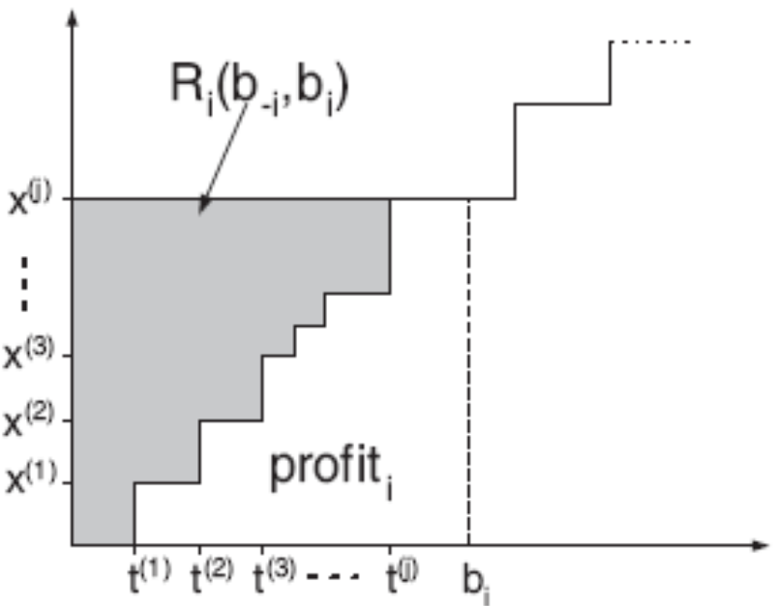
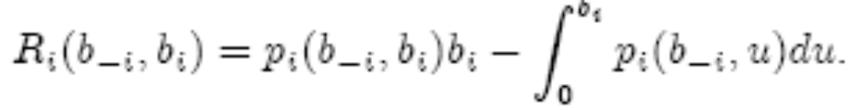
Existing Methods

Slide 20
Threshold Scheme
Suppose x_{i} wins its bid for S_{i}, and we are to compute its payment P_{i}.
Recall that for each x_{i}, we generate a random variable y_{i} that is uniformly distributed in [0..1]
Now we fix y_{i}, and find the smallest b_{i} such that x_{i} can win.
  Binary search on b_{i}, for each attempted value run the item allocation algorithm.

Slide 21
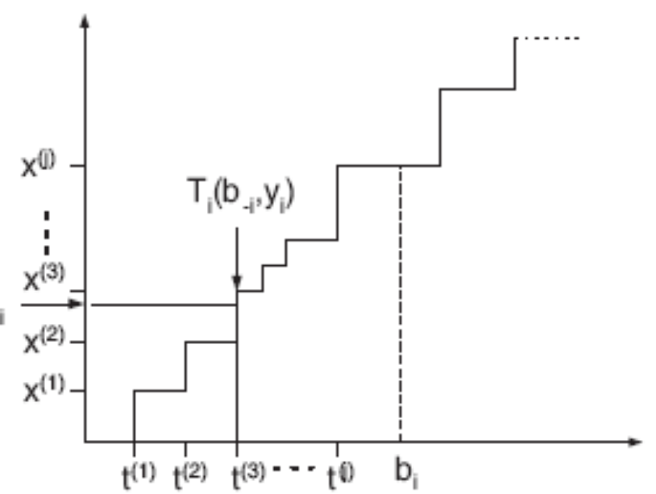
Modified Threshold Scheme
t⁽¹⁾, t⁽²⁾, … t^{(j)}: threshold values for x⁽¹⁾, x⁽²⁾, … x^{(j)}
Let q^{(k)} be the conditional probability that i survives Step 3 and 4, given that it survives Step 2, using x^{(k)}.

Slide 22
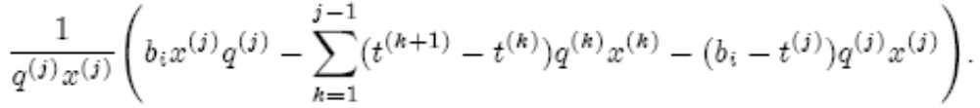

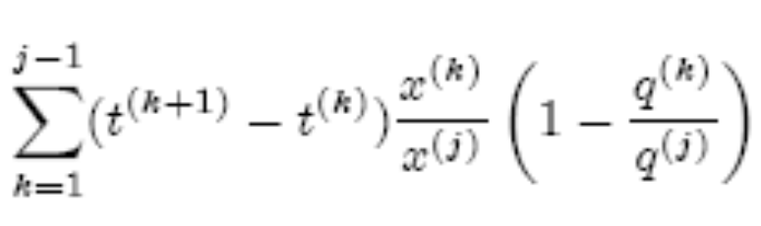
Modified Threshold Scheme
The expected payment of i should be:
The Threshold Scheme actually computes:
Therefore we need a correction term:

Slide 23
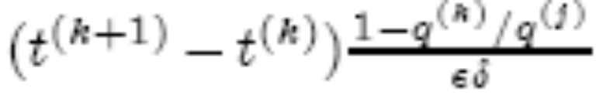
Modified Threshold Scheme
Modified Threshold Scheme: add the correction item
whenever
x^{(k)} ≤ y_{i} ≤ (1+ δε)x^{(k)}
However, computing q^{(k)} is NP-hard.
Solution: run the allocation algorithm to estimate q^{(k)}

Slide 24
Revenue Considerations
We compared the proposed mechanism with fractional VCG (FVCG)
FVCG: pretend that the items are dividable. Then the LP will give us exact results of item allocations. Payment is computed as P_{i} = V(N) – V(N-i), where V(N’) is the optimal LP value using only the players in set N’

Slide 25

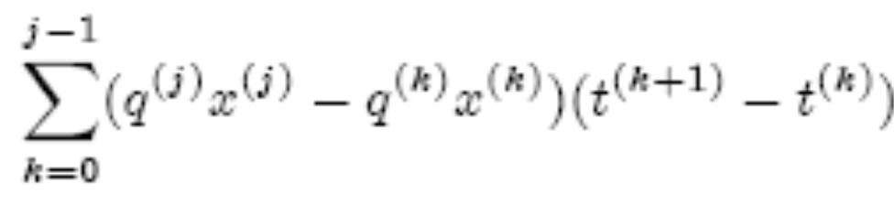
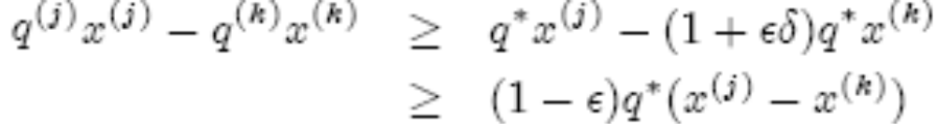
Revenue Considerations
The payment of bidder i
Using FVCG:
Using RandRound:
and
Therefore, the revenue is at least (1-ε)q* times that of FVCG

Slide 26
Comparing Against Optimal Revenue
There is no trivial approach that is truthful and achieves optimal revenue
For example, sometimes VCG gets more revenue than FVCG and sometimes FVCG is better. Reducing the amount of items sometime increases revenue

Slide 27
Lying about the Set
The proposed mechanism can not be applied to the case that bidders can lie about S_{i} (non-single-minded agents)
Example: G = {A, B, C}, n = 3. S₁ = {B, C}, S₂ = {A, B}, S₃ = {A, C}, b₁ = 2, b₂ = 1.5, b₃ = 1.5. Then x = (0.5, 0.5, 0.5)
if Bidder 1 lies and set S₁ = {A, B, C}, then x = {1, 0, 0}, thus benefits from lying.

