Slide 1
Opportunity Cost Algorithms for Combinatorial Auctions
by K. Akcoglu, J. Aspnes, B. DasGupta and M. Kao
Presented by Yin Yang, May06

Slide 2
Background: Combinatorial Auction
A seller wants to sell a set O of objects.
A group of n competing bidders. The i-th bidder offers price p_{i} for a set of objects A_{i} ⊆ O. Let A = {A_{i}}, the set of bids.
Problem: choose a set of bids B ⊆ A, that yields maximum revenue (sum of prices paid) while being consistent (no two sets A_{i} and A_{j} in B overlap).

Slide 3
Background: Comb. Auction (cont.)
We construct a bid graph G = (V, E)
  a node for each bid A_{i}, with weight p_{i}
  an edge connecting two bids if they overlap
The CA problem is transformed to computing the maximum weight independent set in G
Hopeless: this problem is not only NP-hard, but can not be approximated within ratio O(n^{1-ε})

Slide 4
Preliminaries
Given G and an ordering of its nodes ORD:
We say node u is a predecessor of another node v (and v a successor of u) iff.
  (u, v) ∈ E and
  u < v according to ORD
  denoted as u→v
The set of predecessors (successors) are denoted as δ₊(u) (δ₋(u)) respectively

Slide 5
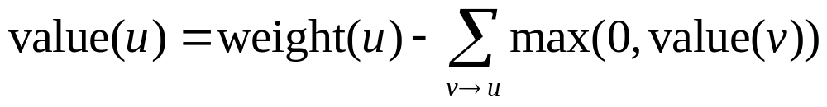
The OpCost Algorithm
Step 1: visit all nodes in ORD order, and compute value(u) for each node u
Step 2: visit all nodes in reverse-ORD order, and chooses node/bid u if
Opportunity Cost
Profitable
Consistent

Slide 6
The LR-OpCost Algorithm
Theoretical Foundation (LR Lemma): Given
  F: a set of feasibility constraints
  w=w₁+w₂ : three weight vectors
If x is an r-approximation of (F, w₁) and (F, w₂), then x is also an r-approximation of (F, w)
Motivation: OpCost is hard to analyze, we instead analyze an equivalent algorithm LR-OpCost
Idea: recursively decompose w (i.e. weight(.)) into two vectors, so that the approximation ratio can be proved by induction

Slide 7
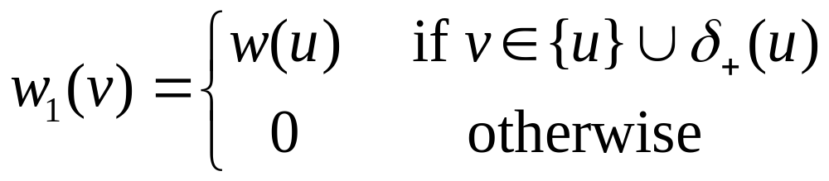
The LR-OpCost Algorithm (Cont.)
Algorithm LR-OpCost (G, w)
Step 1: G₂=G–{u:w(u) < 0}, return {} if G₂={}
Step 2: select the first node (by ORD) u in G₂, and decompose w = w₁+w₂, where
and w₂ = w – w₁
Step 3: B₂ = LR-OpCost(G₂, w₂). Return B₂∪{u} if it is independent, otherwise return B₂.

Slide 8
Analysis of LR-OpCost
Theorem 2: OpCost and LR-OpCost return the same results
  Proof (Sketch): Step 2 essentially computes value(.), Step 3 is the same as select(.)
Theorem 3: The approximation ratio is β(G)
  See next slide
Theorem 4: The time complexity is linear to the size of G, i.e. O(|V|+|E|)
  obviously

Slide 9
Approximation Ratios
Define: β(u) as the max size of independent set among {u} ∪ δ₋(u).
β = β(G) = max β(u)
Proof of approx. ratio (induction):
  Base cases are trivial.
  For each inductive step, assume B₂ is β-approx w.r.t w₂. Then B is also a β-approx w.r.t w₂ , because w₂(u)=0
  For w₁, an upper bound of the max weight independent set is β(u)w(u)<βw(u), B gets w(u)
The bound β is tight
  worst case:w(v)=1 for v with β(v)=β, and others w=1-ε

Slide 10
Properties of β
β=1 for Chordal graphs (no cycle of length >3):
if G=G₁∪G₂, then β(G) ≤ β(G₁) + β(G₂);
if G is node-induced sub-graph of G₁, then β(G) ≤ β(G₁)
Given A (bid set), G and ORD, if:
  for each a ∈ A there is a “frontier set” S_{a} ⊆O of size ≤k, so that for all b that a<_{ORD} b and a ∩ b≠{}, we have S_{a} ∩ b≠{}.
Then β(G) ≤ k
  Proof: in an independent set, each successor b must intersect with S_{a} in a distinct element

Slide 11
Constrained Combinatorial Auction
In order to construct the frontier sets, we need to tweak the problem.
Observation: the objects in one bid are somehow “related”
Model: all objects for sale form an object graph H. Two objects are connected by an edge in H iff. they are “related”
Constraint: the set of objects in one bid must form a connected sub-graph of H.

Slide 12
Background: Tree Decomposition
A tree decomposition of H is a tree T such that each node t ∈T is associated with a set of H’s nodes V_{t}, subject to:
  ∪_{t ∈T} V_{t} = V(H)
  For each uv ∈E(H), ∃V_{t}, u∈V_{t} and v∈V_{t}
  If tree node t₂ lies on the path between t₁ and t₃, then V_{t1} ∩V_{t3} ⊆V_{t2}
The width of a tree decomposition is max|V_{t}|-1, the treewidth of H tw(H) is the smallest width of any tree decompostion of H

Slide 13
Treewidth and β
Theorem: Given G, A, H, T and width(T) = k, we have β(G) ≤ k+1, and the ORD can be computed in linear time.
  Proof: we say t₁ ≤ t₂ if t₁ is an ancestor of t₂. Extend this to a linear order of all tree nodes.
  For each bid a, let t_{a} be the greatest node whose V_{ta} intersects a. Then ORD is the order of the bids’ associated tree nodes.
  (next slide proves V_{ta} is the frontier set of a)

Slide 14
Why V_{ta} is the frontier set of a
Background (node removal lemma): if x, x’ are not in V_{t}, then either (i) x and x’ are separated in H, or (ii) x and x’ are in the same connected component of T-t.
Consider bid a. Let p be the parent of t_{a}, then a∩p={} since p>t_{a}. Because objects in a are connected in H, (i) is eliminated. So all a’s objects are in the same subtree of T-p, which is the subtree rooted at t_{a}.
Now consider a successor b of a, a <_{ORD} b and a∩b≠{}. Then ∃x ∈a∩b in the subtree rooted at t_{a.} Meanwhile, ∃x’ ∈b∩V_{tb} not in this subtree because t_{b} > t_{a}. Similarly (i) is eliminated and (ii) must hold when removing t_{a}. The only possibility is x ∈V_{ta}.

Slide 15
When H is Planar Graph
Corollary: If H is planar, then ∃ORD, β(G)=O(sqrt(n)), which can be computed in O(nlogn) time.
  Proof: existing algorithms can efficiently tree-decompose a planar graph achieving the width bound

Slide 16
Other Case Studies
Objects are intervals. β=1
Objects are intervals partitioned into groups, each group can have only one chosen interval. (β=2)
Any β=k graph adding m such unique-selection constraints. (β=k+m)
Max-weight independent set of any subgraph of a k-dimensional grid. (β=k)
Interval selection: intervals are on a cycle. (β=2)
h-bounded height rectangle selection (β=h)

Slide 17
Hardness of Computing β
For a general graph, β can not be efficiently computed / approximated
Theorem: If an algorithm can approximate β(G) for an n-node DAG G with ratio f(n), then it can be used to approximate the size α(H) of a max-independent set of H with ratio f(n+1)
  Proof: Construct G by giving each edge an arbitrary direction and adding a new source node s, with edges to all other nodes, we then have α(H) ≤ β(s) ≤ β(G) and β(G) ≤ α(H)

Slide 18
Effects of Node Ordering
Theorem (good ORD): For any G, there exists an ORD such that OpCost gets optimal answer.
  Proof: Let A be any independent set in G, choose the ordering so that all nodes in A precedes all nodes not in A. Then value(u) = weight(u) ∀u∈A
Theorem (bad ORD): If all nodes in G has distinct weights, orienting G in order of decreasing weight causes OpCost to return the same results as the greedy algorithm.
  Proof: by induction. value(u) = weight(u) when Greedy chooses u, otherwise value(u) < 0

Slide 19
Budget Constrained CA
A bidder whose car has broken down wants to buy either an engine, a car, or a taxi ride.
Another bidder wants to buy at most three sets of car ornaments, but bid on all
Yet another bidder has $100. He wants to place multiple bids worth more than that.
k-of-n constraint (unweighted)
Weighted budget constraint

Slide 20
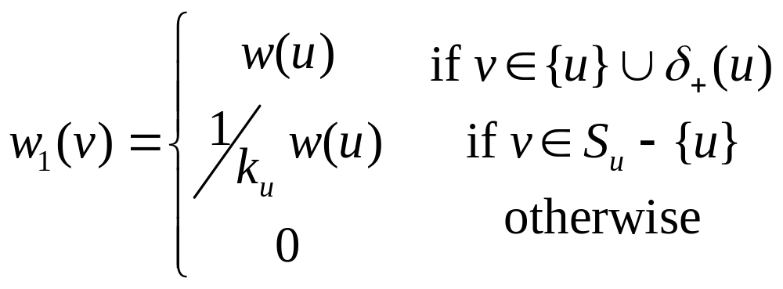
Unweighted Budget Constraints
Problem: bids are partitioned into groups S₁, … S_{r}, no more than k_{i} bids can be chosen in each group.
In OpCost, we change value(u) to
In LR-OpCost, we change w₁(v) to

Slide 21
Analysis
Theorem: Unweighted OpCost/LR-OpCost (β+1)-approximate an optimal set of bids in linear time
  Proof: the main difference from previous proof is in proving the inductive step for w₁. The upper bound now becomes β(u)w(u) + k_{u}/k_{u} w(u) ≤ (β+1)w(u)

Slide 22
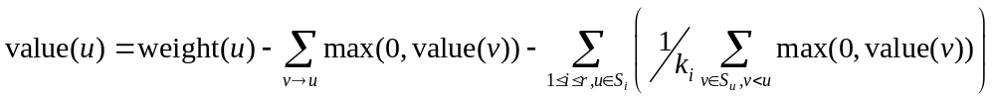
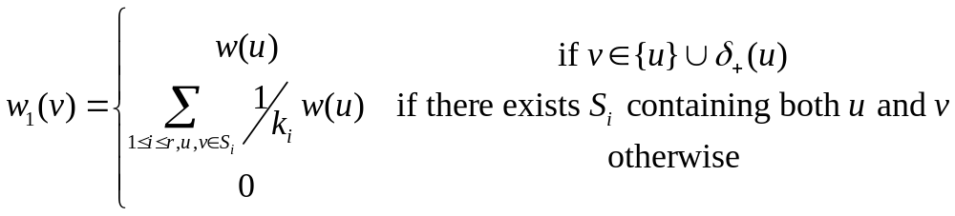
Overlapping Unweighted Constraints
Problem: There are r bid groups S₁, … S_{r} each bid can appear in at most t groups.
OpCost:
LR-OpCost:

Slide 23
Analysis
Approximation ratio: β+t
Running time: O(|V|t+|E|)
  Proof: similar to previous one

Slide 24
Weighted Budget Constraints
Problem: bids are partitioned into groups S₁, …, S_{r}. For each group the total winning bids can have total value no more than b_{i}.
Main challenge: unlike the previous cases, we can not get a good lower bound on w₁-weight.
Solution: run two variations of the algorithm twice and report the better: once for heavy bids with w(v) ≥ 0.5b_{v} and once for light bids with w(v) ≤ 0.5b_{v}

Slide 25
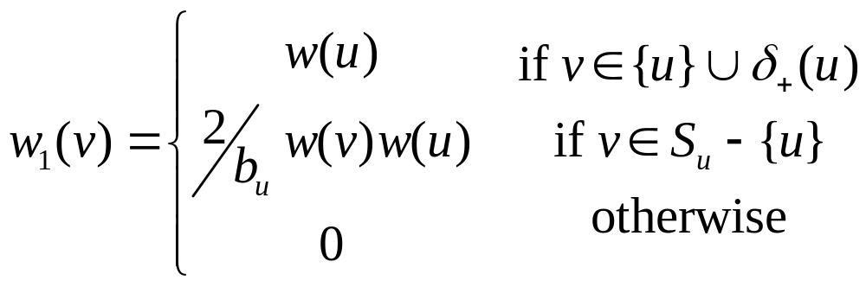
Heavy and Light Runs
The heavy run degenerates to the unweighted case.
For the light run, we use the following w₁(v)

Slide 26
Analysis
The heavy run obtains β+1 approximation
The light run obtains (β+2)-approx.
Overall approx. ratio is 2β+3.
Running time: linear to the size of G

