Slide 1
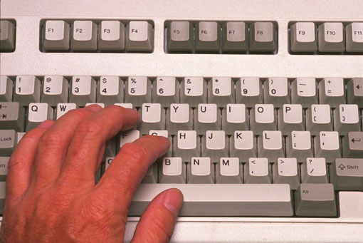
Programming
Introduction to Programming

Slide 2
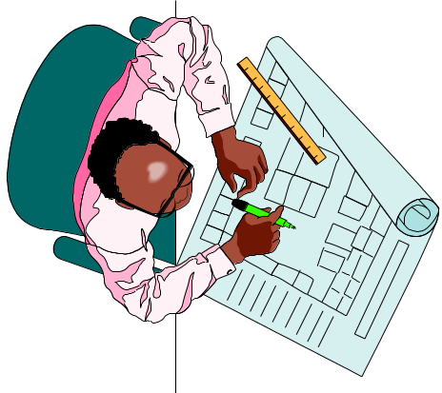

Objectives
To learn fundamental problem solving techniques:
  define a problem
  design an algorithm
  translate into a program
To learn to use the C++ programming language
algorithm

Slide 3
Algorithm
Sequence of instructions, expressed in
  plain informal, human, everyday language
  pseudo-code (pseudo computer program)
  flowchart
counter = 10
while (counter not equal 0) {
decrease counter value
}
Work
Computer
Product
Program

Slide 4
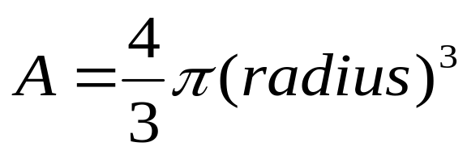
Problem Solving and Algorithm
Read section 1.2 (pp.13-18)
“Compute volume of a sphere”
  input : radius
  process : use formula
  output : A
“What should I do today?”
  input: day of the week
  process:
  output: action
if (day = MON, WED, or FRI)
action = go_to_school;
else
action = go_to_party;

Slide 5
What is C++?
C++ is a programming language.
A formal, computer program performs a specific task
It may interact with the user
  Human work model:
  Computer work model:
Work
Worker
Product
Instructions
Work
Computer
Product
Program

Slide 6


What is C++?
The most popular programming languages:
  C++ (derived from C)
  Basic
  Pascal
  Java
  Perl
  COBOL
  Scheme (Lisp)
  Smalltalk
The most common compilers of C++:
  Microsoft Visual C++
  Borland C++
  g++ (for Unix machines)

Slide 7




Why C++?
Bad News:
  C++ is not easy to learn
Good News:
  Lots of well paid and interesting jobs for C++ programmers
  Most flexible (e.g. database, graphics)
  More low level or system control (e.g. device drivers, operating systems)

Slide 8



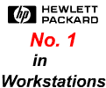

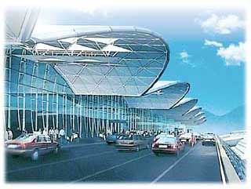



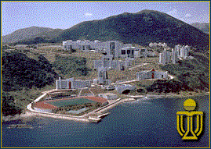




Who Uses C++?
Computer makers such as Sun, SGI, IBM, and HP
Airport
Computer chip manufacturers
like Motorola & Intel
Software companies
Banks
Hong Kong Government
Hospital Authority
Telecommunications
Universities
Startup and .com companies

Slide 9
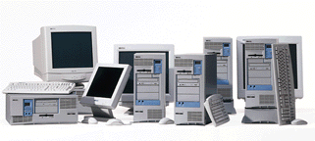

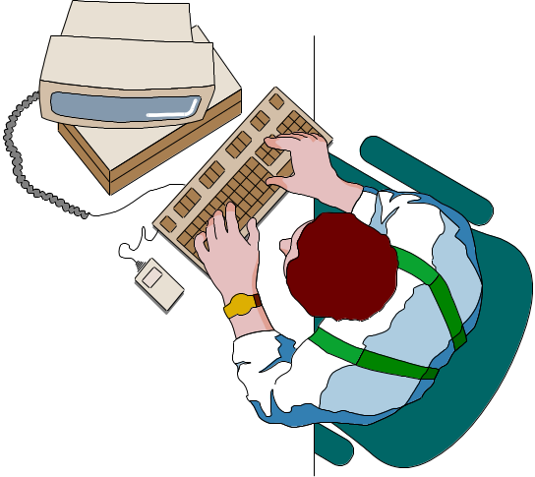
Most Important Feature of C++
Most important feature of C++: PORTABILITY
C++ runs on:
  PC
  Macintosh
  Unix workstations (also, Unix versions of C++ are free!)
  supercomputers

Slide 10
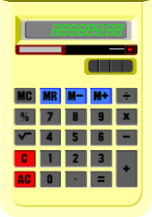
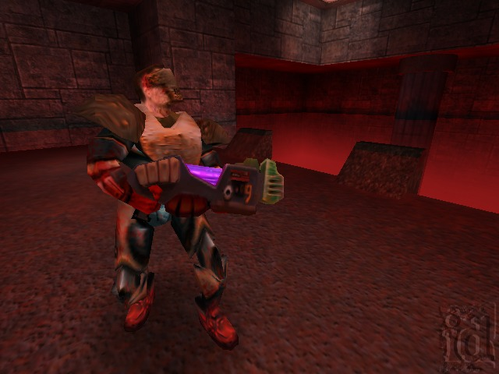



What Can We Do
By the End of the Course?
Program the computer in applications such as the following:
  Program a simple calculator
  Program simple computer games
  Program a small inventory system for a small company
You will be ready to take on part-time programming jobs during Xmas break!

