Slide 1
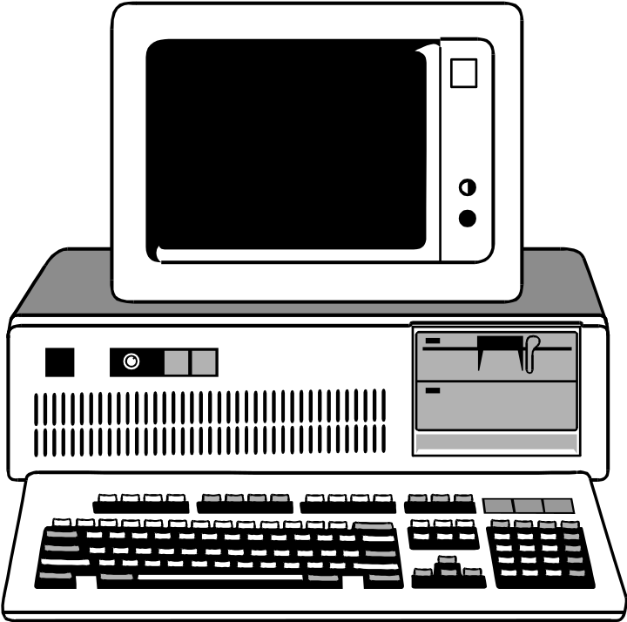
Programming
Hardware and Software

Slide 2
Hardware and Software
Why should we bother with hardware, while we are having a programming (software) class?
  software “drives” hardware
  having some understanding on h/w helps us produce more efficient programs

Slide 3
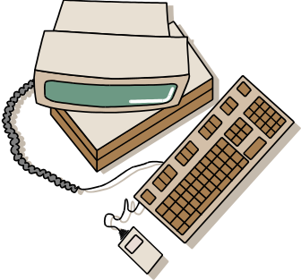
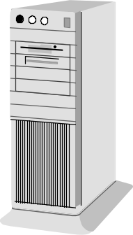
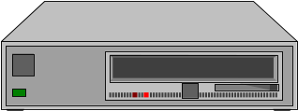

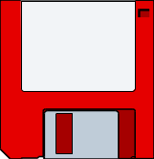
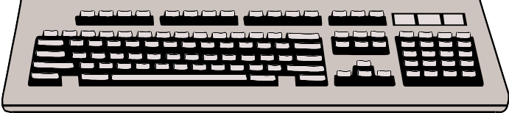
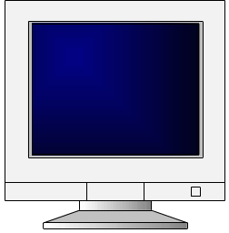
Hardware
Four components of a computer system:
  CPU - central processing unit
    Makes decisions, performs computations, and delegates input/output requests
  Memory
    Stores information
  Input devices
    Gets information from the user to the computer
  Output devices
    Sends information from computer to the user

Slide 4

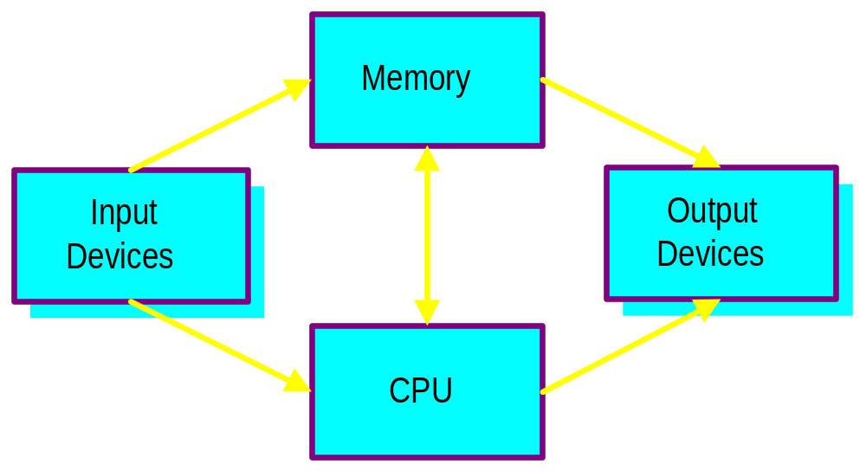
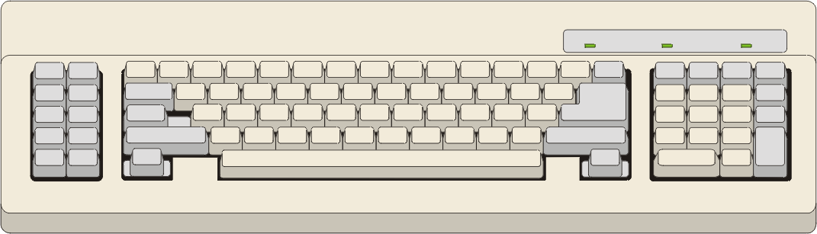
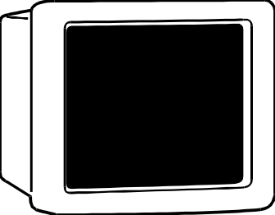
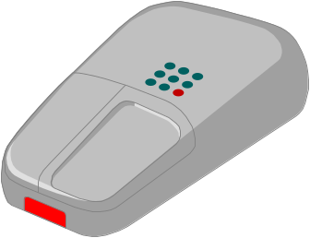

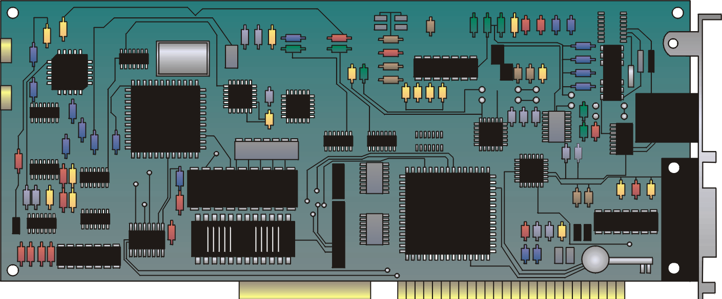

Hardware
Primary and Secondary

Slide 5

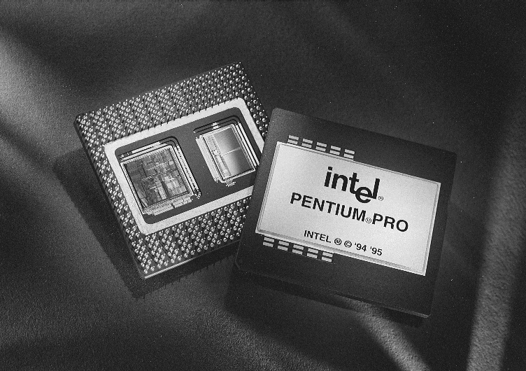
CPU
Core component of the computer
  Arithmetic/Logical Unit (ALU)
    performs arithmetic operations
  Control Unit
    decodes and executes instructions
Data and instructions are encoded in the binary number system 0110 1101 1100 1111 0001
CPU Examples
  Pentium
  Pentium Pro

Slide 6


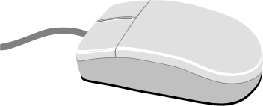
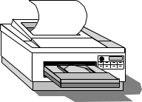

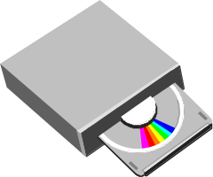
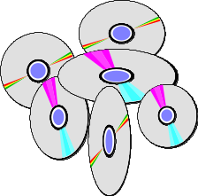


Input and Output Devices
Accessories that allow computer to interface with user
Common input and output devices
  Speakers Mouse Scanner
  Printer Joystick CD-ROM
  Keyboard Microphone

Slide 7
Memory
Secondary Memory
  relatively stable storage (e.g. CD)
  slower retrieval time
  often allows sequential access only
Primary Memory
  main memory in a computer
  aka random access memory, or RAM
  faster (random) access with
    transistor technology
    address location

Slide 8
Memory
Program
RAM in computer
double distance;
double time;
double speed;
speed = 27.3;
time = 4.8;
distance = speed * time;
1000
1008
1016
1024
1032
131.04
<- distance
4.8
<- time
27.3
<- speed

Slide 9
What is so “Random”?
program
RAM in computer
char grade[] = {
‘B’,’D’,’C’,
’E’,’D’,’A’};
char student_grade;
student_grade = grade[3];
255
256
257
258
259
260
B
<- grade[0]
D
C
+
E
D
A
1024
E
<- student_grade

Slide 10


Software
Application software
  Programs designed to perform specific tasks and are easy to use
System software
  Programs that support the execution and development of other programs
  Two major types
    Operating systems
    Translation systems (compilers & linkers)

Slide 11




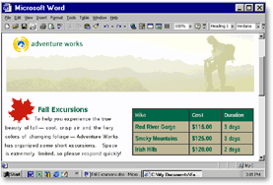

Application Software
Application software has made using computers easy and popular
Common application software:
  Microsoft Word, WordPerfect
  PowerPoint
  Netscape, IE
  PhotoShop, Photo-Paint
  Quick Time

Slide 12


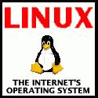




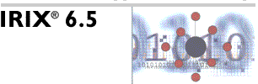

Operating System
Controls and manages the computing resources
Examples
  MSDOS, Windows, Unix
Important services that an operating system provides:
  File system
  Memory management
  Commands to manipulate the file system
  Input and output on a variety of devices
  Window management

Slide 13
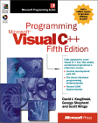
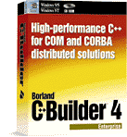
Translation System
Set of programs used to develop software
Types of translators:
  Compiler
  Linker
Examples
  Microsoft Visual C++, Borland C++, g++

Slide 14
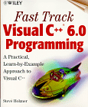
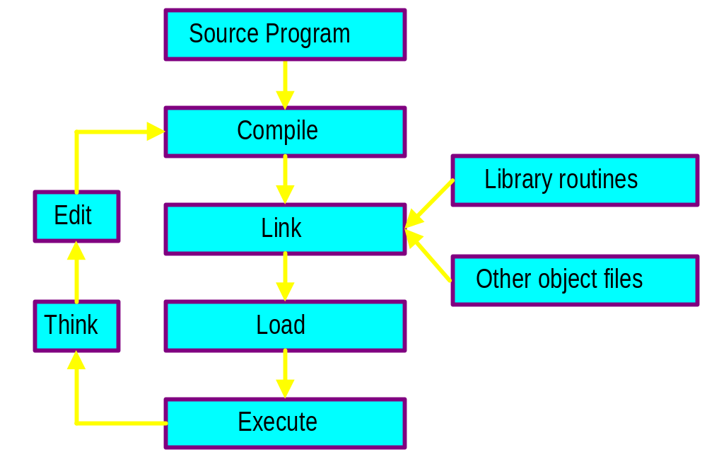
Software Development
Major activities
  Editing (to write the program)
  Compiling (creates.obj file)
  Linking with compiled files (creates .exe file)
    Object files
    Library modules
  Loading and executing
  Testing the program

Slide 15
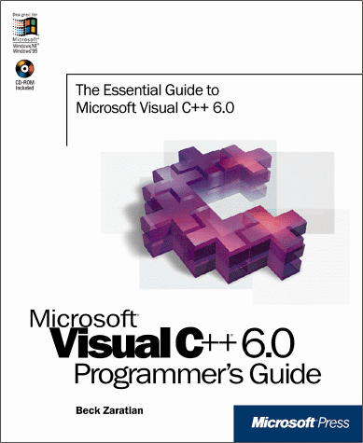

Integrated
Development Environments
Combine all of the capabilities that a programmer would want while developing software (VC++)
  Editor
  Compiler
  Linker
  Loader
  Debugger
  Viewer

Slide 16

Our First Program
Preprocessor
statements
// a simple program
#include <iostream>
use namespace std;
int main() {
cout << "Hello world!" << endl;
return 0;
}
Comments
Function named main() indicates start of program
Ends execution
of main() which ends program
Print
statement
Function

Slide 17
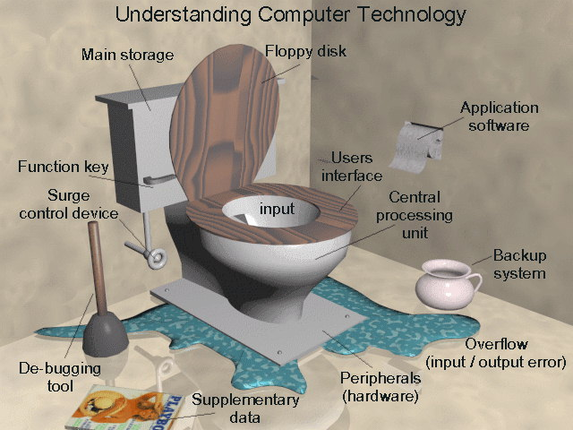
Summary

