Slide 1

Programming
Problem Solving
and
Program Design

Slide 2



Problem Solving Process
Define and analyze the problem.
Develop a solution.
Write down the solution steps in detail.
Test the solution and revise if necessary.
Document and maintain the solution.

Slide 3

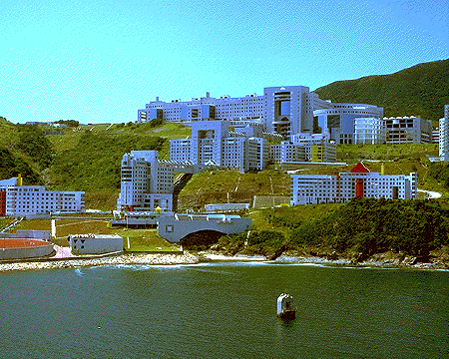


Example 1
Problem Definition:
  To find the best way to travel from HKUST to Central.

Slide 4




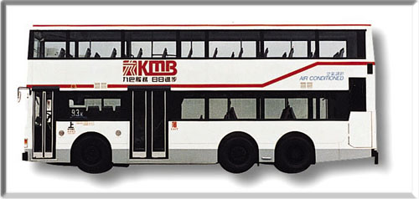


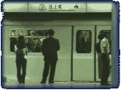
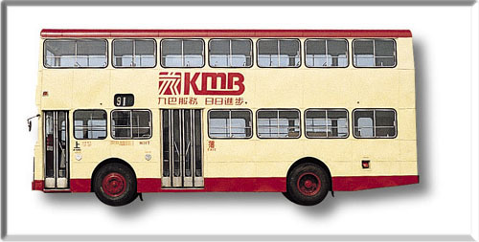
Example 1
Problem Analysis:
  We want to find a way to make the trip quickly and cheaply.
Preliminary Design:
  Find the best way to travel from HKUST to Central by considering all possible routes and modes of transportation.

Slide 5
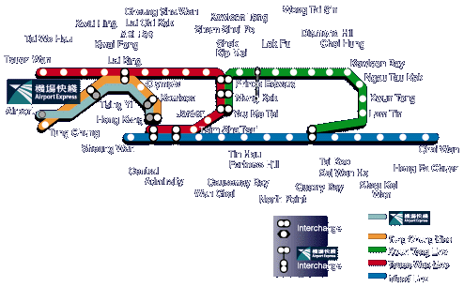

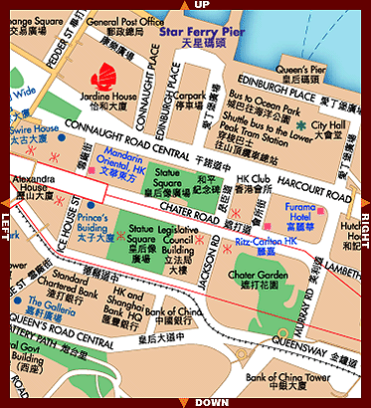

Example 1
Refined Design:
  Evaluate all possible routes and modes of transportation
  Select the route that meets our goal (fastest and cheapest)

Slide 6

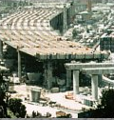

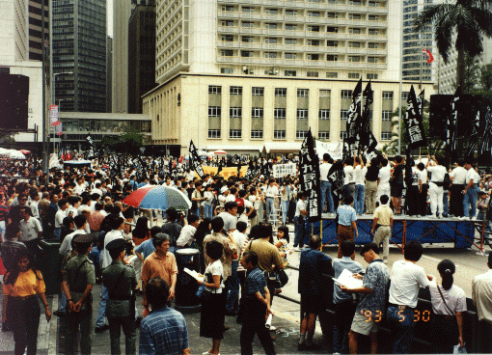
Example 1
Testing:
  Test the recommended route and mode of transportation. Make sure the conditions have not changed (e.g., increased KMB bus fares, road construction).
Documentation:
  Give a detailed description of your solution, and explain why you chose it.
Maintenance:
  Test the program periodically. Adjust for changes by revising the recommended route and updating the documentation.

Slide 7

Programming as a
Problem Solving Process
Define and analyze the problem.
  What is the input & output?
  What constraints must be satisfied?
  What information is essential?
Develop an algorithm.
  What steps must be done?
Implement a program.
Compile, test, and debug the program.
Document and maintain the program.

Slide 8



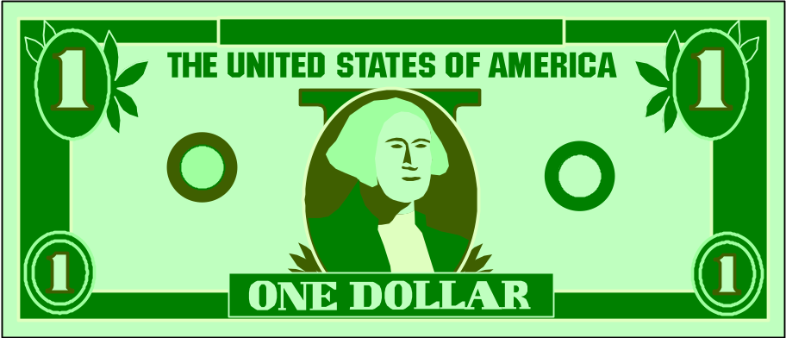

Example 2
Problem Statement:
  Convert US dollars into Hong Kong dollars.
Problem Analysis:
  Input: Amount in US$
  Output: Amount in HK$
  Apply official currency exchange rates.

Slide 9


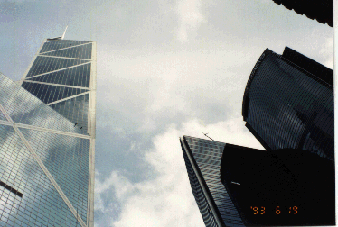

Example 2
Algorithm
  Read in amount in US$
  Calculate the HK$ amount
  Display the results

Slide 10


Example 2
// converts US$ to HK$
#include <iostream>
using namespace std;
int main(){
  double usdollars;
  double hkdollars;
  // read in amount in US$
  cout <<"Enter US$ amount and press return: ";
  cin >> usdollars;
  // calculate the HK$ amount
  hkdollars = 7.8 * usdollars;
  // display the results
  cout << "US$" << usdollars
  << " = HK$" << hkdollars << endl;
  return 0;
}

Slide 11
Example 2
Program Implementation:
  Program comments: //
  Library reference: #include
  Function type: int
  Function name and (lack of) parameters: main( )
  Statement braces: { }
  Variable declaration: double
  Input/output functions: cin, cout

Slide 12

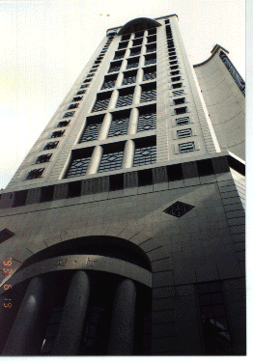


What Makes a Good Program?
Correctness
  Meets the problem requirements
  Produces correct results
Easy to read and understand
Easy to modify
Easy to debug
Efficient
  Fast
  Requires less memory

Slide 13

Example 3
Problem Statement
  Given a collection of nickels (US 5-cent piece) and pennies (US 1-cent piece), find the equivalent number of Hong Kong dollars and 10-cent pieces (houji).
Problem Analysis
  Input:
    nickels (integer) - number of US nickels
    pennies (integer) - number of US pennies
  Output:
    dollars (integer) - number HK dollar coins to return
    houji (integer) - number HK 10-cent coins to return
Constraints: None

Slide 14

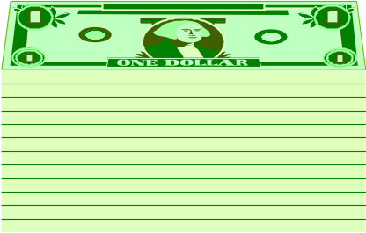

Example 3: Initial Algorithm
1. Read in the numbers of nickels and pennies
2. Compute the total value in US dollars
3. Compute the total value in HK dollars to exchange
4. Find the number of HK dollar coins and houji coins
5. Display the numbers well-labeled

Slide 15

Example 3: Program Skeleton
// File: excoin.cpp
// Determines the number of HK coins to exchange for US coins
#include <iostream>
using namespace std;
int main(){
int nickel; // number of nickels
int penny; // number of pennies
int dollar; // number of HK dollar coins
int houji; // number of HK 10-cent coins
double total_USD; // total value in US$
double total_HKD; // total value in HK$
// 1) Read in the number of nickels and pennies
// 2) Compute the total value in US$
// 3) Compute the total value in HK$ to exchange
// 4) Find the numbers of HK dollar and 10-cent coins
// 5) Display the numbers of HK dollar and 10-cent coins
return 0;
}

Slide 16
Example 3: Refined Algorithm
1. Read in the number of nickels and pennies
2. Compute the total value in US dollars
2.1 total_USD = (5 * nickel + penny)/100
3. Compute the total in HK dollars to exchange
3.1. total_HKD = total_USD * US2HK
4. Find the number of HK dollar coins and 10-cent coins
4.1. total_HK_cent = total_HKD * 100
4.2. dollar = total_HK_cent / 100
4.3. houji = (total_HK_cent % 100) / 10
5. Display the number of HK dollar and 10-cent coins

Slide 17
Illustration of Step 4
Suppose total_HKD in step 3 is $7.48
4.1. total_HK_cent = total_HKD * 100 = 748
4.2. dollar = total_HK_cent / 100
= 748 / 100
= 7 (no of HK dollar coins)
4.3. houji = (total_HK_cent % 100) / 10
= (748 % 100) / 10
= 48 / 10
= 4 (no of HK houji)

Slide 18
C++ Arithmetic Operators
The four operators +, -, *, and / work as we expect with the “normal” precedence rules (e.g., 5+2*3 = 11)
Parenthesis can be inserted to change the order of operations (e.g., (5+2)*3 = 21)
Be careful of integer division -- any remainder is discarded
The % (modulo) operator gives the remainder of integer division

Slide 19
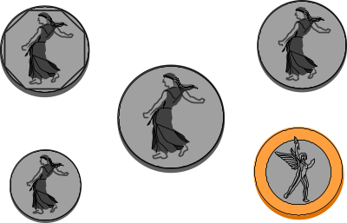
// File: excoin.cpp
// Determines the number of HK coins to exchange for US coins
#include <iostream>
using namespace std;
int main(){
const double US2HK = 7.8; // assume exchange rate is US$1 = HK$7.8
int nickel; // number of nickels
int penny; // number of pennies
int dollar; // number of HK dollar coins
int houji; // number of HK 10-cent coins
double total_USD; // total value in US$
int total_HK_cent; // total value in HK cents
double total_HKD; // total value in HK$
// Read in the number of nickels and pennies
cout << "Enter the number of nickels and press return: ";
cin >> nickel;
cout << "Enter the number of pennies and press return: ";
cin >> penny;

Slide 20
// Compute the total value in US$
total_USD = (5 * nickel + penny) / 100.0;
// Compute the total value in HK$ using the assumed exchange rate
total_HKD = total_USD * US2HK;
// Find the value in HK dollars and change
total_HK_cent = total_HKD * 100;
dollar = total_HK_cent / 100;
houji = (total_HK_cent % 100)/10;
// Display the number of HK dollar and 10-cent coins
cout << "The change is HK " << dollar << " dollars and "
<< houji << " 10-cent coins." << endl;
return 0;
}

Slide 21

Overview on Using Visual C++
Enter source code (by typing or bringing in a file)
Compile source code
  If there are error or warning messages, double-clicking on the error message will cause an arrow to point to the line where the suspected error is. Edit the source code and recompile.
Build execution module
Execute
  If there are errors, edit the source code and recompile
Save source files on your floppy disk (A:)
Remove project directory (or mess) from hard disk (C:) in the computer if you work in lab

