Slide 1
Programming
Dynamic Objects II

Slide 2
A Simple Dynamic List
An integer list: IntArray
Features
  Can be passed by value & reference
  Can be copied
  Can inspect and change elements
  Can add elements to end
  Can inspect list size
  Can print list

Slide 3
Using IntArray
void main(){
IntArray A(5, 1); // sets A to: [ 1 1 1 1 1 ]
IntArray B(10, 2); // sets B to array of 10 2’s
IntArray C(5, 4); // sets C to: [ 4 4 4 4 4 ]
for(int i=0; i<A.Size(); i++) // set A = C
A.setElement(i, B.getElement(i));
A.print(); // [ 2 2 2 2 2 ]
A.copy(C);
A.print(); // [ 4 4 4 4 4 ]
IntArray D(C); // sets D to: [ 4 4 4 4 4 ]
D.setElement(0, 5);
D.addElement(6); // add 6 to end of current array
D.print(); // [ 5 4 4 4 4 6 ]
IntArray E;
E.print(); // [ 0 ]
E.setElement(0, 1);
E.print(); // [ 1 ]
E.addElement(2);
E.print(); // [ 1 2 ]
E.addElement(3);
E.print(); // [ 1 2 3 ]
E.addElement(4);
E.print(); // [ 1 2 3 4 ]
}

Slide 4
class IntArray {
private:
// data members
int *Values; // pointer to elements
int NumberValues; // size of list
public:
// constructors
IntArray(int size=1, int val=0);
IntArray(const int A[], int size);
IntArray(const IntArray &A);
// destructor
~IntArray();
// inspector for size of the list
int Size() const;
// inspector for elements
int getElement(int i) const;
// mutator for elements
void setElement(int i, int value);
// for adding a new element to the end of the array
void addElement(int value);
// mutator to copy whole array
void copy(const IntArray &A);
void print() const; // print the list
};

Slide 5
Default Constructor
IntArray::IntArray(int size, int val){
if(size<=0){
cout << "Bad size for array!" << endl;
exit(0);
}
NumberValues = size;
Values = new int [size];
for(int i=0; i<size; i++)
Values[i] = val;
}

Slide 6
Array-based Constructor
IntArray::IntArray(const int A[], int size) {
if(size<=0){
cout << "Bad size for array!" << endl;
exit(0);
}
NumberValues = size;
Values = new int [size];
for (int i=0; i<size; i++)
Values[i] = A[i];
}

Slide 7
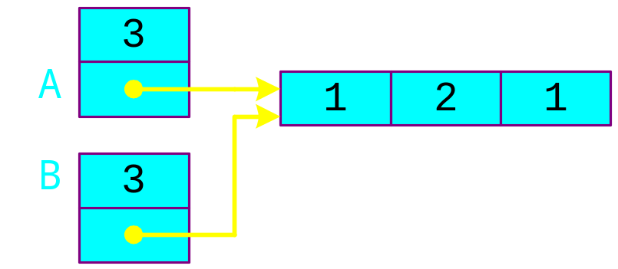
Default Copy Constructor
  IntArray A(3, 1);
Suppose we use the default copy constructor
IntArray B(A);
And then
    A.Values[1] = 2;
But…
  B.Values[1] is changed!
  Not what we expected!
To fix:
  Must use customized copy constructor
3
A
1
2
1
B
3
1
1
1

Slide 8
Customized Copy Constructor
IntArray::IntArray(const IntArray &A){
NumberValues = A.Size();
Values = new int [A.Size()];
if(Values==0){
cout << "Memory allocation error for Values!" << endl;
exit(0);
}
for(int i=0; i<A.Size(); i++)
Values[i] = A.getElement(i);
}

Slide 9
Destructor
What happens when an IntArray goes out of scope?
  If nothing, then we have a memory leak
Need to delete the dynamic memory
  Define a destructor
    A class object going out of scope automatically has its destructor called
IntArray::~IntArray() {
delete [] Values;
}
Notice the tilde

Slide 10
Accessing List Elements
// inspector for elements
int IntArray::getElement(int i) const {
if(i<0 || i>=Size()){
cout << "Illegal subscript!" << endl; exit(0); }
return Values[i];
}
// mutator for elements
void IntArray::setElement(int i, int value) {
if(i<0 || i>=Size()){
cout << "Illegal subscript!" << endl; exit(0); }
Values[i] = value;
}

Slide 11
Copy Operator
void IntArray::copy(const IntArray &A){
if(NumberValues) // delete old array first
delete [] Values;
NumberValues = A.Size();
Values = new int [A.Size()];
if(Values==0){
cout << "Memory allocation error for Values!" << endl;
exit(0);
}
for(int i=0; i<A.Size(); i++)
Values[i] = A.getElement(i);
}

Slide 12
Adding Elements
// for adding a new element to end of array
void IntArray::addElement(int value){
int *oldValues = Values;
Values = new int [NumberValues+1]; // make new array
if(Values==0){
cout << "Memory allocation error for addElement!" << endl;
exit(0);
}
if(NumberValues){ // copy and delete old array
for(int i=0; i<NumberValues; i++)
Values[i] = oldValues[i];
delete [] oldValues;
}
Values[NumberValues] = value;
NumberValues++;
}

Slide 13
print()
  void IntArray::print() const{
  cout << "[ ";
  for(int i=0; i<NumberValues; i++)
  cout << Values[i] << " ";
  cout << "]" << endl;
  }

