Slide 1
Adversarial Search
Chapter 6
Section 1 – 4
The Master vs Machine: A Video

Slide 2
Outline
Optimal decisions
α-β pruning
Imperfect, real-time decisions

Slide 3
Games vs. search problems
"Unpredictable" opponent → specifying a move for every possible opponent reply
Time limits → unlikely to find goal, must approximate
Example: tic-tac-toe
  Relationship to five-in-a-row?

Slide 4

Game tree (2-player, deterministic, turns)

Slide 5

Minimax
Perfect play for deterministic games
Idea: choose move to position with highest minimax value
= best achievable payoff against best play
E.g., 2-ply game:
MAX
MIN

Slide 6

Minimax algorithm

Slide 7
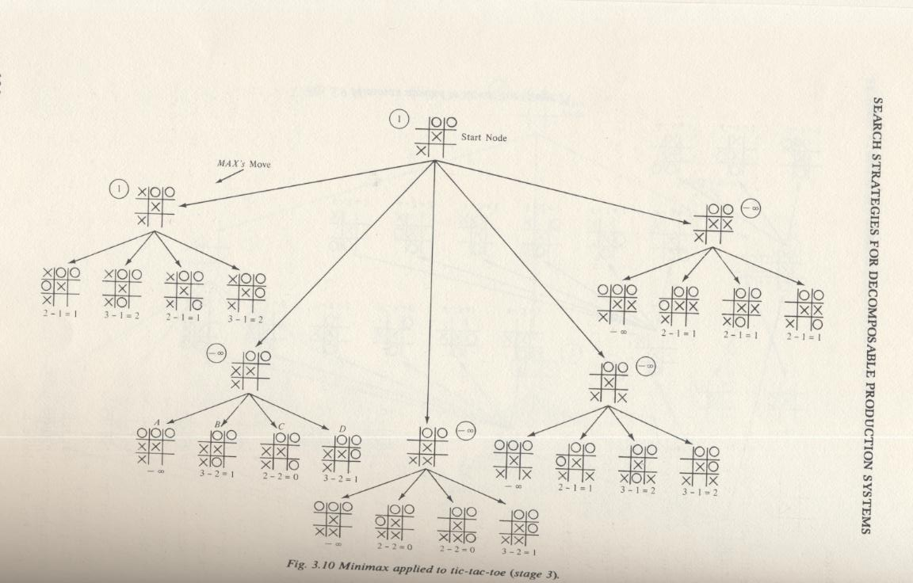
Another Example (From Nilsson “Principles of AI”)

Slide 8
Properties of minimax
Complete? Yes (if tree is finite)
Optimal? Yes (against an optimal opponent)
Time complexity? O(b^{m})
Space complexity? O(bm) (depth-first exploration)
For chess, b ≈ 35, m ≈100 for "reasonable" games
→ exact solution completely infeasible

Slide 9

α-β pruning example

Slide 10

α-β pruning example

Slide 11

α-β pruning example

Slide 12

α-β pruning example

Slide 13

α-β pruning example

Slide 14
Rules for alpha and beta
IF
  node=MIN and ancestor=MAX
  beta(node) <= alpha(ancestor),
  then stop this branch
IF
  node=MAX and
  alpha (node) >= beta(parent),
  then stop this branch

Slide 15
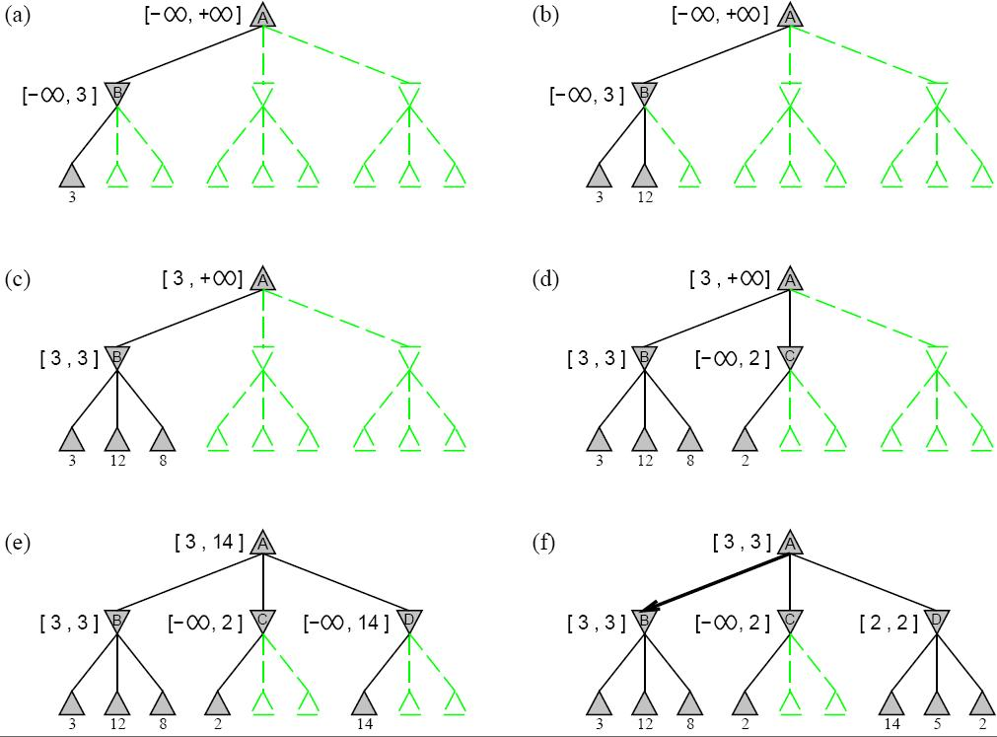
More examples

Slide 16
Properties of α-β
Pruning does not affect final result
Good move ordering improves effectiveness of pruning
With "perfect ordering," time complexity = O(b^{m/2})
  → doubles depth of search
A simple example of the value of reasoning about which computations are relevant (a form of metareasoning)

Slide 17

Why is it called α-β?
α is the value of the best (i.e., highest-value) choice found so far at any choice point along the path for max
If v is worse than α, max will avoid it
  → prune that branch
Define β similarly for min

Slide 18

The α-β algorithm

Slide 19

The α-β algorithm

Slide 20
Resource limits
Suppose we have 100 secs, explore 10⁴ nodes/sec
→ 10⁶ nodes per move
Standard approach:
cutoff test:
  e.g., depth limit (perhaps add quiescence search)
evaluation function
  = estimated desirability of position

Slide 21
Evaluation functions
For chess, typically linear weighted sum of features
Eval(s) = w₁ f₁(s) + w₂ f₂(s) + … + w_{n} f_{n}(s)
e.g., w₁ = 9 with
f₁(s) = (number of white queens) – (number of black queens), etc.

Slide 22
Cutting off search
MinimaxCutoff is identical to MinimaxValue except
  Terminal? is replaced by Cutoff?
  Utility is replaced by Eval
Does it work in practice?
b^{m} = 10⁶, b=35 → m=4
4-ply lookahead is a hopeless chess player!
  4-ply ≈ human novice
  8-ply ≈ typical PC, human master
  12-ply ≈ Deep Blue, Kasparov

Slide 23
Deterministic games in practice
Checkers: Chinook ended 40-year-reign of human world champion Marion Tinsley in 1994. Used a precomputed endgame database defining perfect play for all positions involving 8 or fewer pieces on the board, a total of 444 billion positions.
Chess: Deep Blue defeated human world champion Garry Kasparov in a six-game match in 1997. Deep Blue searches 200 million positions per second, uses very sophisticated evaluation, and undisclosed methods for extending some lines of search up to 40 ply.
  http://www.math.duke.edu/~blake/chess.html
Othello: human champions refuse to compete against computers, who are too good.
Go: human champions refuse to compete against computers, who are too bad. In go, b > 300, so most programs use pattern knowledge bases to suggest plausible moves.

Slide 24
Summary
Games are fun to work on!
They illustrate several important points about AI
perfection is unattainable → must approximate
good idea to think about what to think about

