Slide 1
Logical Agents
Chapter 7

Slide 2

A simple knowledge-based agent
The agent must be able to:
  Represent states, actions, etc.
  Incorporate new percepts
  Update internal representations of the world
  Deduce hidden properties of the world
  Deduce appropriate actions

Slide 3

Wumpus World PEAS description
Performance measure
  Gold: +1000, death: -1000
  -1 per step, -10 for using the arrow
Environment
  Squares adjacent to wumpus are smelly
  Squares adjacent to pit are breezy
  Glitter iff gold is in the same square
  Shooting kills wumpus if you are facing it
  Shooting uses up the only arrow
  Grabbing picks up gold if in same square
  Releasing drops the gold in same square
Sensors: Stench, Breeze, Glitter, Bump, Scream
Actuators: Left turn, Right turn, Forward, Grab, Release, Shoot

Slide 4

Exploring a wumpus world
2
1
[1,2]
1
2
3
4

Slide 5

Exploring a wumpus world
2
1
[1,2]
1
2
3
4

Slide 6

Exploring a wumpus world
2
1
[1,2]
1
2
3
4

Slide 7

Exploring a wumpus world
2
1
[1,2]
1
2
3
4

Slide 8

Exploring a wumpus world
2
1
[1,2]
1
2
3
4

Slide 9

Exploring a wumpus world
2
1
[1,2]
1
2
3
4

Slide 10

Exploring a wumpus world
2
1
[1,2]
1
2
3
4

Slide 11

Exploring a wumpus world
2
1
[1,2]
1
2
3
4

Slide 12
Logic in general
Logics are formal languages for representing information such that conclusions can be drawn
Syntax defines the sentences in the language
Semantics define the "meaning" of sentences;
  i.e., define truth of a sentence in a world
E.g., the language of arithmetic
  x+2 ≥ y is a sentence; x2+y > {} is not a sentence
  x+2 ≥ y is true iff the number x+2 is no less than the number y
  x+2 ≥ y is true in a world where x = 7, y = 1
  x+2 ≥ y is false in a world where x = 0, y = 6

Slide 13
Entailment
Entailment means that one thing follows from another:
KB ╞ α
Knowledge base KB entails sentence α if and only if α is true in all worlds where KB is true
  E.g., the KB containing “the Rockets won” and “the Lakers won” entails “Either the Rockets won or the Lakers won”
  E.g., x+y = 4 entails 4 = x+y
  Entailment is a relationship between sentences (i.e., syntax) that is based on semantics

Slide 14

Models
Logicians typically think in terms of models, which are formally structured worlds with respect to which truth can be evaluated
We say m is a model of a sentence α if α is true in m
M(α) is the set of all models of α
Then KB ╞ α iff M(KB) ⊆ M(α)
  E.g. KB = Giants won and Reds
  won α = Giants won
How to check?
  truth table!

Slide 15
E.g. Entailment in NBA
the KB
  “the Rockets won” and
  “the Lakers won”
  entails “Either the Rockets won or the Lakers won”
Check with the xxxx table
  ?

Slide 16

Entailment in the wumpus world
Situation after detecting nothing in [1,1], moving right, breeze in [2,1]
Consider possible models for KB assuming only pits
3 Boolean choices ⇒ 8 possible models

Slide 17

Wumpus models

Slide 18

Wumpus models
[1,2]
KB = wumpus-world rules + observations

Slide 19

Wumpus models
[1,2]
KB = wumpus-world rules + observations
α₁ = "[1,2] is safe", KB ╞ α₁, proved by model checking

Slide 20
Wumpus models
[1,2]
KB = wumpus-world rules + observations

Slide 21

Wumpus models
[1,2]
KB = wumpus-world rules + observations
α₂ = "[2,2] is safe", KB ╞ α₂

Slide 22
Inference
KB ├_{i} α = sentence α can be derived from KB by procedure i
Soundness: i is sound if whenever KB ├_{i} α, it is also true that KB╞ α
Completeness: i is complete if whenever KB╞ α, it is also true that KB ├_{i} α
Preview: we will define a logic (first-order logic) which is expressive enough to say almost anything of interest, and for which there exists a sound and complete inference procedure.
That is, the procedure will answer any question whose answer follows from what is known by the KB.

Slide 23
Propositional logic: Syntax
Propositional logic is the simplest logic – illustrates basic ideas
The proposition symbols P₁, P₂ etc are sentences
  If S is a sentence, ¬S is a sentence (negation)
  If S₁ and S₂ are sentences, S₁ ∧ S₂ is a sentence (conjunction)
  If S₁ and S₂ are sentences, S₁ ∨ S₂ is a sentence (disjunction)
  If S₁ and S₂ are sentences, S₁ ⇒ S₂ is a sentence (implication)
  If S₁ and S₂ are sentences, S₁ ⇔ S₂ is a sentence (biconditional)

Slide 24
Propositional logic: Semantics
Each model specifies true/false for each proposition symbol
  E.g. P_{1,2} P_{2,2} P_{3,1}
  false true false
With these symbols, 8 possible models, can be enumerated automatically.
Rules for evaluating truth with respect to a model m:
¬S is true iff S is false
S₁ ∧ S₂ is true iff S₁ is true and S₂ is true
S₁ ∨ S₂ is true iff S₁is true or S₂ is true
S₁ ⇒ S₂ is true iff S₁ is false or S₂ is true
i.e., is false iff S₁ is true and S₂ is false
S₁ ⇔ S₂ is true iff S₁⇒S₂ is true andS₂⇒S₁ is true
Simple recursive process evaluates an arbitrary sentence, e.g.,
¬P_{1,2} ∧ (P_{2,2} ∨ P_{3,1}) = true ∧ (true ∨ false) = true ∧ true = true

Slide 25

Truth tables for connectives

Slide 26
Wumpus world sentences: KB
Let P_{i,j} be true if there is a pit in [i, j].
Let B_{i,j} be true if there is a breeze in [i, j].
KB:
  ¬ P_{1,1}
  ¬B_{1,1}
  B_{2,1}
"Pits cause breezes in adjacent squares"
  B_{1,1} ⇔ (P_{1,2} ∨ P_{2,1})
  B_{2,1} ⇔ (P_{1,1} ∨ P_{2,2} ∨ P_{3,1})
R1
R2
R3
R4
R5

Slide 27

Model Checking: Truth tables for inference
alpha_1 = not P_{12} (“[1,2] is safe”)

Slide 28

Inference by enumeration
You can skip this slide…
Depth-first enumeration of all models is sound and complete
For n symbols, time complexity is O(2^{n}), space complexity is O(n)
Extend the model by assigning P=true

Slide 29

Logical equivalence
Two sentences are logically equivalent iff true in same models: α ≡ ß iff α╞ β and β╞ α

Slide 30
Validity and satisfiability
A sentence is valid if it is true in all models,
  e.g., True, A ∨¬A, A ⇒ A, (A ∧ (A ⇒ B)) ⇒ B
  A → B == ¬A or B
Validity is connected to inference via the Deduction Theorem:
  KB ╞ α if and only if (KB ⇒ α) is valid
A sentence is satisfiable if it is true in some model
  e.g., A∨ B, C
A sentence is unsatisfiable if it is true in no models
  e.g., {A} ∧ {¬A} == {}
Satisfiability is connected to inference via the following:
  KB ╞ α if and only if (KB ∧¬α) is unsatisfiable

Slide 31
Proof methods
Proof methods divide into (roughly) two kinds:
  Application of inference rules
    Legitimate (sound) generation of new sentences from old
    Proof = a sequence of inference rule applications
    Can use inference rules as operators in a standard search algorithm
    Typically require transformation of sentences into a normal form
  Model checking
    truth table enumeration (always exponential in n)
    improved backtracking, e.g., Davis--Putnam-Logemann-Loveland (DPLL)
    heuristic search in model space (sound but incomplete)
    e.g., min-conflicts-like hill-climbing algorithms

Slide 32
Resolution
Conjunctive Normal Form (CNF)
  conjunction of disjunctions of literals
  clauses
  E.g., (A ∨ ¬B) ∧ (B ∨ ¬C ∨ ¬D)
Resolution inference rule (for CNF):
l1 ∨ … l_{i} ∨… ∨ l_{k}, m₁ ∨ … m_{j} … ∨ m_{n}
l1 ∨ … ∨ l_{i-1} ∨ l_{i+1} ∨ … ∨ l_{k} ∨ m₁ ∨ … ∨ m_{j-1} ∨ m_{j+1} ∨... ∨ m_{n}
where l_{i} and m_{j} are complementary literals.
E.g., P_{1,3} ∨ P_{2,2} ∨ ¬P_{2,2}
P_{1,3}
Resolution is sound and complete
for propositional logic

Slide 33
Resolution Inference Rule
A → B,
A
What can we derive?
Modus Ponens Inference Rule:
  Conclude B
Resolution:
  A or B,
  not A or C
  Then, conclude B or C
not A or B
A
Conclude: B
Set notation:
{not A, B} and {A, C}
Union: {B, C}
Clause
Literal: proposition, or its negation
Both MP and R are sound rules

Slide 34
Resolution is sound!
Soundness of resolution inference rule:
¬(l_{i} ∨ … ∨ l_{i-1} ∨ l_{i+1} ∨ … ∨ l_{k}) ⇒ l_{i}
¬m_{j} ⇒ (m₁ ∨ … ∨ m_{j-1} ∨ m_{j+1} ∨... ∨ m_{n})
¬(l_{i} ∨ … ∨ l_{i-1} ∨ l_{i+1} ∨ … ∨ l_{k}) ⇒ (m₁ ∨ … ∨ m_{j-1} ∨ m_{j+1} ∨... ∨ m_{n})
… finish the inference for resolution…

Slide 35
Conversion to CNF
B_{1,1} ⇔ (P_{1,2} ∨ P_{2,1})
Eliminate ⇔, replacing α ⇔ β with (α ⇒ β)∧(β ⇒ α).
  (B_{1,1} ⇒ (P_{1,2} ∨ P_{2,1})) ∧ ((P_{1,2} ∨ P_{2,1}) ⇒ B_{1,1})
2. Eliminate ⇒, replacing α ⇒ β with ¬α∨ β.
  (¬B_{1,1} ∨ P_{1,2} ∨ P_{2,1}) ∧ (¬(P_{1,2} ∨ P_{2,1}) ∨ B_{1,1})
3. Move ¬ inwards using de Morgan's rules and double-negation:
  (¬B_{1,1} ∨ P_{1,2} ∨ P_{2,1}) ∧ ((¬P_{1,2} ∧ ¬P_{2,1}) ∨ B_{1,1})
4. Apply distributivity law (∧ over ∨) and flatten:
  (¬B_{1,1} ∨ P_{1,2} ∨ P_{2,1}) ∧ (¬P_{1,2} ∨ B_{1,1}) ∧ (¬P_{2,1} ∨ B_{1,1})

Slide 36
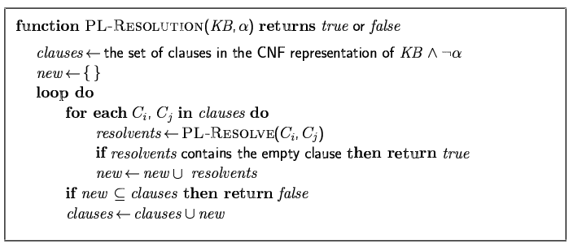
Resolution algorithm
Proof by contradiction, i.e., show KB∧¬α unsatisfiable

Slide 37

Resolution example
KB = (B_{1,1} ⇔ (P_{1,2}∨ P_{2,1})) ∧¬ B_{1,1}
α = ¬P_{1,2}

Slide 38
Forward and backward chaining
Prolog
Horn Form (restricted)
  KB = conjunction of Horn clauses
  Horn clause =
    proposition symbol; or
    (conjunction of symbols) ⇒ symbol
  E.g., C ∧ (B ⇒ A) ∧ (C ∧ D ⇒ B)
Modus Ponens (for Horn Form): complete for Horn KBs
α₁, … ,α_{n}, α₁ ∧ … ∧ α_{n} ⇒ β
β
Can be used with forward chaining or backward chaining.
These algorithms are very natural and run in linear time

Slide 39
Resolution Refutation
Proof by contradiction
Try the following:
  QY is my teacher
  If someone is a a teacher, then he has some students
  Prove that QY has some students
Steps:
  1. write down the propositional logic symbols
    Teacher, Students, QY
  2. write down the KB
    QY
    QY → Teacher
      not QY or Teacher
    Teacher → Students
      not Teacher or Students
  3. write down the negation of the theorem to be proved
    not Students
  4. use resolution to show the empty clause follows

Slide 40
Proof Part
{not QY, Teacher}
{not Teacher, Students}
{not Students}
{QY}
    -------
5. [2, 3] {not Teacher}
6. [1,4] {Teacher}
7 [5, 6] {}

Slide 41
More Examples

Slide 42
Next Topic:
The WalkSAT algorithm
Incomplete, local search algorithm
Evaluation function: The min-conflict heuristic of minimizing the number of unsatisfied clauses
Balance between greediness and randomness

Slide 43
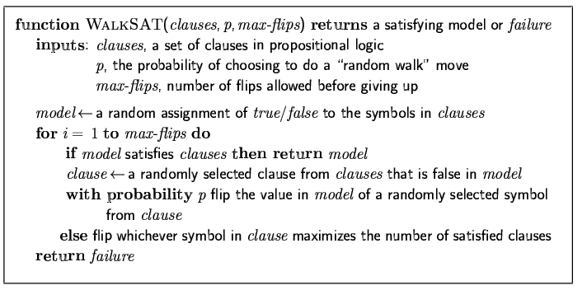
The WalkSAT algorithm

Slide 44
(¬D ∨ ¬B ∨ C) ∧ ( ¬A ∨ ¬C)
State1: A=1, B=C=D=1
Successors = (Take a proposition, and change its value)

Slide 45
Hard satisfiability problems
Consider random 3-CNF sentences. e.g.,
(¬D ∨ ¬B ∨ C) ∧ (B ∨ ¬A ∨ ¬C) ∧ (¬C ∨ ¬B ∨ E) ∧ (E ∨ ¬D ∨ B) ∧ (B ∨ E ∨ ¬C)
C=0, D=0,
  m = number of clauses=5
  n = number of symbols
  Hard problems seem to cluster near m/n = 4.3 (critical point)
  Question: what is m, n in this example?
  Question: give some satisfying models?
  = 5

Slide 46
Example
Using Walksat to prove Q from KB in Forward Chaining Example page.
What is m?
What is n?
What is m/n?

Slide 47
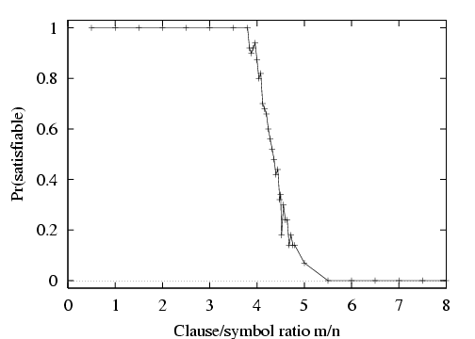
Hard satisfiability problems

Slide 48
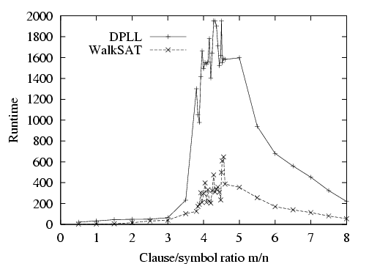
Hard satisfiability problems
Median runtime for 100 satisfiable random 3-CNF sentences, n = 50

Slide 49
Inference-based agents in the wumpus world
A wumpus-world agent using propositional logic:
  ¬P_{1,1}
  ¬W_{1,1}
  B_{x,y} ⇔ (P_{x,y+1} ∨ P_{x,y-1} ∨ P_{x+1,y} ∨ P_{x-1,y})
  S_{x,y} ⇔ (W_{x,y+1} ∨ W_{x,y-1} ∨ W_{x+1,y} ∨ W_{x-1,y})
  W_{1,1} ∨ W_{1,2} ∨ … ∨ W_{4,4}
  ¬W_{1,1} ∨ ¬W_{1,2}
  ¬W_{1,1} ∨ ¬W_{1,3}
  …
⇒ 64 distinct proposition symbols, 155 sentences

Slide 50
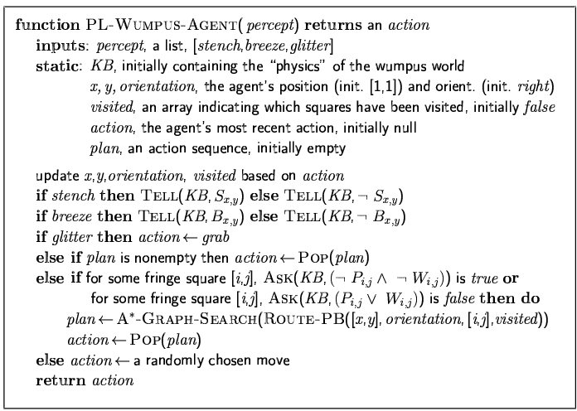

Slide 51
Expressiveness limitation of propositional logic
KB contains "physics" sentences for every single square
For every time t and every location [x,y],
L_{x,y} ∧ FacingRight^{t} ∧ Forward^{t} ⇒ L_{x+1,y}
Rapid proliferation of clauses
t
t

Slide 52
Summary
Logical agents apply inference to a knowledge base to derive new information and make decisions
Basic concepts of logic:
  syntax: formal structure of sentences
  semantics: truth of sentences wrt models
  entailment: necessary truth of one sentence given another
  inference: deriving sentences from other sentences
  soundness: derivations produce only entailed sentences
  completeness: derivations can produce all entailed sentences
Wumpus world requires the ability to represent partial and negated information, reason by cases, etc.
Resolution is complete for propositional logic
Forward, backward chaining are linear-time, complete for Horn clauses
Propositional logic lacks expressive power

